Slide 1
Software Engineering I
Lecture 5
Zaheer Ahmed

Slide 2
Object-Oriented Lifecycle Models
Object-oriented lifecycle models appreciate the need for iteration within and between phases. There are a number of these models. All of these models incorporate some form of iteration, parallelism, and incremental development.

Slide 3
eXtreme Programming(XP)
Extreme Programming to be used with small teams of developers who need to develop software quickly in an environment of rapidly-changing requirements.
XP teams design software for specific functionalities without adding any functionalities that are not specifically requested that may slow down the process, keeping the development course simple through systematic and regular testing and design improvements.

Slide 4
eXtreme Programming(XP)
The Planning Process -- The desired features of the software, which are communicated by the customer, are combined with cost estimates provided by the programmers to determine what the most important factors of the software are. This stage is sometimes called the Planning Game.
Small Releases -- The software is developed in small stages that are updated frequently, typically every two weeks.
Metaphor -- All members on an XP team use common names and descriptions to guide development and communicate on common terms.
Simple Design -- The software should include only the code that is necessary to achieve the desired results communicated by the customer at each stage in the process. The emphasis is not on building for future versions of the product.

Slide 5
eXtreme Programming(XP)
Testing -- Testing is done consistently throughout the process. Programmers design the tests first and then write the software to fulfill the requirements of the test. The customer also provides acceptance tests at each stage to ensure the desired results are achieved.
Refactoring -- XP programmers improve the design of the software through every stage of development instead of waiting until the end of the development and going back to correct flaws.
Pair Programming -- All code is written by a pair of programmers working at the same machine.

Slide 6
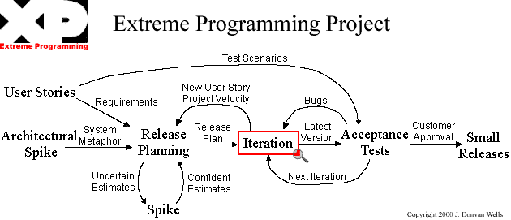
Extreme Programming

Slide 7
Extreme Programming
(animation is to be added)
Architectural spike
User stories
Release Planning
Iteration
Acceptance test
Spike
Small release

Slide 8
Maintenance
Further development
Fountain Model
Operations
Features
  Overlap (parallelism)
  Arrows (iteration)
  Smaller maintenance circle
Implementation and integration
Implementation
Object-oriented design
Object-oriented analysis
Requirements

Slide 9
Rational Unified Process (RUP)
Rational Unified Process is very closely associated with UML and Krutchen’s architectural model.
In this model a software product is designed and built in a succession of incremental iterations. It incorporates early testing and validation of design ideas and early risk mitigation. The horizontal dimension represents the dynamic aspect of the process. This includes cycles, phases, iterations, and milestones. The vertical dimension represents the static aspect of the process described in terms of process components which include activities, disciplines, artifacts, and roles. The process emphasizes that during development, all activities are performed in parallel, however, and at a given time one activity may have more emphasis than the other.

Slide 10
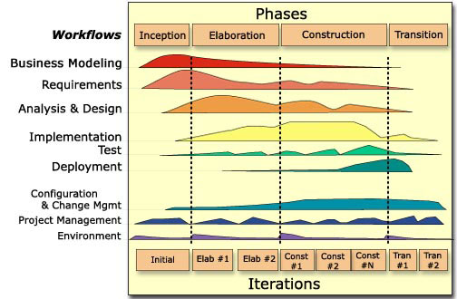
Rational Unified Process
(this Figure is from P. Krutchen’s paper)

Slide 11
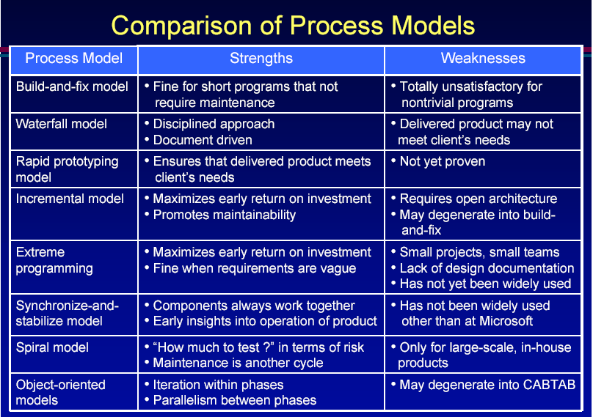

Slide 12
Documentation Phase?
There is NO documentation phase
Every phase must be fully documented before starting the next phase
  Postponed documentation may never be completed
  The responsible individual may leave
  The product is constantly changing—we need the documentation to do this
  The design (for example) will be modified during development, but the original designers may not be available to document it

Slide 13
Phase | Documents | QA
Requirement Definition | Rapid prototype, or Requirements document | Rapid prototype Reviews
Functional Specification | Specification document (specifications) Software Product Management Plan | Traceability FS Review Check the SPMP
Design | Architectural Design Detailed Design | Traceability Review
Coding | Source code Test cases | Traceability Review Testing
Integration | Source code Test cases | Integration testing Acceptance testing
Maintenance | Change record Regression test cases | Regression testing

Slide 14
Traceability matrix
Requirement ID | Use Case ID | UID | Class/ function | Test Case ID

Slide 15
Conclusions
Different life-cycle models
Each with own strengths
Each with own weaknesses
Criteria for deciding on a model include
  The organization
  Its management
  Skills of the employees
  The nature of the product
Best suggestion
  “Mix-and-match” life-cycle model

Slide 16
Summary of Today’s Lecture

