Slide 1
Software Engineering I
Lecture 7
Zaheer Ahmed
Requirement Engineering

Slide 2
Business Requirements
Business requirements collected from multiple sources might conflict. For example, consider a kiosk product with embedded software that will be sold to retail stores and used by the store’s customers. The kiosk developer’s business objectives include the following

Slide 3
Business Requirements
leasing or selling the kiosk to the retailers
selling consumables through the kiosk to the customer
attracting customer to the brand
modifying the nature of the historical developer-customer relationship
The retailer’s business interest could include:
making money from customer use of kiosk
attracting more customers to the store
saving money if the kiosk replaces manual operations
saving money if the kiosk replaces manual operations
•

Slide 4
Business Requirements
The developer might want to establish a high-tech and exciting new direction for customers, while the retailer wants a simple solution and the customer wants convenience and features. The tension among these three parties with their different goals, constraints, and cost factors can lead to conflicting business requirements, which must be resolved before the kiosk’s software requirements are detailed

Slide 5
The Vision Statement
The vision statement should reflect a balanced view that will satisfy the need of diverse customers. It can be somewhat idealistic but should be grounded in the realities of existing or anticipated customer markets, enterprise architectures, organizational strategic
directions, and resource limitations.

Slide 6
Chemical Tracking System
The chemical tracking system will allow scientists to request containers of chemicals to be supplied by chemical stockroom or by vendors. The location of every chemical container within the company, the quantity of the material remaining in it, and the complete history of each container’s location and usage will be known by the system at all times. The company will save 25% on chemical costs by fully exploiting chemicals already available within the company, by disposing of fewer partially used or expired containers, and by using a standard chemical purchasing process. The chemical tracking system will also generate all reports required to comply with federal and state government regulations that require the reporting of chemical usage, storage, and disposal.

Slide 7
Assumptions and Dependencies
All assumptions that were made when conceiving the project have to be recorded. For example, the management sponsor for the chemical tracking system assumed that it would replace the existing chemical stockroom inventory system and that it would interface to the appropriate purchasing department applications

Slide 8
Scope
Project scope defines the concept and range of the proposed solution, and limitations
identify certain capabilities that the product will not include. Clarifying the scope and
limitations helps to establish realistic stakeholder’s expectations.

Slide 9
Scope and Initial Release
The major features that will be included in the initial release of the project should be summarized. Describe the quality characteristics that will enable the product to provide the intended benefits to its various customer communities.

Slide 10
The Context Diagram
The scope description establishes the boundary between the system we are developing and everything else in the universe. The context diagram graphically illustrates this
boundary by showing the connections between the system being developed or the problem being addressed, and the outside world.

Slide 11
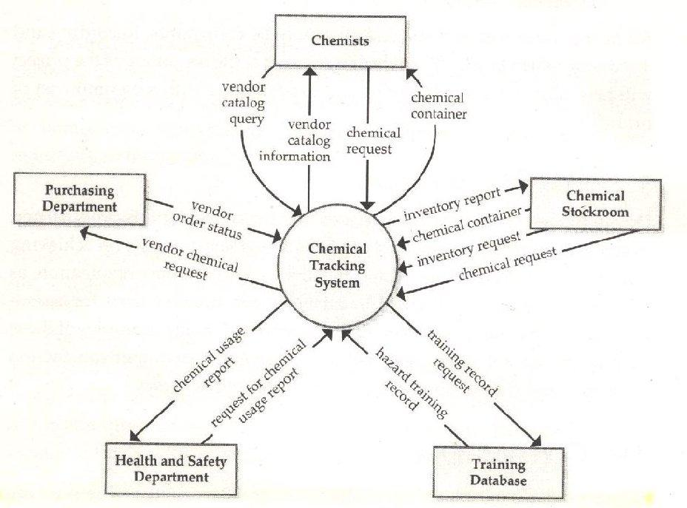
Context diagram of the Chemical Tracking System.

Slide 12
Use Cases and Customer-Developer Relationship
One tool used to organize and structure the requirements is such a fashion is called use case modeling.
It is modeling technique developed by Ivar Jacobson to describe what a new system should do or what an existing system already does. It is now part of a standard software modeling language known as the Unified Modeling Language (UML). It captures a
discussion process between the system developer and the customer.

Slide 13
Use Case Model Components
A use case model has two components, use cases and actors.
In a use case model, boundaries of the system are defined by functionality that is handled by the system. Each use case specifies a complete functionality from its initiation by an actor until it has performed the requested functionality. An actor is an entity that has an interest in interacting with the system. An actor can be a human or some other device or system.

Slide 14
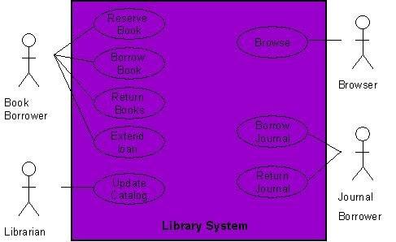
Example

Slide 15
Use Diagram for a Library System
As an example, consider the following use case diagram for a library management system. In this diagram, there are four actors namely Book Borrower, Librarian, Browser, and Journal Borrower.

Slide 16
Creating a Use Case Model
Creating a use case model is an iterative activity. The iteration starts with the identification of actors. In the next step, use cases for each actor are determined which define the system. After that, relationships among use cases are defined. It must be understood that these are not strictly sequential steps and it is not necessary that all actors must be identified before defining their use cases. These activities are sort of parallel and concurrent and a use case model will evolve slowly from these activities. This activity stops when no new use cases or actors are discovered. At the end, the model is validated.

Slide 17
Relationship among Use Cases
The UML allows us to extend and reuse already defined use cases by defining the relationship among them. Use cases can be reused and extended in two different fashions: extends and uses.
In the cases of “uses” relationship, we define that one use case invokes the steps defined in another use case during the course of its own execution
The “extends” relationship is kind of a generalization- specialization relationship. In this case a special instance of an already existing use case is created. The new use case inherits all the properties of the existing use case, including its actors.

Slide 18
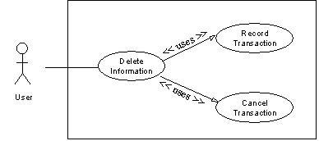
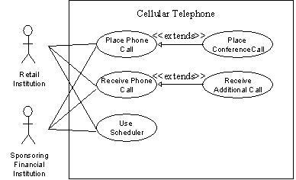
Delete Information use

Slide 19
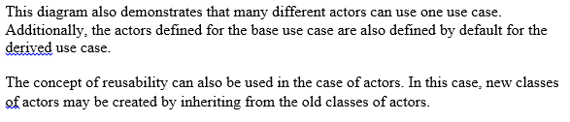
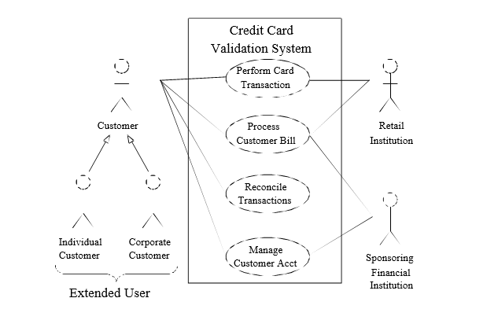
Relationship of Several components of Software Requirements

Slide 20
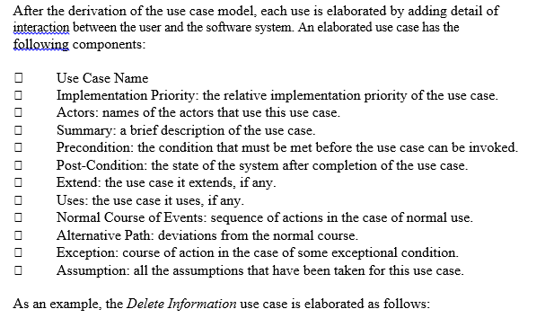
Elaborated Use Cases

Slide 21
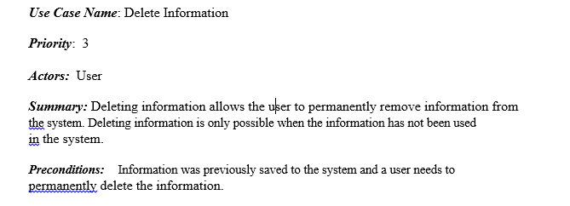
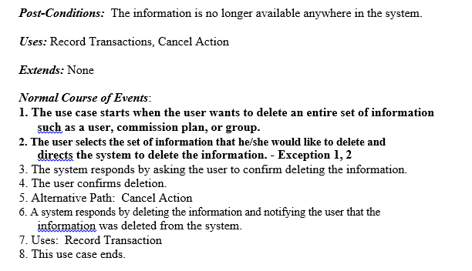

Slide 22
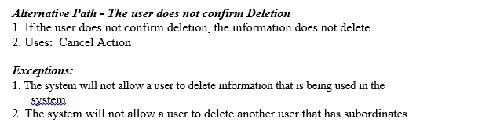
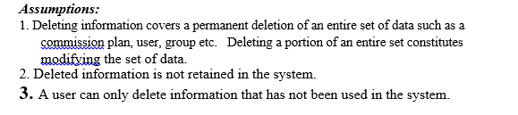

Slide 23
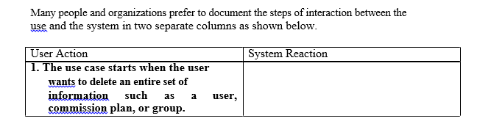
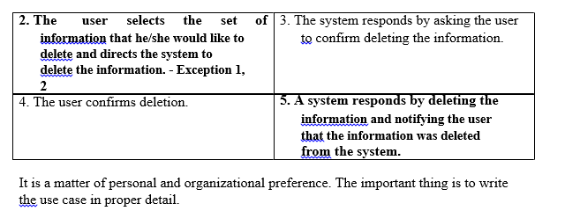
Alternative Ways of Documenting the Use Case

Slide 24
