Slide 1
Introducing HTML Basics
Hyper Text markup Language

Slide 2
History
HTML was created by Berners-Lee in late 1991 but "HTML 2.0" was the first standard HTML specification which was published in 1995. HTML 4.01 was a major version of HTML and it was published in late 1999. Though HTML 4.01 version is widely used but currently we are having HTML-5 version which is an extension to HTML 4.01, and this version was published in 2012.

Slide 3
HTML
HTML, the markup language behind virtually every page of the World Wide Web
Not a programming language, it is a markup language
Mark up our text documents so that web browsers know how to display them and to define hypertext links within them to provide navigation within or between them
Uses markup tags to describe web pages
Tool
HTML markup employ only ordinary keyboard characters, all you really need is a good text editor to construct HTML pages
Notepad
Dreamweaver
Provides line numbering and syntax highlighting

Slide 4
What is HTML?
HTML is a language for describing web pages.
HTML is a markup language for describing web documents (web pages).
HTML stands for Hyper Text Markup Language
A markup language is a set of markup tags
HTML documents are described by HTML tags
Each HTML tag describes different document content

Slide 5
Example Explained
The DOCTYPE declaration defines the document type to be HTML
The text between <html> and </html> describes an HTML document
The text between <head> and </head> provides information about the document
The text between <title> and </title> provides a title for the document
The text between <body> and </body> describes the visible page content
The text between <h1> and </h1> describes a heading
The text between <p> and </p> describes a paragraph

Slide 6
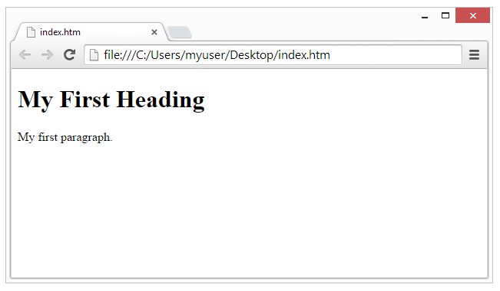
Web Browsers
The purpose of a web browser (Chrome, IE, Firefox, Safari) is to read HTML documents and display them.
The browser does not display the HTML tags, but uses them to determine how to display the document:

Slide 7
HTML
<!DOCTYPE html PUBLIC "-//W3C//DTD XHTML 1.0 Transitional//EN" "http://www.w3.org/TR/xhtml1/DTD/xhtml1-transitional.dtd">
<html xmlns="http://www.w3.org/1999/xhtml">
<head>
<meta http-equiv="Content-Type" content="text/html; charset=iso-8859-1" />
<title> A Simple HTML Document </title>
</head>
<body>
<h1>My HTML Page</h1>
Welcome to my first page written in HTML.<br />
This is simply a text document with HTML markup to show some
words in <b>bold</b> and some other words in <i>italics</i>.
<br />
</body>
</html>

Slide 8
HTML

Slide 9
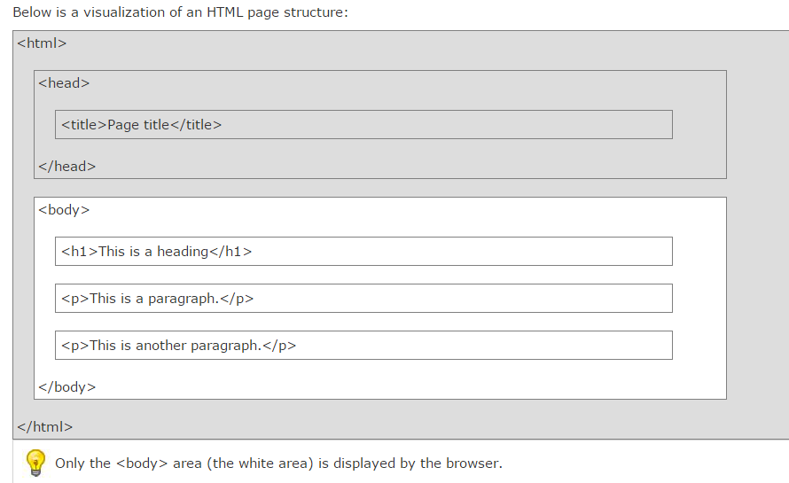
HTML Page Structure

Slide 10
HTML
DOCTYPE element
notify the browser of the “flavor” of HTML used in the document
HTML 4.0 Transitional, a fairly forgiving version of the HTML specification that allows the use of some earlier markup styles and structures in addition to the latest HTML 4.0 specifications
<head> …</head>
the document’s head section is used to store information about the document that is not to be displayed in the browser window
<title>…</title>
the document title fulfils a number of functions, among them:
Search engines often use the page title (among other factors) to help them decide what a page is about
When you bookmark a page, it is generally saved by default as the document
Title
Most browsers, when minimized, display the title of the current document on their icon or taskbar button
link, meta, and script elements
Notes:
The doc type declaration is not an HTML tag; it is an instruction to the web browser about what version of the markup language the page is written in.
The doctype declaration refers to a Document Type Definition (DTD). The DTD specifies the rules for the markup language, so that the browsers can render the content correctly.
The <meta> tag provides metadata about the HTML document. Metadata will not be displayed on the page, but will be machine parsable. Meta elements are typically used to specify page description, keywords, author of the document, last modified, and other metadata.

Slide 11
HTML
<body>…</body>
body of the document contains text to be interpreted and displayed to the user via the browser window
Bold
Italics
Headings
Line break
Horizontal line
Adding Attributes to HTML Tags
<body bgcolor=”#cccccc”>
… page content goes here …
</body>
Images
<img src=”myimagefile.jpg” border=”2” width=”250” height=”175” />
alt=”Description of Image”
Tables
<table>
Hyperlinks
A hyperlink can contain images as well as text

Slide 12
HTML Basic Examples
All HTML documents must start with a type declaration: <!DOCTYPE html>.
The HTML document itself begins with <html> and ends with </html>.
The visible part of the HTML document is between <body> and </body>.
<html>
<body>
<h1>My First Heading</h1>
<p>My first paragraph.</p>
</body>
</html>

Slide 13
HTML Headings
HTML headings are defined with the <h1> to <h6> tags:
<html>
<body>
<h1>This is heading 1</h1>
<h2>This is heading 2</h2>
<h3>This is heading 3</h3>
<h4>This is heading 4</h4>
<h5>This is heading 5</h5>
<h6>This is heading 6</h6>
</body>
</html>

Slide 14
HTML Headings
Headings are defined with the <h1> to <h6> tags.
<h1> defines the most important heading. <h6> defines the least important heading.

Slide 15
Headings Are Important
Use HTML headings for headings only. Don't use headings to make text BIG or bold.
Search engines use your headings to index the structure and content of your web pages.
Users skim your pages by its headings. It is important to use headings to show the document structure.
h1 headings should be main headings, followed by h2 headings, then the less important h3, and so on.

Slide 16
HTML Horizontal Rules
The <hr> tag creates a horizontal line in an HTML page.
The hr element can be used to separate content:
<html>
<body>
<p>The hr tag defines a horizontal rule:</p>
<hr>
<p>This is a paragraph.</p>
<hr>
<p>This is a paragraph.</p>
<hr>
<p>This is a paragraph.</p>
</body>
</html>

Slide 17
HTML Paragraphs
HTML paragraphs are defined with the <p> tag:
<html>
<body>
<p>This is a paragraph.</p>
<p>This is a paragraph.</p>
<p>This is a paragraph.</p>
</body>
</html>

Slide 18
HTML Display(Formatting and Fonts)
You cannot be sure how HTML will be displayed.
Large or small screens, and resized windows will create different results.
With HTML, you cannot change the output by adding extra spaces or extra lines in your HTML code.
The browser will remove extra spaces and extra lines when the page is displayed.
Any number of spaces, and any number of new lines, count as only one space.

Slide 19
HTML Paragraphs
HTML Display
You cannot be sure how HTML will be displayed.
Large or small screens, and resized windows will create different results.
With HTML, you cannot change the output by adding extra spaces or extra lines in your HTML code.
The browser will remove extra spaces and extra lines when the page is displayed.
Any number of spaces, and any number of new lines, count as only one space.

Slide 20
Example
<html>
<body>
<p>
This paragraph
contains a lot of lines
in the source code,
but the browser
ignores it.
</p>
<p>
This paragraph
contains a lot of spaces
in the source code,
but the browser
ignores it.
</p>
<p>
The number of lines in a paragraph depends on the size of the browser window. If you resize the browser window, the number of lines in this paragraph will change.
</p>

Slide 21
HTML Line Breaks
The HTML <br> element defines a line break.
Use <br> if you want a line break (a new line) without starting a new paragraph:
<!DOCTYPE html>
<html>
<body>
<p>This is<br>a para<br>graph with line breaks</p>
</body>
</html>

Slide 22
Formatted Text
Tag | Format
<i>….</i> | Italic
<b>…</b> | Bold
<tt>….</tt> | Typewriter effect
<em>……</em> | emphasis
<blink>……</blink> | Blinking
<sup>….</sup> | superscript
<sub>……. </sub> | subscript
<u>……</u> | underline
<strike>strikethrough</strike>(<del>) | strikethrough

Slide 23
Nonbreaking Spaces
Suppose you want to use the phrase "12 Angry Men." Here you would not want a browser to split the "12, Angry" and "Men" across two lines:
An example of this technique appears in the movie "12 Angry Men."
In cases where you do not want the client browser to break text, you should use a nonbreaking space entity &nbsp; instead of a normal space. For example, when coding the "12 Angry Men" in a paragraph, you should use something similar to the following code:

Slide 24
HTML Fonts
Fonts play very important role in making a website more user friendly and increasing content readability. Font face and color depends entirely on the computer and browser that is being used to view your page but you can use HTML <font> tag to add style, size, and color to the text on your website. You can use a <basefont> tag to set all of your text to the same size, face, and color.
The font tag is having three attributes called size, color, and face to customize your fonts. To change any of the font attributes at any time within your webpage, simply use the <font> tag. The text that follows will remain changed until you close with the </font> tag. You can change one or all of the font attributes within one <font> tag.

Slide 25
Font attribute
Size
Face
Color
Back ground Color
<bgcolor>

Slide 26

HTML Elements
HTML elements are written with a start tag, with an end tag, with the content in between:
<tagname>content</tagname>
The HTML element is everything from the start tag to the end tag:
<p>My first HTML paragraph.</p>
Start tag | Element content | End tag
<h1> | My First Heading | </h1>
<p> | My first paragraph. | </p>
<br>

Slide 27
HTML Attributes
Attributes provide additional information about HTML elements.
HTML Attributes
HTML elements can have attributes
Attributes provide additional information about an element
Attributes are always specified in the start tag
Attributes come in name/value pairs like: name="value"

Slide 28
Example of Attributes
The title Attribute
HTML paragraphs are defined with the <p> tag.
In this example, the <p> element has a title attribute. The value of the attribute is "About W3Schools":

Slide 29
HTML Attributes
Below is an alphabetical list of some attributes often used in HTML:
Attribute | Description
alt | Specifies an alternative text for an image
disabled | Specifies that an input element should be disabled
href | Specifies the URL (web address) for a link
id | Specifies a unique id for an element
src | Specifies the URL (web address) for an image
style | Specifies an inline CSS style for an element
title | Specifies extra information about an element (displayed as a tool tip)
value | Specifies the value (text content) for an input element.
Align | To specify the place of the text of tag.

Slide 30
HTML Styles
Every HTML element has a default style (background color is white and text color is black).
Changing the default style of an HTML element, can be done with the style attribute.
This example changes the default background color from white to lightgrey:
<!DOCTYPE html>
<html>
<body style="background-color:lightgrey">
<h1>This is a heading</h1>
<p>This is a paragraph.</p>
</body>
</html>

Slide 31
The HTML Style Attribute
The HTML style attribute has the following syntax:
style="property:value“
<html>
<body>
<h1 style="color:blue">This is a heading</h1>
<p style="color:red">This is a paragraph.</p>
</body>
</html>

Slide 32
Style Tasks
Use the style attribute for styling HTML elements
Use background-color for background color
Use color for text colors
Use font-family for text fonts
Use font-size for text sizes
Use text-align for text alignment

Slide 33
HTML Fonts
The font-family property defines the font to be used for an HTML element:
<html>
<body>
<h1 style="font-family:verdana">This is a heading</h1>
<p style="font-family:courier">This is a paragraph.</p>
</body>
</html>

Slide 34
HTML Text Size
The font-size property defines the text size to be used for an HTML element:
<html>
<body>
<h1 style="font-size:300%">This is a heading</h1>
<p style="font-size:160%">This is a paragraph.</p>
</body>
</html>

Slide 35
HTML Text Alignment
The text-align property defines the horizontal text alignment for an HTML element
<html>
<body>
<h1 style="text-align:center">Centered heading</h1>
<p>This is a paragraph.</p>
</body>
</html>

Slide 36
HTML Text Formatting Elements
Text Formatting
This text is bold This text is italic This is ^{superscript}

Slide 37
HTML Formatting Elements
In the previous slide, you learned about HTML styling, using the HTML style attribute.
HTML also defines special elements, for defining text with a special meaning.
HTML uses elements like <b> and <i> for formatting output, like bold or italic text.
Formatting elements were designed to display special types of text:

Slide 38
Home Task
Bold text <b>
Important text <strong>
Italic text <i>
Emphasized text <em>
Marked text <mark>
Small text <small>
Deleted text <del>
Inserted text <ins>
Subscripts <sub>
Superscripts <sup>

Slide 39
HTML Comments
you can add comments to your HTML source by using the following syntax:
<html>
<body>
<!-- This is a comment -->
<p>This is a paragraph.</p>
<!-- Comments are not displayed in the browser -->
</body>
</html>

Slide 40
HTML Comments
Note: There is an exclamation point (!) in the opening tag, but not in the closing tag.
Comments are not displayed by the browser, but they can help document your HTML.
With comments you can place notifications and reminders in your HTML:

Slide 41
Test
Validation service ( validator.w3.org )
Checking a document’s syntax
URL that specifies the location of the file
Uploading a file to the site
http://validator.w3.org/#validate_by_upload

Slide 42
Home Task
Made report on Marquee Tag.
Resource
http://www.w3schools.com
http://www.tutorialspoint.com

