Slide 1
HTML Block Element
List Table div spam

Slide 2
HTML LISTS
HTML offers web authors three ways for specifying lists of information. All lists must contain one or
more list elements. Lists may contain:
<ul> - An unordered list. This will list items using plain bullets.
<ol> - An ordered list. This will use different schemes of numbers to list your items.
<dl> - A definition list. This arranges your items in the same way as they are arranged in a dictionary.

Slide 3
HTML Unordered Lists
An unordered list is a collection of related items that have no special order or sequence. This list is created by using HTML <ul> tag. Each item in the list is marked with a bullet.
<!DOCTYPE htm l>
<htm l>
<head>
<title>HTML Unordered List</title>
</head>
<body>
<ul>
<li>Beetroot</li>
<li>Ginger</li>
<li>Potato</li>
<li>Radish</li>
</ul>
</body>
</htm l>
Out Put This will produce following result: Beetroot Ginger Potato Radish

Slide 4
The type Attribute
You can use type attribute for <ul> tag to specify the type of bullet you like. By default it is a disc. Following are the possible options:
<ul type="square">
<ul type="disc">
<ul type="circle">
<htm l>
<head>
<title>HTML Unordered List</title>
</head>
<body>
<ul type="square">
<li>Beetroot</li>
<li>Ginger</li>
<li>Potato</li>
<li>Radish</li>
</ul>
</body>
</htm l>
Out Put Beetroot Ginger Potato Radish

Slide 5
HTML Ordered Lists
If you are required to put your items in a numbered list instead of bulleted then HTML ordered list will be used. This list is created by using <ol> tag. The numbering starts at one and is incremented by one for each successive ordered list element tagged with <li>.
<htm l>
<head>
<title>HTML Ordered List</title>
</head>
<body>
<ol>
<li>Beetroot</li>
<li>Ginger</li>
<li>Potato</li>
<li>Radish</li>
</ol>
</body>
</htm l>
This will produce following result: 1. Beetroot 2. Ginger 3. Potato 4. Radish

Slide 6
The type Attribute
You can use type attribute for <ol> tag to specify the type of numbering you like. By default it is a number. Following are the possible options:
<ol type="1"> - Default-Case Numerals.
<ol type="I"> - Upper-Case Numerals.
<ol type="i"> - Lower-Case Numerals.
<ol type="a"> - Lower-Case Letters.
<ol type="A"> - Upper-Case Letters.
<ol type="A">
<li>Beetroot</li>
<li>Ginger</li>
<li>Potato</li>
<li>Radish</li>
</ol>
This will produce following result: A. Beetroot B. Ginger C. Potato D. Radish

Slide 7
The start Attribute
You can use start attribute for <ol> tag to specify the starting point of numbering you need. Following are the possible options:
<ol type="1" start="4"> - Num erals starts with 4.
<ol type="I" start="4"> - Num erals starts with IV.
<ol type="i" start="4"> - Num erals starts with iv.
<ol type="a" start="4"> - Letters starts with d.
<ol type="A" start="4"> - Letters starts with D.

Slide 8
Example
This will produce following result: iv. Beetroot v. Ginger vi. Potato vii. Radish
<htm l>
<head>
<title>HTML Ordered List</title>
</head>
<body>
<ol type="i" start="4">
<li>Beetroot</li>
<li>Ginger</li>
<li>Potato</li>
<li>Radish</li>
</ol>
</body>
</htm l>

Slide 9
HTML Definition Lists
HTML and XHTML support a list style which is called definition lists where entries are listed like in dictionary or encyclopedia. The definition list is the ideal way to present a glossary, list of terms, or other name/value list.
Definition List makes use of following three tags.
<dl> - Defines the start of the list
<dt> - A term
<dd> - Term definition
</dl> - Defines the end of the list

Slide 10
Example
Out Put HTML This stands for Hyper Text Markup Language HTTP This stands for Hyper Text Transfer Protocol
<htm l>
<head>
<title>HTML Definition List</title>
</head>
<body>
<dl>
<dt><b>HTML</b></dt>
<dd>This stands for Hyper Text Markup Language</dd>
<dt><b>HTTP</b></dt>
<dd>This stands for Hyper Text Transfer Protocol</dd>
</dl>
</body>
</htm l>

Slide 11
HTML TABLES
The HTML tables allow web authors to arrange data like text, images, links, other tables, etc. into rows and columns of cells. The HTML tables are created using the <table> tag in which the <tr> tag is used to create table rows and <td> tag is used to create data cells.

Slide 12
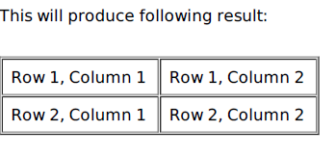
Example
<htm l>
<head>
<title>HTML Tables</title>
</head>
<body>
<table border="1">
<tr>
<td>Row 1, Colum n 1</td>
<td>Row 1, Colum n 2</td>
</tr>
<tr>
<td>Row 2, Colum n 1</td>
<td>Row 2, Colum n 2</td>
</tr>
</table>
</body>
</htm l>
Here border is an attribute of <table> tag and it is used to put a border across all the cells. If you do not need a border then you can use border="0".

Slide 13
HTML BLOCKS
All the HTML elements can be categorized into two categories a Block Level Elements b Inline Elements
Block Elements
Block elements appear on the screen as if they have a line break before and after them. For
example the <p>, <h1>, <h2>, <h3>, <h4>, <h5>, <h6>, <ul>, <ol>, <dl>, <pre>, <hr />,
<blockquote>, and <address> elements are all block level elements. They all start on their own new line, and anything that follows them appears on its own new line.
Inline Elements
Inline elements, on the other hand, can appear within sentences and do not have to appear on a new line of their own. The <b>, <i>, <u>, <em>, <strong>, <sup>, <sub>, <big>, <small>,
<li>, <ins>, <del>, <code>, <cite>, <dfn>, <kbd>, and <var> elements are all inline elements.

Slide 14
Grouping HTML Elements
There are two important tags which we use very frequently to group various other HTML tags I <div> tag and ii <span> tag
The <div> tag
This is the very important block level tag which plays a big role in grouping various other HTML tags and applying CSS on group of elements. Even now <div> tag can be used to create webpage layout where we define different parts Left, Right, Topic of the page using <div> tag. This tag does not provide any visual change on the block but this has more meaning when it is used with CSS.

Slide 15
The <div> Element
The <div> element is a block-level element that is often used as a container for other HTML elements.
The <div> element has no required attributes, but style and class are common.
When used together with CSS, the <div> element can be used to style blocks of content:

Slide 16
Example
<div style="background-color:black; color:white; padding:20px;">
<h2>London</h2>
<p>London is the capital city of England. It is the most populous city in the United Kingdom, with a metropolitan area of over 13 million inhabitants.</p>
<p>Standing on the River Thames, London has been a major settlement for two millennia, its history going back to its founding by the Romans, who named it Londinium.</p>
</div>

Slide 17
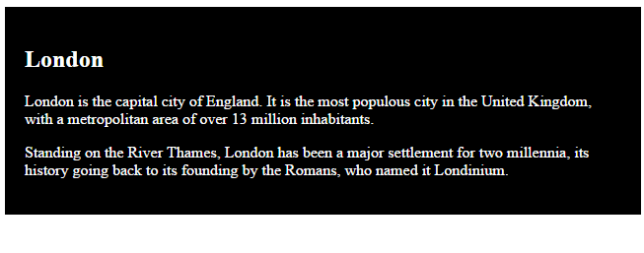
Example

Slide 18
Website Layouts
Most websites have put their content in multiple columns (formatted like a magazine or newspaper).
Multiple columns are created by using <div> or <table> elements. CSS are used to position elements, or to create backgrounds or colorful look for the pages.

Slide 19
HTML Layouts - Using <div> Elements
The div element is a block level element used for grouping HTML elements.
The following example uses five div elements to create a multiple column layout, creating the same result as in the previous example:

Slide 20
Example
<!DOCTYPE html> <html> <body> <div id="container" style="width:500px"> <div id="header" style="background-color:#FFA500;"> <h1 style="margin-bottom:0;">Main Title of Web Page</h1></div> <div id="menu" style="background-color:#FFD700;height:200px;width:100px;float:left;"> <b>Menu</b><br> HTML<br> CSS<br> JavaScript</div> <div id="content" style="background-color:#EEEEEE;height:200px;width:400px;float:right;"> Content goes here</div> <div id="footer" style="background-color:#FFA500;clear:both;text-align:center;"> Copyright © W3Schools.com</div> </div> </body> </html>

Slide 21
Results
Main Title of Web Page
Menu HTML CSS JavaScript | Content goes here
Copyright © W3Schools.com

Slide 22
HTML Layouts - Using Tables
A simple way of creating layouts is by using the HTML <table> tag.
Multiple columns are created by using <div> or <table> elements. CSS are used to position elements, or to create backgrounds or colorful look for the pages.
The following example uses a table with 3 rows and 2 columns - the first and last row spans both columns using the colspan attribute:

Slide 23
Example
<!DOCTYPE html> <html> <body> <table width="500" border="0"> <tr> <td colspan="2" style="background-color:#FFA500;"> <h1>Main Title of Web Page</h1> </td> </tr> <tr> <td style="background-color:#FFD700;width:100px;"> <b>Menu</b><br> HTML<br> CSS<br> JavaScript </td> <td style="background-color:#EEEEEE;height:200px;width:400px;"> Content goes here</td> </tr> <tr> <td colspan="2" style="background-color:#FFA500;text-align:center;"> Copyright © W3Schools.com</td> </tr> </table> </body> </html>

Slide 24
Main Title of Web Page
Menu HTML CSS JavaScript | Content goes here
Copyright © W3Schools.com

Slide 25
The HTML <span> Element
The HTML <span> element is an inline element that can be used as a container for text.
The <span> element has no special meaning.
When used together with CSS, the <span> element can be used to set style attributes to parts of the text.

Slide 26
HTML <span> Tag
<!DOCTYPE html>
<html>
<body>
<p>My mother has <span style="color:blue;font-weight:bold">blue</span> eyes and my father has <span style="color:darkolivegreen;font-weight:bold">dark green</span> eyes.</p>
</body>
</html>
Out Put
My mother has blue eyes and my father has dark green eyes.

Slide 27
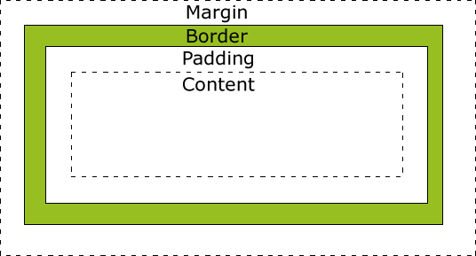
The CSS Box Model

Slide 28
The CSS Box Model
Margin
Clears an area around the border. The margin does not have a background color, and it is completely transparent
Border
A border that lies around the padding and content. The border is affected by the background color of the box
Padding
Clears an area around the content. The padding is affected by the background color of the box
Content
The content of the box, where text and images appear

