Slide 1
Artificial Intelligence
Waqas Haider Khan Bangyal

Slide 2
Artificial Neural Networks

Slide 3
In Today's Lecture ...
Introduction
What is a Neural Network?
Mathematical Model of a Neuron
Network Architectures
Training
Commonly Used Activation Functions
Typical Problem Areas

Slide 4
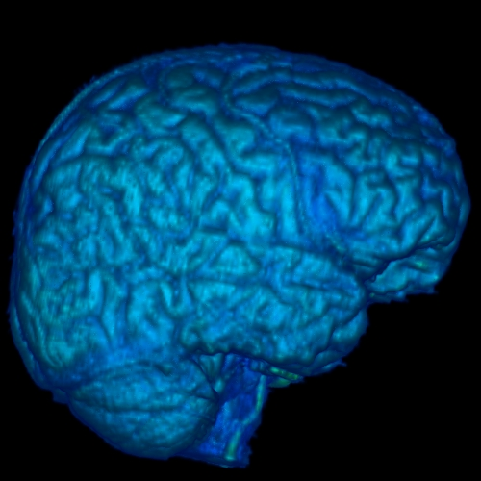
Welcome to the World of
Artificial Neural Networks
Brain
A marvelous piece of architecture and design.
In association with a nervous system, it controls the life patterns, communications, interactions, growth and development of hundreds of million of life forms.

Slide 5
Some Statistics
There are about 10¹⁰ to 10¹⁴ nerve cells (called neurons) in an adult human brain.
Neurons are highly connected with each other. Each nerve cell is connected to hundreds of thousands of other nerve cells.
Passage of information between neurons is slow (in comparison to transistors in an IC). It takes place in the form of electrochemical signals between two neurons in milliseconds.
Energy consumption per neuron is low (approximately 10⁻⁶ Watts).

Slide 6

How do the actual
neurons look like?
Look more like some
blobs of ink… aren’t they!
Taking a more closer look
reveals that there is a
large collection of different
molecules, working together
coherently, in an organized
manner.
Put together, they form the
best information processing
system in the known universe.

Slide 7
Salient Features of a Neuron
Nucleus
Axon
Synapse
Axons from
another
neurons
Cell Body
Synapse
Dendrites
Mind you, a neuron is a three dimensional entity!

Slide 8
Information Processing in a Neural Network
Flow of Information
A few Neurons and their synaptic junctions

Slide 9
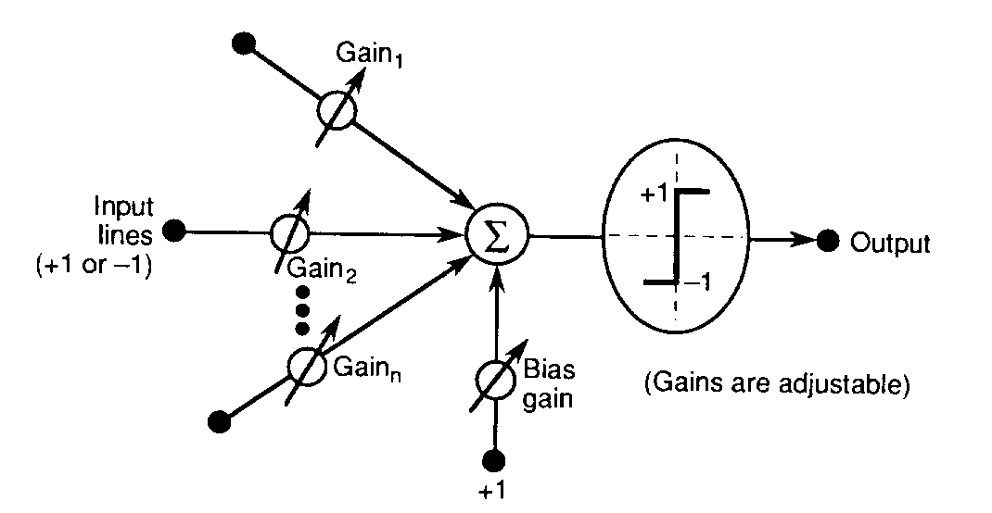
Mathematical Model of
A Typical Neuron

Slide 10
Basics of an Artificial Neural Network
An artificial neural network is an information processing system that has certain performance characteristics in common with biological neural networks.
An ANN can be characterized by:
Architecture: The pattern of connections between different neurons.
Training or Learning Algorithms: The method of determining weights on the connections.
Activation Function: The nature of function used by a neuron to become activated.

Slide 11
Architecture
There are two basic categories:
Feed-forward Neural Networks
These are the nets in which the signals flow from the input units to the output units, in a forward direction.
They are further classified as:
Single Layer Nets
Multi-layer Nets
Recurrent Neural Networks
These are the nets in which the signals can flow in both directions from the input to the output or vice versa.

Slide 12
Model 1: A Single Layer Net
w₁₁
X₁
Y₁
w₂₁
w₃₁
w₁₂
X₂
Y₂
w₂₂
l
l
l
w₃₂
l
l
l
X_{n}
w₁₃
Y_{m}
w_{2m}
w_{nm}
Input
Units
Output
Units

Slide 13

Model 2: A Multi-Layer Net
X₁
w₁₁
v₁₁
Y₁
w_{i1}
Z₁
v_{j1}
l
l
l
w_{n1}
v_{p1}
l
l
l
l
l
l
w_{1j}
v_{1k}
X_{i}
Z_{j}
Y_{k}
w_{ij}
v_{jk}
w_{nj}
l
l
l
v_{pk}
Biological
Neurons
In Action
l
l
l
l
l
l
w_{1p}
v_{1m}
Z_{p}
X_{n}
w_{ip}
v_{jm}
Y_{m}
w_{np}
v_{pm}
Input
Units
Hidden
Units
Output
Units

Slide 14
Model 3: A Recurrent Net
1
w₁₁
1
X₁
Y₁
w_{1n}
v_{1n}
v_{1m}
w_{1m}
X_{n}
Y_{m}
w_{nm}
1
1

Slide 15
Training
Supervised Training
Training is accomplished by presenting a sequence of training vectors or patterns, each with an associated target output vector.
The weights are then adjusted according to a learning algorithm.
During training, the network develops an associative memory. It can then recall a stored pattern when it is given an input vector that is sufficiently similar to a vector it has learned.
Unsupervised Training
A sequence of input vectors is provided, but no traget vectors are specified in this case.
The net modifies its weights and biases, so that the most similar input vectors are assigned to the same output unit.

Slide 16
Common Activation Functions
1. Binary Step Function
(a “threshold” or “Heaviside” function)
2. Bipolar Step Function
3. Binary Sigmoid
Function (Logistic
Sigmoid)
3. Bipolar Sigmoid
4. Hyperbolic -
Tangent

Slide 17
Typical Problem Areas
The number of application areas in which artificial neural networks are used is growing daily.
Some of the representative problem areas, where neural networks have been used are:
Pattern Completion: ANNs can be trained on a set of visual patterns represented by pixel values.
If subsequently, a part of an individual pattern (or a noisy pattern) is presented to the network, we can allow the network’s activation to propagate through the net till it converges to the original (memorised) visual pattern.
The network is acting like a “content- addressable” memory.

Slide 18
Typical Problem Areas
Classification: An early example of this type of network was trained to differentiate between male and female faces.
It is actually very difficult to create an algorithm to do so yet, an ANN has shown to have near-human capacity to do so.
Optimization: It is notoriously difficult to find algorithms for solving optimization problems (e.g. TSP).
There are several types of neural networks which have been shown to converge to ‘good-enough’ solutions i.e. solutions which may not be globally optimal but can be shown to be close to the global optimum for any given set of parameters.

Slide 19
Typical Problem Areas
Feature Detection: An early example of this is the phoneme producing feature map of Kohonen:
The network is provided with a set of inputs and must learn to pronounce the words; in doing so, it must identify a set of features which are important in phoneme production
Data Compression: There are many ANNs which have been shown to be capable of representing input data in a compressed format loosing as little of the information as possible.
Approximation: Given examples of an input to output mapping, a neural network can be trained to approximate the mapping so that a future input will give approximately the correct answer i.e. the answer which the mapping should give.

Slide 20
Typical Problem Areas
Association: We may associate a particular input with a particular output so that given the same (or similar) input again, the net will give the same (or a similar) output again.
Prediction: This task may be stated as: given a set of previous examples from a time series, such as a set of closing prices of Karachi Stock Exchange, to predict the next (future) sample.
Control: For example to control the movement of a robot arm (or truck, or any non-linear process) to learn what inputs (actions) will have the correct outputs (results)

Slide 21
In Today's Lecture ...
Perceptron
Simple Perceptron for Pattern Classification
Perceptron: Algorithm
Perceptron: Example
Perceptron: Matlab code the example
Assignment 1

Slide 22
Perceptron
Perceptrons had perhaps the most far-reaching impact of any of the early neural nets.
A number of different types of Perceptrons have been used and described by various workers.
The original perceptrons had three layers of neurons – sensory units, associator units and a response unit – forming an approximate model of a retina.
Under suitable assumptions, its iterative learning procedure can be proved to converge to the correct weights i.e., the weights that allow the net to produce the correct output value for each of the training input patterns.

Slide 23
Simple Perceptron for Pattern Classification
The architecture of a simple perceptron for performing single classification is shown in the figure.
The goal of the net is to classify each input pattern as belonging, or not belonging, to a particular class.
Belonging is signified by the output unit giving a response of +1; not belonging is indicated by a response of -1.
A zero output means that it is not decisive.
1
X₁
b
w₁
X₂
w₂
Y₂
l
l
l
w_{n}
X_{n}

Slide 24
Perceptron: Algorithm
Initialize weights, bias and the threshold θ. Also set the learning rate α such that ( 0 < α <=1).
While stopping condition is false, do the following steps.
For each training pair s:t, do steps 4 to 7.
Set the activations of input units. x_{i} = s_{i}
Compute the response of the output unit.
Update weights and bias if an error occurred for this pattern.
If y is not equal to t (under some limit) then
w_{i}(new) = w_{i}(old) + α x_{i} t for i = 1 to n
b(new) = b(old) + α t
end if
Test stopping condition: If no weight changed in step 3, stop, else continue.

Slide 25
Perceptron: Example
Lets consider the following training data:
Inputs Target
x1 x2 t
1 1 1
1 0 -1
0 1 -1
0 0 -1
We initialize the weights to be w1 = 0, w2 = 0 and b = 0. Also we set α = 1, and θ = 0.2.
The following table shows the sequence in which the net is provided with the input one by one and checked for the required target.

Slide 26
Perceptron: Example
Input
Bias
Net
Input
Output
Target
Weights
x₁
x₂
y_{in}
y
t
w₁
w₂
b
1
0
0
0
1
1
1
0
0
1
1
1
1
1
0
1
2
1
-1
0
1
0
0
1
1
1
1
-1
0
0
-1
0
0
1
-1
-1
-1
0
0
-1
2
1
1
1
-1
-1
1
1
1
0
1
0
1
1
1
-1
0
1
-1
0
1
1
0
0
-1
0
0
-2
0
0
1
-2
-1
-1
0
0
-2

Slide 27
Perceptron: Example
Input
Bias
Net
Input
Output
Target
Weights
x₁
x₂
y_{in}
y
t
w₁
w₂
b
10
1
1
1
1
1
1
2
3
-4
1
0
1
-2
-1
-1
2
3
-4
0
1
1
-1
-1
-1
2
3
-4
0
0
1
-4
-1
-1
2
3
-4
Thus the positive response is given by all the points
such that
And the negative response is given by all the points
such that

Slide 28
Decision Boundaries
We note that the output of the Perceptron is 1(positive), if the net input ‘yin’ is greater than θ.
Also that the output is -1(negative), if the net input ‘yin’ is less than –θ.
We also know that
yin = b + x1*w1 + x2*w2
in this case
Thus we have
2*x1 + 3*x2 – 4 > 0.2 (+ve output)
2*x1 + 3*x2 – 4 < -0.2 (-ve output)
Removing the inequalities and simplifying them gives us the following two equations:
2*x1 + 3*x2 = 4.2
2*x1 + 3*x2 = 3.8

Slide 29
Decision Boundaries
These two equations are equations of straight lines in x1,x2-plane.
These lines geometrically separate out the input training data into two classes.
Hence they serve as acting like decision boundaries.
The two lines have the same slope, but their y-intercepts are different. So essentially, we have two parallel straight lines acting line decision boundaries for out input data.
The parameter θ, determines the separation between two lines (and hence the width of the indecisive region).

Slide 30
Perceptron: Example
Graphically
x₂
(0, 1)
(1, 1)
x₁
(0, 0)
(1, 0)
Undecided
Region

Slide 31
That's it for today!

