Slide 1
Artificial Intelligence
Waqas Haider Khan Bangyal

Slide 2
Introduction
Some definitions
“a system composed of many simple processing elements operating in parallel whose function is determined by network structure, connection strengths, and the processing performed at computing elements or nodes.” - DARPA (1988)
A neural network: A set of connected input/output units where each connection has a weight associated with it
During the learning phase, the network learns by adjusting the weights so as to be able to predict the correct class output of the input signals

Slide 3
When to Consider Neural Networks
Input: High-Dimensional and Discrete or Real-Valued
– e.g., raw sensor input
– Conversion of symbolic data to numerical representations
Output: Discrete or Real Vector-Valued
– e.g., low-level control policy for a robot actuator
– Similar qualitative/quantitative (symbolic/numerical) conversions may apply
Data: Possibly Noisy
Result: Human Readability Less Important Than Performance
-Performance measured purely in terms of accuracy and efficiency
Examples
– Speech phoneme recognition
– Image classification
– Time signal prediction, Robotics, and many others

Slide 4
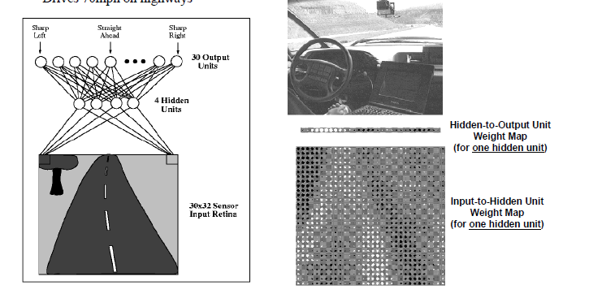
Autonomous Learning Vehicle in a Neural Net (ALVINN)

Slide 5
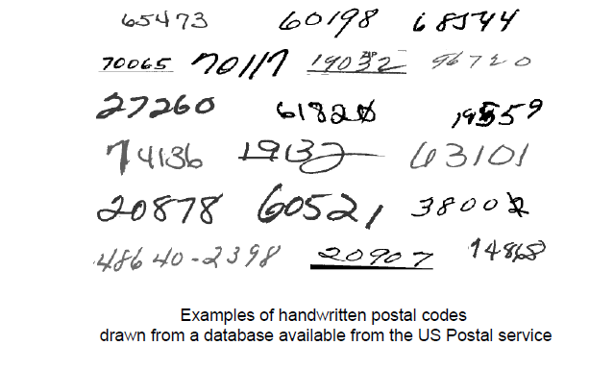
Image Recognition and Classification of Postal Codes

Slide 6
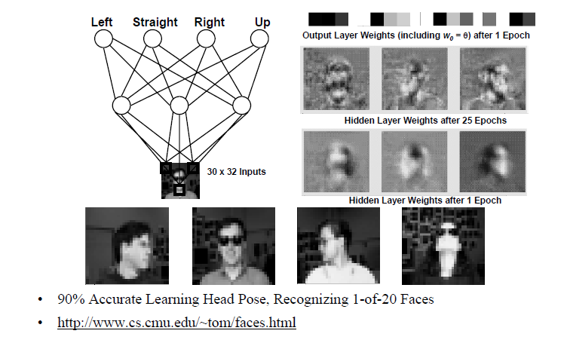
Example: Neural Nets for Face Recognition

Slide 7
Biological Inspirations
Humans perform complex tasks like vision, motor control, or language understanding very well
One way to build intelligent machines is to try to imitate the (organizational principles of) human brain

Slide 8
Biological Inspirations
Some numbers…
– The human brain contains about (or over) 10 billion nerve cells (neurons)
– Each neuron is connected to the others through 10000 synapses
Properties of the brain
– It can learn, reorganize itself from experience
– It adapts to the environment
– It is robust and fault tolerant

Slide 9
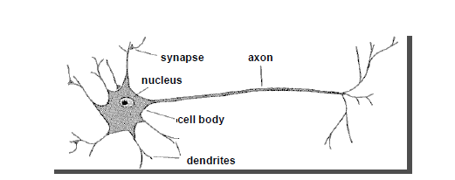
Biological neuron
A neuron has
– A branching input (dendrites)
– A branching output (the axon)
The information circulates from the dendrites to the axon via the cell body
•Axon connects to dendrites via synapses
– Synapses vary in strength
– Synapses may be excitatory or inhibitory

Slide 10
Human Brain
The brain is a highly complex, non-linear, and parallel computer, composed of some 10¹¹ neurons that are densely connected (~10⁴ connection per neuron). We have just begun to understand how the brain works...
A neuron is much slower (10⁻³sec) compared to a silicon logic gate (10⁻⁹sec), however the massive interconnection between neurons make up for the comparably slow rate.
– Complex perceptual decisions are arrived at quickly (within a few hundred milliseconds)
100-Steps rule: Since individual neurons operate in a few milliseconds, calculations do not involve more than about 100 serial steps and the information sent from one neuron to another is very small (a few bits)
Plasticity: Some of the neural structure of the brain is present at birth, while other parts are developed through learning, especially in early stages of life, to adapt to the environment (new inputs).

Slide 11
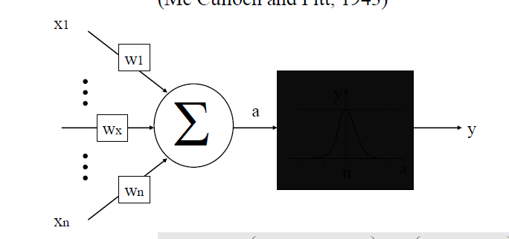
The Artificial Neuron (Mc Culloch and Pitt, 1943)

Slide 12
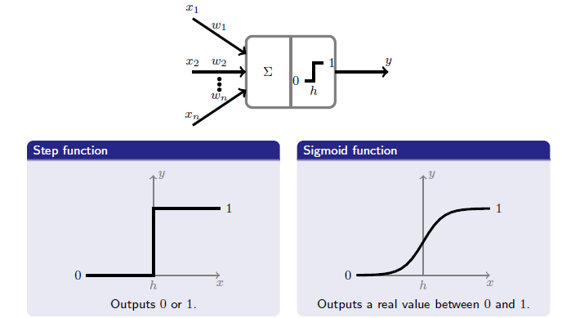
Activation Functions

Slide 13
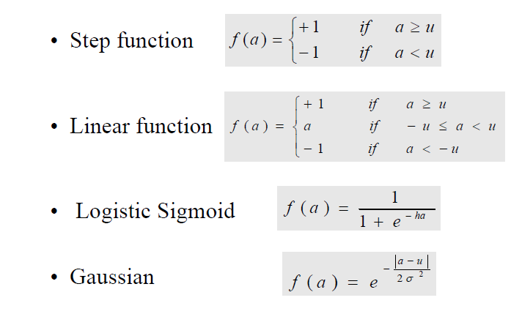
Activation Function
Choice of activation (transfer) function:

Slide 14
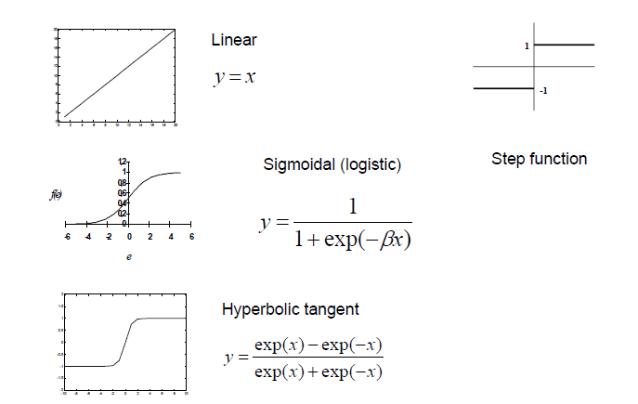
Activation Function

Slide 15
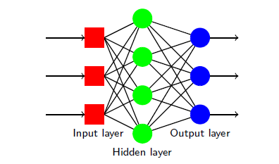
Topologies of Neural Networks
Feed Forward Neural Networks
The information is propagated from the inputs to the outputs
NO cycle between outputs and inputs
Feedforward: No loops, input → hidden layers → output

Slide 16
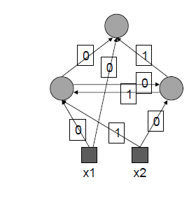
Topologies of Neural Networks
Recurrent Neural Networks
Use feedback
Can have arbitrary topologies
Training is more difficult

Slide 17
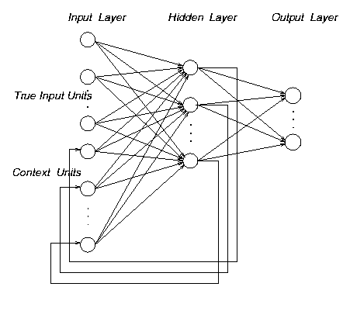
Topologies of Neural Networks
recurrent
(feedback connections)
feedforward
(directed, a-cyclic)
Feedforward Vs Recurrent networks
Feedforward: No loops, input → hidden layers → output
Recurrent: Use feedback

Slide 18
Learning neural networks
The procedure that consists in estimating the parameters of neurons (usually weights) so that the whole network can perform a specific task
Basic types of learning
– The supervised learning
– The unsupervised learning
• The Learning process (supervised)
– Present the network a number of inputs and their corresponding outputs
– See how closely the actual outputs match the desired ones
– Modify the parameters to better approximate the desired outputs

Slide 19
Learning neural networks
Supervised versus unsupervised learning
Supervised networks use a “teacher”
The desired output for each input is provided by user
Unsupervised networks find hidden statistical patterns in input data
Clustering, principal component analysis

Slide 20
Neural Network Design

Slide 21
NN DESIGN
Data Representation
Network Topology
Network Parameters
Training
Validation

Slide 22
1) Data Representation
Inputs normalisation:
Each input variable should be processed so that the mean value is small or close to zero or at least very small when compared to the standard deviation.

Slide 23
1) Data Representation
Initialisation of weights:
If synaptic weights are assigned large initial values neurons are driven into saturation.
If synaptic weights are assigned small initial values algorithms operate around the origin.

Slide 24
2) Topologies of Neural Networks
recurrent
(feedback connections)
feedforward
(directed, a-cyclic)
Feedforward Vs Recurrent networks
Feedforward: No loops, input → hidden layers → output
Recurrent: Use feedback (positive or negative)

Slide 25
2) Topologies of Neural Networks
Architecture of the network:
How many layers?
How many nodes?
How many nodes per layer?

Slide 26
2) Topologies of Neural Networks
Structure of artificial neuron nodes
Choice of activation (transfer) function:

Slide 27
2) Topologies of Neural Networks

Slide 28
3) Setting the parameters
How are the weights initialised?
How is the learning rate chosen?
How many hidden layers and how many neurons?
Which activation function ?
How to preprocess the data ?
How many examples in the training data set?

Slide 29
4) Network Training
How do you ensure that a network has been well trained?
Objective:
To achieve good generalization accuracy
Establish a maximum acceptable error rate
Train the network
Validate the trained network against a separate test set which is usually referred to as a test set

Slide 30
4) Network Training
Mastering ANN Parameters
Typical Range
learning rate - 0.1 0.01 - 0.99
momentum - 0.8 0.1 - 0.9
Fine tuning :
adjust individual parameters at each node and/or connection weight
automatic adjustment during training

Slide 31
Applications of ANN
Aerospace
– High performance aircraft autopilots, flight path simulations, aircraft control systems, autopilot enhancements, aircraft component simulations, aircraft component fault detectors
Automotive
– Automobile automatic guidance systems, warranty activity analyzers
Banking
– Check and other document readers, credit application evaluators
Defense
– Weapon steering, target tracking, object discrimination, facial recognition, new kinds of sensors, sonar, radar and image signal processing including data compression, feature extraction and noise suppression, signal/image identification
Electronics
– Code sequence prediction, integrated circuit chip layout, process control, chip failure analysis, machine vision, voice synthesis, nonlinear modeling

Slide 32
Applications of ANN
Robotics
– Trajectory control, forklift robot, manipulator controllers, vision systems
• Speech
– Speech recognition, speech compression, vowel classification, text to speech synthesis
Securities
– Market analysis, automatic bond rating, stock trading advisory systems
Telecommunications
– Image and data compression, automated information services, real-time translation of spoken language, customer payment processing systems
Transportation
– Truck brake diagnosis systems, vehicle scheduling, routing system

Slide 33
Neural Network as a Classifier
Weakness
Long training time
Require a number of parameters typically best determined empirically, e.g., the network topology or ``structure.“
Poor interpretability: Difficult to interpret the symbolic meaning behind the learned weights and of ``hidden units" in the network

Slide 34
Neural Network as a Classifier
Strength
High tolerance to noisy data
Ability to classify untrained patterns
Well-suited for continuous-valued inputs and outputs
Successful on a wide array of real-world data
Techniques have recently been developed for the extraction of rules from trained neural networks

Slide 35
Drawbacks of ANN
ANNs drawbacks:
Lack of criteria to define the optimal network size => genetic algorithms?
Many parameters to tune
Time and cost computational requirements

Slide 36
