Slide 1
Artificial Intelligence
Waqas Haider Khan Bangyal

Slide 2
Multi-Layer Perceptron (MLP)

Slide 3
Overview of the Lecture
Why multilayer perceptrons?
Some applications of multilayer perceptrons.
Learning with multilayer perceptrons:
The backpropagation learning algorithm.

Slide 4
History
1943: McCulloch–Pitts “neuron”
Started the field
1962: Rosenblatt’s perceptron
Learned its own weight values; convergence proof
1969: Minsky & Papert book on perceptrons
Proved limitations of single-layer perceptron networks
1982: Hopfield and convergence in symmetric networks
Introduced energy-function concept
1986: Backpropagation of errors
Method for training multilayer networks

Slide 5
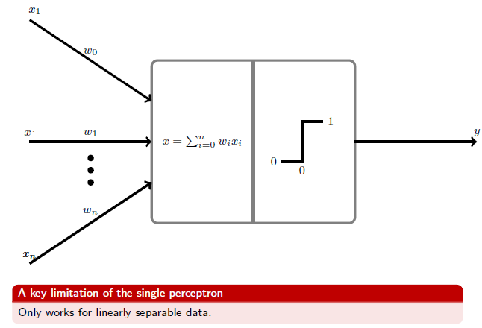
Recap: Perceptrons

Slide 6
Two-dimensional plots of basic logical operations
A perceptron can learn the operations AND and OR, but not Exclusive-OR.

Slide 7
Multilayer neural networks
A multilayer perceptron (MLP) is a feed forward neural network with one or more hidden layers.
The network consists of an input layer of source neurons, at least one middle or hidden layer of computational neurons, and an output layer of computational neurons.
The input signals are propagated in a forward direction on a layer-by-layer basis.

Slide 8
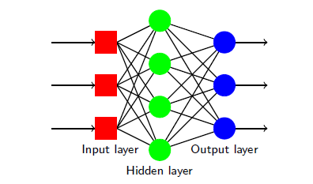
Multilayer Perceptron with Single hidden layers

Slide 9
Multilayer Perceptron with Single hidden layers

Slide 10
What does the middle layer hide?
A hidden layer “hides” its desired output. Neurons in the hidden layer cannot be observed through the input/output behaviour of the network. There is no obvious way to know what the desired output of the hidden layer should be.
Commercial ANNs incorporate three and sometimes four layers, including one or two hidden layers. Each layer can contain from 10 to 1000 neurons. Experimental neural networks may have five or even six layers, including three or four hidden layers, and utilise millions of neurons.

Slide 11
Back-propagation neural network
Learning in a multilayer network proceeds the same way as for a perceptron.
A training set of input patterns is presented to the network.
The network computes its output pattern, and if there is an error − or in other words a difference between actual and desired output patterns − the weights are adjusted to reduce this error.

Slide 12
Back-propagation neural network
In a back-propagation neural network, the learning algorithm has two phases.
Forward Pass: First, a training input pattern is presented to the network input layer. The network propagates the input pattern from layer to layer until the output pattern is generated by the output layer.
Backward Pass: If this pattern is different from the desired output, an error is calculated and then propagated backwards through the network from the output layer to the input layer. The weights are modified as the error is propagated.

Slide 13
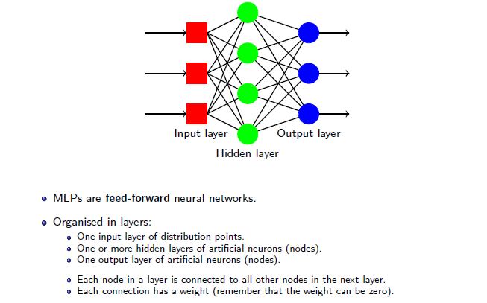
Multilayer Perceptrons (MLPs)

Slide 14
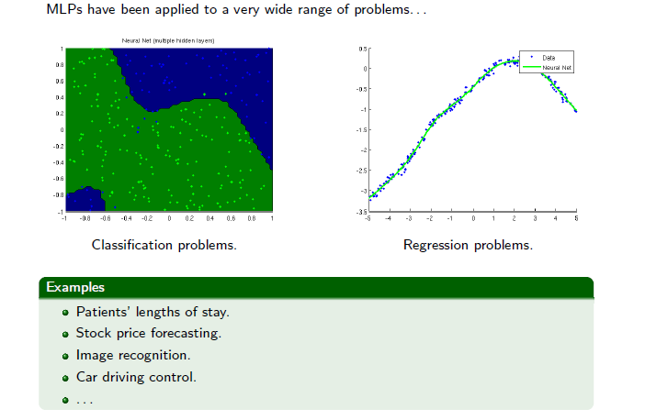
Applications of MLPs

Slide 15
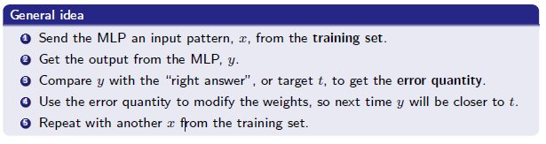
Learning with MLPs

Slide 16
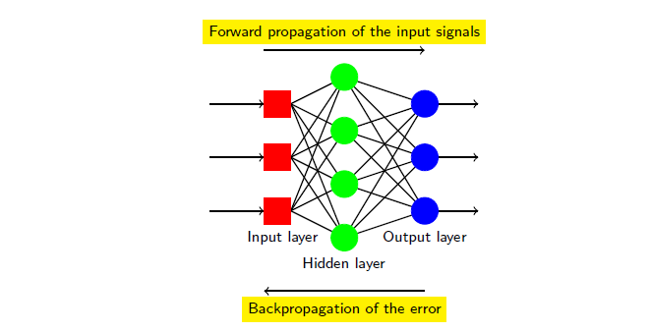
Backpropagation

Slide 17
Three-layer back-propagation neural network

Slide 18
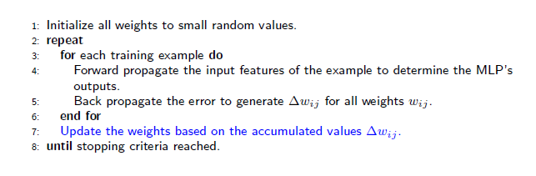
Backpropagation

Slide 19
Types of problems
The BP algorithm is used in a great variety of problems:
Time series predictions
Credit risk assessment
Pattern recognition
Speech processing
Cognitive modelling
Image processing
Control
BP is the standard algorithm against which all other NN algorithms are compared!!

Slide 20
Advantages & Disadvantages
The MLP trained with the BP algorithm is a universal approximator of functions
The BP algorithm is computationally efficient
The BP algorithm has robustness
The convergence of the BP can be very slow, especially in large problems, depending on the method
The BP algorithm suffers from the problem of local minima

Slide 21
B.P Algorithm and its solved examples are attached in MS Word File.

Slide 22
