Slide 1
Artificial Intelligence
Waqas Haider Khan Bangyal

Slide 2
Decision Tree Learning
Learning Decision Trees
Decision tree induction is a simple but powerful learning paradigm. In this method a set of training examples is broken down into smaller and smaller subsets while at the same time an associated decision tree get incrementally developed. At the end of the learning process, a decision tree covering the training set is returned.
The decision tree can be thought of as a set sentences (in Disjunctive Normal Form) written propositional logic.
Some characteristics of problems that are well suited to Decision Tree Learning are:
Attribute-value paired elements
Discrete target function
Disjunctive descriptions (of target function)
Works well with missing or erroneous training data

Slide 3
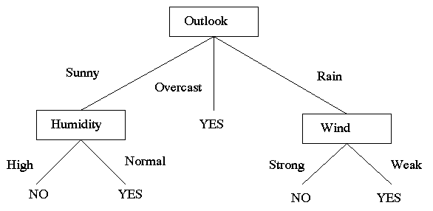
Decision Tree Learning
(Outlook = Sunny ∧ Humidity = Normal) ∨ (Outlook = Overcast) ∨ (Outlook = Rain ∧ Wind = strong)

Slide 4
Decision Tree Learning
Day
Outlook
Temperature
Humidity
Wind
PlayTennis
D1
Sunny
Hot
High
Weak
No
D2
Sunny
Hot
High
Strong
No
D3
Overcast
Hot
High
Weak
Yes
D4
Rain
Mild
High
Weak
Yes
D5
Rain
Cool
Normal
Weak
Yes
D6
Rain
Cool
Normal
Strong
No
D7
Overcast
Cool
Normal
Strong
Yes
D8
Sunny
Mild
High
Weak
No
D9
Sunny
Cool
Normal
Weak
Yes
D10
Rain
Mild
Normal
Weak
Yes
D11
Sunny
Mild
Normal
Strong
Yes
D12
Overcast
Mild
High
Strong
Yes
D13
Overcast
Hot
Normal
Weak
Yes
D14
Rain
Mild
High
Strong
No

Slide 5
Decision Tree Learning
Building a Decision Tree
First test all attributes and select the on that would function as the best root;
Break-up the training set into subsets based on the branches of the root node;
Test the remaining attributes to see which ones fit best underneath the branches of the root node;
Continue this process for all other branches until
all examples of a subset are of one type
there are no examples left (return majority classification of the parent)
there are no more attributes left (default value should be majority classification)

Slide 6
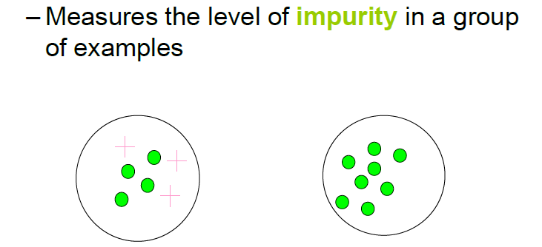
Impurity/Entropy(informal)

Slide 7
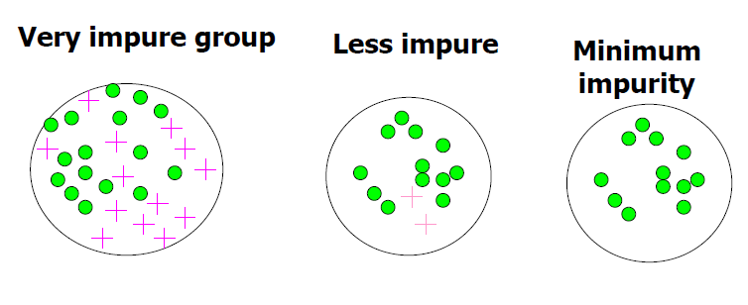
Impurity

Slide 8
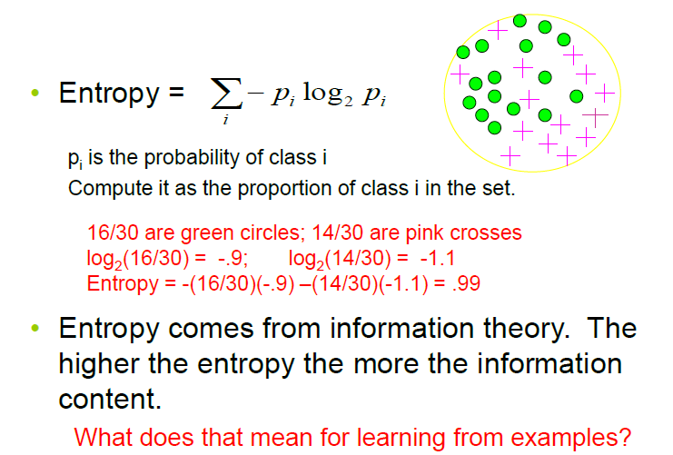
Entropy
Entropy: a common way to measure impurity

Slide 9
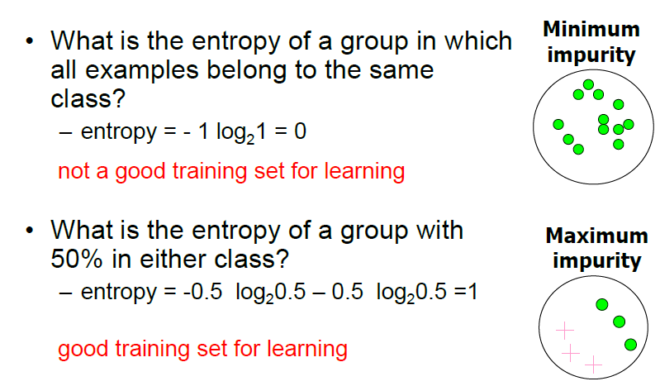
2-Class Cases:

Slide 10
Information Gain
Information Gain
We want to determine which attribute in a given set of training feature vectors is most useful for discriminating between the classes to be learned.
Information gain tells us how important a given attribute of the feature vectors is.
We will use it to decide the ordering of attributes in the nodes of a decision tree.

Slide 11
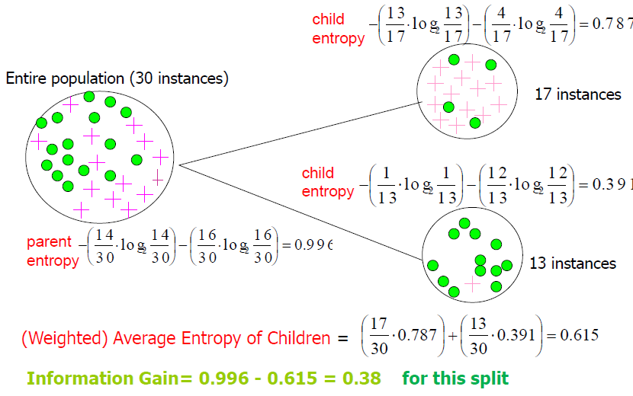
Calculating Information Gain
Information Gain= entropy(parent) –[average entropy(children)]

Slide 12
Decision Tree Learning
Determining which attribute is best (Entropy & Gain)
Entropy (E) is the minimum number of bits needed in order to classify an arbitrary example as yes or no
E(S) = Σ^{c}_{i=1} –p_{i} log₂ p_{i ,}
Where S is a set of training examples,
c is the number of classes, and
p_{i} is the proportion of the training set that is of class i
For our entropy equation 0 log₂ 0 = 0
The information gain G(S,A) where A is an attribute
G(S,A) ≡ E(S) - Σ_{v in Values(A)} (|S_{v}| / |S|) * E(Sv)

Slide 13
Decision Tree Learning
Let’s Try an Example!
Let
E([X+,Y-]) represent that there are X positive training elements and Y negative elements.
Therefore the Entropy for the training data, E(S), can be represented as E([9+,5-]) because of the 14 training examples 9 of them are yes and 5 of them are no.

Slide 14
Decision Tree Learning: A Simple Example
Let’s start off by calculating the Entropy of the Training Set.
E(S) = E([9+,5-]) = (-9/14 log₂ 9/14) + (-5/14 log₂ 5/14)
= 0.94

Slide 15
Decision Tree Learning: A Simple Example
Next we will need to calculate the information gain G(S,A) for each attribute A where A is taken from the set {Outlook, Temperature, Humidity, Wind}.

Slide 16
Decision Tree Learning: A Simple Example
The information gain for Outlook is:
G(S,Outlook) = E(S) – [5/14 * E(Outlook=sunny) + 4/14 * E(Outlook = overcast) + 5/14 * E(Outlook=rain)]
G(S,Outlook) = E([9+,5-]) – [5/14*E(2+,3-) + 4/14*E([4+,0-]) + 5/14*E([3+,2-])]
G(S,Outlook) = 0.94 – [5/14*0.971 + 4/14*0.0 + 5/14*0.971]
G(S,Outlook) = 0.246

Slide 17
Decision Tree Learning: A Simple Example
G(S,Temperature) = 0.94 – [4/14*E(Temperature=hot) + 6/14*E(Temperature=mild) + 4/14*E(Temperature=cool)]
G(S,Temperature) = 0.94 – [4/14*E([2+,2-]) + 6/14*E([4+,2-]) + 4/14*E([3+,1-])]
G(S,Temperature) = 0.94 – [4/14 + 6/14*0.918 + 4/14*0.811]
G(S,Temperature) = 0.029

Slide 18
Decision Tree Learning: A Simple Example
G(S,Humidity) = 0.94 – [7/14*E(Humidity=high) + 7/14*E(Humidity=normal)]
G(S,Humidity = 0.94 – [7/14*E([3+,4-]) + 7/14*E([6+,1-])]
G(S,Humidity = 0.94 – [7/14*0.985 + 7/14*0.592]
G(S,Humidity) = 0.1515

Slide 19
Decision Tree Learning: A Simple Example
G(S,Wind) = 0.94 – [8/14*0.811 + 6/14*1.00]
G(S,Wind) = 0.048

Slide 20
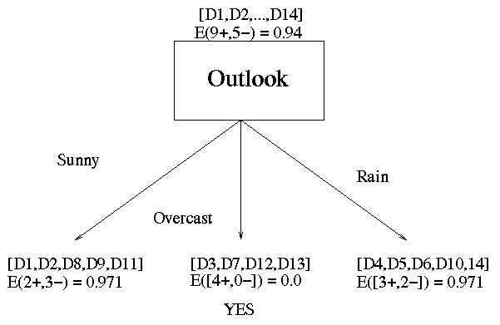
Decision Tree Learning: A Simple Example
Outlook is our winner!

Slide 21
Decision Tree Learning: A Simple Example
Now that we have discovered the root of our decision tree we must now recursively find the nodes that should go below Sunny, Overcast, and Rain.

Slide 22
Decision Tree Learning: A Simple Example
G(Outlook=Rain, Humidity) = 0.971 – [2/5*E(Outlook=Rain ^ Humidity=high) + 3/5*E(Outlook=Rain ^Humidity=normal]
G(Outlook=Rain, Humidity) = 0.02
G(Outlook=Rain,Wind) = 0.971- [3/5*0 + 2/5*0]
G(Outlook=Rain,Wind) = 0.971

Slide 23
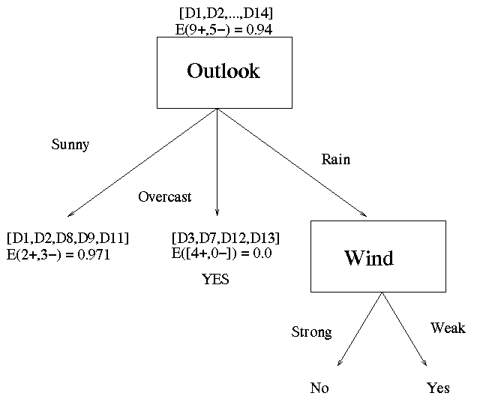
Decision Tree Learning: A Simple Example
Now our decision tree looks like:

