Slide 1
Artificial Intelligence
Waqas Haider Khan Bangyal

Slide 2
Data Mining Overview
Data Mining
Data warehouses and OLAP (On Line Analytical Processing.)
Clustering: Hierarchical and Partitioned approaches
Classification: Decision Trees , ANN, Bayesian classifiers and G.A
Association Rules Mining
Advanced topics: outlier detection, web mining

Slide 3
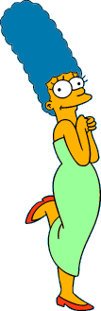



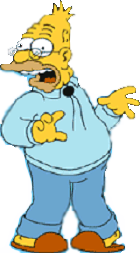
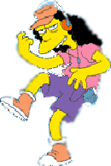
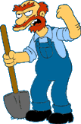

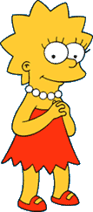
What is a natural grouping among these objects?

Slide 4


What is a natural grouping among these objects?
Clustering is subjective
Siaad's Family
School Employees
Females
Males

Slide 5
What is Clustering?
Also called unsupervised learning, sometimes called classification by statisticians and sorting by psychologists and segmentation by people in marketing
Organizing data into classes such that there is
high intra-class similarity
low inter-class similarity
Finding the class labels and the number of classes directly from the data (in contrast to classification).
More informally, finding natural groupings among objects.

Slide 6
What is clustering?
Clustering is the classification of objects into different groups, or more precisely, the partitioning of a data set into subsets (clusters), so that the data in each subset (ideally) share some common trait - often according to some defined distance measure.

Slide 7
What is Clustering?
You can say this “unsupervised classification”
Clustering is alternatively called as “grouping”
Intuitively, if you would want to assign same label to a data points that are “close” to each other
Thus, clustering algorithms rely on a distance metric between data points
Sometimes, it is said that the for clustering, the distance metric is more important than the clustering algorithm

Slide 8
Idea and Applications
Clustering is the process of grouping a set of physical or abstract objects into classes of similar objects.
It is also called unsupervised learning.
It is a common and important task that finds many applications.
Applications in Search engines:
Structuring search results
Suggesting related pages
Automatic directory construction/update
Finding near identical/duplicate pages

Slide 9
What is Cluster Analysis?
Cluster: a collection of data objects
Similar to one another within the same cluster
Dissimilar to the objects in other clusters
Cluster analysis
Grouping a set of data objects into clusters
Clustering is unsupervised classification: no predefined classes
Typical applications
As a stand-alone tool to get insight into data distribution
As a preprocessing step for other algorithms

Slide 10
Desirable Properties of a Clustering Algorithm
Scalability (in terms of both time and space)
Ability to deal with different data types
Minimal requirements for domain knowledge to determine input parameters
Able to deal with noise and outliers
Insensitive to order of input records
Incorporation of user-specified constraints
Interpretability and usability

Slide 11
Examples of Clustering Applications
Marketing: Help marketers discover distinct groups in their customer bases, and then use this knowledge to develop targeted marketing programs
Land use: Identification of areas of similar land use in an earth observation database
Insurance: Identifying groups of motor insurance policy holders with a high average claim cost
City-planning: Identifying groups of houses according to their house type, value, and geographical location
Earth-quake studies: Observed earth quake epicenters should be clustered along continent faults

Slide 12
Concepts in Clustering
“Defining distance between points
A good clustering is one where
(Intra-cluster distance) the sum of distances between objects in the same cluster are minimized,
(Inter-cluster distance) while the distances between different clusters are maximized
Objective to minimize: F(Intra,Inter)

Slide 13
What Is Good Clustering?
A good clustering method will produce high quality clusters with
high intra-class similarity
low inter-class similarity
The quality of a clustering result depends on both the similarity measure used by the method and its implementation.
The quality of a clustering method is also measured by its ability to discover some or all of the hidden patterns.

Slide 14
Types of clustering
Hierarchical algorithms: these find successive clusters
using previously established clusters.
1. Agglomerative ("bottom-up"): Agglomerative algorithms begin with each element as a separate cluster and merge them into successively larger clusters.
2. Divisive ("top-down"): Divisive algorithms begin with the whole set and proceed to divide it into successively smaller clusters.
2. Partitional clustering: Partitional algorithms determine all clusters at once. They include:
K-means and derivatives
Fuzzy c-means clustering
QT clustering algorithm

Slide 15
Classical clustering methods
Partitioning methods
k-Means (and EM), k-Medoids
Hierarchical methods
agglomerative, divisive, BIRCH
Model-based clustering methods

Slide 16
K-MEANS CLUSTERING
Simply speaking k-means clustering is an algorithm to classify or to group the objects based on attributes/features into K number of group.
K is positive integer number.
The grouping is done by minimizing the sum of squares of distances between data and the corresponding cluster centroid.

Slide 17

Common Distance measures:
Distance measure will determine how the similarity of two elements is calculated and it will influence the shape of the clusters.
They include:
1. The Euclidean distance (also called 2-norm distance) is given by:
2. The Manhattan distance (also called taxicab norm or 1-norm) is given by:

Slide 18

Common Distance measures:
3.The maximum norm is given by:
4. The Mahalanobis distance corrects data for different scales and correlations in the variables.
5. Inner product space: The angle between two vectors can be used as a distance measure when clustering high dimensional data
6. Hamming distance (sometimes edit distance) measures the minimum number of substitutions required to change one member into another.

Slide 19
K-means
Works when we know k, the number of clusters we want to find
Idea:
Randomly pick k points as the “centroids” of the k clusters
Loop:
For each point, put the point in the cluster to whose centroid it is closest
Recompute the cluster centroids
Repeat loop (until there is no change in clusters between two consecutive iterations.)
Iterative improvement of the objective function:
Sum of the squared distance from each point to the centroid of
its cluster

Slide 20
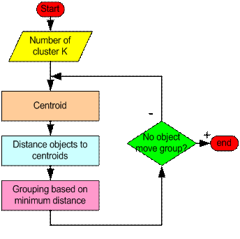
How the K-Mean Clustering algorithm works?

Slide 21
How the K-Mean Clustering algorithm works?
Step 1: Begin with a decision on the value of k = number of clusters .
Step 2:
Put any initial partition that classifies the data into k clusters. You may assign the training samples randomly, or systematically as the following:
1.Take the first k training sample as single- element clusters
2. Assign each of the remaining (N-k) training sample to the cluster with the nearest centroid. After each assignment, recompute the centroid of the gaining cluster.

Slide 22
How the K-Mean Clustering algorithm works?
Step 3: Take each sample in sequence and compute its distance from the centroid of each of the clusters. If a sample is not currently in the cluster with the closest centroid, switch this sample to that cluster and update the centroid of the cluster gaining the new sample and the cluster losing the sample.
Step 4 . Repeat step 3 until convergence is achieved, that is until a pass through the training sample causes no new assignments.

Slide 23
K-means Overview
An unsupervised clustering algorithm
“K” stands for number of clusters, it is typically a user input to the algorithm; some criteria can be used to automatically estimate K
It is an approximation to an NP-hard combinatorial optimization problem
K-means algorithm is iterative in nature
It converges, however only a local minimum is obtained
Works only for numerical data
Easy to implement

Slide 24
Weaknesses of K-Mean Clustering
When the numbers of data are not so many, initial grouping will determine the cluster significantly.
The number of cluster, K, must be determined before hand. Its disadvantage is that it does not yield the same result with each run, since the resulting clusters depend on the initial random assignments.
We never know the real cluster, using the same data, because if it is inputted in a different order it may produce different cluster if the number of data is few.
It is sensitive to initial condition. Different initial condition may produce different result of cluster. The algorithm may be trapped in the local optimum.

Slide 25
Applications of K-Mean Clustering
It is relatively efficient and fast. It computes result at O(tkn), where n is number of objects or points, k is number of clusters and t is number of iterations.
k-means clustering can be applied to machine learning or data mining
Used on acoustic data in speech understanding to convert waveforms into one of k categories (known as Vector Quantization or Image Segmentation).
Also used for choosing color palettes on old fashioned graphical display devices and Image Quantization.

Slide 26
CONCLUSION
K-means algorithm is useful for undirected knowledge discovery and is relatively simple. K-means has found wide spread usage in lot of fields, ranging from unsupervised learning of neural network, Pattern recognitions, Classification analysis, Artificial intelligence, image processing, machine vision, and many others.

Slide 27
Real-Life Numerical Example of K-Means Clustering
We have 4 medicines as our training data points object and each medicine has 2 attributes. Each attribute represents coordinate of the object. We have to determine which medicines belong to cluster 1 and which medicines belong to the other cluster.
Object | Attribute1 (X): weight index | Attribute 2 (Y): pH
Medicine A | 1 | 1
Medicine B | 2 | 1
Medicine C | 4 | 3
Medicine D | 5 | 4

Slide 28
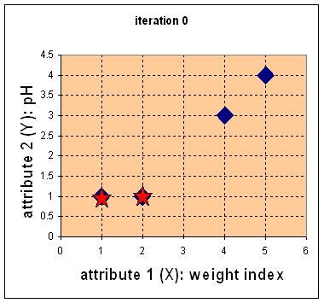
Step 1:
Initial value of centroids : Suppose we use medicine A and medicine B as the first centroids.
Let and c₁ and c₂ denote the coordinate of the centroids, then c₁=(1,1) and c₂=(2,1)

Slide 29
Objects-Centroids distance : we calculate the distance between cluster centroid to each object.
Let us use ρ(a, b) = |x2 – x1| + |y2 – y1|
distance matrix at iteration 0 is
So, we fill in these values in the table:
Object | Mean (Centroid) Cluster-1 (1,1) | Mean (Centroid) Cluster-2 (2,1) | Clusters
(1,1) | 0 | 1 | Cluster-1
(2,1) | 1 | 0 | Cluster-2
(4,3) | 5 | 4 | Cluster-2
(5,4) | 7 | 6 | Cluster-2
point mean1
x1, y1 x2, y2
(1, 1) (1, 1)
ρ(a, b) = |x2 – x1| + |y2 – y1|
ρ(point, mean1) = |x2 – x1| + |y2 – y1|
= |1 – 1| + |1 – 1|
= 0 + 0
= 0
point mean2
x1, y1 x2, y2
(1, 1) (2, 1)
ρ(a, b) = |x2 – x1| + |y2 – y1|
ρ(point, mean1) = |x2 – x1| + |y2 – y1|
= |2 – 1| + |1 – 1|
= 1 + 0
= 0
So, which cluster should the point (1, 1) be placed in? The one, where the point has the shortest distance to the mean – that is mean 1 (cluster 1), since the distance is 0.

Slide 30
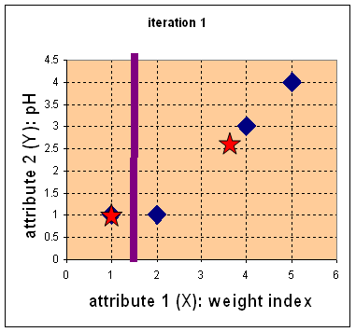

Step 2:
Objects clustering : We assign each object based on the minimum distance.
Medicine A is assigned to group 1, medicine B to group 2, medicine C to group 2 and medicine D to group 2.
The elements of Group matrix below is 1 if and only if the object is assigned to that group.

Slide 31
Iteration-2, Objects-Centroids distances : The next step is to compute the distance of all objects to the new centroids.
Similar to step 2, we have distance matrix at iteration 1 is
Cluster 1 Cluster 2
(1, 1) (2, 1)
(4, 3)
(5, 4)
Next, we need to re-compute the new cluster centers (means). We do so, by taking the mean of all points in each cluster.
For Cluster 1, we only have one point A1(1, 1), which was the old mean, so the cluster center remains the same.
For Cluster 2, we have ( (2+4+5)/3, (1+3+4)/3 ) = (3.6, 2.6)
In Iteration2, we basically repeat the process from Iteration1 this time using the new means we computed.
That was Iteration1 (epoch1). Next, we go to Iteration3 (epoch3), Iteration4, and so on until the means do not change anymore.
Object | Mean (Centroid) Cluster-1 (1,1) | Mean (Centroid) Cluster-2 (3.6,2.6) | Clusters
(1,1) | 0 | 4.2 | Cluster-1
(2,1) | 1 | 3.2 | Cluster-1
(4,3) | 5 | 4.2 | Cluster-2
(5,4) | 7 | 4 | Cluster-2

Slide 32
We get the final grouping as the results as:
Object | Feature1(X): weight index | Feature2 (Y): pH | Group (result)
Medicine A | 1 | 1 | 1
Medicine B | 2 | 1 | 1
Medicine C | 4 | 3 | 2
Medicine D | 5 | 4 | 2

