Slide 1
Artificial Intelligence
Dr. Waqas Haider Khan Bangyal

Slide 2
Course Contents
Introduction
Crisp / Classical Set Theory
Fuzzy Set Theory
Crisp Logic
Fuzzy Logic
Fuzzy Inference System (FIS)

Slide 3
Introduction

Slide 4
How Do We Answer These Queries?
Is it a dolphin?
Yes / No
What is the current room-temperature?
20°C, 25°C, 30°C, 35°C, etc
What is the running time of each iteration of the loop in the program?
5 ms, 40 ms, 1 s, etc
These types of statements are called “crisp”, because they are precise and clear.

Slide 5
How Do We Answer These Queries?
Is she honest?
Extremely Honest, Very Honest, Honest at Times, Very Dishonest, or Extremely Dishonest
Is he tall?
Very Tall, Slightly Tall, Medium, Slightly Short, Very Short
These kinds of statements are called “fuzzy”, because they are vague.

Slide 6
Logic
Logic is the science of reasoning.
Example 1:
If the switch B is pressed and the electricity is present, then the bulb will be turned on.
Example 2:
If the water is hot and the tea-sachet is dipped in it, then the water color will become brown.
1st example represents classical / crisp logic
2nd example represents fuzzy logic.

Slide 7
Crisp Boundaries in Real Life…
Often, it is hard to set crisp or precise boundaries in the real life.
For example:
A student is good, if he receives marks more than 60%.
What if someone gets 59.8%?
A person is tall, if his height is more than 6.5 ft.?
What if someone is 6.4 ft?
A thing is heavy, if its weight is more than 20 kg?
What if something weighs 19.8 kg?

Slide 8
What is Fuzzy Logic (FL)?
It is the logic that deals with the relative importance of precision.
How important is it to be exactly right when a rough (vague) answer will do?
Fuzzy set theory is an excellent mathematical tool to handle the uncertainty arising due to vagueness.
It was originally proposed by Lutfi A. Zadeh in 1965.

Slide 9
What is Fuzzy Logic? (contd.)
Fuzzy logic is a convenient way to map an input space to an output space.
It says…
You tell me how good your service was at a restaurant…
I’ll tell you what the tip for the waiter should be.
You tell me how hot you want the water…
I’ll adjust the faucet valve to the right setting.
You tell me how far away the subject of your photograph is…
I’ll focus the lens for you.
You tell me how fast the car is going and how hard the motor is working…
I’ll shift the gears for you.

Slide 10
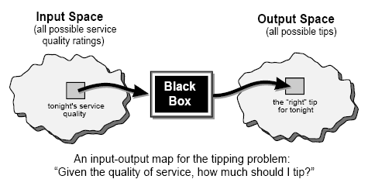
Input-Output Mapping
What could go in the black box?
Fuzzy system, linear system, expert system, neural network, differential equations, interpolated multidimensional lookup tables, or even a spiritual advisor.
In almost every case, you can build the same product without fuzzy logic, but fuzzy is faster and cheaper — Lotfi Zadeh

Slide 11
Why Fuzzy Logic?
It is conceptually easy to understand.
The mathematical concepts behind fuzzy reasoning are very simple.
It is flexible.
With any given system, it’s easy to layer more functionality on top of it without starting again from scratch.
It can easily model nonlinear functions.
You can create a fuzzy system to match any set of input-output data.
This process is made particularly easy by adaptive techniques like ANFIS (Adaptive Neuro-Fuzzy Inference Systems).

Slide 12
Where is Fuzzy Logic Used?
The past few years have witnessed a rapid growth in the number and variety of applications of fuzzy logic.
It is being used in:
Consumer products (e.g., cameras, camcorders, washing machines, and microwave ovens),
Industrial process control,
Medical instrumentation,
Automobiles,
And so on…

Slide 13
Course Progress
Introduction
Crisp / Classical Set Theory
Fuzzy Set Theory
Crisp Relations
Fuzzy Relations
Crisp Logic
Fuzzy Logic
Fuzzy Inference System (FIS)

Slide 14
Classical Set Theory

Slide 15
Classical Set
It is a well defined collection of objects (elements).
“Well defined” means “the object either belongs to or does not belong to the set”
That is why it’s called a “crisp” set.
Examples:
A = Set of positive integer numbers = {1, 2, 3, …}
B = {Peacock, Swan, Dove}
C = {x | (x > 0) and (x mod 5 = 0)} = {5, 10, 15, …}

Slide 16
Universe of Discourse
It is a set which, with reference to a particular context, contains all possible elements having same characteristics and from which other sets can be formed.
It’s usually called a “universal set”.
Examples:
The universal set of all students in a university.
The universal set of all integer numbers.

Slide 17
Operations on Classical Sets
Union
Intersection
Difference
Complement

Slide 18
Union
The union of two sets A and B is the set of all elements that belong to A or B or both, without replication.
Exercise 1: Draw a Venn diagram for AUB…
Example
If A = {1, 2, 3} and B = {3, 4, 5}
Then, A U B = {1, 2, 3, 4, 5}

Slide 19
Intersection
The intersection of two sets A and B is a set of the elements which belong to both A and B.
Exercise 2: Draw a Venn diagram for A∩B…
Example
If A = {1, 2, 3} and B = {3, 4, 5}
Then, A ∩ B = {3}
If A∩B = Ø, then A and B are called “disjoint sets”.
For example, if A = {1, 2} and B = {4, 5}, they are disjoints sets.

Slide 20
Difference
The difference of sets A and B is a set A-B, which contains only those elements of A which are not in B.
Exercise 3: Draw a Venn diagram of a set A – B…
Example
If A = {a, e, i, o, u} and B = {a, u}
Then, A – B = {e, i, o}

Slide 21
Complement
The complement of set A is the set of all elements which are in the universal set E but not in A.
Exercise 4: Draw a Venn diagram of a set A^{c}…
Example
If a universal set E = {1, 2, 3, 4, 5} and A = {1, 3, 5}
Then A^{c} = {2, 4}

Slide 22
Course Progress
Introduction
Crisp / Classical Set Theory
Fuzzy Set Theory
Crisp Logic
Fuzzy Logic
Fuzzy Inference System (FIS)

Slide 23
Fuzzy Set Theory

Slide 24
Introduction to Fuzzy Sets
In a crisp / classical set, an element from the universal set is either absent or present.
There is no in-between situation such as “partially present”.
But, in a fuzzy set, every element from the universe of discourse is present with a degree of membership in the range [0.0, 1.0].
The degree of membership is denoted by μ.
If μ = 0.0, the element is said to be “absent”.
If μ = 1.0, the element is said to be “completely present”.
If 0.0 < μ < 1.0, the element is said to be “partially present”.
The more the membership value, the more the element belongs to the fuzzy set.

Slide 25
Definition of a Fuzzy Set
A fuzzy set, A, defined on a universe of discourse, Z, may be written as a collection of ordered pairs:
where z is a particular element of Z and μ_{A}(z) is its membership value.
Note
A crisp set can be considered as a special case of a fuzzy set, in which μ is either 0 or 1.

Slide 26
Definition of a Fuzzy Set (contd.)
Example
Let Z = {g₁, g_{2 ,} g_{3 ,} g_{4 ,} g₅} be a fuzzy reference set of students (i.e., universe of discourse)
It is understood that every element in a universe of discourse has membership value of 1).
On the universe of discourse Z, set A is a fuzzy set of “smart” students, as:

Slide 27
Basic Fuzzy Set Operations
The basic fuzzy set operations are:
Union
Intersection
Complement
Difference

Slide 28
Union of Fuzzy Sets
The union of two fuzzy sets A and B on a universe of discourse Z is a new fuzzy set C on Z with a membership function defined as:

Slide 29
Example
Z: Universe of discourse
Age of people
A: Fuzzy set of young people in Z, as:
A = {(10, 1), (20, 1), (30, 0.5), (40, 0) , (50, 0), (60, 0)},
B: Fuzzy set of middle-aged people in Z, as:
B = {(10, 0), (20, 0), (30, 0.5), (40, 1), (50, 0.5), (60, 0)}
Then, C = A U B in Z is:
C = {(10, 1), (20, 1), (30, 0.5), (40, 1), (50, 0.5), (60, 0)}

Slide 30
Intersection of Fuzzy Sets
The intersection of two fuzzy sets A and B on a universe of discourse Z is a new fuzzy set C on Z with a membership function defined as:

Slide 31
Example
Z: Universe of discourse
Age of people
A: Fuzzy set of young people in Z, as:
A = {(10, 1.0), (20, 1), (30, 0.5), (40, 0) , (50, 0), (60, 0)},
B: Fuzzy set of middle-aged people in Z, as:
B = {(10, 0), (20, 0), (30, 0.5), (40, 1), (50, 0.5), (60, 0)}
Then, C = A ∩ B in Z is:
C = {(10, 0), (20, 0), (30, 0.5), (40, 0), (50, 0), (60, 0)}
= {(30, 0.5)} (A singleton fuzzy set!)

Slide 32
Complement of a Fuzzy Set
The complement of a fuzzy set A, denoted by Ā or A^{c}, on a universe of discourse Z is a set, of which membership function is
μ_{Ā} (z) = 1 - μ_{A}(z)
for all z belonging to Z.
Example:
Z: Universe of discourse
Age of people
A: Fuzzy set of young people in Z, as:
A = {(10, 1), (20, 1), (30, 0.5), (40, 0) , (50, 0), (60, 0)},
Then, Ā is the fuzzy set of not-young people in Z, as:
Ā = {(10, 0), (20, 0), (30, 0.5), (40, 1), (50, 1), (60, 1)}

Slide 33
Difference of Fuzzy Sets
The difference of two fuzzy sets A and B on a universe of discourse Z is a new fuzzy set C, defined as:
C = A – B = A ∩ B^{c}
Example
Let
A = {(z1,0.2), (z2, 0.5), (z3, 0.6)}
B = {(z1,0.1), (z2, 0.4), (z3, 0.5)}
Then,
B^{c} = {(z1,0.9), (z2, 0.6), (z3, 0.5)}, and
C = A – B = A ∩ B^{c} = {(z1,0.2), (z2, 0.5), (z3, 0.5)}

Slide 34
Example
A = {(z₁, 0.4), (z₂, 0.8), (z₃, 0.6)},
B = {(z₁, 0.2), (z₂, 0.6), (z₃, 0.9)}
(A^{c} ∩ B) U (A ∩ B^{c}) = ?

Slide 35
Solution to Exercise 10
We have:
A = {(z₁, 0.4), (z₂, 0.8), (z₃, 0.6)},
B = {(z₁, 0.2), (z₂, 0.6), (z₃, 0.9)}
Then,
A^{c} = {(z₁, 0.6), (z₂, 0.2), (z₃, 0.4)}
B^{c} = {(z₁, 0.8), (z₂, 0.4), (z₃, 0.1)}
A^{c} ∩ B = {(z₁, 0.2), (z₂, 0.2), (z₃, 0.4)}
A ∩ B^{c} = {(z₁, 0.4), (z₂, 0.4), (z₃, 0.1)}
Therefore, the disjunctive sum of A and B is C, as:
C = (A^{c} ∩ B) U (A ∩ B^{c}) = {(z₁, 0.4), (z₂, 0.4), (z₃, 0.4)}

Slide 36
Course Progress
Introduction
Crisp / Classical Set Theory
Fuzzy Set Theory
Crisp Logic
Fuzzy Logic
Fuzzy Inference System (FIS)

Slide 37
Crisp Logic

Slide 38
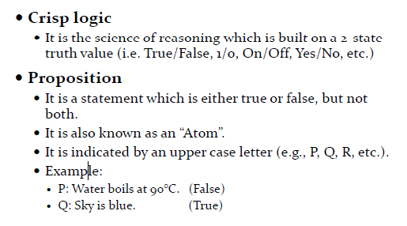
Definitions

Slide 39
Connectives (contd.)
Unary Connective
It requires only one proposition (i.e., input).
NOT is unary connective.
Binary Connective
It requires two propositions (i.e., inputs).
AND, OR, IMPLIES, and EQUAL are binary operators.
Conjunction Operation
AND operation is also called a conjunction operation.
Disjunction Operation
OR operation is also called a disjunction operation.

Slide 40
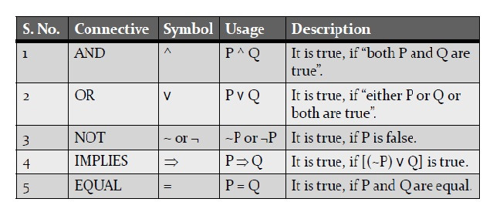
Connectives
They are operators that link propositions to represent complex phenomena in the real world.

Slide 41
Connectives (contd.)
Antecedent and Consequent
The proposition occurring before IMPLIES (=>)connective is called “antecedent”.
The proposition occurring after IMPLIES (=>) connective is called “consequent”.

Slide 42
The Negation Operator
The unary negation operator “¬” (NOT) transforms a proposition into its logical negation.
E.g. If p = “I have brown hair.”
then ¬p = “I do not have brown hair.”
Truth table for NOT:

Slide 43
The Conjunction Operator
The binary conjunction operator “∧” (AND) combines two propositions to form their logical conjunction.
E.g.
If p=“I will have salad for lunch.” and q=“I will have steak for dinner.”,
then
p∧q=“I will have salad for lunch and I will have steak for dinner.”

Slide 44
Conjunction Truth Table
Note that a conjunction p₁ ∧ p₂ ∧ … ∧ p_{n} of n propositions will have 2^{n} rows in its truth table.
¬ and ∧ operations together are universal, i.e., sufficient to express any truth table!

Slide 45
The Disjunction Operator
The binary disjunction operator “∨” (OR) combines two propositions to form their logical disjunction.
p=“That car has a bad engine.”
q=“That car has a bad carburetor.”
p∨q=“Either that car has a bad engine, or that car has a bad carburetor.”

Slide 46
Disjunction Truth Table
Note that p∨q means that p is true, or q is true, or both are true!
So this operation is also called inclusive or, because it includes the possibility that both p and q are true.
“¬” and “∨” together are also universal.

Slide 47
Disjunction Truth Table
Note that p∨q means that p is true, or q is true, or both are true!
So this operation is also called inclusive or, because it includes the possibility that both p and q are true.
“¬” and “∨” together are also universal.

Slide 48
The Implication Operator
The implication p → q states that p implies q.
It is FALSE only in the case that p is TRUE but q is FALSE.
E.g., p=“I am elected.” q=“I will lower taxes.”
p → q = “If I am elected, then I will lower taxes” (else it could go either way)

Slide 49
Implication Truth Table
p → q is false only when p is true but q is not true.
p → q does not imply that p causes q!
p → q does not imply that p or q are ever true!
E.g. “(1=0) → pigs can fly” is TRUE!

Slide 50
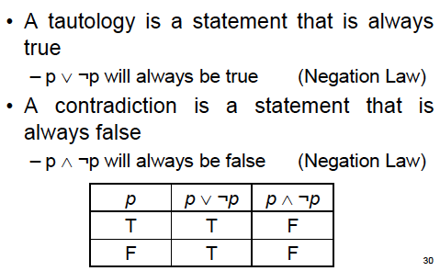
Tautology and Contradiction

Slide 51
Fuzzy Logic

Slide 52
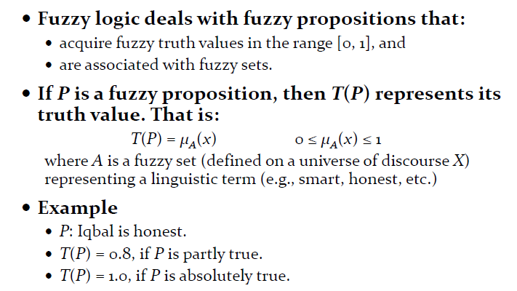
Fuzzy Logic

Slide 53
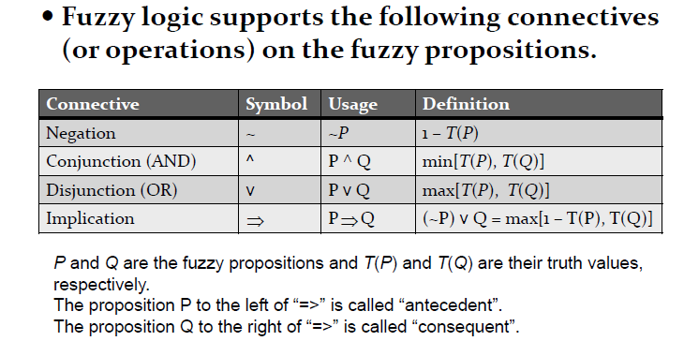
Fuzzy Connectives

Slide 54
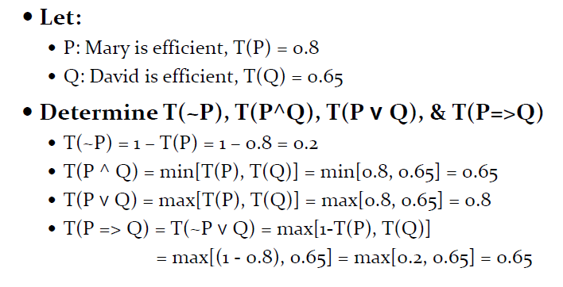
Example

Slide 55
Classical Set:|
A={ 1,2 3}
B={a,b}
Ax B={ (1,a),(1,b),(2,a),(2,b),(3,a),(3,b)}
…………………………………………………………………………
Fuzzy Set:
A={(1,0.3),(2,0.6),(3,0.8)}
B={(a,0.4),(b,0.9)}
A x B={(1,0.3)

Slide 56
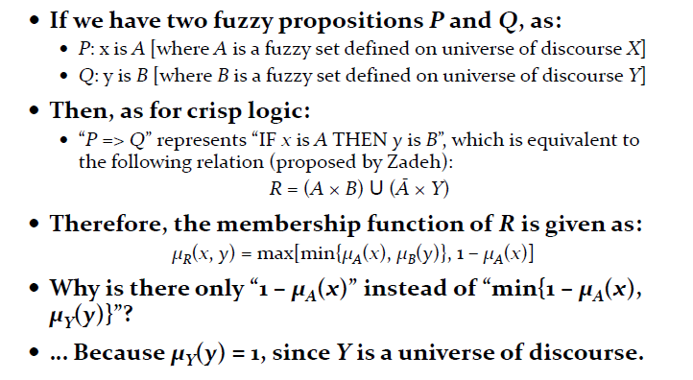
Fuzzy IF‐THEN Rule

Slide 57
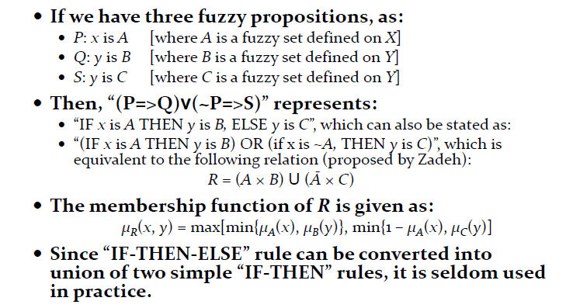
Fuzzy IF-THEN RULES

Slide 58
Classical Set:
A={1,2,3}
B={a,b}
A x B={(1,a),(1,b),(2,a),(2,b),(3,a),(3,b) }
………………………………………………………………….
Fuzzy Set:
A={ (1,0.4),(2,0.5),(3,0.4)}
B={ (a,0.9),(b,0.7)}
A x B={(1,a,0.4),(1,a,0.9) }
={ }

Slide 59
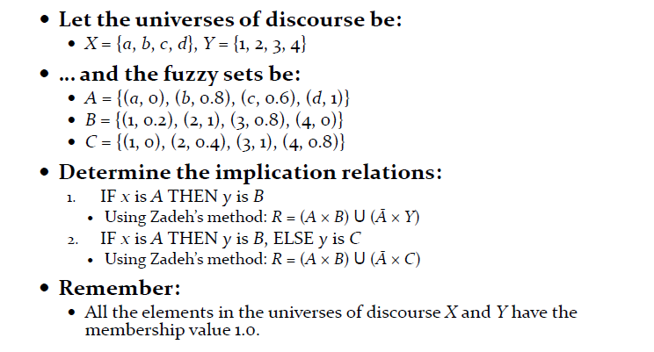
Exercise

Slide 60
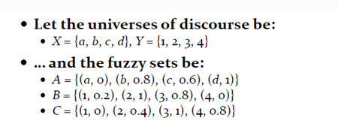

Exercise

Slide 61
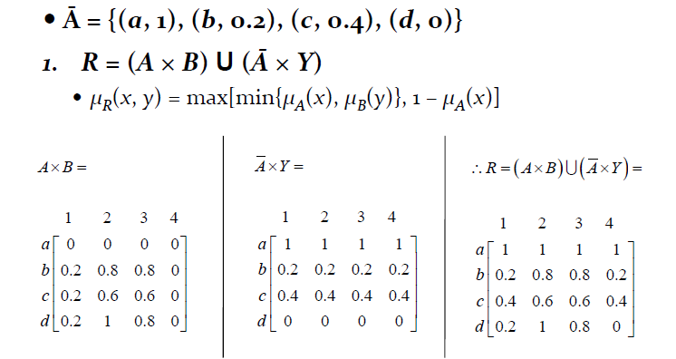
Solution

Slide 62
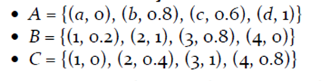

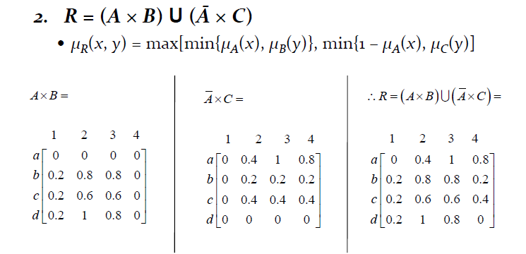
Solution

Slide 63
FUZZY INFERENCE SYSTEM

Slide 64
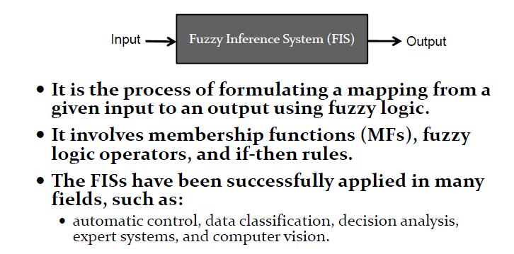
INTRODUCTION TO FIS

Slide 65
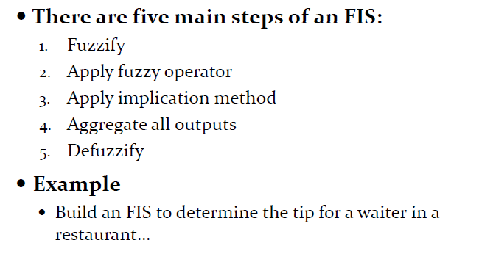
Main Steps of FIS

Slide 66
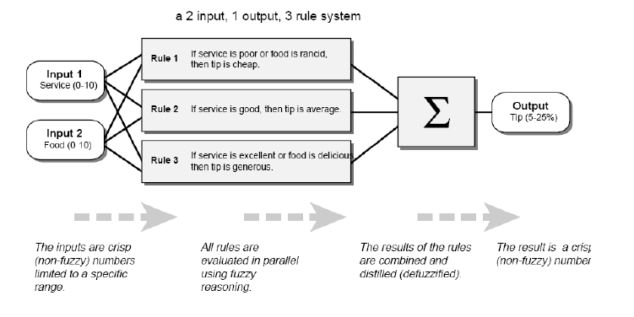
FIS to Determine the Tip for a Waiter

Slide 67
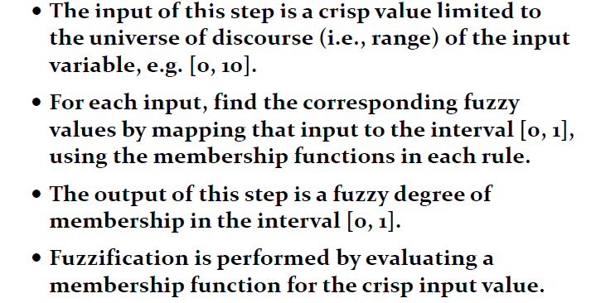
Step 1: Fuzzify

Slide 68
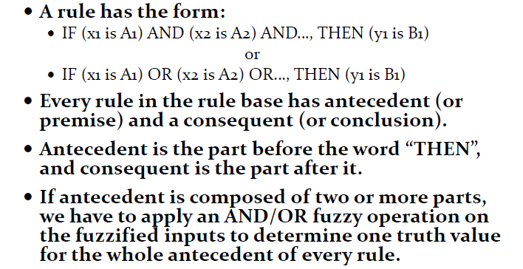
Step 2: Apply Fuzzy Operator

Slide 69
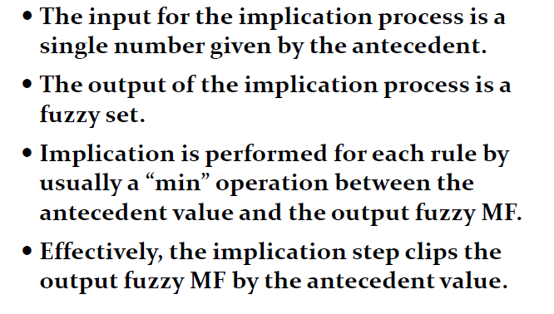
Step 3:Apply Implication Operator

Slide 70
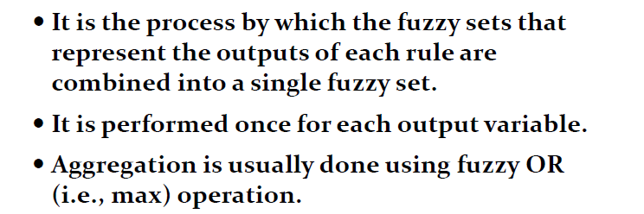
Step 4: Aggregate All Outputs

Slide 71
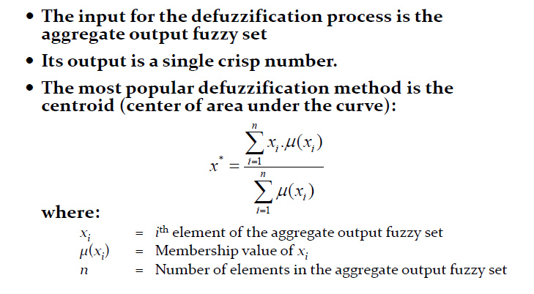
Step 5: Defuzzify

Slide 72
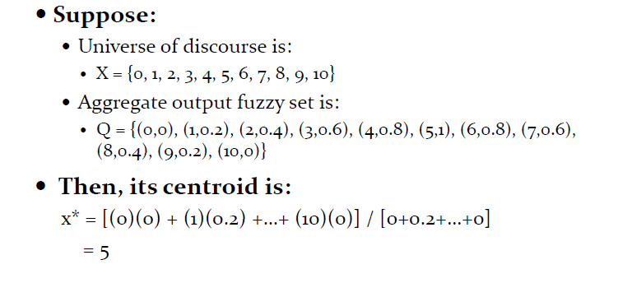
Centroid Example

Slide 73
THANKS

