Slide 1
Artificial Intelligence
By
Waqas Haider Khan Bangyal

Slide 2
Why we study Artificial Intelligence?
New emerging field
Involvement in our daily life
AI is playing role in defense, robots, expert systems, games etc

Slide 3
What does “artificial” intelligence mean?
Programming a computer to successfully perform tasks that are thought to require intelligence
Playing chess
Proving theorems
Translating Russian into English
Walking across a room
Recognizing a familiar face
Understanding directions

Slide 4
The Turing Test
This is the critical part of the Turing test, substitute a computer for one of the people.
Now the human is obligated to give you truthful, human-like responses; but the computer is trying to fool you into thinking that it is human!

Slide 5
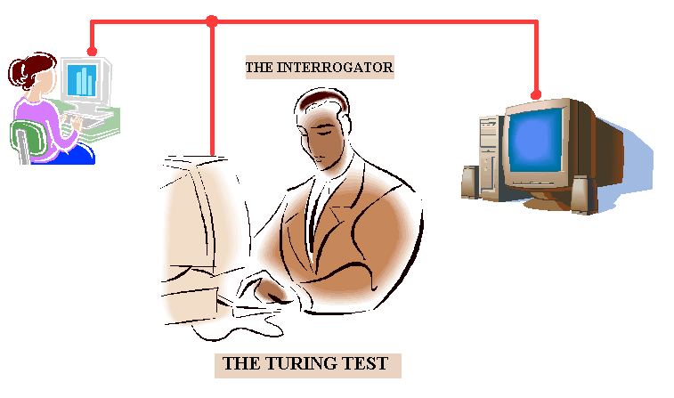

Slide 6
The Turing Test
It is considered to be any situation in which a human converses with an unseen respondent and attempts to determine if the dialogue is being conducted with a human or a computer.
If a computer can fool you into believing that you are talking to a human, the computer can be said to be intelligent.

Slide 7
Intelligent Test for Computers
Alan Turing, a pioneer in the theory of computation, once proposed an intelligent test for computer programs [Turing 1950].
In one variant of the Turing Test, a human judge is allowed to interrogate a program through some sort of an interface such as a video terminal. If the program can fool the human into believing that it is another human responding rather than a computer, then the program is judged intelligent.
You can imagine variants of this test in which you manipulate a robot’s environment to see how robot responds and judge the robot as intelligent or not, depending on whether the robot responds in accordance with how a human might in the same situation.

Slide 8
Computers are
Good at:
Number crunching
Storing information
Airline scheduling
Transmitting data
Structured data bases
Graphics
Bad at:
Writing poetry
Composing music
Understanding speech
Driving cars
Enjoying peaches
Learning new things

Slide 9
INTELLIGENCE
Natural
God made
Associated with human
Human behavior
Psychology
Five senses
Symbolic data
Fuzzy ness
Artificial
Man made
Associated with machines
To emulate human behavior in terms of computational processes
Various sensors
Numeric + Symbolic
Uncertainty to be dealt with

Slide 10
AI programming Vs. Conventional programming
AI
Primarily symbolic
Heuristic, Solution steps implicit
Control structure separate from knowledge base
Easy to modify
Satisfactory answers acceptable
CONVENTIONAL
Primarily numeric
Algorithmic, Solution step explicit
Information and control integrated
Difficult to modify
Correct answers required

Slide 11
ELEMENTS OF AI
NLP
Heuristic
Search
Knowledge
Rep.
T.Prov.
ROBOTS
& MV
Languages
& Tools
Reasoning
& Logic
ES

Slide 12
Strong AI
It makes the bold claim that computers can be made to think on a level (at least) equal to humans.
Weak AI
It simply states that some “thinking like” features can be added to computers make them more useful tools like expert systems, speech recognition software etc.

Slide 13

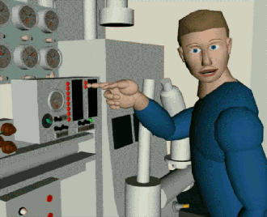
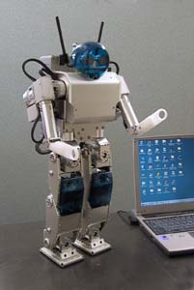
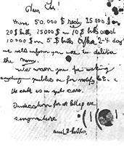
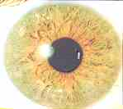
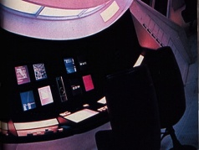

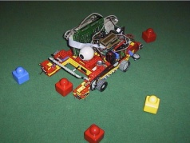
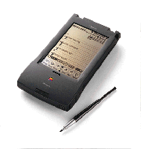
AI Technologies and Applications
AI TECHNOLOGIES
ROBOTICS
EXPERT
SYSTEMS
VISION
SPEECH
NLU
CAI
GAME
PLAYING
LEARNING
KE
GPS
T. PROVING
Factory
Automation
Fault
Diagnosis
Perception
Understanding
Comm.
Learning
and teaching
Neural
Networks
Acquisition
Guidance
Generation
Grammer
Text
understanding
Autonomous
Vehicals
Intelligent
Assistant
Text to
Speech
Parallel
Computing
Inspection
Text
generation
Mechatronics
Medical,
Control, etc.
Verification
Speaker
Genetic
Algorithms
Explanation

Slide 14
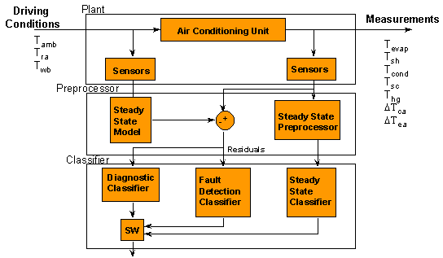

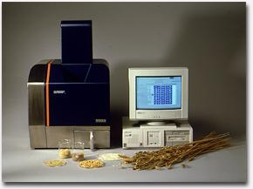
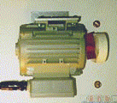
Domain Specific Applications of AI
APPLICATIONS
MEDICAL
SCIENCE
& ENGG.
INDUSTRY
MILITARY
SERVICES
SPACE
FINANCIAL
NATURAL
RESOURCES
Diagnosis
Plant
control
Factory
M, P & S
Surveillance
Intelligent
KB Access
Groupd
Ops. Aid
Tax Prep.
Prospecting
Aids
Treatment
Data
interpretation
Target
Trk. & Recog.
ES
Drilling
Ops.
Intelligent
Robots
P & S
Monitoring
Intelligent
design
Autonomous
Vehicles
Traffic
control
Remote
Ops.
Inspection
Intelligent
Consultant
Resource
Recovery
Knowledge
Automation
Chem.
& Bio.
Synthesis
Mechatronics
Expert
Advisors
Sensor
Fusion
Resource
Management

Slide 15
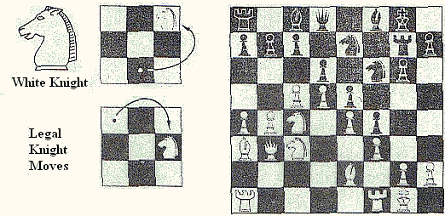
Playing Chess
A game of chess can be analyzed by a symbolic program. Each chess piece is represented by a symbol, and the rules governing legal moves are represented by symbolic expressions.

Slide 16

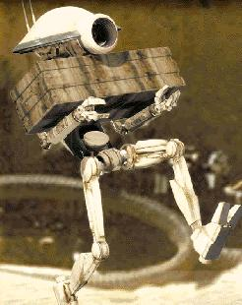
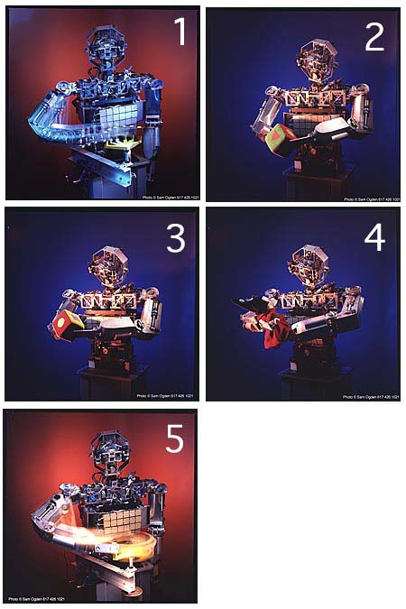
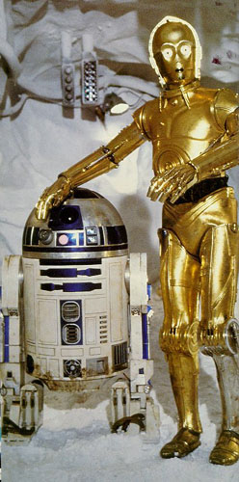
Robots

Slide 17
