Slide 1
AVL Tree Example
(This is the example we did in tutorial on Thursday)
Slides by Jagoda Walny
CPSC 335, Tutorial 02
Winter 2008

Slide 2
AVL trees are self-balancing binary search trees.
Each node of an AVL tree is assigned a balance factor as follows:
-1 if the depth of the node’s left subtree is 1 more than the depth of the right node’s left sub tree
+1 if the depth of the node’s left sub tree is 1 more than the depth of the right node’s left subtree
0 if both of the node’s subtrees has the same depths
-2 if the depth of the node’s left subtree is 2 more than the depth of the right node’s left sub tree
+2 if the depth of the node’s left sub tree is 2 more than the depth of the right node’s left subtree
If the balance factor becomes -2 or +2, the tree must be rebalanced.
Next: Rotations -->

Slide 3
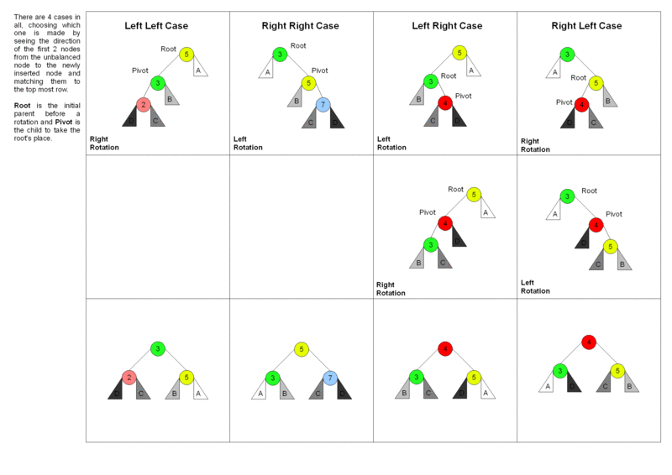
If the balance factor of a node in an AVL tree is +2 or -2, the node is rotated to re-balance the tree using one of the four cases shown in the following picture:
The 4 cases of AVL tree rebalancing using rotations. Picture created by Marc Tanti, licensed for reuse under the GNU Free Documentation License, Version 1.2
Next: example -->

Slide 4
Initial AVL tree with balance factors:
Balance ok
0
57
0
26
+1
72
-1
25
0
38
0
63
-1
94
0
3
0
37
0
47
0
78
Next step: insert 1 -->

Slide 5
Insert 1 and recalculate balance factors
Balance not ok
(Balance factor of -2 is not allowed)
-1
57
-1
26
+1
72
-2
25
0
38
0
63
-1
94
-1
3
0
37
0
47
0
78
0
1
Next step: Find rebalancing case -->

Slide 6
Balance not ok
Find rebalancing case
-1
57
-1
26
+1
72
Left Left Case
-2
25
0
38
0
63
-1
94
Pivot
-1
3
0
37
0
47
0
78
0
1
Next step: apply Left Left rebalancing -->

Slide 7
Balance ok
Rebalance and recalculate balance factors
0
57
0
26
+1
72
0
3
0
38
0
63
-1
94
0
1
0
25
0
37
0
47
0
78
Next step: insert 30 -->

Slide 8
Balance ok
Insert 30 and recalculate balance factors
-1
57
+1
26
+1
72
0
3
-1
38
0
63
-1
94
0
1
0
25
-1
37
0
47
0
78
0
30
Next step: Insert 32 -->

Slide 9
Balance not ok
Insert 32 and recalculate balance factors
-2
57
+2
26
+1
72
0
3
-2
38
0
63
-1
94
0
1
0
25
-2
37
0
47
0
78
+1
30
0
32
Next step: Find rebalancing case -->

Slide 10
Balance not ok
Find rebalancing case
-2
57
+2
26
+1
72
0
3
-2
38
0
63
-1
94
0
1
0
25
-2
37
0
47
0
78
+1
30
Left Right Case
0
32
Next step: Rebalance (Step 1) -->

Slide 11
Balance not ok
Rebalance (Step 1)
-2
57
+2
26
+1
72
0
3
-2
38
0
63
-1
94
0
1
0
25
-2
37
0
78
0
47
-1
32
0
30
Next step: Rebalance (Step 2) -->

Slide 12
Balance ok
Rebalance (Step 2) and recalculate balance factors
-1
57
+1
26
+1
72
0
3
-1
38
0
63
-1
94
0
1
0
25
0
32
0
47
0
78
0
30
0
37
Next step: Insert 35 -->

Slide 13
Balance not ok
Insert 35 and recalculate balance factors
-2
57
+2
26
+1
72
0
3
-2
38
0
63
-1
94
0
1
0
25
+1
32
0
47
0
78
0
30
-1
37
0
35
Next step: Find rebalancing case -->

Slide 14
Balance not ok
Insert 35
-2
57
+2
26
Start from first spot (from bottom of tree) where balance factor is incorrect.
+1
72
0
3
-2
38
0
63
-1
94
0
1
0
25
+1
32
0
47
0
78
Left Right Case
0
30
-1
37
0
35
Next step: Rebalance (Step 1) -->

Slide 15
Balance not ok
Rebalance (Step 1)
-2
57
+2
26
+1
72
0
3
-2
38
0
63
-1
94
0
1
0
25
-2
37
0
47
0
78
0
32
0
30
0
35
Next step: Rebalance (Step 2) -->

Slide 16
Balance ok
Rebalance (Step 2)
-1
57
+1
26
+1
72
0
3
0
37
0
63
-1
94
0
1
0
25
0
32
+1
38
0
78
0
30
0
35
0
47
Next step: Finished! -->

Slide 17
Balance ok
Finished!
-1
57
+1
26
+1
72
0
3
0
37
0
63
-1
94
0
1
0
25
0
32
+1
38
0
78
0
30
0
35
0
47
Exercise: insert 36

