Slide 1

SALES LETTER

Slide 2
Sales letters
Introduction:
In order to convince the customer sales letters are lengthy as compare to other letters. Sales letters are a kind of advertisement of a product or service. It has to “educate, persuade and convince” the customer.
Sales letters are not only lengthy, they also have some literature, brochure, pamphlet etc
Sales letters are aimed at catching attention of some particular class.

Slide 3
SALES LETTER
A sales letter is a piece of direct mail which is designed to convince the reader to purchase a particular product or service in the absence of a salesman.
It has been defined as "A form of direct mail in which an advertiser sends a letter to a potential customer."

Slide 4
FEATURES
It is used to introduce products or services to consumers.
It use formal letter structures.
It is impersonal because they are sent to more than one person.
It is a form of advertising.

Slide 5
Sales letters
Advantages of sales letters:
Sales letters get straight to the reader and can compel more attention.
It has not to face competition like advertisement.
It is easy to avoid a salesman but not a sales letter.
It has advantage of personal touch.
It is very cheap as compared to other publicity.

Slide 6
Sales letters
Disadvantages of sales letters:
A sales letter has to perform various functions in a very limited space.
It has to arouse interest and desire in a limited space.
Sales letters are uninvited and hence not likely to get a warm welcome.

Slide 7

Sales letters
Formulas for organizing sales letters:
The most effective formula is known as AIDA
A Attention I Interest
D Desire A Action

Slide 8
COMPONENTS
Headline:
The headline is the most prominent text on the sales letter, and is designed to be among the first item the reader attends to understand.
Body :
This section is typically quite long. This section will typically contain testimonials from the firm's customers as well as pictures and information about the product. On the internet, the body copy may include embedded video or audio.

Slide 9
COMPONENTS
Call to action:
All sales letters include a call to action which is intended to get the customer to commit to purchasing the product or service, typically without any further intervention.
Graphic design:
The graphic design of a sales letter is an important part of the branding. The font, layout, line spacing, paragraph formatting, images, etc. all have an effect on the efficacy of the letter.

Slide 10
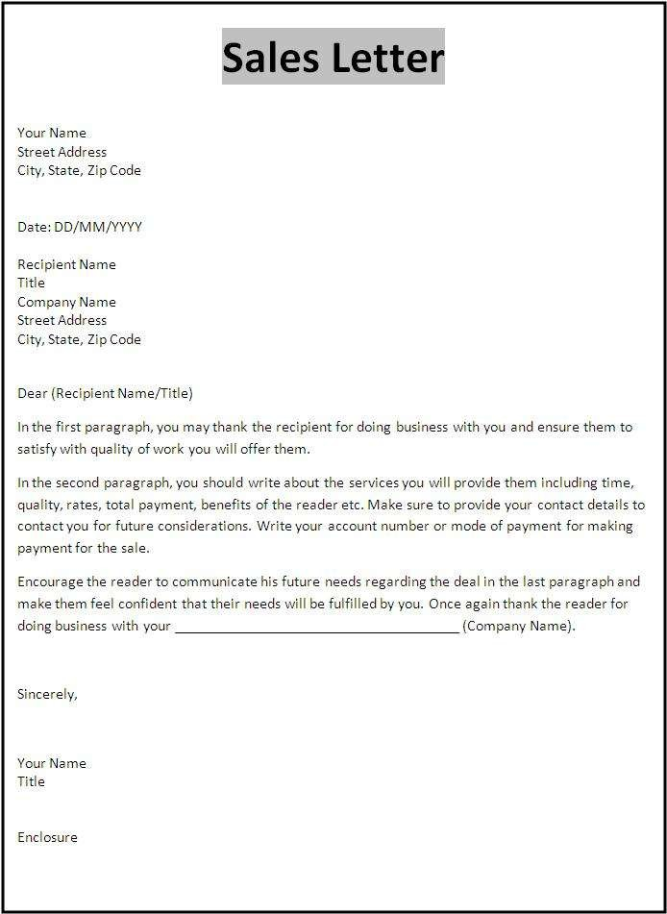

Slide 11
TYPES OF SALES LETTER
Introductory Sales Letter:
This letter is usually sent to introduce a consumer or business customer to your company and products. It explains how readers would benefit from purchasing your products over other brands. Companies sometimes offer a trial period in an introductory sales letter. This letter should be limited to one page. It must grab people's attention, build their interest and prompt their desire to visit the store to buy your products.

Slide 12
TYPES OF SALES LETTER
Product Update Sales Letter:
It is to introduce your old and existing customers of old products about new ones. This letter describes the advantages of the new products over older ones. This letter may contain offers for customers to buy the new product.
Selling Incentive Sales Letter:
This letter promotes existing products among current customers by offering a discount, rebate or contest prize for a limited time.

Slide 13
TYPES OF SALES LETTER
Thank You Sales Letter:
It is important to thank your customers for their business. This letter mention how much you value your customers. Keep it short, and briefly mention that your products are always available when the customer needs them.
Invitation Sales Letter:
If your company is celebrating anniversary, a letter is sent to your customers to make them feel important. Briefly mention your products in the letter, and invite customers to enjoy the celebration. You may want to decorate your business establishment or offer free refreshments for the occasion.

Slide 14
TYPES OF SALES LETTER
Holiday Celebration Sales Letter:
This letter gives you a chance to offer your product as a potential gift for your customers' family, friends or work associates. This letter begins with, "We'd like to wish you a happy holiday season here at ABC Jewelry. We just received a limited supply of tie clamps and bracelets with diamond studs that make wonderful gifts for that special someone. Visit our store now while the supply lasts."

Slide 15
TYPES OF SALES LETTER
Lost Customer Sales Letter:
The lost customer sales letter is designed for customers who have not purchased products or have canceled their service. You should state that you miss these customers and apprise them of any new products or specials.

Slide 16
Sales letters
Hints for drafting sales letters:
Begin the letter in a manner that arouse curiosity.
Give a bright description of the product or service.
Tell the benefits of the product or service.
Convince the reader by giving evidence.
encourage the reader to act at once.
Offer some attractive schemes.

Slide 17
Sales letters
Opening statements:
There are certain people whom we are glad to welcome as special customers and YOU are one of them.
May we take a moment of your time to do you a favour?

Slide 18
Sales letters
Closing statements:
Guarantee yourself with a worry-free future by purchasing our…
Get today to ensure ultimate economy and win free coupons worth Rs. .
Act now and save Rs. .

Slide 19
A sales letter to promote car loan schemes
Kotak mahindra finance ltd.
203, Star Plaza
Rajkot – 360003
May 10, 2012
Dr. Rakesh Patel 3, Station Plot Gondal
Dear Sir,

Slide 20
Sales letters
When you take a car loan from us, you can be absolutely sure that there are no hidden cost of any kind.
What there will be however, are a whole lot of features which make taking a loan a very relaxing experience. For example, there is doorstep service, tailor-made packages, quick one-person approval and simple documentation and processing.

Slide 21
Sales letters
In short, we do everything to make sure you don’t pay, through your nose. For further details you may call us on (0281) 2465098 or 2465099.
Yours
faithfully,
Sales Manager

Slide 22


