Slide 1
Normalization

Slide 2
Data Normalization
The process of producing simpler and more reliable database structure is called normalization.
Process consists of different stages known as normal form.

Slide 3
Use of Normalization
When data large and scattered
When data is complicated and redundant

Slide 4
Characteristics of normalized database
Each relation must have key field
All fields must contain atomic data
There must be no repeating value.
Each field in a relation depend on the key fields

Slide 5
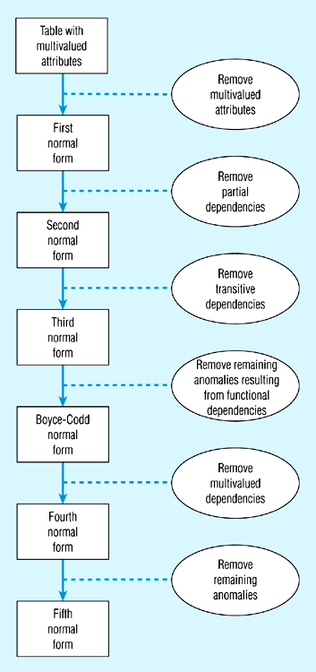
Steps in normalization

Slide 6
Data Redundancy
Major aim of relational database design is to group attributes into relations to minimize data redundancy and reduce file storage space required by base relations.
Problems associated with data redundancy are illustrated by comparing the following Staff and Branch relations with the StaffBranch relation.

Slide 7
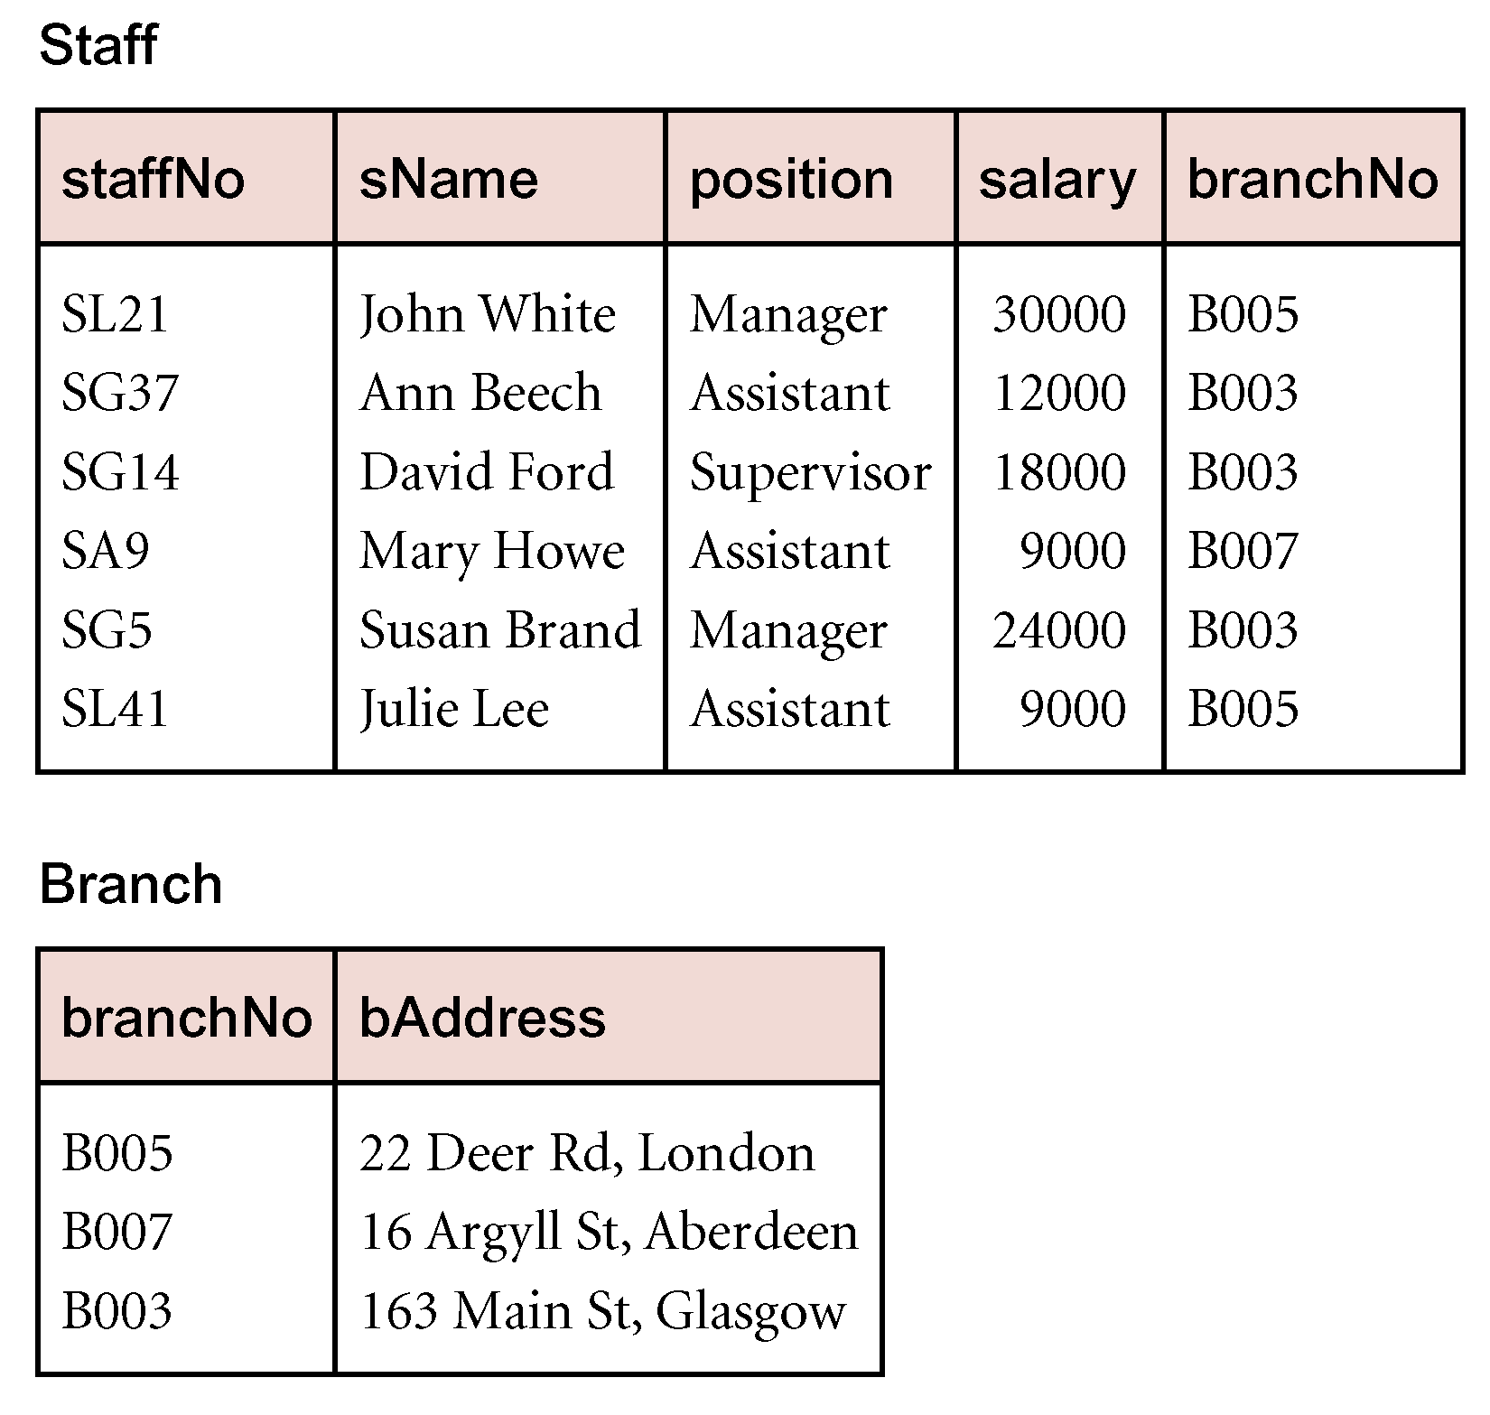
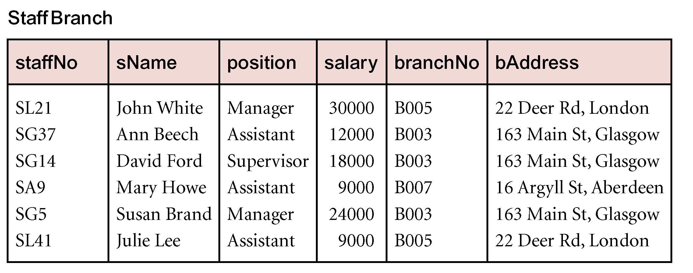
Data Redundancy

Slide 8
Data Redundancy
StaffBranch relation has redundant data: details of a branch are repeated for every member of staff.
In contrast, branch information appears only once for each branch in Branch relation and only branchNo is repeated in Staff relation, to represent where each member of staff works.

Slide 9
Update Anomalies
Relations that contain redundant information may potentially suffer from update anomalies.
Types of update anomalies include:
Insertion,
Deletion,
Modification.

Slide 10
Database Tables and Normalization
The Need for Normalization
Case of a Construction Company
Building project -- Project number, Name, Employees assigned to the project.
Employee -- Employee number, Name, Job classification
The company charges its clients by billing the hours spent on each project. The hourly billing rate is dependent on the employee’s position.
Periodically, a report is generated.
The table whose contents correspond to the reporting requirements is shown in Table 5.1.

Slide 11
Scenario
A few employees works for one project.
Project Num : 15
Employee Num : 101, 102, 103, 105
Project Name : Evergreen

Slide 12
Sample Form
Project Num : 15
Project Name : Evergreen
Emp Num | Emp Name | Job Class | Chr Hours | Hrs Billed | Total
101
102
103
105

Slide 13
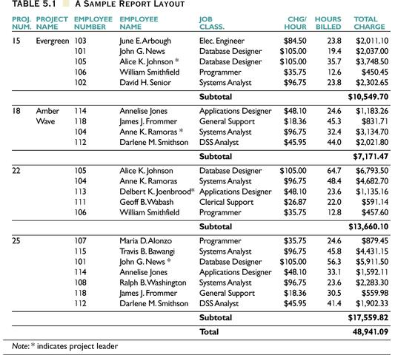

Slide 14
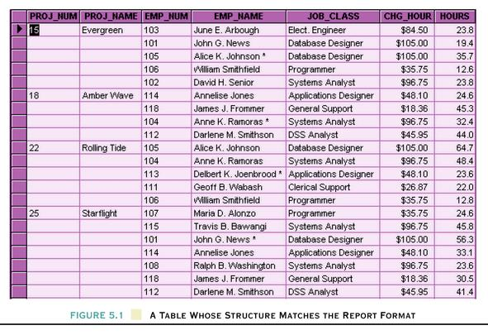
Table Structure Matches the Report Format

Slide 15
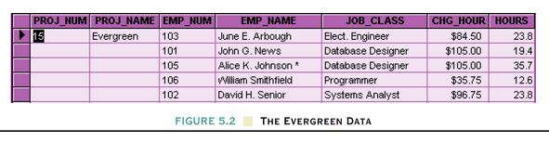
First Normal Form
Every attribute value is atomic
A relational table must not contain repeating groups.
Repeating groups can be eliminated by adding the appropriate entry in at least the primary key column(s).

Slide 16
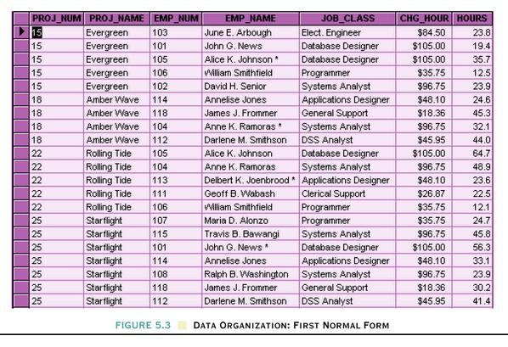
Data Organization: First Normal Form
After
Before

Slide 17
First Normal Form (1 NF)
1NF Definition
The term first normal form (1NF) describes the tabular format in which:
All the key attributes are defined.
There are no repeating groups in the table.
All attributes are dependent on the primary key.

Slide 18
Functional Dependency
Main concept associated with normalization.
Functional Dependency
Describes relationship between attributes in a relation.
If A and B are attributes of relation R, B is functionally dependent on A (denoted A  B), if each value of A in R is associated with exactly one value of B in R.

Slide 19
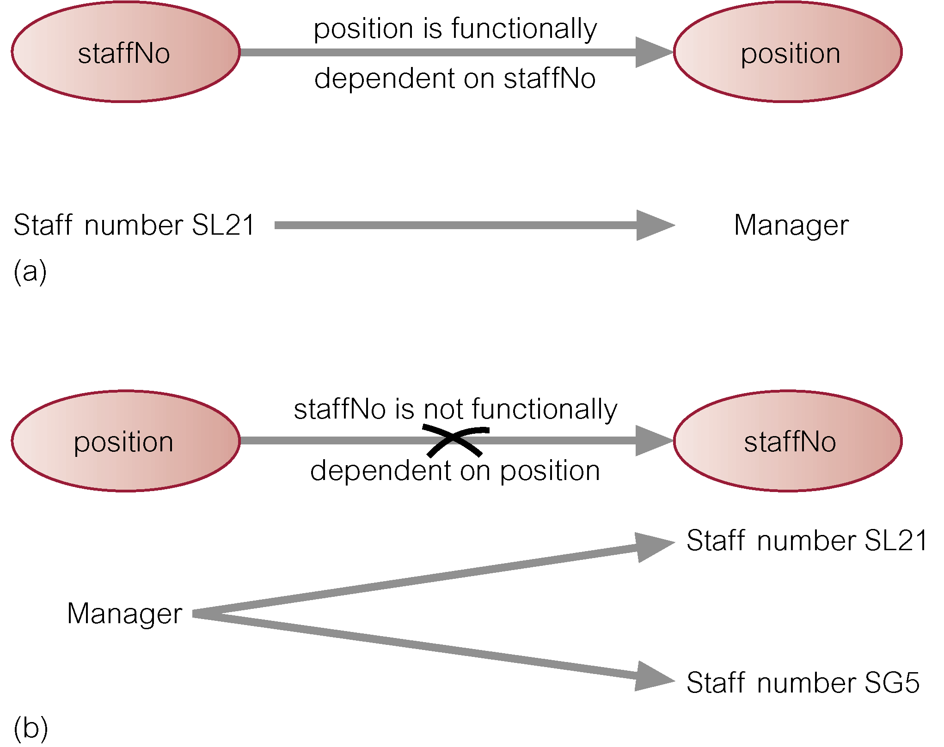
Functional Dependency

Slide 20
Second Normal Form
1NF plus every non-key attribute is fully functionally dependent on the ENTIRE primary key
Every non-key attribute must be defined by the entire key, not by only part of the key
No partial functional dependencies

Slide 21
Functional Dependency Example
Dependency on entire primary key
EmpID
CourseTitle
Name
DeptName
Salary
DateCompleted
Dependency on only part of the key
EmpID, CourseTitle ➔ DateCompleted
EmpID ➔ Name, DeptName, Salary
Therefore, NOT in 2nd Normal Form!!

Slide 22
Both are full functional dependencies
EmpID
Name
DeptName
Salary
EmpID
CourseTitle
DateCompleted

Slide 23
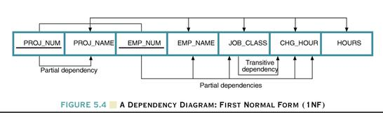
Dependency Diagram
Dependency Diagram
The primary key components are bold, underlined, and shaded in a different color.
The arrows above entities indicate all desirable dependencies, i.e., dependencies that are based on PK.
The arrows below the dependency diagram indicate less desirable dependencies -- partial dependencies and transitive dependencies.

Slide 24
Second Normal Form (2 NF)
Conversion to Second Normal Form
Starting with the 1NF format, the database can be converted into the 2NF format by
Writing each key component on a separate line, and then writing the original key on the last line and
Writing the dependent attributes after each new key.
PROJECT (PROJ_NUM, PROJ_NAME)
EMPLOYEE (EMP_NUM, EMP_NAME, JOB_CLASS, CHG_HOUR)
ASSIGN (PROJ_NUM, EMP_NUM, HOURS)

Slide 25
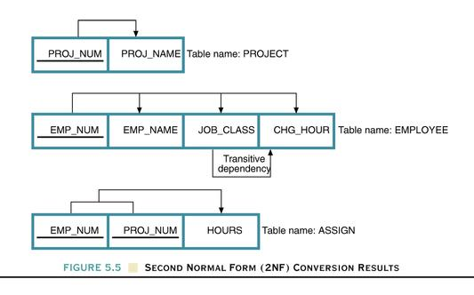
Dependency Diagram

Slide 26
Second Normal Form (2 NF)
A table is in 2NF if:
It is in 1NF and
It includes no partial dependencies; that is, no attribute is dependent on only a portion of the primary key.
(It is still possible for a table in 2NF to exhibit transitive dependency; that is, one or more attributes may be functionally dependent on nonkey attributes.)

Slide 27
Third Normal Form
2NF PLUS no transitive dependencies (one attribute functionally determines a second, which functionally determines a third)

Slide 28
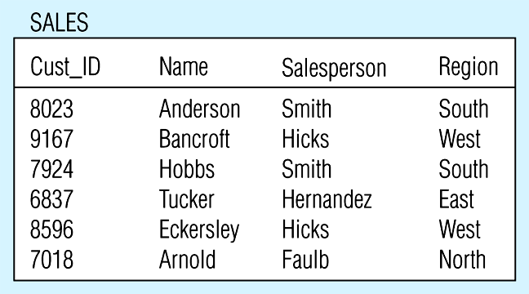
Relation with transitive dependency Example
(a) SALES relation with simple data

Slide 29
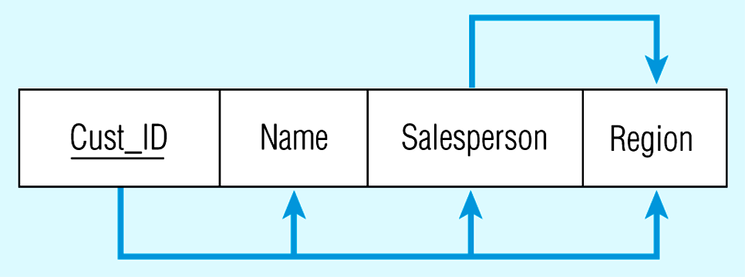
Relation with transitive dependency Example
CustID → Name
CustID → Salesperson
CustID → Region
All this is OK
(2nd NF)
BUT
CustID → Salesperson → Region
Transitive dependency
(not 3rd NF)

Slide 30
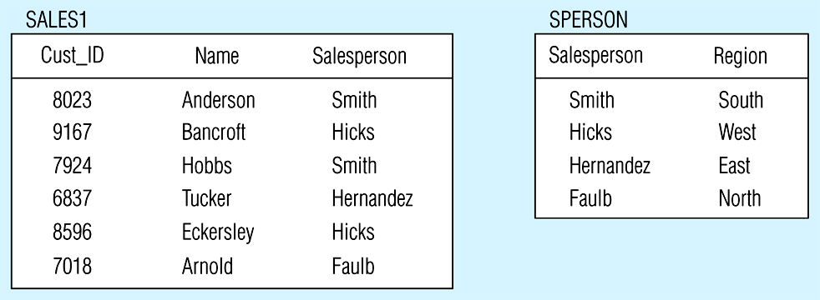
Removing a transitive dependency
(a) Decomposing the SALES relation

Slide 31
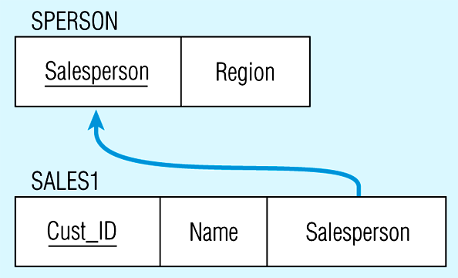
Relations in 3NF
Salesperson → Region
CustID → Name
CustID → Salesperson
Now, there are no transitive dependencies…
Both relations are in 3rd NF

Slide 32
Third Normal Form (3 NF)
Conversion to Third Normal Form
Create a separate table with attributes in a transitive functional dependence relationship.
PROJECT (PROJ_NUM, PROJ_NAME)
ASSIGN (PROJ_NUM, EMP_NUM, HOURS)
EMPLOYEE (EMP_NUM, EMP_NAME, JOB_CLASS)
JOB (JOB_CLASS, CHG_HOUR)

Slide 33
Practice Example
.
Normalize the below table up to 3rd normal form
Student-ID | Specialization | Name | Specialization Semester | Semester Start-Date | Semester End-Date | Specialization Supervisor
Vu001 | SE | Faizan | Fall2009 | 05-07-09 | 31-12-09 | Prof Majid
Vu001 | AI | Faizan | Spring2010 | 05-02-10 | 30-06-10 | Prof Saeed
Vu002 | AI | Zafar | Spring2010 | 05-02-10 | 30-06-10 | Prof Saeed
Vu003 | SE | Ahmad | Fall2009 | 05-07-09 | 31-12-09 | Prof Majid
Vu003 | Networks | Ahmad | Spring2010 | 05-02-10 | 30-06-10 | Prof Wajid
Vu003 | AI | Ahmad | Fall2010 | 05-07-10 | 31-12-10 | Prof Saeed
Vu004 | SE | Fahad | Fall2010 | 05-07-10 | 31-12-10 | Prof Majid
Vu004 | AI | Fahad | Spring2011 | 05-02-11 | 30-06-11 | Prof Saeed

Slide 34
BCNF
Boyce and Codd Normal Form is a higher version of the Third Normal form.
For a table to be in BCNF, following conditions must be satisfied:
R must be in 3rd Normal Form
and, for each functional dependency ( X → Y ), X should be a candidate key.
Consider a database table that stores employee information and has the attributes <Employee_Id>, <First_name>, <Last_name>, and <Title>. In this table, the field <Employee_Id> determines first_name and last_name and <title>.

Slide 35
4NF
A table is said to be in the Fourth Normal Form when,
It is in the Boyce-Codd Normal Form.
And, it doesn't have Multi-Valued Dependency.

Slide 36
Example
A multivalued dependency is best illustrated using an example. In a table containing a list of three things - college courses, the lecturer in charge of each course and the recommended book for each course - these three elements (course, lecturer and book) are independent of one another. Changing the course’s recommended book, for instance, has no effect on the course itself. This is an example of multivalued dependency: An item depends on more than one value. In this example, the course depends on both lecturer and book.

