Slide 1
Software Engineering I
Lecture 7
Zaheer Ahmed
Requirement Engineering

Slide 2
Some Risks from Inadequate Requirement Process
1. Creeping user requirements contribute to over runs and degrade product quality.
2. Insufficient user involvement leads to unacceptable products.
3. Ambiguous requirements lead to ill-spent time and rework.
(As an example, consider the following Urdu Phrase: “Rooko mut jane doo”. Now, depending upon where a reader places the comma in this statement, two)
4. Gold-plating by developers and users adds unnecessary features.
5. Minimal specifications lead to missing key requirements and hence result in an unacceptable product
6. Incompletely defined requirements make accurate project planning and tracking impossible.

Slide 3
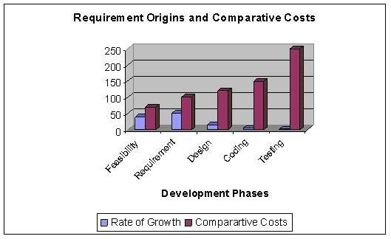

Slide 4
Levels of Software Requirements
Software requirements are defined at various levels of detail and granularity.
Requirements at different level of detail also mean to serve different purposes. We first look at these different levels and then will try to elaborate the difference between these with the help of different examples.

Slide 5
Business Requirements:
These are used to state the high-level business objective of the organization or customer requesting the system or product. They are used to document main system features and functionalities without going into their nitty-gritty details. They are captured in a document describing the project vision and scope.

Slide 6
User Requirements:
User requirements add further detail to the business requirements. They are called user requirements because they are written from a user’s perspective and the focus of user requirement describe tasks the user must be able to accomplish in order to fulfill the above stated business requirements. They are captured in the requirement definition document.

Slide 7
Functional Requirements:
The next level of detail comes in the form of what is called functional requirements. They bring-in the system’s view and define from the system’s perspective the software functionality the developers must build into the product to enable users to accomplish their tasks stated in the user requirements - thereby satisfying the business requirements

Slide 8
Non-Functional Requirements
In the last section we defined a software requirement as a document that describes all the services provided by the system along with the constraints under which it must
operate. That is, the requirement document should not only describe the functionality needed and provided by the system, but it must also specify the constraints under
which it must operate. Constraints are restrictions that are placed on the choices available to the developer for design and construction of the software product.

Slide 9
Example
Let us now look at an example to understand the difference between these different types of requirements.
Let us assume that we have a word-processing system that does not have a spell checker. In order to be able to sell the product, it is determined that it must have a spell checker. Hence the business requirement could be stated as: user will be able to correct spelling errors in a document efficiently. Hence, the Spell checker will be included as a feature in the product.

Slide 10
Example
In the next step we need to describe what tasks must be included to accomplish the above-mentioned business requirement. The resulting user requirement could be as
follows: finding spelling errors in the document and decide whether to replace each misspelled word with the one chosen from a list of suggested words. It is important to note that this requirement is written from a user’s perspective.

Slide 11
Stakeholders
As mentioned earlier, in order to develop a good requirement document, it is imperative to involve all kinds of user in the requirement engineering process. The first step in fulfillment of this need is the identification of all the stakeholders in the system.
Stakeholders are different people who would be interested in the software. It is important to recognize that management carries a lot of weight, but they usually are not the actual users of the system.

Slide 12
Stakeholders
Different stakeholders have different requirements – sometimes even conflicting. On top of that internal politics may influence requirements. The role of stakeholders cannot be overemphasized. A study of over 8300 projects revealed that the top two reasons for any project failure are lack of user input and incomplete requirements.

Slide 13
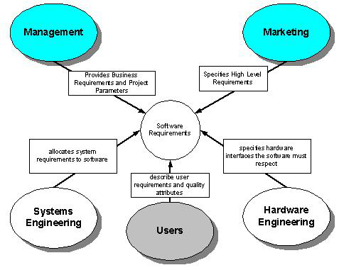

Slide 14
Requirement Statement Characteristics
A good Requirements statement document must possess the following characteristics.
Complete - Each requirement must fully describe the functionality to be delivered.
Correct - Each requirement must accurately describe the functionality to be built.
Feasible - It must be possible to implement each requirement within the known capabilities and limitations of the system and its environment.

Slide 15
Requirement Statement Characteristics
 Necessary -Each requirement should document something that the customer really need or something that is required for conformance to an external system requirement or standard.
 Prioritized - An implementation priority must be assigned to each requirement, feature or use case to indicate how essential it is to a particular product release.
 Unambiguous - All readers of a requirement statement should arrive at a single,
consistent interpretation of it.
 Verifiable – User should be able to devise a small number of tests or use other verification approaches, such as inspection or demonstration, to determine whetherthe requirement was properly implemented.

Slide 16
Requirement Engineering
What is the problem to be solved?
What are the characteristics of the entity that is used to solve the problem?
How will the entity be realized?
How will the entity be constructed?
What approach will be used to uncover errors that were made in the design and
construction of the entity?
How will the entity be supported over the long term when users of the entity
request corrections, adaptations, and enhancements?
These questions force us to look at the software development process from different
angles and require different tools and techniques to be adopted at different stages and
Requirement engineering mainly deals with the definition phase of the system.

Slide 17
Software Requirements Definitions
Before talking about the requirement process in general and discussing different tools and techniques used for developing a good set of requirements, let us first look at a few definitions of software requirements.
Jones defines software requirements as a statement of needs by a user that triggers the development of a program or system.
According to Ian Summerville, requirements are a specification of what should be implemented. They are descriptions of how the system should behave, or of a system

Slide 18
IEEE defines software requirements
1. A condition or capability needed by user to solve a problem or achieve an objective.
2. A condition or capability that must be met or possessed by a system or system
component to satisfy a contract, standard, specification, or other formally imposed document.
3. A documented representation of a condition or capability as in 1 or 2.
As can be seen, these definitions slightly differ from one another but essentially say the same thing: a software requirement is a document that describes all the services provided by the system along with the constraints under which it must operate.

Slide 19
Requirement Specification Characteristics
A good Requirements specification document should possess the following characteristics.
 Complete - No requirement or necessary information should be missing.
 Consistent – No requirement should conflict with other software or higher-level system or business requirements.
 Modifiable - One must be able to revise the Software Requirement Specification when necessary and maintain a history of changes made to each requirement.
Traceable - One should be able to link each requirement to its origin and to the design elements, source code, and test cases that implement and verify the correct implementation of the requirement.

Slide 20
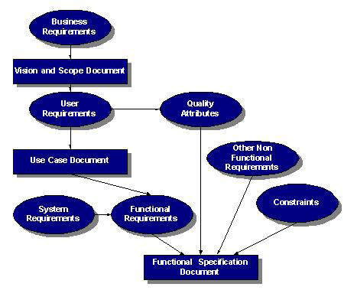
Relationship of Several components of Software Requirements

