Slide 1
Data Structures-CS-204 Lecture#3 Linked List
Fakhera Nazir

Slide 2
Options for implementing an ADT List
Array
It has a fixed size
Data must be shifted during insertions and deletions
Linked list
It is able to grow in size as needed
Does not require the shifting of items during insertions and deletions

Slide 3
What’s wrong with Array and Why lists?
Disadvantages of arrays as storage data structures:
slow searching in unordered array
slow insertion in ordered array
Fixed size
Linked lists solve some of these problems
Linked lists are general purpose storage data structures and are versatile.

Slide 4
Array Limitations
Arrays
Simple,
Fast
but
Must specify size at construction time
Murphy’s law
Construct an array with space for n
n = twice your estimate of largest collection
Tomorrow you’ll need n+1
More flexible system?

Slide 5
Linked Lists
Flexible space use
Dynamically allocate space for each element as needed
Include a pointer to the next item
Linked list
Each node of the list contains
the data item
a pointer to the next node
Data
Next

Slide 6
Linked Lists
Each data item is embedded in a link.
Each Link object contains a reference to the next link in the list of items.
In an array items have a particular position, identified by its index.
In a list the only way to access an item is to traverse the list

Slide 7
Linked List
A Flexible structure, because can grow and shrink on demand.
Elements can be:
Inserted
Accessed
Deleted At any position
Lists can be:
Concatenated together.
Split into sublists.
Mostly used in Applications like:
Information Retrieval
Programming language translation
Simulation

Slide 8
Linked List
Pointer Based Implementation of Linked List ADT
Dynamically allocated data structures can be linked together to form a chain.
A linked list is a series of connected nodes (or links) where each node is a data structure.
A linked list can grow or shrink in size as the program runs.
This is possible because the nodes in a linked list are dynamically allocated.

Slide 9
List Operations
If new information needs to be added to the list, the program –
a) Allocates another node
b) Inserts it into the series.
If a piece of information is to be deleted from the list, the program –
a) Deletes the node containing the information

Slide 10
Array List Vs Linked List
(The programmer doesn’t need to know how many nodes will be in the list. They are created in memory as needed).
a) Speed of insertion or deletion from the list.
e.g. with an array, to insert an element, requires all elements beyond the insertion point to be moved forward one position to make room for the new element.
Similarly, to delete an element, requires all elements after the insertion point to be moved back one position to close the gap.
When a node is inserted, or deleted from a linked list, none of the other nodes have to be moved!!!!

Slide 11
Composition of Linked List
Each node in the linked list contains –
a) One or more members that represent data (e.g. inventory records, customer names, addresses, telephone numbers, etc).
b) A pointer, that can point to another node.
Data Members Pointer

Slide 12
Composition of linked List
A linked list is called “linked” because each node in the series (i.e. the chain) has a pointer to the next node in the list, e.g.
NULL
List Head
a) The list head is a pointer to the first node in the list.
b) Each node in the list points to the next node in the list.
c) The last node points to NULL (the usual way to signify the end).
Note, the nodes in a linked list can be spread out over the memory.

Slide 13
Linked List
Actual picture in memory:
1051
6
1052
1063
current
1053
1063
1054
2
head
1055
1051
1056
2
6
8
7
1
1057
7
1058
1060
current
1059
1060
1
1061
0
head
1062
1054
1063
8
1064
1057
1065
Notes:
End of lecture 2
The second goal is the “nuts and bolts” of the course.
The third goal prepares a student for the future.

Slide 14
List Declarations
How to declare a linked list in C or C++?
Step 1) Declare a data structure for the nodes.
e.g. the following struct could be used to create a list where each node holds a float -
struct ListNode
{
float value;
struct ListNode *next;
};

Slide 15
List Declarations
a) The first member of the ListNode struct is a float called value.
It is to hold the node’s data.
b) The second member is a pointer called next.
It is to hold the address of any object that is a ListNode struct.
Hence each ListNode struct can point to the next one in the list.
The ListNode struct contains a pointer to an object of the same type
as that being declared. It is called a self-referential data structure.
This makes it possible to create nodes that point to other nodes of
the same type.

Slide 16
List Declarations
Step 2) Declare a pointer to serve as the list head, e.g
ListNode *head;
Before you use the head pointer, make sure it is initialized to NULL,
so that it marks the end of the list.
Once you have done these 2 steps
(i.e. declared a node data structure, and
created a NULL head pointer, you have an empty linked list.
struct ListNode { float value; struct ListNode *next; }; ListNode *head; // List head pointer
The next thing is to implement operations with the list.

Slide 17
Link List Operations
There are 5 basic linked list operations
Appending a node
Traversing a list
Inserting a node
Deleting a node
Destroying the list

Slide 18
Appending a Node
To append a node to a linked list, means adding it to the end of the list.
The appendNode function accepts a float argument, num.
The function will -
a) allocate a new ListNode structure
b) store the value in num in the node’s value member
c) append the node to the end of the list
This can be represented in pseudo code as follows-

Slide 19
Appending a Node (Pseudocode)
a) Create a new node.
b) Store data in the new node.
c) If there are no nodes in the list Make the new node the first node. Else Traverse the List to Find the last node. Add the new node to the end of the list. End If.

Slide 20
Appending a Node (Code)
void appendNode(float num) { ListNode *newNode, *nodePtr; // Allocate a new node & store num newNode = new ListNode; newNode->value = num; newNode->next = NULL; // If there are no nodes in the list make newNode the first node if ( head == NULL) head = newNode; else // Otherwise, insert newNode at end { // Initialize nodePtr to head of list nodePtr = head; // Find the last node in the list while (nodePtr->next!=NULL)
{ nodePtr = nodePtr->next;
} // Insert newNode as the last node nodePtr->next = newNode; } }

Slide 21
Code Description - 1
We examine this important piece of code in detail.
The function declares the following local variables –
ListNode *newNode, *nodePtr;
The newNode pointer will be used to allocate and point to the new node.
The nodePtr pointer will be used to travel down the linked list, looking for the last node.
The next few statements –
i) create a new node
ii) store num in its value member.
newNode = new ListNode;
newNode->value = num;
newNode->next = NULL;
The last statement above is important. This node will become the last node in the list, so its next pointer must point to NULL

Slide 22
Code Description - 2
Now test the head pointer to see if there are any nodes already
in the list. If head points to NULL, we make the new node the
first in the list.
Do this by making head point to the new node, i.e.
If (head == NULL)
head = newNode;
But, if head does not point to NULL, then there must already be nodes in the list.
The else part must then contain code to -
a) Find the end of the list
b) Insert the new node.

Slide 23
Code Description - 3
else { // Otherwise, insert newNode at end // Initialize nodePtr to head of list nodePtr = head; // Find the last node in the list while (nodePtr->next) nodePtr = nodePtr->next;
// Insert newNode as the last node nodePtr->next = newNode; }
The code uses nodePtr to travel down the list. It does this by assigning nodePtr to head.
nodePtr = head;
A while loop is then used to traverse (i.e. travel through) the list, looking for the last node (that will have its next member pointing to NULL).
while(nodePtr->next)
nodePtr = nodePtr->next;
Now the nodePtr is pointing to the last node in the list, so make its next member point to newNode. nodePtr->next = newNode;
Remember, newNode->next already points to NULL.

Slide 24
Main Program
// This program demonstrates a simple append // operation on a linked list. #include <iostream.h> void main(void) { *head = NULL; appendNode(2.5); appendNode(7.9); appendNode(12.6); }
(This program displays no output.)

Slide 25
Program Step Through
We step thru the above program, observing how the appendNode
function builds a linked list to store the 3 argument values.
The head pointer is automatically initialized to 0 (NULL), indicating
the list is empty.
The first call to appendNode passes 2.5 as the argument.
A new node is allocated in memory.
2.5 is copied into its value member, and NULL is assigned to its
next pointer.

Slide 26
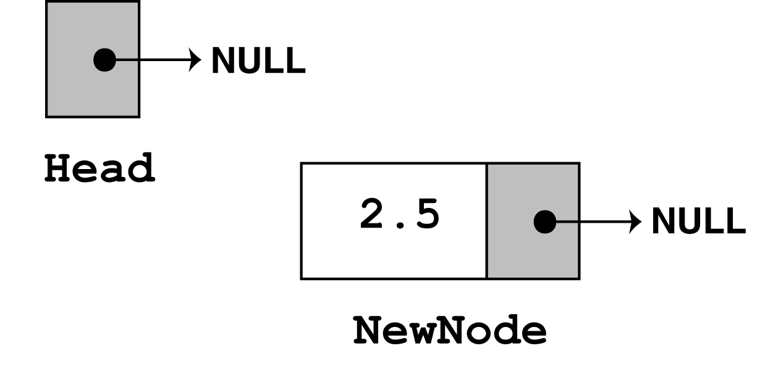
Program Step Through - 1
newNode = new ListNode; newNode->value = num; newNode->next = NULL;
The next statement to execute is the following if statement.
if (head != NULL) head = newNode;
Since head points to NULL, then the condition !head is true, so
the statement, head = newNode is executed, making newNode
the first node in the list.
There are no more statements to execute, so control returns to function main.

Slide 27
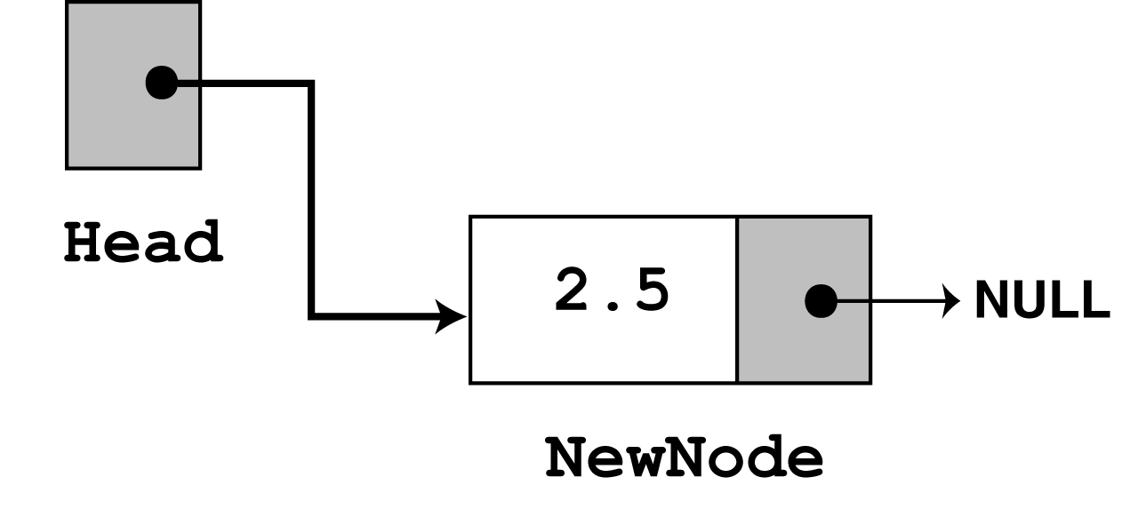
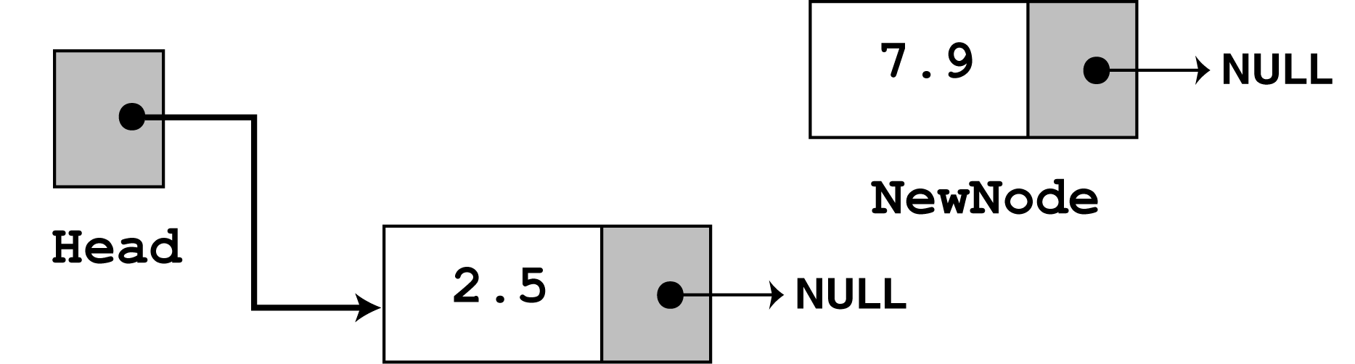
Program Step Through - 2
There are no more statements to execute, so control returns to the function main.
In the second call to appendNode, 7.9 is passed as the argument.
Again, the first 3 statements create a new node, which stores the argument in the node’s value member, and assigns its next pointer to NULL. Visually this is -

Slide 28
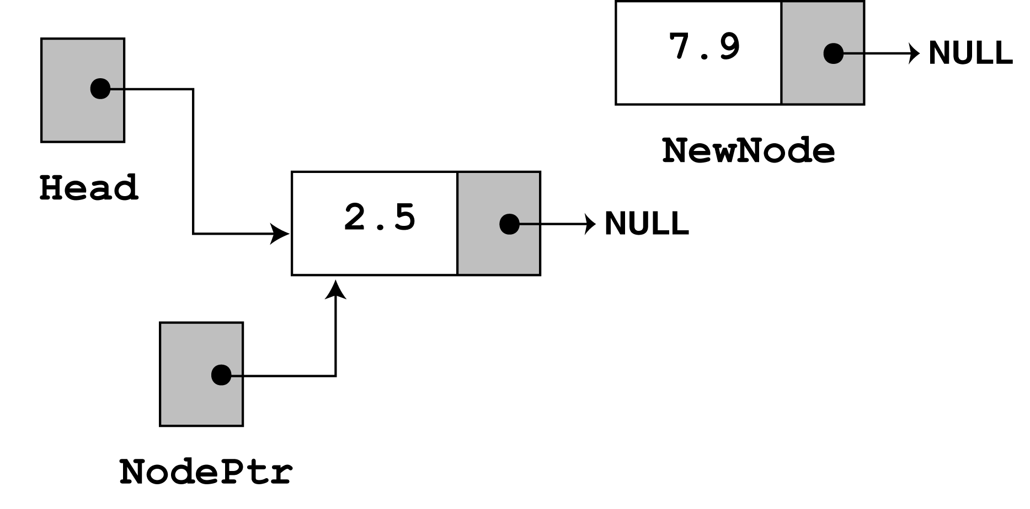
Program Step Through - 3
Since head no longer points to NULL, the else part of the if statement
is executed.
else // Otherwise, insert newNode at end { // Initialize nodePtr to head of list nodePtr = head; // Find the last node in the list while (nodePtr->next) nodePtr = nodePtr->next;
// Insert newNode as the last node nodePtr->next = newNode; }
The first statement in the else block assigns the value in head
to nodePtr. So, nodePtr and head point to the same node.

Slide 29
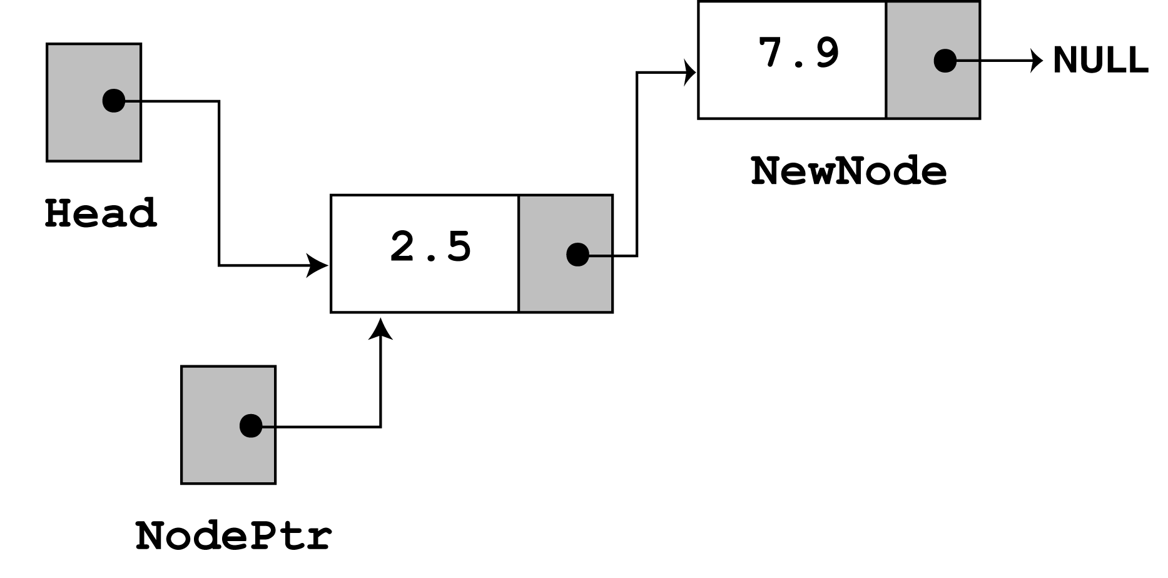
Program Step Through - 4
Look now at the next member of the node that nodePtr points at.
Its value is NULL, so nodePtr->next also points to NULL.
So, nodePtr is already at the end of the list, so the while loop
terminates.
The last statement, nodePtr->next = newNode, causes
nodePtr->next to point to the new node. This appends newNode to
the end of the list, as shown -

Slide 30
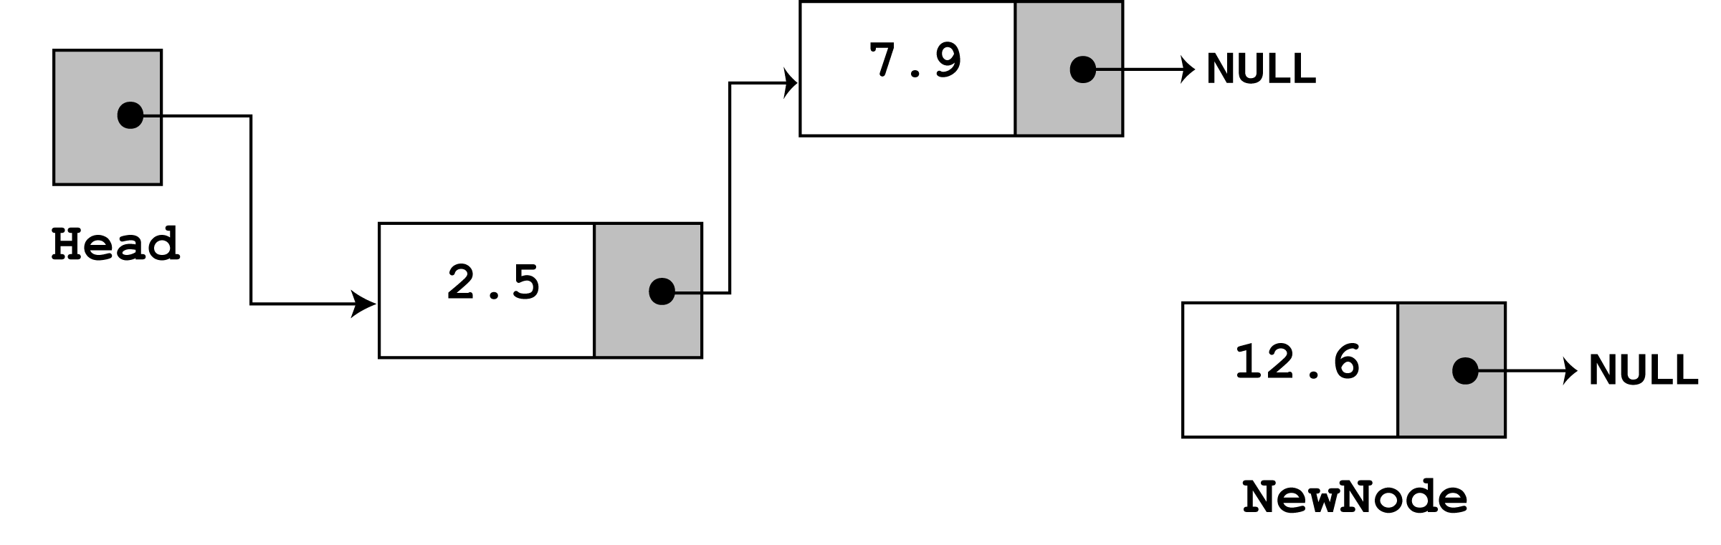
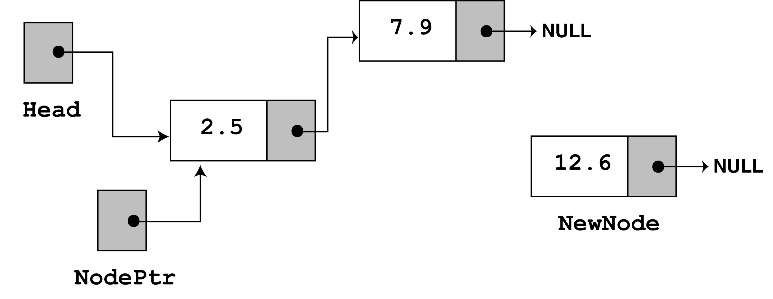
Program Step Through - 5
The third time appendNode is called, 12.6 is passed as argument.
Again, the first 3 statements create a node with the argument stored
in the value member.
Now, the else part of the if statement executes. Again nodePtr is
made to point to the same node as head.

Slide 31
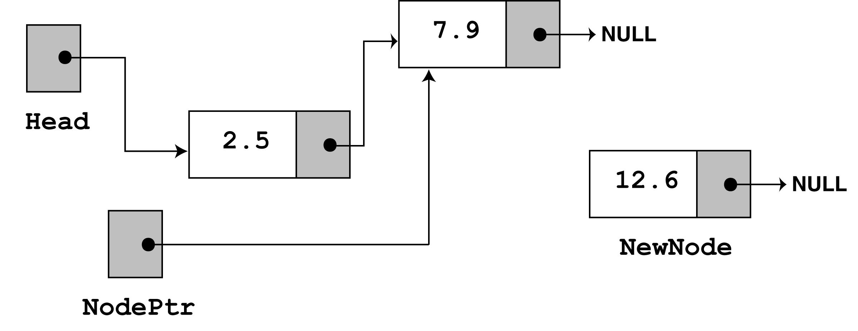
Program Step Through - 6
Since nodePtr->next is not NULL, the while loop will execute.
After its first iteration, nodePtr will point to the second node in the
list.
The while loop’s conditional test will fail after the first iteration
because nodePtr->next now points to NULL.
The last statement nodePtr->next = newNode causes
nodePtr->next to point to the new node. This appends newNode
to the end of the list, as shown -

Slide 32
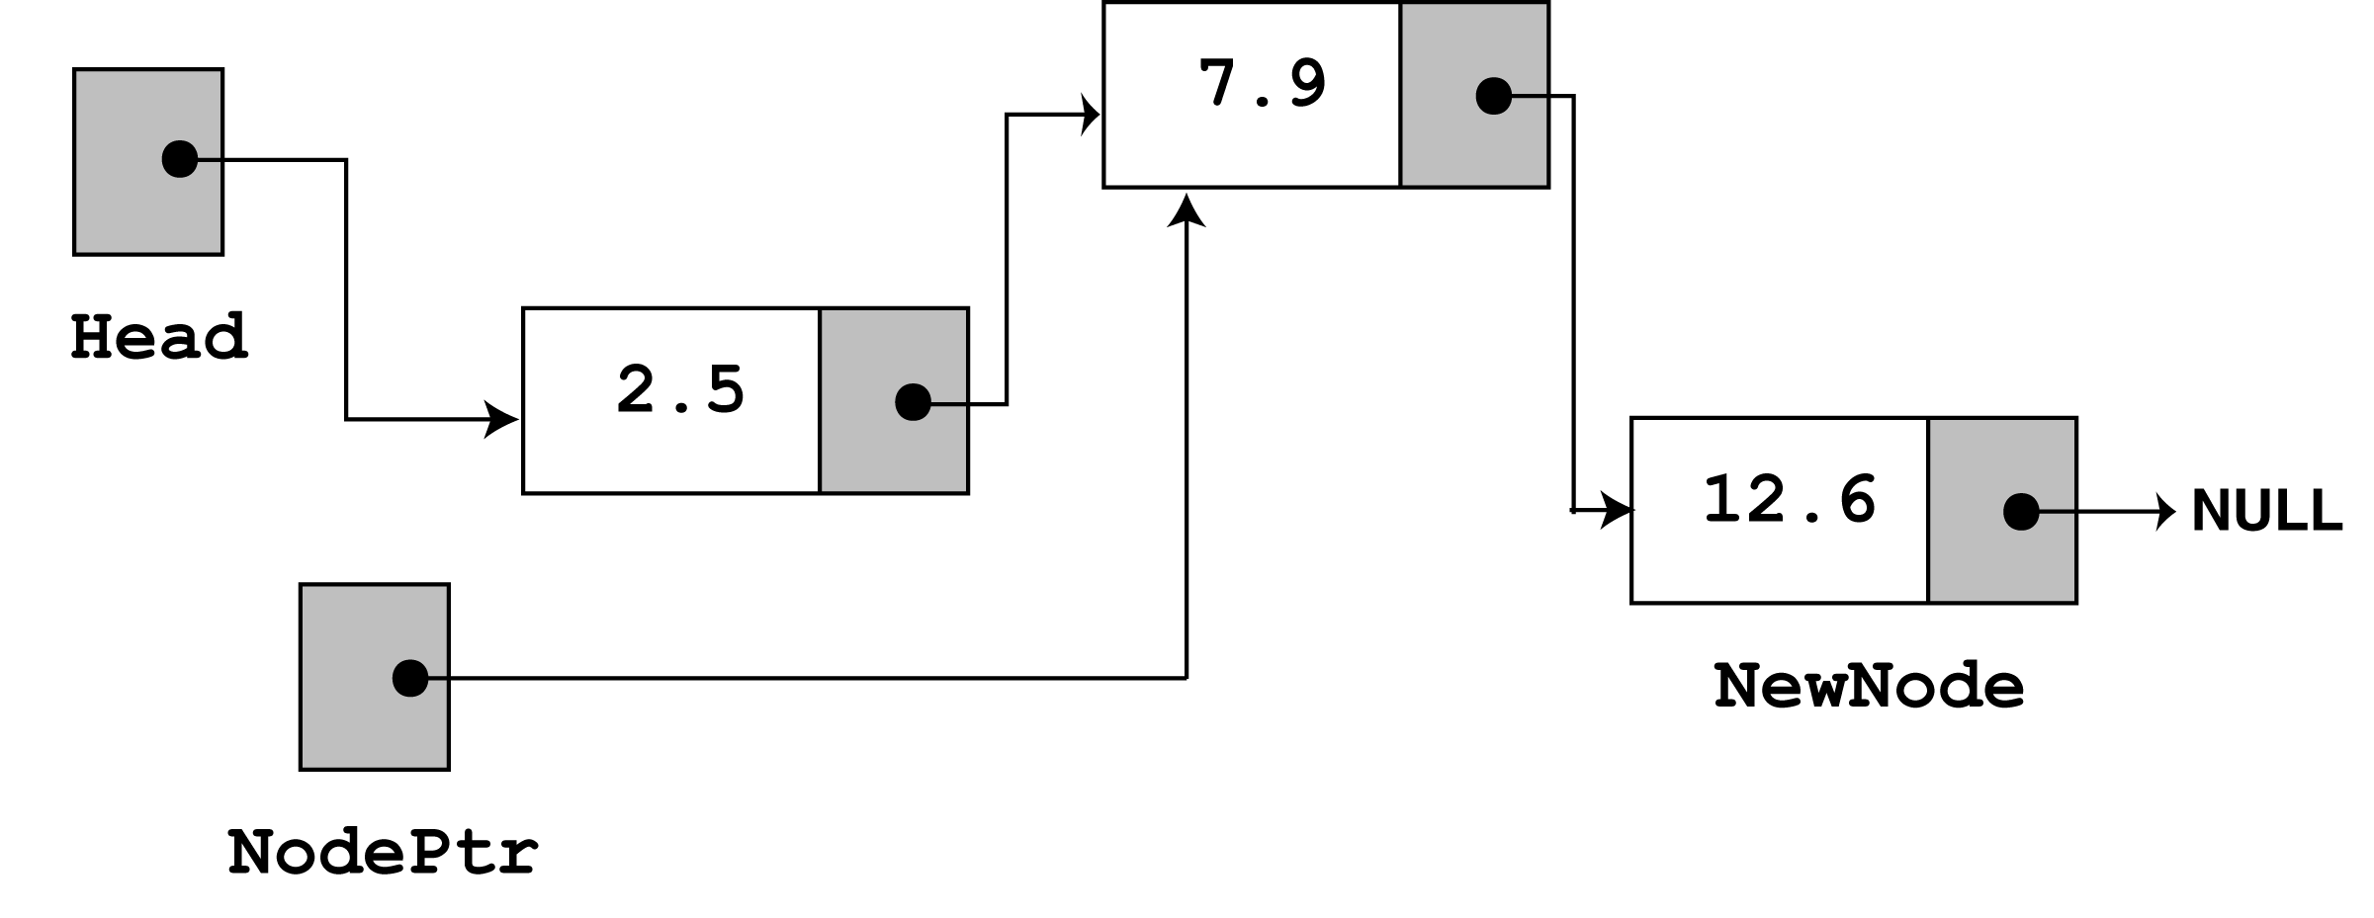
Program Step Through - 7
The above is the final state of the linked list.

Slide 33
Traversing a Linked List
The previous function appendNode, used a while loop that traverses, or travels through the linked list.
We now demonstrate the displayList member function, that traverses the list, displaying the value member of each node.
void displayList(void) {
ListNode *nodePtr;
nodePtr = head;
while(nodePtr) {
cout << nodePtr->value << endl;
nodePtr = nodePtr->next;
}
}

Slide 34
Traverse List Pseudocode
Assign list head to node pointer
While node pointer is not NULL
Display the value member of the node pointed to by node pointer.
Assign node pointer to its own next member.
End While.

Slide 35
Traverse List Program
// This program calls the displayList member function. // The funcion traverses the linked list displaying // the value stored in each node. #include <iostream.h> void main(void) { *head = NULL; appendNode(2.5); appendNode(7.9); appendNode(12.6);
displaylist();
}
2.5 7.9 12.6

Slide 36
Summary
Data structure Operations
Traverse, Search, Insert, Delete, Sort, Merge
Options for Implementing ADT List
Array-based and Pointer based
Linked List
Linked List Operations
Append
Traverse

