Slide 1
Data Structure and Algorithm
Lecture-2
Fakhera Nazir

Slide 2
Array
An array is simply a number of memory locations, each of which can store an item of data of the same data type and which are all referenced through the same variable name.
Array: a set of pairs (index and value)
data structure
For each index, there is a value associated with that index.
representation (possible) implemented by using consecutive memory.

Slide 3
Arrays
Name of array (Note that all elements of this array have the same name, c)
Array
  Group of consecutive memory locations
  Same name and type
To refer to an element, specify
  Array name
  Position number
Format:
    arrayname[ position number ]
  First element at position 0
  n element array named c:
    c[ 0 ], c[ 1 ], c[2] .................... c[ n – 1 ]
c[0]
-45
c[1]
6
c[2]
0
c[3]
72
c[4]
1543
c[5]
-89
c[6]
0
c[7]
62
c[8]
-3
c[9]
1
c[10]
6453
c[11]
78
Position number of the element within array c

Slide 4
Arrays
Array elements are like normal variables
    c[ 0 ] = 3;
    cout<< c[ 0 ] ;
  If x equals 3
    c[ 5 - 2 ] == c[ 3 ] == c[ x ]

Slide 5
Declaring Arrays
When declaring arrays, specify
  Name
  Type of array
  Number of elements
    arrayType arrayName[ numberOfElements ];
  Examples:
    int c[ 10 ];
    float myArray[ 3284 ];
Declaring multiple arrays of same type
  Format similar to regular variables
  Example:
    int b[ 100 ], x[ 27 ];

Slide 6
Examples Using Arrays
Initializers
    int n[ 5 ] = { 1, 2, 3, 4, 5 };
  If not enough initializers, rightmost elements become 0
      int n[ 5 ] = { 0 }
    All elements 0
  If too many a syntax error is produced syntax error
  C arrays have no bounds checking
If size omitted, initializers determine it
    int n[ ] = { 1, 2, 3, 4, 5 };
  5 initializers, therefore 5 element array

Slide 7
Array Implementations
In an array, the sequentiality of a list is maintained by the order structure of elements in the array (indexes).
Although searching an array for an individual element can be very efficient, insertion and deletion of elements are complex and inefficient processes.

Slide 8
Linked Lists
A Linked List is an ordered collection of data in which each element contains the location of the next element or elements.
In a linked list, each element contains two parts: data and one or more links.
The data part holds the application data – the data to be processed.
Links are used to chain the data together. They contain pointers that identify the next element or elements in the list.

Slide 9
Basic Operations on a Array
Add a value.
2. Delete a value.
3. Search for a value.
4. Traverse (walk) the array.
(Useful for counting operations or aggregate operations)

Slide 10
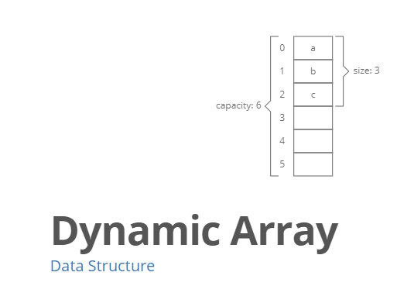


Slide 11
Basic Operations on a Array
Although we can apply conventional operations defined for each element of an array , there are some operations that we can define on an array as a data structure. The common operations on arrays as structures are searching, insertion, deletion, retrieval and traversal.
Although searching, retrieval and traversal of an array is an easy job, insertion and deletion is time consuming. The elements need to be shifted down before insertion and shifted up after deletion.

Slide 12
Insertion
In inserting operation, new items are added into an array. A new item can be added
1. At the end of array
2. At some specified location within array
3. At Start of array

Slide 13
Insertion at the End of Array
AIM: Write an algorithm to add four(4) values into elements at end of array that has already six values stored.
1.Input the elements in the array of size N
2. Repeat step 3 to 4 for i=6 to 9
3.Input value n in array
4. arr[i]=n
N++;
[end of step-2 loop]
5. Exit

Slide 14
Insert at Specific Location
A new value can be inserted at a specified location in an array.
To insert a new value, the values of all the existing elements are removed one step forward or backward to make space for the new value.

Slide 15
Algorithm: Insertion value at a specific location
AIM: Write an algorithm to insert a value M at location pos in an array arr having N elements
1. Input value in M
2. Input position in Pos
[move elements one step forward]
3. Repeat step 4 to 5 WHILE n>=pos
4. arr[n+1]=arr[n]
5. [end of step-3 loop]
6. [Insert Value at Position Pos]
arr[pos]=M
7. Exit

Slide 16
Deletion
In deletion operation, the elements are removed from the array.
Like Insertion, deletion can be performed
1. At end
2. At specific location
3. At start

Slide 17
Deletion At End
Deleting or removing a data item at the end of array is simple and easy.
To remove the last element from array, the last element is accessed and deleted by placing a null value or by decreasing the size of array by one element of it is the last element of array.

Slide 18
Deleting Item from Array at End
AIM: Write an algorithm to delete the value of an array arr having N elements
1.Input the values in Array of size N
2.Repeat step for i=0 to n-1
3. Print arr[i]
[end of loop]
4. Exit

Slide 19
Deletion at Some Specific Location
When an item is removed from a specified location within array, the items from the location up to the end of array are moved one location towards the beginning of the array.
The size of array also decreases

Slide 20
Deletion of Item from Array
AIM: Write an algorithm to delete the value at location K of an array arr having N elements
1. Input the values in Array
2. Input Location K
3. If K>n then
Print “ Invalid Location”
    Return
    End If
4. Repeat for i= k to n-1
arr[i]=arr[i+1]
[ end of loop]
5. Exit

Slide 21
Traversing
In traversing operation, “ each element of an array is accessed exactly once for processing”.
It is also called the visiting of the array.
Arrays are linear data structures and simple steps are required to traverse them

Slide 22
Algorithm: Traversing Linear Array
AIM: Write the algorithm to compute the sum of values of elements of linear array.
Input values in array
Sum=0
[compute the sum of array ]
REPEAT FOR i=0 to 9
sum=sum+arr[i]
[ end of loop]
PRINT sum
EXIT

Slide 23
Searching
The process finding a specific data item and its location is called searching.
If data is found the search is called successful , otherwise it is called unsuccessful.
Searching in Array can be
1. linear Search
2. Binary Search

Slide 24
Searching
Linear Search Description:
The linear search compares each element of the array with the search key until the search key is found.
To determine that a value is not in the array, the program must compare the search key to every element in the array ‘A’.
It is also called “Sequential Search” because it traverses the data sequentially to locate the element.

Slide 25
Linear Search: Algorithm
AIM: Write a program to do Linear Search using a given Search Key in an unsorted Linear Array ‘Arr’ which has N values in it.
1. Input the values in array
2. Repeat step-2 for K = 0 to N-1
3. if(Arr [K] = SKEY)
return K [Successful Search, value found at K location]
[ End of loop of step-2 ]
4. return -1 [Un-Successful, Value not found]
5. End.

Slide 26
Binary Search
Binary Search Description:
The binary search algorithm can only be used with sorted array and eliminates one half of the elements in the array being searched after each comparison.
The binary search algorithm applied to our array A works as follows:

Slide 27
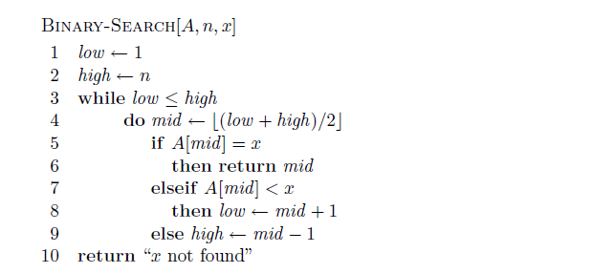
Binary Search

Slide 28
Arrays: Pros and Cons
Pros:
Fast element access.
Cons:
Impossible to resize.
Many applications require resizing!
Required size not always immediately available.

Slide 29
Disadvantages of Array
Using an Array here has disadvantages.
Most importantly, when an element is added or removed, the elements to the right have to be moved as well.
Linked list can be easily expanded or reduced; Array needs a contiguous memory space and may not even be possible to resize.

Slide 30
THANKS

