Slide 1
An Introduction to Data Structures and Abstract Data Types
Start from slide#9

Slide 2
The Need for Data Structures
Data structures organize data
⇒ more efficient programs.
More powerful computers ⇒ more complex applications.
More complex applications demand more calculations.
Complex computing tasks are unlike our everyday experience.
Notes:
A primary concern for this course is efficiency.
You might believe that faster computers make it unnecessary to be concerned with efficiency. However…
So we need special training.

Slide 3
Organizing Data
Any organization for a collection of records can be searched, processed in any order, or modified.
The choice of data structure and algorithm can make the difference between a program running in a few seconds or many days.
Notes:
If you are willing to pay enough in time delay. Example: Simple unordered array of records.

Slide 4
Efficiency
A solution is said to be efficient if it solves the problem within its resource constraints.
  Space
  Time
The cost of a solution is the amount of resources that the solution consumes.
Notes:
Alternate definition: Better than known alternatives (“relatively efficient”).
Space and time are typical constraints for programs.
This does not mean always strive for the most efficient program. If the program operates well within resource constraints, there is no benefit to making it faster or smaller.

Slide 5
Selecting a Data Structure
Select a data structure as follows:
Analyze the problem to determine the resource constraints a solution must meet.
Determine the basic operations that must be supported. Quantify the resource constraints for each operation.
Select the data structure that best meets these requirements.
Notes:
Typically want the “simplest” data structure that will meet the requirements.

Slide 6
Some Questions to Ask
Are all data inserted into the data structure at the beginning, or are insertions interspersed with other operations?
Can data be deleted?
Are all data processed in some well-defined order, or is random access allowed?
Notes:
These questions often help to narrow the possibilities.
If data can be deleted, a more complex representation is typically required.

Slide 7
Data Structure Philosophy
Each data structure has costs and benefits.
Rarely is one data structure better than another in all situations.
A data structure requires:
  space for each data item it stores,
  time to perform each basic operation,
  programming effort.
Notes:
The space required includes data and overhead.
Some data structures/algorithms are more complicated than others.

Slide 8
Data Structure Philosophy (cont)
Each problem has constraints on available space and time.
Only after a careful analysis of problem characteristics can we know the best data structure for the task.
Bank example:
  Start account: a few minutes
  Transactions: a few seconds
  Close account: overnight

Slide 9
Abstract Data Types
Abstract Data Type (ADT): a definition for a data type solely in terms of a set of values and a set of operations on that data type.
Each ADT operation is defined by its inputs and outputs.
Encapsulation: Hide implementation details.

Slide 10
Data Structure
A data structure is the physical implementation of an ADT.
  Each operation associated with the ADT is implemented by one or more subroutines in the implementation.
Data structure usually refers to an organization for data in main memory.
File structure is an organization for data on peripheral storage, such as a disk drive.

Slide 11
Data Structures
Data structure is a representation of data and the operations allowed on that data.
CS 307 Fundamentals of Computer Science

Slide 12
Abstract Data Types
In Object Oriented Programming data and the operations that manipulate that data are grouped together in classes
Abstract Data Types (ADTs) or data structures or collections store data and allow various operations on the data to access and change it
CS 307 Fundamentals of Computer Science

Slide 13
Why Abstract?
Specify the operations of the data structure and leave implementation details to later
many, many different ADTs
  picking the right one for the job is an important step in design
  "Get your data structures correct first, and the rest of the program will write itself."
  -Davids Johnson
High level languages often provide built in ADTs,
  the C++ STL, the Java standard library
CS 307 Fundamentals of Computer Science

Slide 14
The Core Operations
Every Collection ADT should provide a way to:
  add an item
  remove an item
  find, retrieve, or access an item
Many, many more possibilities
  is the collection empty
  make the collection empty
  give me a sub set of the collection
  and on and on and on…
Many different ways to implement these items each with associated costs and benefits
CS 307 Fundamentals of Computer Science

Slide 15
Implementing ADTs
when implementing an ADT the operations and behaviors are already specified
  think Java interface
CS 307 Fundamentals of Computer Science

Slide 16
The Grand Tour
Why study ADTs?
Why reimplement some of them?
How many of you will actually go out and create your own linked list ADT from scratch?
Remember, the primary goal is to learn how to use and create ADTs
  also learn the behavior of some of the more conventional ADTs
CS 307 Fundamentals of Computer Science

Slide 17
Lists
Items have a position in this Collection
  Random access or not?
Array Lists
Linked Lists
public class Node
{ private Object data;
private Node next;
}
last
first
CS 307 Fundamentals of Computer Science

Slide 18
Stacks
Collection with access only to the last element inserted
Last in first out
insert/push
remove/pop
top
make empty
Data4
Top
Data3
Data2
Data1
CS 307 Fundamentals of Computer Science

Slide 19
Queues
Collection with access only to the item that has been present the longest
Last in last out or first in first out
priority queues and deque
Front
Back
Data1
Data2
Data3
Data4
CS 307 Fundamentals of Computer Science

Slide 20
Trees
Similar to a linked list
public class TreeNode
{ private Object data;
private TreeNode left;
private TreeNode right;
}
Root
CS 307 Fundamentals of Computer Science

Slide 21
Other Types of Trees
Binary Search Trees
  sorted values
Heaps
  sorted via a different algorithm
AVL and Red-Black Trees
  binary search trees that stay balanced
Splay Trees
B Trees
CS 307 Fundamentals of Computer Science

Slide 22
HashTables
Take a key, apply function
f(key) = hash value
store data or object based on hash value
Sorting O(N), access O(1) if a perfect hash function and enough memory for table
how deal with collisions?
CS 307 Fundamentals of Computer Science

Slide 23
The Java Collection Interface
boolean isEmpty()
int size()
boolean add(Object x)
boolean contains(Object x)
boolean remove(Object x)
void clear()
Object[] toArray()
Iterator iterator()
CS 307 Fundamentals of Computer Science

Slide 24
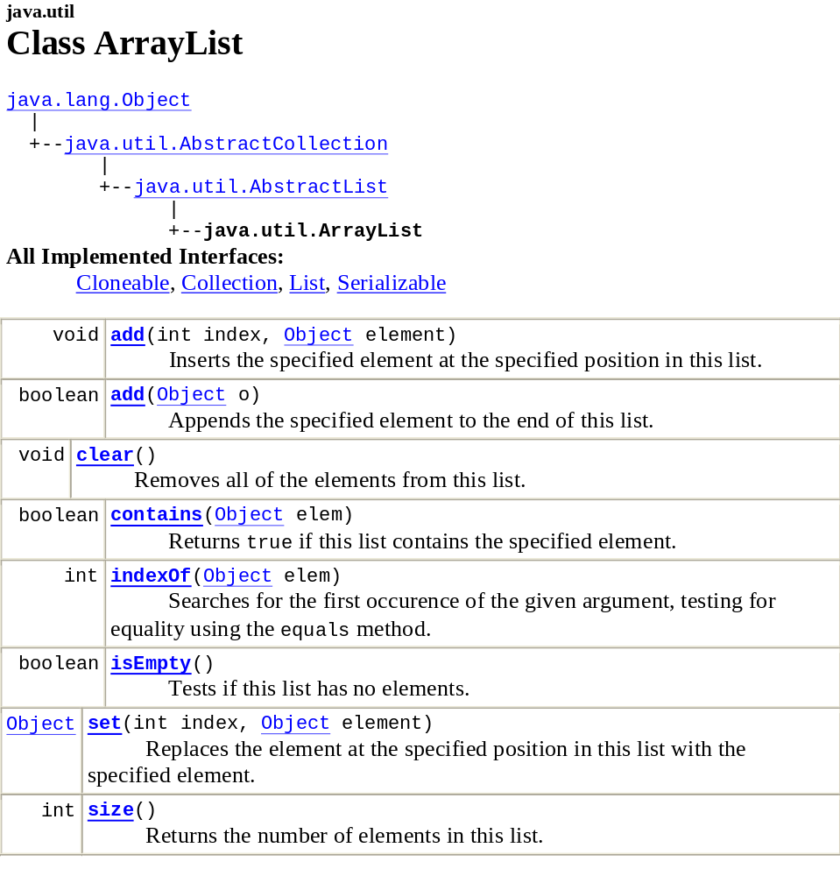
Example - ArrayList
CS 307 Fundamentals of Computer Science

Slide 25
EXAMPLE
Array as Array List ADT
CS 204
Data Structures

Slide 26
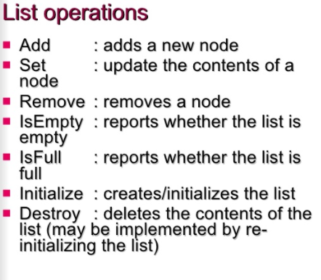

Slide 27
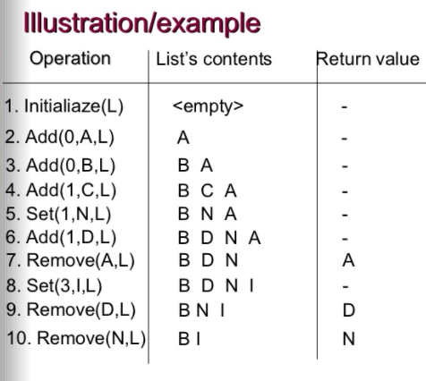

Slide 28
