Slide 1
Data Structures Lecture 04
1

Slide 2
Last Lecture Summary
Data structure Operations
Traverse, Search, Insert, Delete, Sort, Merge
Options for Implementing ADT List
Array-based and Pointer based
Linked List
Linked List Operations
Append
Traverse
2

Slide 3
Objectives Overview
Linked List Operations
Insert
Delete

Slide 4
Inserting a Node in a Linked List
Inserting a node in the middle of a list is more complicated than appending a node.
Assume all values in the list are sorted, and you want all new values to be inserted in their proper position (preserving the order of the list).
We will use the same ListNode structure again, with pseudo code
4

Slide 5
Inserting a Node - Pseudocode
Precondition Linked List is in sorted order
Create a new node. Store data in the new node. If there are no nodes in the list Make the new node the first node. Else Find the first node whose value is greater than or equal the new value, or the end of the list (whichever is first). Insert the new node before the found node, or at the end of the list if no node was found. End If.

Slide 6
Insert – Implementation Explanation
num holds the float value to be inserted in list
newNode is used to allocate a new node and store num in it
The algorithm finds first node whose value is greater that or equal to the new node. The new node is then inserted before the found node
nodePtr will be used to traverse the list and will point to the node being inspected
previousNode points to the node previous to nodePtr
previousNode is initialized to null in the start

Slide 7
Insert – Implementation Code - I
void insertNode(float num) { ListNode *newNode, *nodePtr, *previousNode; // Allocate a new node & store Num in the new node newNode = new ListNode; newNode->value = num; // Initialize previous node to NULL
previousNode = NULL; // If there are no nodes in the list make newNode the first node if (head == NULL) { head = newNode; newNode->next = NULL; } else { // Otherwise, insert newNode. // Initialize nodePtr to head of list nodePtr = head;
// Skip all nodes whose value member is less than num. while (nodePtr->Next != NULL && nodePtr->value < num) { previousNode = nodePtr; nodePtr = nodePtr->next;
} // end While loop

Slide 8
Insert – Implementation Code - II
// If the new mode is to be the 1st in the list, // insert it before all other nodes. if (previousNode == NULL)
{ head = newNode; newNode->next = nodePtr; } else
// the new node is inserted either in the middle or in the last { previousNode->next = newNode; newNode->next = nodePtr; } } // end of outer else } // End of insertnode function

Slide 9
Main Program using insertNode
// This program calls the displayList member function. // The function traverses the linked list displaying // the value stored in each node. #include <iostream.h> void main(void) { head = NULL; // Build the list appendNode(2.5); appendNode(7.9); appendNode(12.6); // Insert a node in the middle of the list insertNode(10.5); // Dispay the list displayList(); }
Program Output
2.5 7.9 10.5 12.6

Slide 10
Program Step Through - 1
As in previous program, this program calls the appendNode function 3 times to build the list with the values 2.5, 7.9, 12.6
The insertNode function is called with argument 10.5
In insertNode, the new node is created, and the function argument num is copied to its value member
Since the list already has nodes stored in it, so the condition (head == NULL) becomes false and
the else part of the if statement will execute.
It begins by assigning nodePtr to Head, i.e.

Slide 11
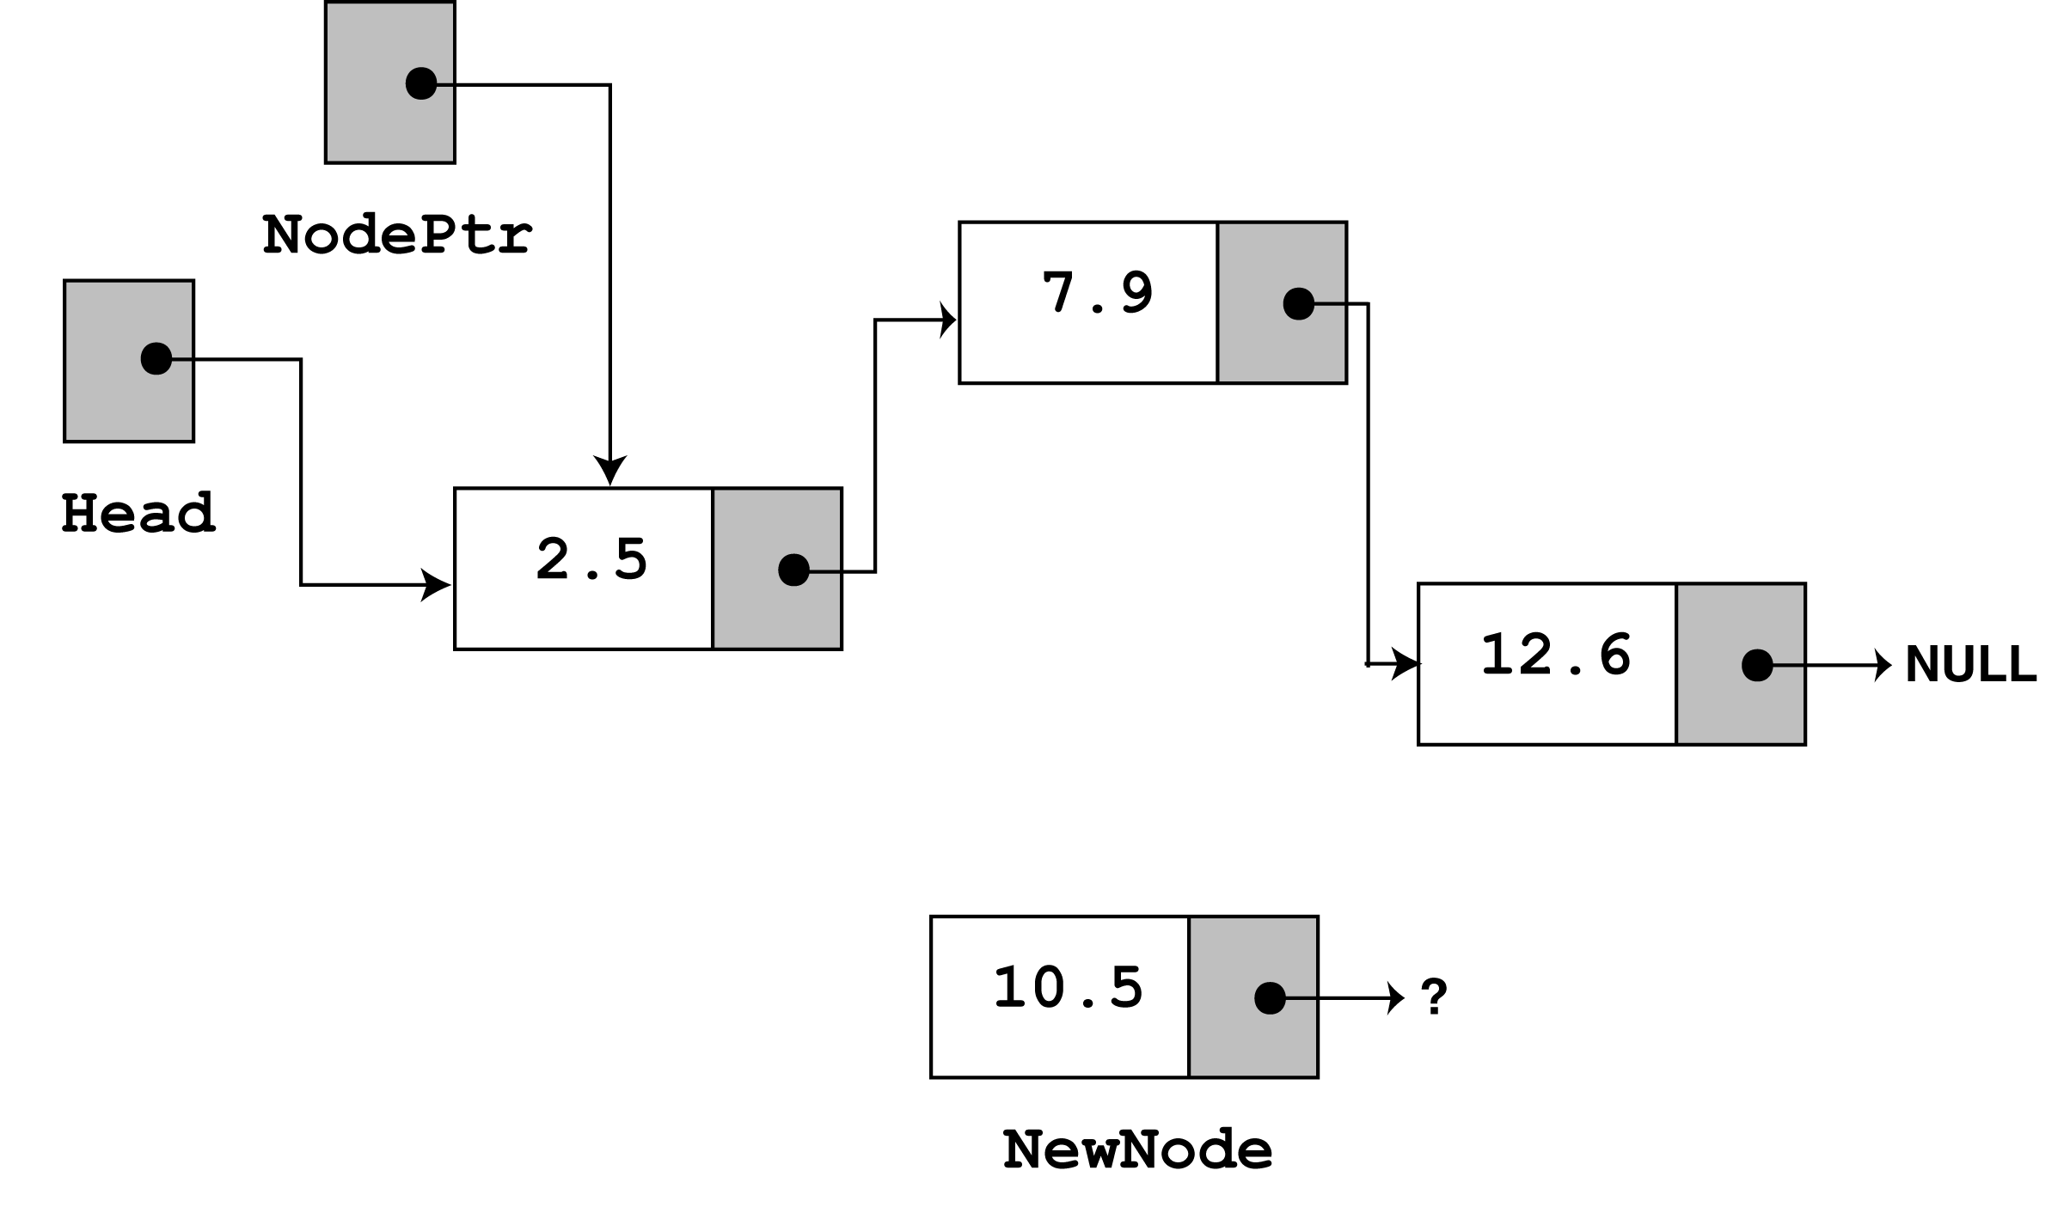
Program Step Through - 2
If the list is empty then
if (head == NULL) { head = newNode; newNode->next = NULL; }

Slide 12
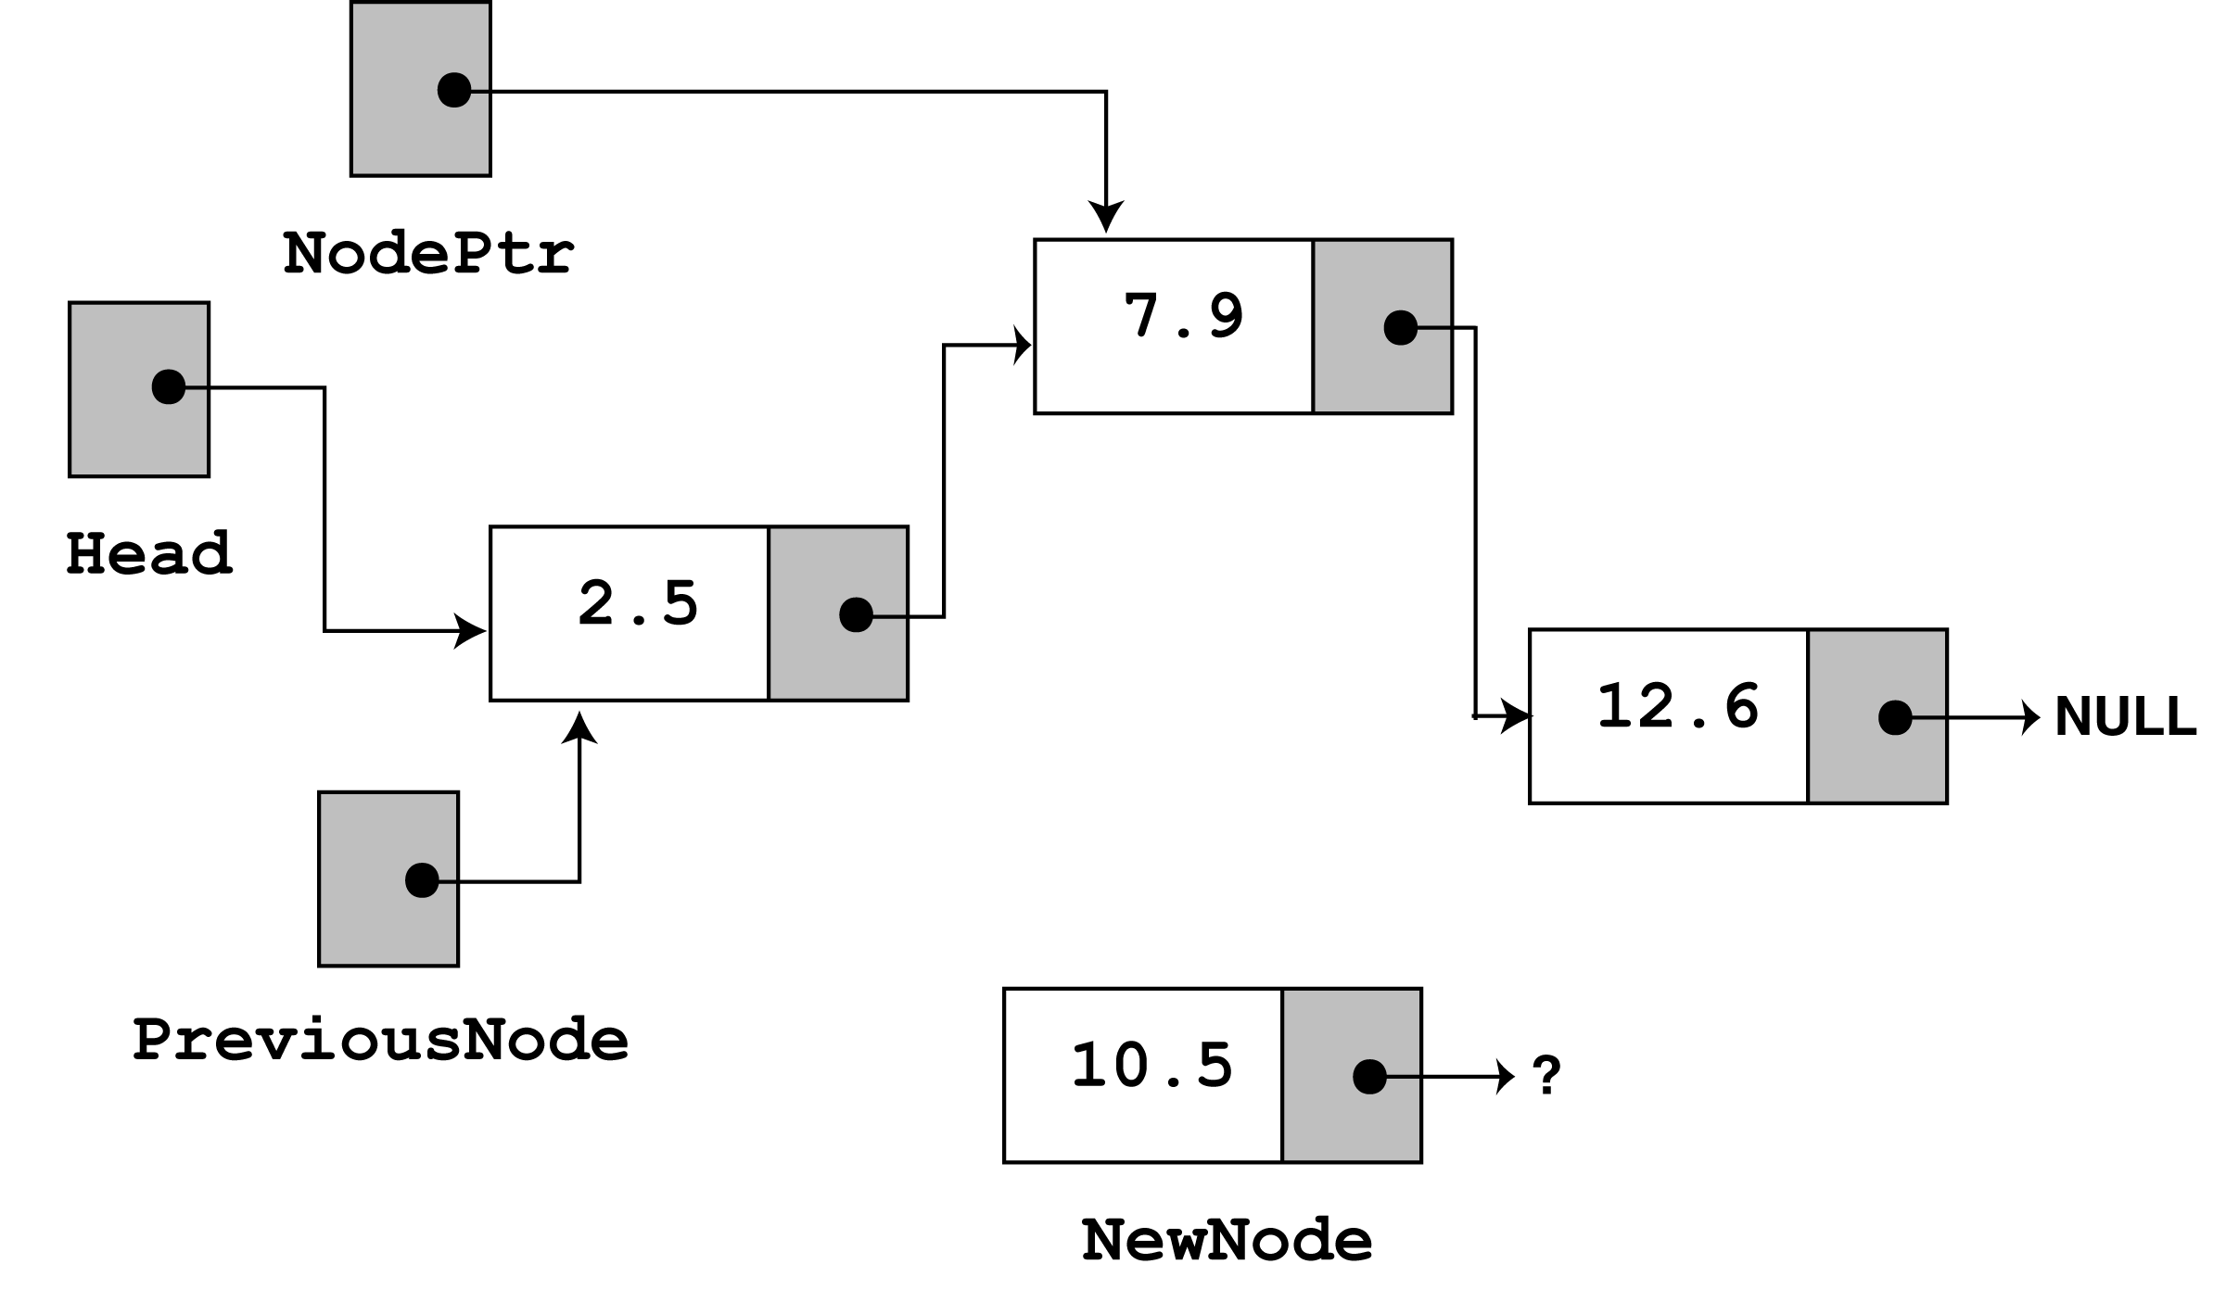
Program Step Through - 3
Since nodePtr is not NULL, and nodePtr->value is less than num, the while loop will iterate and the body is executed.
During the iteration,
1. previousNode is made to point to the node that nodePtr is pointing to.
2. nodePtr is then advanced to point to the next node. i.e.
while (nodePtr != NULL && nodePtr->value < num) { previousNode = nodePtr; nodePtr = nodePtr->next
} // end While loop

Slide 13
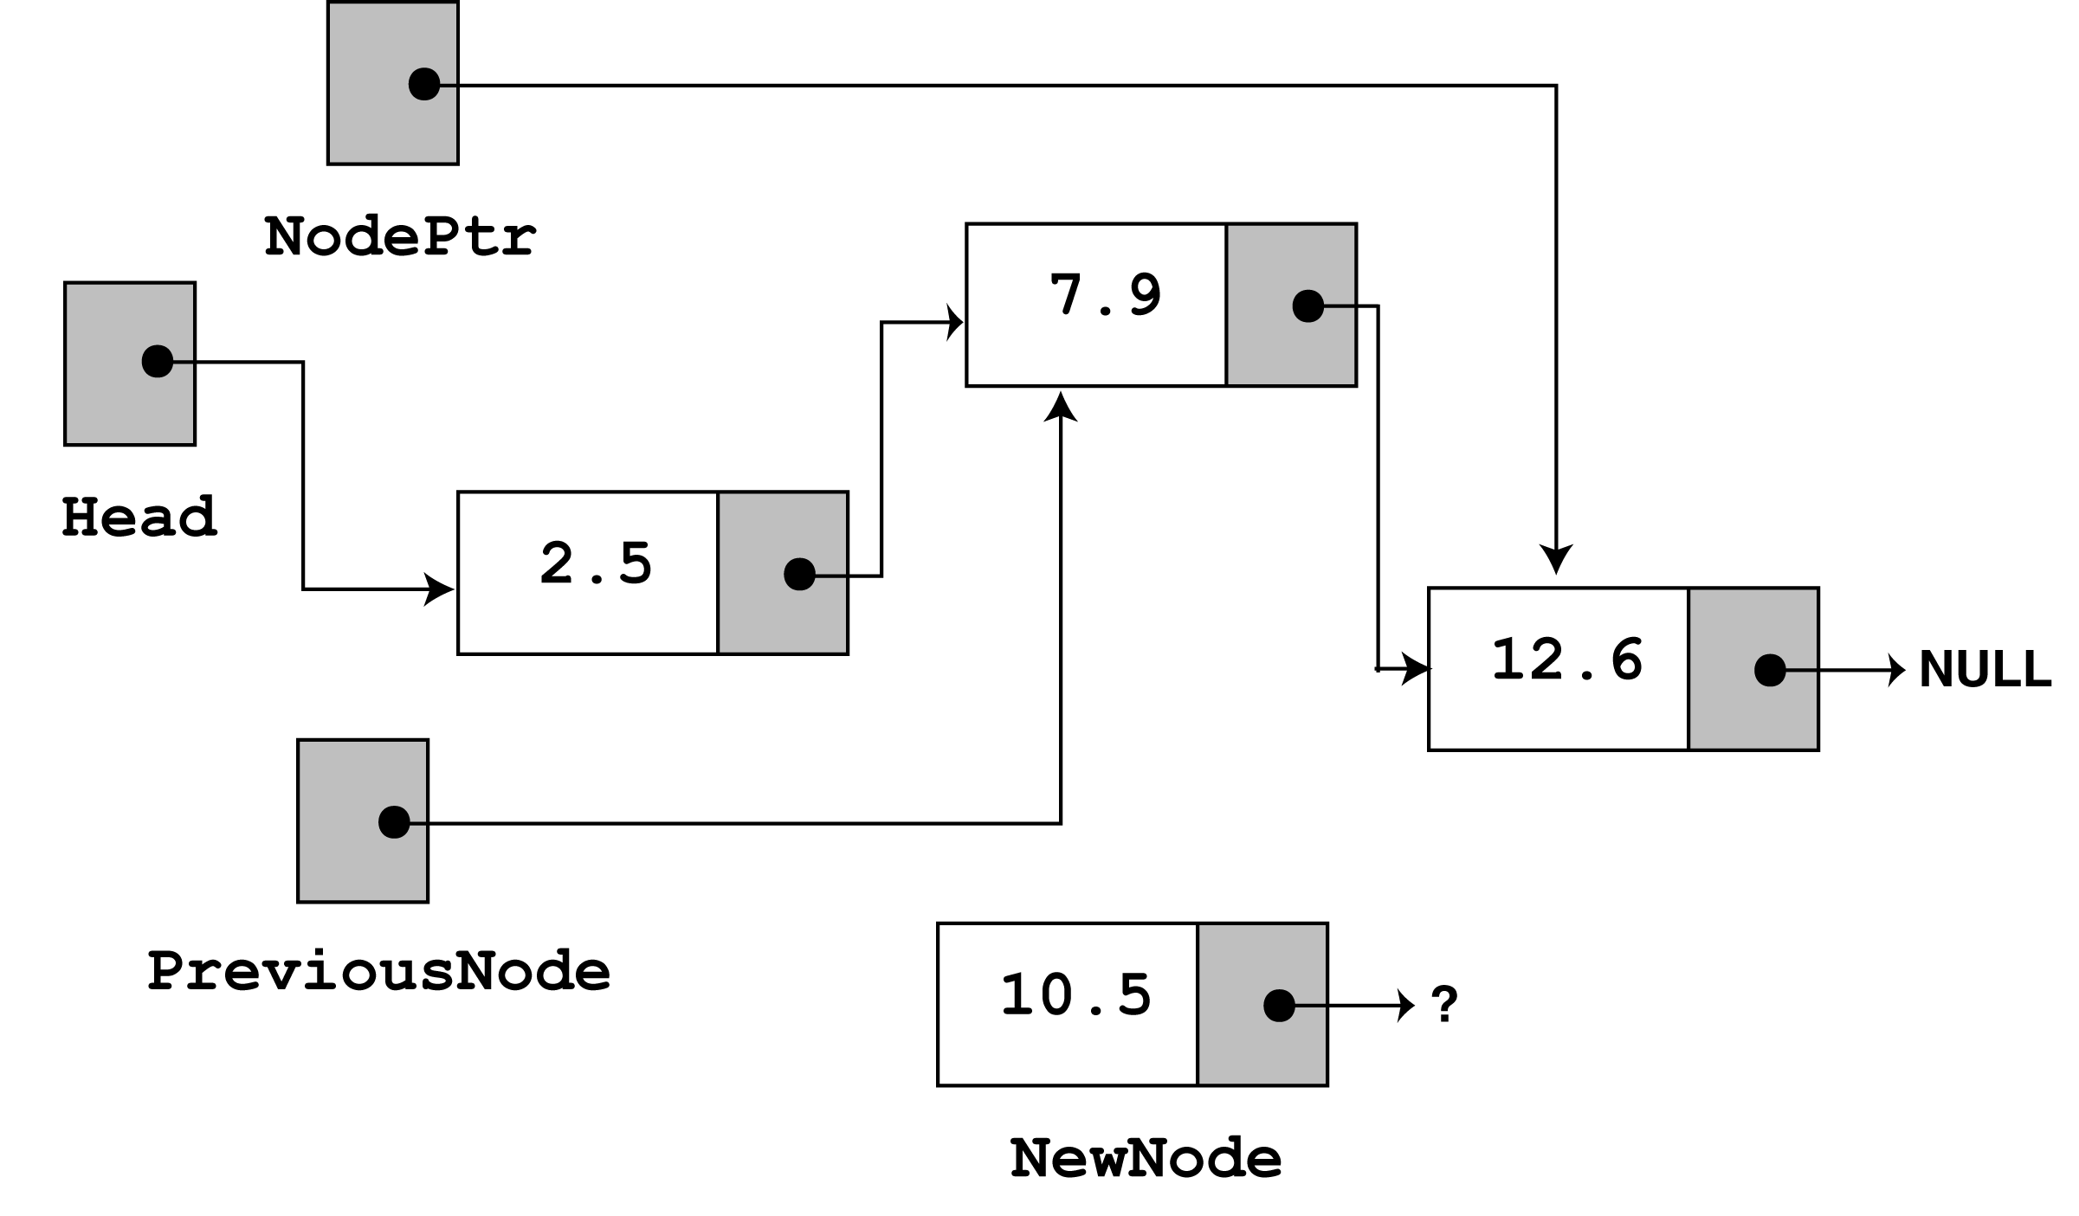
Program Step Through - 4
The loop does its test once more.
Since nodePtr is not NULL, and nodePtr->value is less than num, the loop iterates a second time.
During the second iteration, both previousNode and nodePtr are advanced by one node in the list, i.e.
while (nodePtr != NULL && nodePtr->value < num) { previousNode = nodePtr; nodePtr = nodePtr->next
} // end While loop

Slide 14
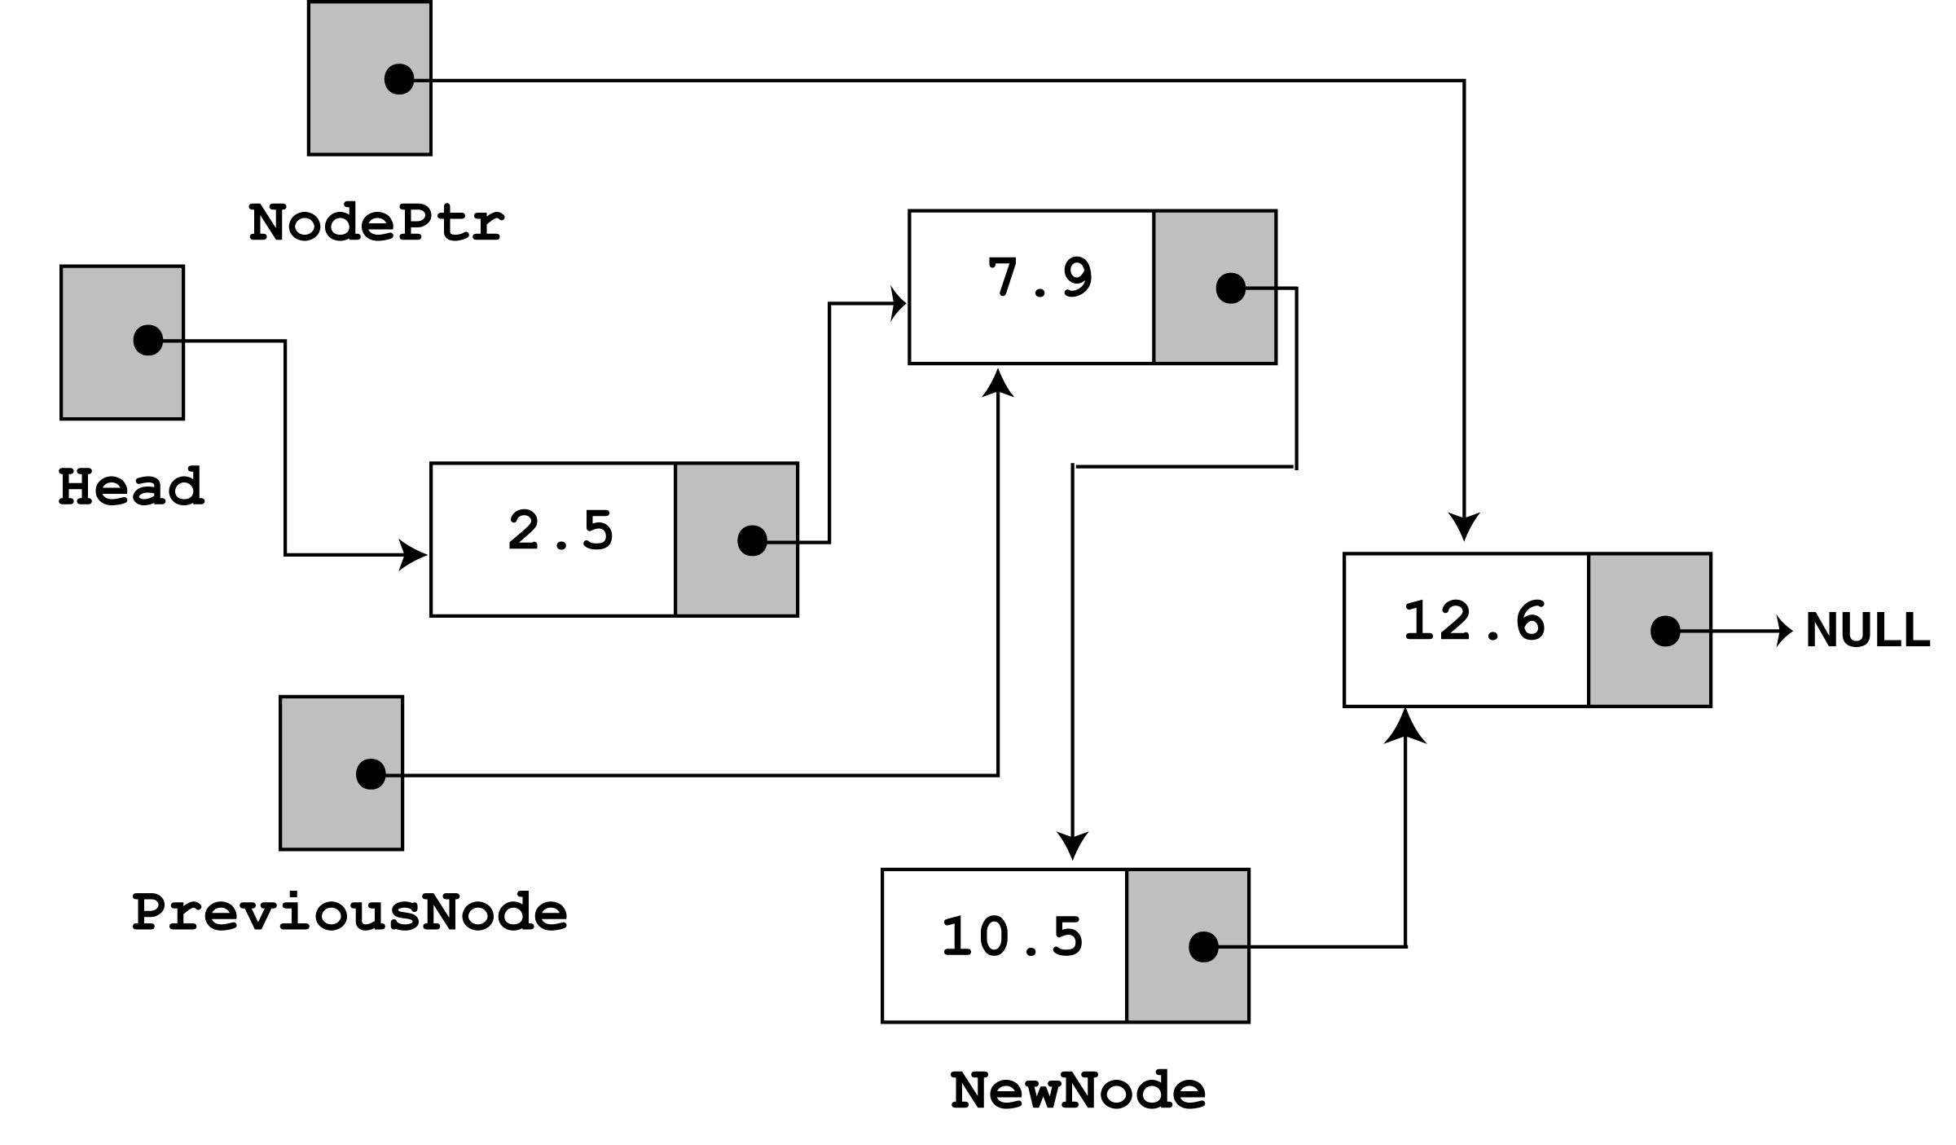
Program Step Through - 5
This time, the loop’s test will fail, because nodePtr is not less than num.
The statements after the loop will execute, which cause
previousNode->next to point to newNode, and
newNode->next to point to nodePtr, i.e.
previousNode->next = newNode; newNode->next = nodePtr;

Slide 15
Program Step Through - 6
This leaves the list in its final state.
The nodes (you will see if you follow the links from the head pointer to NULL) are stored in the order of their value members.
The main program then calls the displayList() function to traverse the list and display all the nodes stored in it.

Slide 16
Deleting a Node in a Linked List
This requires 2 steps –
Remove the node from the list without breaking the links created by the next pointers.
Delete the node from memory
We will consider the following cases
List is empty i.e it does not contain any node
Deleting the first node
Deleting the node in the middle of the list
Deleting the last node in the list

Slide 17
Deleting a Node - Algorithm
The deleteNode member function searches for a node with a particular value and deletes it from the list.
It uses an algorithm similar to the insertNode function.
The two node pointers nodePtr and previousPtr are used to traverse the list (as before).
When nodePtr points to the node to be deleted, adjust the pointers previousNode->next is made to point to nodePtr->next.
This marks the node pointed to by nodePtr to be deleted safely from the list .
The final step is to free the memory used by the node pointed to by nodePtr using the delete operator.

Slide 18
Deleting a Node – Implementation Code
void deleteNode(float num) { ListNode *nodePtr, *previousNode; // If the list is empty, do nothing and return to calling program. if (head == NULL) return; // Determine if the first node is the one if (head->value == num) { nodePtr = head;
head = head->next; delete nodePtr; }
else { // Initialize nodePtr to head of list nodePtr = head;
// Skip all nodes whose value member is not equal to num while (nodePtr != NULL && nodePtr->value != num) { previousNode = nodePtr; nodePtr = nodePtr->next; } // end of while loop //Link previous node to the node after nodePtr, and delete nodePtr previousNode->next = nodePtr->next; delete nodePtr;
} // end of else part
} // end of deleteNode function

Slide 19
Main Program using deleteNode
// This program demonstrate the deletenode function. #include <iostream.h> void main(void) { head = NULL; // Build the list appendNode(2.5); appendNode(7.9); appendNode(12.6); cout << "Here are the initial values:\n"; displayList(); cout << endl; cout << "Now deleting the node in the middle.\n"; cout << "Here are the nodes left.\n"; deleteNode(7.9); displayList(); cout << endl;
cout << "Now deleting the last node.\n"; cout << "Here are the nodes left.\n"; deleteNode(12.6); displayList(); cout << endl; cout << "Now deleting the only remaining node.\n"; cout << "Here are the nodes left.\n"; deleteNode(2.5); displayList(); } // end of main function

Slide 20
Program Output
Here are the initial values: 2.5 7.9 12.6 Now deleting the node in the middle. Here are the nodes left. 2.5 12.6 Now deleting the last node. Here are the nodes left. 2.5 Now deleting the only remaining node. Here are the nodes left.

Slide 21
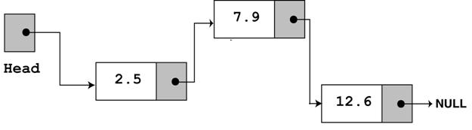
Program Step Through - 1
After the following three calls to the function appendNode
appendNode(2.5);
appendNode(7.9);
appendNode(12.6);
The list will be in the following position :

Slide 22
Program Step Through - 2
After the execution of following
cout << "Here are the initial values:\n"; displayList(); cout << endl;
The Program Output will be the following:
Here are the initial values: 2.5 7.9 12.6

Slide 23
Program Step Through - 3
To show how deleteNode works, we do a step through of the call to deleteNode with value 7.9
Look at the else part of the 2nd if statement. It is here the function does its thing, since the list is not empty, and the first node does not contain 7.9
else {// Initialize nodePtr to head of list nodePtr = head;
// Skip all nodes whose value member is not equal to num while (nodePtr != NULL && nodePtr->value != num) { previousNode = nodePtr; nodePtr = nodePtr->next; } // end of while loop
The node pointers nodePtr and previousPtr are used to traverse the list (as with the insertNode function).
The while loop terminates when the value 7.9 is found. When this happens the list and other pointers are in the following state -

Slide 24
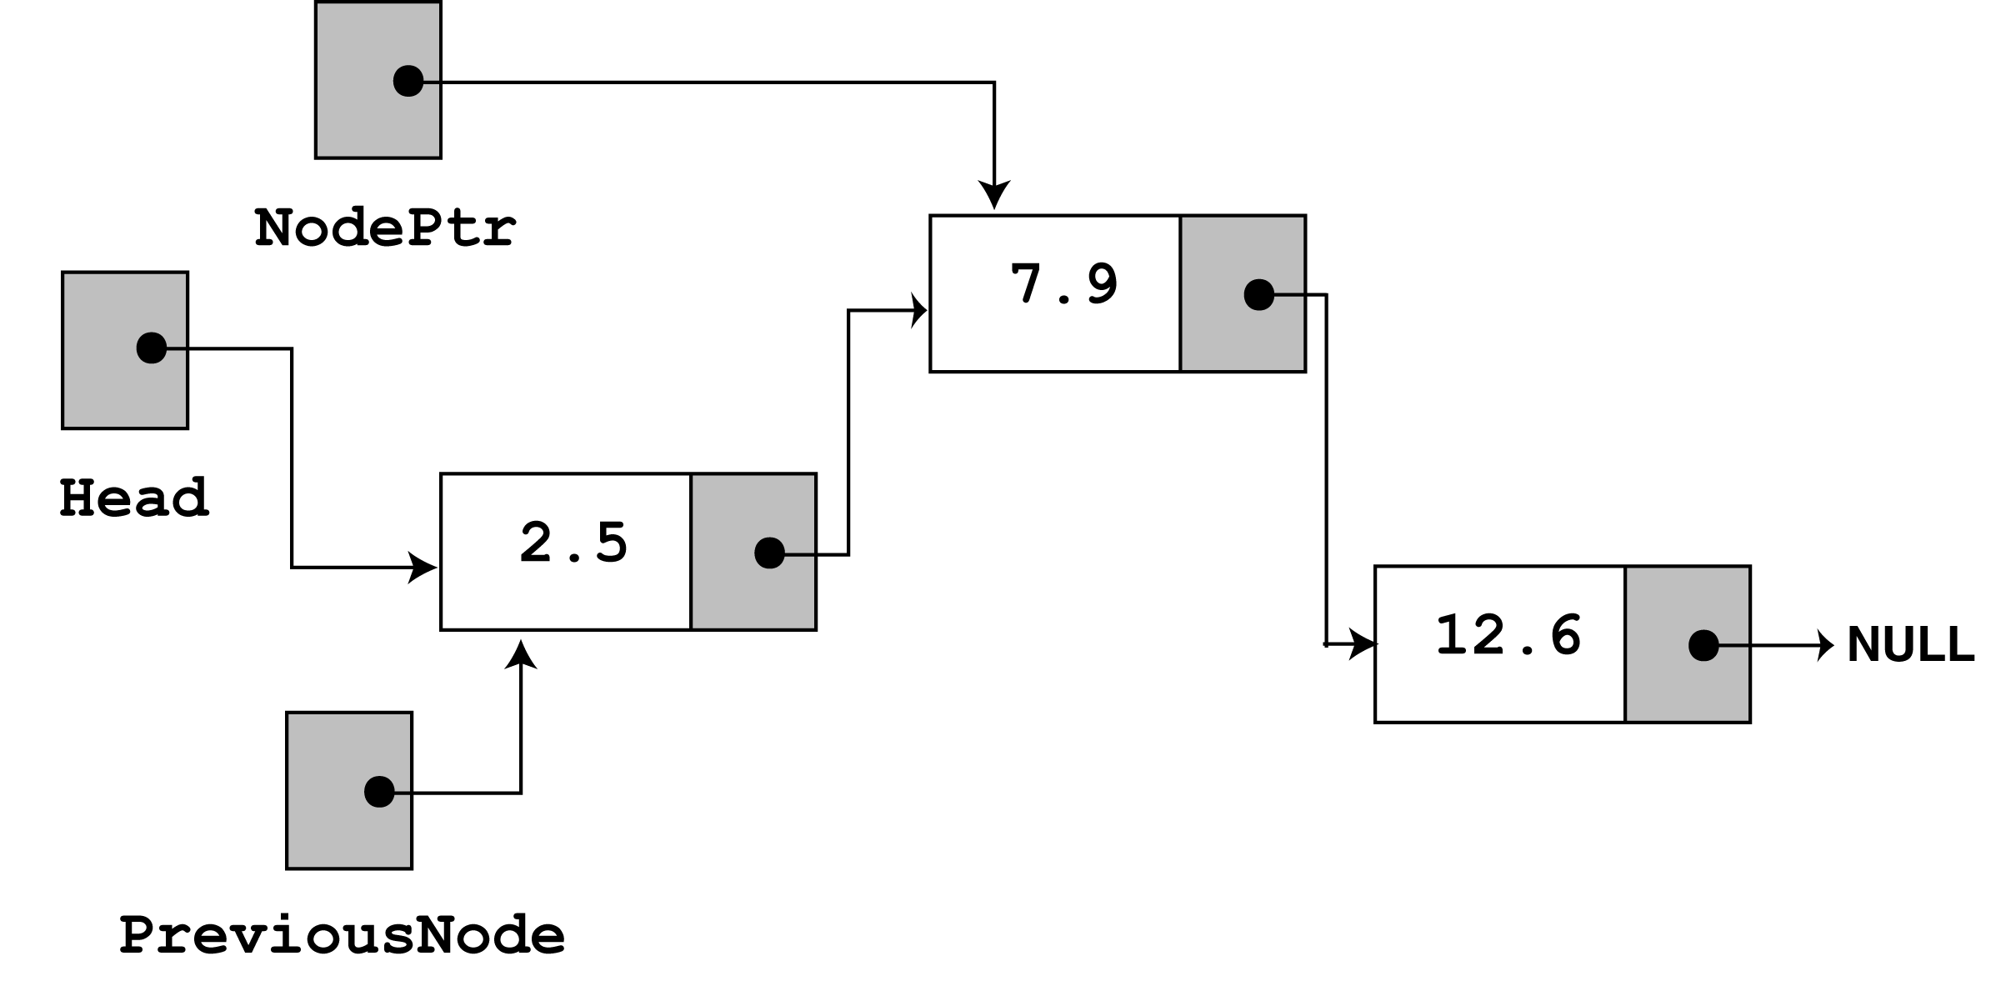
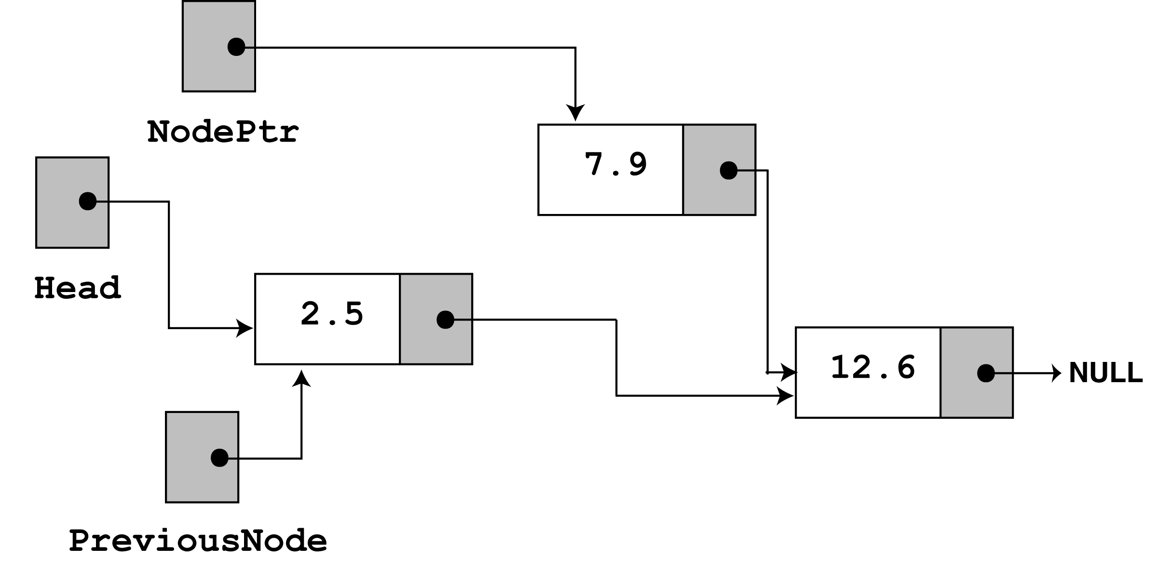
Program Step Through - 4
Then the following statement executes –
previousNode->next = nodePtr->next;
This causes the links in the list to bypass the node that nodePtr points to

Slide 25
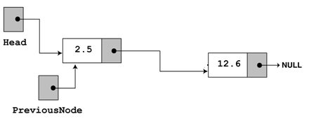
Program Step Through - 5
The node still exists in memory, but it is bypassed from the list.
The bypass node pointed by nodePtr is then destroyed with the statement :
delete nodePtr;
The linked List will be in the following state :

Slide 26
Program Step Through - 6
After the execution of following
cout << "Now deleting the node in the middle.\n"; cout << "Here are the nodes left.\n"; deleteNode(7.9); displayList(); cout << endl;
The Program Output will be the following:
Now deleting the node in the middle. Here are the nodes left. 2.5 12.6

Slide 27
Program Step Through - 7
We will now do a step through of the call to deleteNode with value 12.6
Look at the else part of the 2nd if statement. It is here the function does its thing, since the list is not empty, and the first node does not contain 12.6
else {// Initialize nodePtr to head of list nodePtr = head;
// Skip all nodes whose value member is not equal to num while (nodePtr != NULL && nodePtr->value != num) { previousNode = nodePtr; nodePtr = nodePtr->next; } // end of while loop
The node pointers nodePtr and previousPtr are used to traverse the list (as with the insertNode function).
The while loop terminates when the value 12.6 is found. When this happens the list and other pointers are in the following state -

Slide 28
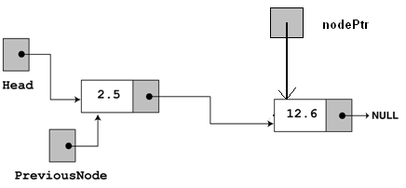
Program Step Through - 8
Then the following statement executes –
previousNode->next = nodePtr->next;
This causes the links in the list to bypass the node that nodePtr points to. The node still exists in memory.
The bypass node pointed by nodePtr is then destroyed with the statement :
delete nodePtr;

Slide 29
Program Step Through - 9
After the execution of following
cout << "Now deleting the last node.\n"; cout << "Here are the nodes left.\n"; deleteNode(12.6); displayList(); cout << endl;
The Program Output will be the following:
Now deleting the last node. Here are the nodes left. 2.5

Slide 30
Program Step Through - 10
We will now do a step through of the call to deleteNode with value 2.5
Look at the 2nd if statement.
It is here the function does its thing,
since the list is not empty, and the first node contains 2.5
// Determine if the first node is the one if (head->value == num) { nodePtr = head;
head = head->next; delete nodePtr; }

Slide 31
Program Step Through - 11
After the execution of following
cout << "Now deleting the only remaining node.\n"; cout << "Here are the nodes left.\n"; deleteNode(2.5); displayList(); cout << endl;
The Program Output will be the following:
Now deleting the only remaining node. Here are the nodes left.

Slide 32
Summary
Linked List Operations
Insert
Delete

