Slide 1
Objectives Overview
Graphs
Definition and Terminology
Representation of Graphs
Array based
Linked List
Common Operations on Graphs
Graph Traversals
Breadth First Search (BSF)
Depth First Search (DFS)

Slide 2
Graph
Abstract data type that is meant to implement the graph concept from mathematics
A graph data structure consists of a finite (and possibly mutable) set of ordered pairs, called edges or arcs, of certain entities called nodes or vertices
An edge (x, y) is said to point or go from x to y
The nodes may be part of the graph structure, or may be external entities represented by integer indices or references.
A graph data structure may also associate to each edge some edge value,
such as a symbolic label or a numeric attribute (cost, capacity, length, etc.)

Slide 3
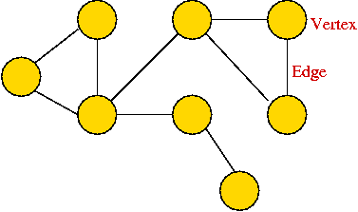
Graph - Terminology
Node or Vertex or Terminal or Endpoint
Edge or Arc or Link

Slide 4
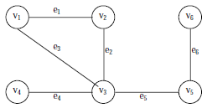
Graph - Example
Consider the following graph, G
Then the vertex V and edge E can be represented as:
V = {v1, v2, v3, v4, v5, v6} and E = {e1, e2, e3, e4, e5, e6}
E = {(v1, v2) (v2, v3) (v1, v3) (v3, v4),(v3, v5) (v5, v6)}
There are six edges and vertex in the graph

Slide 5
Graph Definition
A graph G consists of two sets
a finite, nonempty set of vertices V(G)
a finite, possible set of edges E(G)
G(V, E) represents a graph
An undirected graph is one in which the pair of vertices in a edge is unordered, (v0, v1) = (v1,v0)
A directed graph is one in which each edge is a directed pair of vertices, <v0, v1> != <v1,v0>
tail
head
5

Slide 6
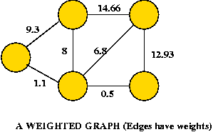
Graph Terminology
Graph is an ordered pair G = (V, E)
V = set of vertices
E = set of edges (2-element subset) ⊆ (V×V)
Types of graphs
Undirected: edge (u, v) = (v, u); for all v, (v, v) ∉ E (No self loops.)
Directed: (u, v) is edge from u to v, denoted as u → v. Self loops are allowed.
Weighted: each edge has an associated weight, given by a weight function w : E → R.

Slide 7
Graph Terminology
Graph is an ordered pair G = (V, E)
V = set of vertices
E = set of edges (2-element subset) ⊆ (V×V)
The vertices belonging to an edge are called the ends, endpoints, or end vertices of the edge
A vertex may exist in a graph and not belong to an edge
V and E are usually taken to be finite
The order of a graph is |V| (the number of vertices)
A graph's size is |E|, the number of edges
The degree of a vertex is the number of edges that connect to it, where an edge that connects to the vertex at both ends (a loop) is counted twice

Slide 8
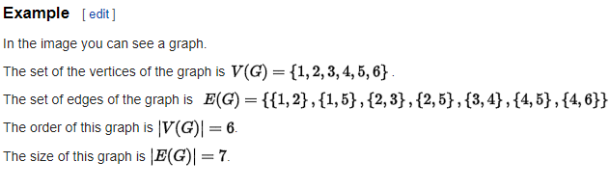
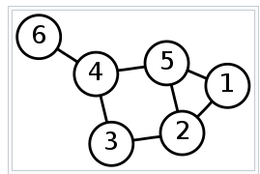

Slide 9
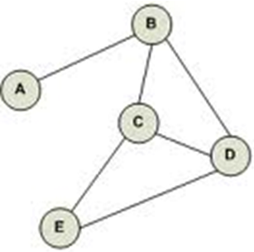
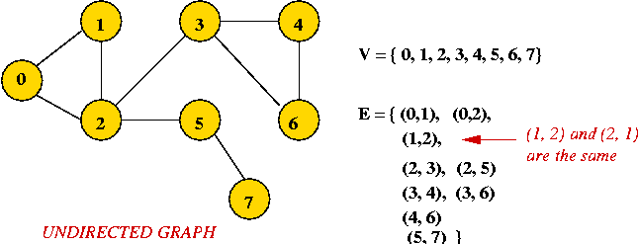
Undirected Graph
An undirected graph is one in which edges have no orientation
The edge (A, B) is identical to the edge (B, A)
(v0, v1) = (v1,v0)

Slide 10
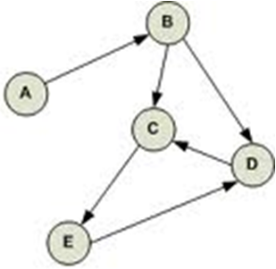
Directed Graph
A directed graph or digraph is an ordered pair D = (V, A) with
V, a set whose elements are called vertices or nodes, and
A, a set of ordered pairs of vertices, called arcs, directed edges, or arrows.
An arc a = (x, y) is considered to be directed from x to y
y is called the head and x is called the tail of the arc
y is said to be a direct successor of x, and x is said to be a direct predecessor of y
If a path leads from x to y, then
y is said to be a successor of x and reachable from x, and
x is said to be a predecessor of y.

Slide 11
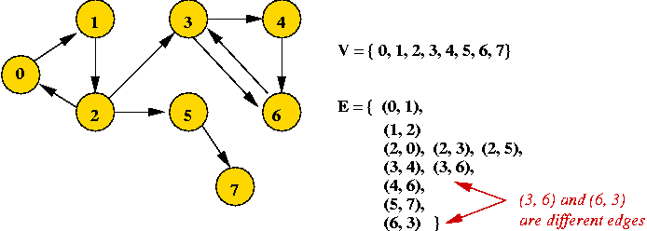
Directed Graph

Slide 12
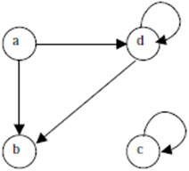
Directed Graph - Example
If an edge that is incident from and into the same vertex, say (d, d) or (c, c) in figure, is called a loop
Two vertices are said to be adjacent if they are joined by an edge
Consider edge (a, b), the vertex a is said to be adjacent to the vertex b, and the vertex b is said to be adjacent to vertex a
A vertex is said to be an isolated vertex if there is no edge incident with it
In this figure vertex C is an isolated vertex

Slide 13
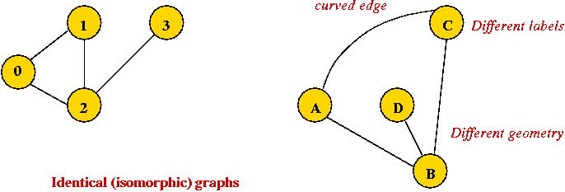
Identical Graph
Edges can be drawn "straight" or "curved”
Geometry of drawing has no particular meaning
Both figures represents the same identical graph

Slide 14


Sub-Graph
Let G = (V, E) be a graph
A graph G1 = (V1, E1) is said to be a sub-graph of G if E1 is a subset of E and V1 is a subset of V such that the edges in E1 are incident only with the vertices in V1
For example, Fig.(b) is a sub-graph of Fig. (a)
Fig (a)
Fig (b)

Slide 15

Spanning Sub-Graph
A sub-graph of G is said to be a spanning sub-graph if it contains all the vertices of G
For example Fig.(c) shows a spanning sub-graph of Fig.(a).
Fig (a)
Fig (c)

Slide 16
Degree of a Vertex
The number of edges incident on a vertex is its degree
The degree of vertex a, is written as degree (a)
If the degree of vertex a is zero, then vertex a is called isolated vertex
For example the degree of the vertex a in following figure is 3

Slide 17
Weighted Graph
A graph G is said to be weighted graph if every edge and/or vertices in the graph is assigned with some weight or value
A weighted graph can be defined as G = (V, E, We, Wv) where V is the set of vertices, E is the set of edges and We is a weight of the edges whose domain is E and Wv is a weight of the vertices whose domain is V

Slide 18
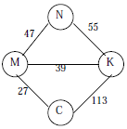
Weighted-Graph Example
Consider the following figure
Here V = {N, K, M, C,}
E = {(N, K), (N,M,), (M,K), (M,C), (K,C)}
We = {55,47, 39, 27, 113} and Wv = {N, K, M, C}

Slide 19
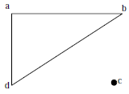
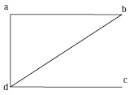
Connected and Disconnected Graph
An undirected graph is said to be connected if there exist a path from any vertex to any other vertex
Otherwise it is said to be disconnected
Fig. A shows the disconnected graph, where the vertex c is not connected to the graph
Fig. B shows the connected graph, where all the vertexes are connected

Slide 20
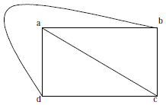
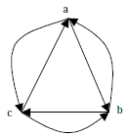
Complete Graph
A graph G is said to complete (or fully connected or strongly connected) if there is a path from every vertex to every other vertex or an edge between every pair of vertices.
Let a and b are two vertices in the directed graph, then it is a complete graph if there is a path from a to b as well as a path from b to a
Fig X illustrates the complete undirected graph
Fig Y shows the complete directed graph
Fig X
Fig Y

Slide 21
Path and Cycle
A path in a graph is a sequence of vertices such that from each of its vertices there is an edge to the next vertex in the sequence
A path may be infinite
But a finite path always has
a first vertex, called its start vertex, and
a last vertex, called its end vertex
Both of them are called terminal vertices of the path
The other vertices in the path are internal vertices.
A cycle is a path such that the start vertex and end vertex are the same
The choice of the start vertex in a cycle is arbitrary

Slide 22
Graph - Some Definitions
Degrees:
Undirected graph: the degree of a vertex is the number of edges incident to it.
Directed graph: the out-degree is the number of (directed) edges leading out, and the in-degree is the number of (directed) edges terminating at the vertex.
Neighbors:
Two vertices are neighbors (or are adjacent) if there's an edge between them.
Two edges are neighbors (or are adjacent) if they share a vertex as an endpoint.
Connectivity:
Undirected graph : Two vertices are connected if there is a path that includes them.
Directed graph: Two vertices are strongly-connected if there is a (directed) path from one to the other

Slide 23
Graph - Some Definitions
Components:
A subgraph is a subset of vertices together with the edges from the original graph that connects vertices in the subset.
Undirected graph : A connected component is a subgraph in which every pair of vertices is connected.
Directed graph: A strongly-connected component is a subgraph in which every pair of vertices is strongly-connected.

Slide 24
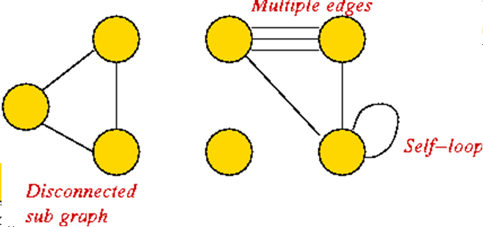
Graph Conventions
Self-loops (occasionally used).
Multiple edges between a pair of vertices (rare)
Disconnected pieces or sub graph (frequent in some applications)

Slide 25
Representation of Graphs
Two standard ways.
Adjacency Lists.
Adjacency Matrix.
a
b
a
b
d
c
b
a
c
c
d
c
d
a
b
d
a
c
1
2
1 2 3 4
1 0 1 1 1
2 1 0 1 0
3 1 1 0 1
4 1 0 1 0
a
b
c
d
3
4

Slide 26
Adjacency Lists
Consists of an array Adj of |V| lists.
One list per vertex.
For u ∈ V, Adj[u] consists of all vertices adjacent to u.
a
b
a
b
d
c
b
c
c
d
If weighted, store weights also in adjacency lists.
c
d
d
a
b
a
b
d
c
b
a
c
c
d
c
d
a
b
d
a
c

Slide 27
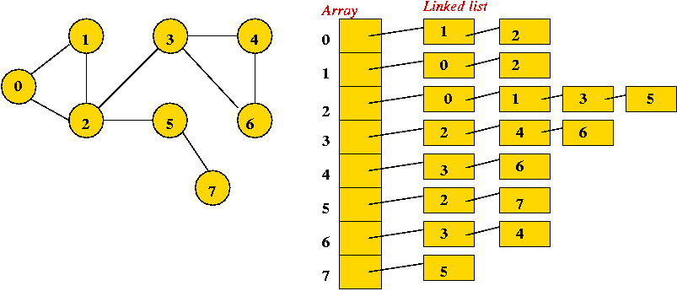
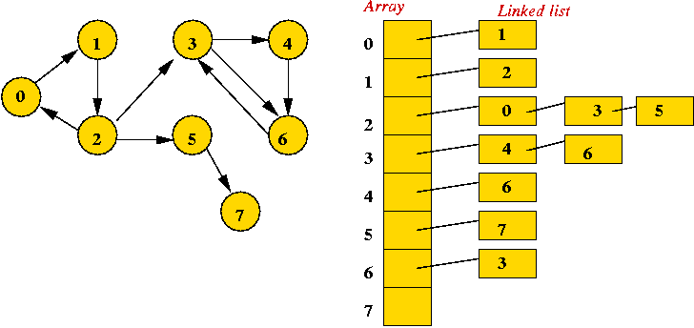
Adjacency List

Slide 28
Adjacency Matrix
|V| × |V| matrix A.
Number vertices from 1 to |V| in some arbitrary manner.
A is then given by:
1
2
1 2 3 4
1 0 1 1 1
2 0 0 1 0
3 0 0 0 1
4 0 0 0 0
a
b
c
d
4
3
1
2
1 2 3 4
1 0 1 1 1
2 1 0 1 0
3 1 1 0 1
4 1 0 1 0
a
b
A = A^{T} (transpose)
for undirected graphs.
c
d
3
4

Slide 29
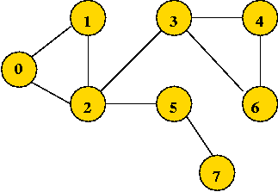
Adjacency Matrix - Undirected
use a 2D matrix
Row i has "neighbor" information about vertex j.
adjMatrix[i][j] = 1
if and only if there's an edge between vertices i and j
adjMatrix[i][j] = 0 otherwise
adjMatrix[i][j] == adjMatrix[j][i] if undirected graph
0 1 2 3 4 5 6 7
0 0 1 1 0 0 0 0 0
1 1 0 1 0 0 0 0 0
1 1 0 1 0 1 0 0
0 0 1 0 1 0 1 0
4 0 0 0 1 0 0 1 0
0 0 1 0 0 0 0 1
0 0 0 1 1 0 0 0
7 0 0 0 0 0 1 0 0

Slide 30
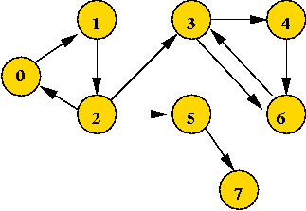
Adjacency Matrix - Directed
use a 2D matrix
Row i has "neighbor" information about vertex j.
adjMatrix[i][j] = 1
if and only if there's an edge from vertices i to j
adjMatrix[j][[i] = 0 otherwise
0 1 2 3 4 5 6 7
0 0 1 0 0 0 0 0 0
1 0 0 1 0 0 0 0 0
1 0 0 1 0 1 0 0
0 0 0 0 1 0 1 0
4 0 0 0 0 0 0 1 0
0 0 0 0 0 0 0 1
0 0 0 1 0 0 0 0
7 0 0 0 0 0 0 0 0

Slide 31
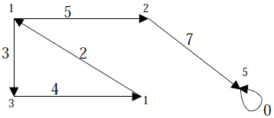
Adjacency Matrix – Weighted Graph
The weight of the edge (i, j) is simply stored as the entry in i th row and j th column of the adjacency matrix
There are some cases where zero can also be the possible weight of the edge,
Then we have to store some sentinel value for non-existent edge, which can be a negative value
Since weight of the edge is always a positive number

Slide 32
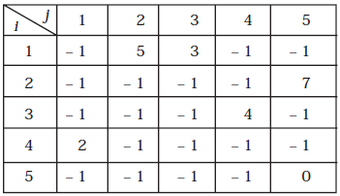
Adjacency Matrix – Weighted Graph
The adjacency matrix A for a directed weighted graph G = (V, E, We ) can be represented as:
Aij = Wij { if there is an edge from Vi to Vj then represent its weight Wij}
Aij = – 1 { if there is no edge from Vi to Vj}

Slide 33
Representation of Graphs - List
Adjacency list
Vertices are stored as records or objects, and every vertex stores a list of adjacent vertices
Allows the storage of additional data on the vertices.
Incidence list
Vertices and edges are stored as records or objects
Each vertex stores its incident edges, and each edge stores its incident vertices
Allows the storage of additional data on vertices and edges

Slide 34
Representation of Graphs - Array
Adjacency matrix
A two-dimensional matrix, in which the rows represent source vertices and columns represent destination vertices
Data on edges and vertices must be stored externally
Only the cost for one edge can be stored between each pair of vertices.
Incidence matrix
A two-dimensional Boolean matrix, in which the rows represent the vertices and columns represent the edges
The entries indicate whether the vertex at a row is incident to the edge at a column.

Slide 35
Common Operations on Graphs
adjacent(G, x, y): tests whether there is an edge from node x to node y
neighbors(G, x): lists all nodes y such that there is an edge from x to y
add(G, x, y): adds to G the edge from x to y, if it is not there
delete(G, x, y): removes the edge from x to y, if it is there
get_node_value(G, x): returns the value associated with the node x
set_node_value(G, x, a): sets the value associated with the node x to a
Structures that associate values to the edges usually also provide:
get_edge_value(G, x, y): returns the value associated to the edge (x,y)
set_edge_value(G, x, y, v): sets the value associated to the edge (x,y) to v

Slide 36
Initialize Graph – Adjacency Matrix
int adjMatrix[4][4];
void initialize () {
for (int i=0; i < 4 ; i++)
{
for (int j=0; j < 4; j++)
adjMatrix[i][j] = 0;
}
numEdges = 0
}
void add (int startVertex, int endVertex) {
adjMatrix[startVertex] [endVertex] = 1;
adjMatrix[endVertex] [startVertex] = 1; // Remove this for directed graphs
numEdges++;
}

Slide 37
Graph Search or Traversal
"Searching" here means "exploring" a particular graph.
Searching will help reveal properties of the graph
e.g., is the graph connected?
Usually, the input is: vertex set and edges (in no particular order).
Two Techniques
Breadth First Search (BSF)
Depth First Search (DSF)

Slide 38
Breadth First Search - Undirected
Mark all vertices as "unvisited“
Initialize a queue (to empty)
Find an unvisited vertex and apply breadth-first search to it
In breadth-first search, add the vertex's neighbors to the queue
Repeat: extract a vertex from the queue, and add its "unvisited" neighbors to the queue

Slide 39
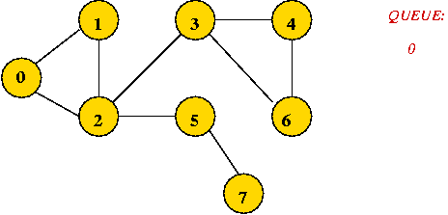

Breadth First Search – Trace (1)
Initially, place vertex 0 in the queue
Dequeue 0
=> mark it as visited, and add its unvisited neighbors to queue:

Slide 40
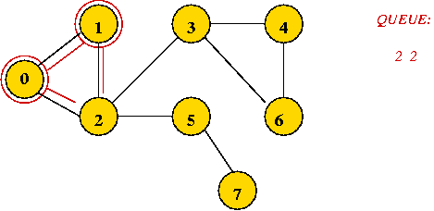
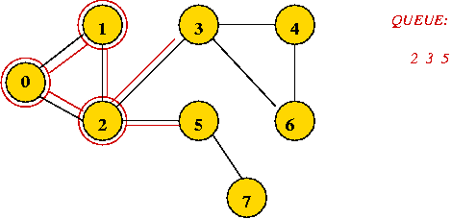
Breadth First Search – Trace (2)
Dequeue 1
=> mark it as visited, and add its unvisited neighbors to queue:
Dequeue 2
=> mark it as visited, and add its unvisited neighbors to queue:

Slide 41
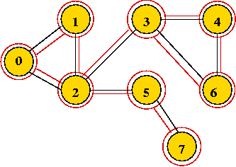
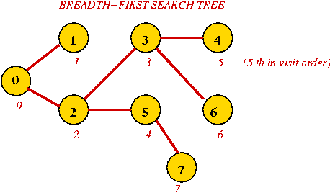
Breadth First Search – Trace (3)
Dequeue 2 => it's already visited, so ignore.
Continuing ...

Slide 42
Breadth First Search - Algorithm
Algorithm:
Input: A graph's adjacency matrix, number of vertices n
// Visit order will start with "0", so initialize to -1
1. for i=0 to n-1
2. visitOrder[i] = -1
3. endfor
// A counter for the order:
0 1 2 3 4 5 6 7
0 0 1 0 0 0 0 0 0
1 0 0 1 0 0 0 0 0
1 0 0 1 0 1 0 0
0 0 0 0 1 0 1 0
4 0 0 0 0 0 0 1 0
0 0 0 0 0 0 0 1
0 0 0 1 0 0 0 0
7 0 0 0 0 0 0 0 0

Slide 43
Breadth First Search - Algorithm
Algorithm: breadthFirstSearch (adjMatrix, v)
Input: vertex v, adjMatrix is assumed to be global
1. create queue; // Queue needs to be reset for each tree
2. Enqueue (v); // Place root of tree on the queue.
3. while queue not empty // Continue processing vertices until no more can be added
4. Deque(v); // Remove a vertex
5. if visitOrder[v] < 0 // If it hasn't been visited ...
6. visitOrder[v] = 0; // Visit the vertex.
8. for i=0 to n-1 // Look for neighbors to visit.
9. if adjMatrix[v][i] = 1 and i != v // Check self-loop: i != v
10. Enqueue (i)
11. endif
12. endfor
13. endif
14. endwhile

Slide 44
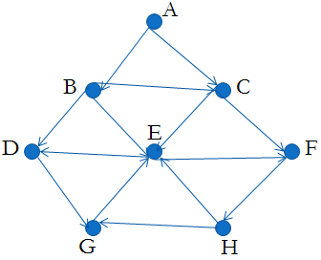
Breadth First Search (BFS)
Given an input graph G = (V, E) and a source vertex S from where the searching starts
The breadth first search systematically traverse the edges of G to explore every vertex that is reachable from S
Then examine all the vertices neighbor to source vertex S
Then traverse all the neighbors of the neighbors of source vertex S and so on
A queue is used to keep track of the progress of traversing the neighbor nodes
Suppose the source vertex is A

Slide 45
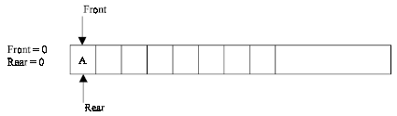
Breadth First Search (BFS)
Step 1: Initially push A (the source vertex) to the queue
Step 2: Dequeue (or remove) the front element A from the queue (by incrementing front =front +1) and display it
Then Enqueue (or add) the neighboring vertices of A to the queue, (by incrementing Rear = Rear +1) if it is not in queue

Slide 46
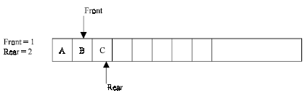
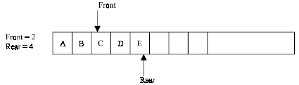
Breadth First Search (BFS)
Step 3: Dequeue the front element B from the queue and display it. Then add the neighboring vertices of B to the queue, if it is not in queue
One of the neighboring element C of B is preset in the queue, So C is not added to queue

Slide 47
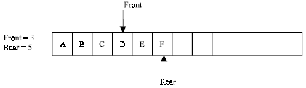
Breadth First Search (BFS)
Step 4: Remove the front element C and display it. Add the neighboring vertices of C, if it is not present in queue
One of the neighboring elements E of C is present in the queue, so E is not added

Slide 48
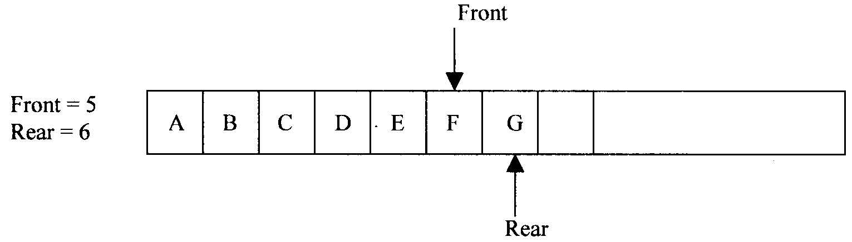
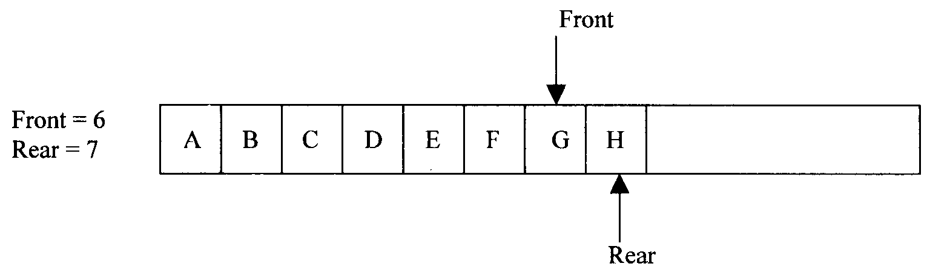
Breadth First Search (BFS)
Step 5: Remove the front element D, and add the neighboring vertex if it is not present in queue
Step 6: Again the process is repeated (until front>rear). Remove the front element E of the queue and add the neighboring vertex if it is not present in queue

Slide 49
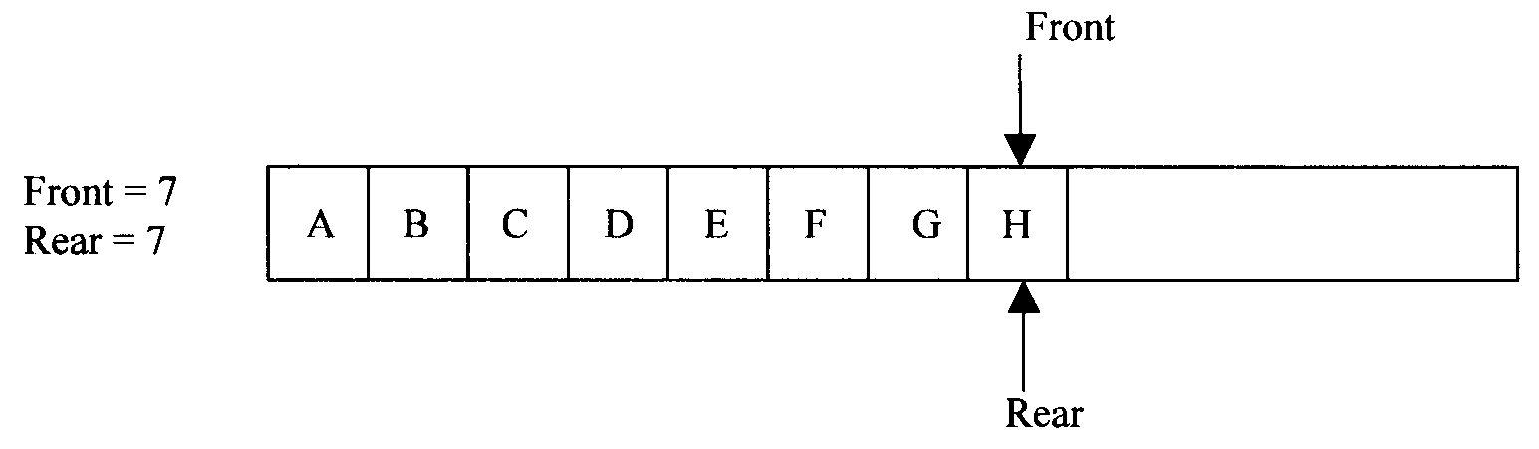
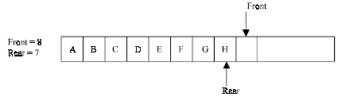
Breadth First Search (BFS)

Slide 50
Breadth First Search (BFS) - Algorithm
1. Input the vertices of the graph and its edges G = (V, E)
2. Input the source vertex and assign it to the variable S.
3. Enqueue or add the source vertex to the queue.
4. Repeat the steps 5 and 6 until the queue is empty (i.e., front > rear)
5. Dequeue the front element of the queue and display it as visited.
6. Enqueue the vertices, which is neighbor to just, popped element, if it is not in the queue and displayed (i.e., not visited).
7. Exit

Slide 51
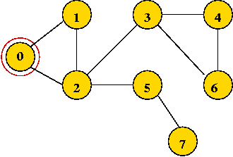
Depth First Search - Undirected Graph
Mark all vertices as "unvisited“
Visit first vertex
Recursively visit its "unvisited" neighbors.
Example: Start with vertex 0 and mark it visited.

Slide 52
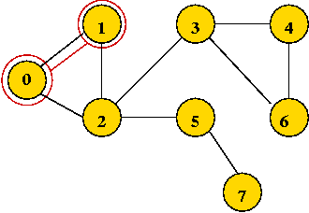
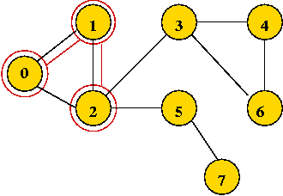
Depth First Search – Trace (1)
Visit the first neighbor 1, mark it visited.
Explore 1's first neighbor, 2.

Slide 53
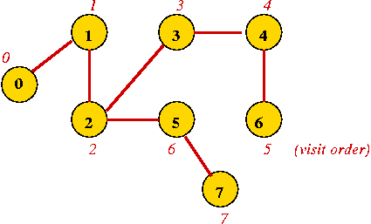
Depth First Search – Trace (2)
Continuing until all vertices are visited ...
Vertices are marked in order of visit.
An edge to an unvisited neighbor that gets visited next is in the depth-first search tree

Slide 54
Depth First Search - Algorithm
Algorithm:
Input: A graph's adjacency matrix, number of vertices n
// Visit order will start with "0", so initialize to -1
1. for i=0 to n-1
2. visitOrder[i] = -1
3. endfor
// Look for an unvisited vertex and explore its tree.
// We need this because the graph may have multiple components.

Slide 55
Depth First Search - Algorithm
Algorithm: depthFirstSearch (v)
Input: vertex v, adjMatrix is assumed to be global
// Mark vertex v as visited
2. visitOrder[v] = 0;
// Look for first unvisited neighbour
3. for i=0 to n-1
4. if adjMatrix[v][i] = 1 and i != v
5. If visitOrder[i] < 0
// If unvisited visit recursively
6. depthFirstSearch(i)
7. endif
8. endif
9. endfor

Slide 56
Depth First Search(Stack implementation)
The Depth First Search (DFS), as its name suggest, is to search deeper in the graph, when ever possible
Given an input graph G = (V, E) and a source vertex S, from where the searching starts
First we visit the starting node
Then we travel through each node along a path, which begins at S
That is we visit a neighbor vertex of S and again a neighbor of a neighbor of S, and so on
The implementation of DFS is almost same except a stack is used instead of the queue

Slide 57
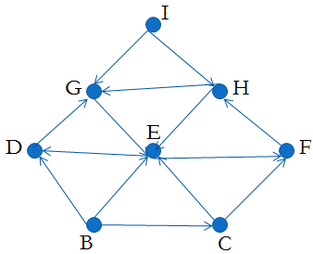
Depth First Search - Example
Suppose the source vertex is I

Slide 58
Depth First Search - LIFO
Step 1: Initially push I on to the stack.
STACK: I
DISPLAY:
Step 2: Pop and display the top element, and then push all the neighbors of popped element (i.e., I) onto the stack
STACK: G, H
DISPLAY: I
Step 3: Pop and display the top element and then push all the neighbors of popped the element (i.e., H) onto top of the stack, if it is not visited

Slide 59
Depth First Search - Example
STACK: G, E
DISPLAY: I, H
The popped element H has two neighbors E and G. G is already visited, means G is either in the stack or displayed
Here G is in the stack, so only E is pushed onto the top of the stack
Step 4: Pop and display the top element of the stack.
Push all the neighbors of the popped element on to the stack, if it is not visited
STACK: G, D, F
DISPLAY: I, H, E

Slide 60
Depth First Search - Example
Step 5: Pop and display the top element of the stack
Push all the neighbors of the popped element onto the stack, if it is not visited.
STACK: G, D
DISPLAY: I, H, E, F
The popped element (or vertex) F has neighbor(s) H, which is already visited
Then H is displayed, and will not be pushed again on to the stack

Slide 61
Depth First Search - Example
Step 6: The process is repeated as follows.
STACK: G
DISPLAY: I, H, E, F, D
STACK: //now the stack is empty
DISPLAY: I, H, E, F, D, G
So I, H, E, F, D, G is the DFS traversal of graph from the source vertex I

Slide 62



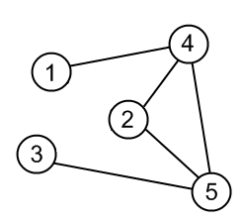
Depth First Search – Example Trace
In DFS, each vertex has three possible colors representing its state:
white: vertex is unvisited;
gray: vertex is in progress
black: DFS has finished processing the vertex.
Consider this source Graph

Slide 63
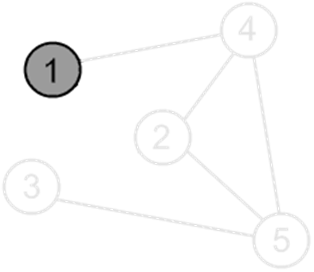
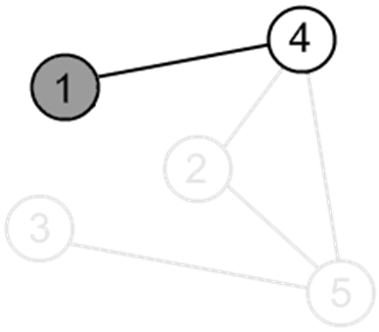
Depth First Search – Example Trace
Mark a vertex 1 as visited.
Print the vertex.
There is an edge (1, 4) and a vertex 4 is unvisited. Go there.

Slide 64
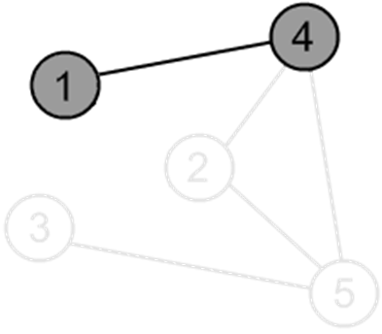
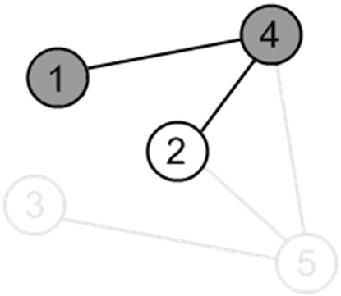
Depth First Search – Example Trace
Mark a vertex 4 as visited.
Print the vertex.
There is an edge (4, 2) and a vertex 2 is unvisited. Go there.

Slide 65
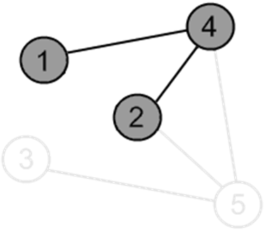
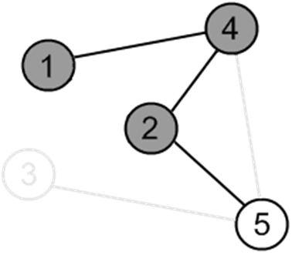
Depth First Search – Example Trace
Mark a vertex 2 as visited.
Print the vertex.
There is an edge (2, 5) and a vertex 5 is unvisited. Go there.

Slide 66
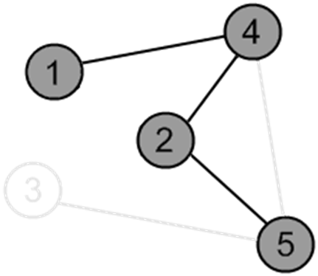

Depth First Search – Example Trace
Mark a vertex 5 as visited.
Print the vertex.
There is an edge (5, 3) and a vertex 3 is unvisited. Go there.

Slide 67


Depth First Search – Example Trace
Mark a vertex 3 as visited.
Print the vertex.
There are no ways to go from the vertex 3.
So, backtrack to the vertex 5 to check other adjacent vertices of the vertex 5

Slide 68


Depth First Search – Example Trace
There is an edge (5, 4), but the vertex 4 is already visited.
So do not go to the vertex 4. Continue with other adjacent vertices of vertex 5.
There are no ways to go from the vertex 5.
So, backtrack to the vertex 2 to check other adjacent vertices of the vertex 2.

Slide 69


Depth First Search – Example Trace
There are no more edges, adjacent to vertex 2. So, backtrack to the vertex 4 to check other adjacent vertices of the vertex 4
There is an edge (4, 5), but the vertex 5 is already visited. So do not go to the vertex 5. Continue with other adjacent vertices of vertex 4.

Slide 70


Depth First Search – Example Trace
There are no more edges, adjacent to the vertex 4. So, backtrack to the vertex 1 to check other adjacent vertices of the vertex 1
There are no more edges, adjacent to the vertex 1.
DFS is over.

Slide 71
Depth First Traversal
A depth first traversal method tends to traverse very long, narrow trees;
whereas breadth first traversal method tends to traverse very wide, short trees.

Slide 72
Summary
Graphs
Definition and Terminology
Representation of Graphs
Array based
Linked List
Common Operations on Graphs
Graph Traversals
Breadth First Search (BSF)
Depth First Search (DFS)

Slide 73
I receive the following error. I have filled in all educational field.
Fill in the relevant vacancies of your training information and upload the necessary documents!

