Slide 1
Objectives Overview
Trees
Concept
Examples and Applications
Definition
Terminology
Types of Trees
General Trees
Representation and Traversal
Binary Tree
Types and Representations

Slide 2
Tree - Introduction
Trees are very flexible, versatile and powerful non-linear data structure
It can be used to represent data items possessing hierarchical relationship
A tree can be theoretically defined as a finite set of one or more data items (or nodes) such that
There is a special node called the root of the tree
Remaining nodes (or data item) are partitioned into number of subsets each of which is itself a tree, are called subtree
A tree is a set of related interconnected nodes in a hierarchical structure

Slide 3
Tree - Introduction
Some data is not linear (it has more structure!)
Family trees
Organizational charts
Linked lists etc don’t store this structure information.
Linear implementations are sometimes inefficient or otherwise sub-optimal for our purposes
Trees offer an alternative
Representation
Implementation strategy
Set of algorithms

Slide 4
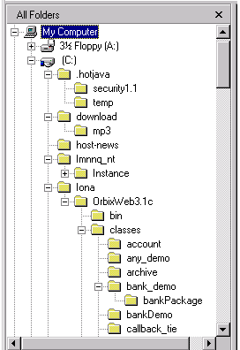
Tree Examples
Where have you seen a tree structure before?
Examples of trees:
Directory tree
Family tree
Company organization chart
Table of contents etc.

Slide 5
Tree Example – Tic Tac Toe
X
X
X
X
X
O
X
O
X
X
X
X
O
O
O

Slide 6
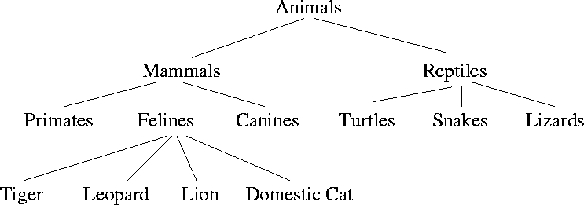
Tree Example – Taxonomy Tree

Slide 7
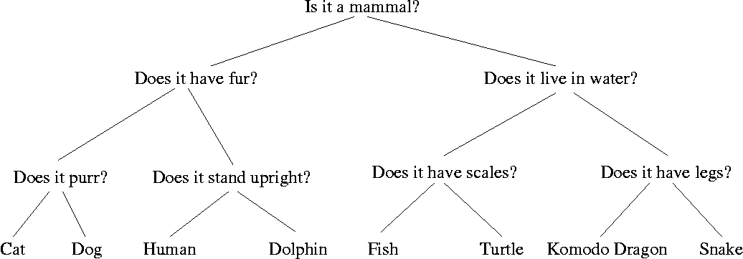
Tree Example – Decision Tree
tool that uses a tree-like graph or model of decisions and their possible consequences
including chance event outcomes, resource costs, and utility
It is one way to display an algorithm.

Slide 8
What is a Tree Useful for?
Artificial Intelligence – planning, navigating, games
Representing things:
Simple file systems
Class inheritance and composition
Classification, e.g. taxonomy (the is-a relationship again!)
HTML pages/ DOM model tree

Slide 9
Tree - Definition
A tree is a finite set of one or more nodes such that:
There is a specially designated node called the root.
The remaining nodes are partitioned into n>=0 disjoint sets T1, ..., Tn, where each of these sets is a tree.
We call T1, ..., Tn the subtrees of the root r
Each of whose roots are connected by a directed edge from r
A tree is a collection of N nodes, one of which is the root and N-1 edges

Slide 10
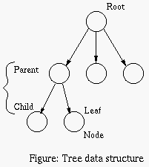
Tree – Basic Terminology
Each data item within a tree is called a 'node’
The highest data item in the tree is called the 'root' or root node
First node in hierarchical arrangement of data
Below the root lie a number of other 'nodes'. The root is the 'parent' of the nodes immediately linked to it and these are the 'children' of the parent node
Leaf node has no children

Slide 11
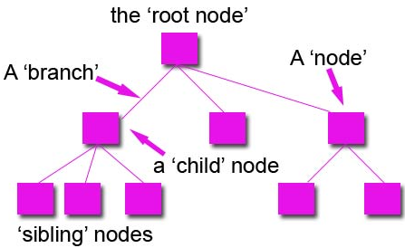
Tree – Basic Terminology
If nodes share a common parent, then they are 'sibling' nodes, just like a family.
The link joining one node to another is called the 'branch'.
This tree structure is a general tree
Leaves: nodes with no children (also known as external nodes)
Internal Nodes: nodes with children
The ancestors of a node are all the nodes along the path from the root to the node

Slide 12
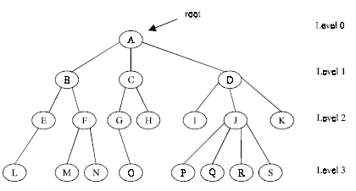
Tree – Basic Terminology
‘A’ is root node
Each data item in a tree is known as node
It specifies the data information and links to other data items
Degree of a node is the number of sub-trees of a node in a given tree
In the example
Degree of node A is 3
Degree of node B is 2
Degree of node C is 2
Degree of node D is 3
Degree of node J is 4

Slide 13
Tree – Basic Terminology
Degree of a tree is the maximum degree of node in a given tree
Degree of node J is 4
All other nodes have less or equal degree
So degree of the tree is 4
A node with degree zero (0) is called terminal node or a leaf
Nodes M,N,I,O etc are leaf nodes
Any node whose degree is not zero is called a non-terminal node

Slide 14
Tree – Basic Terminology
Levels of a Tree
The tree is structured in different levels
The entire tree is leveled in such a way that the root node is always of level 0
Its immediate children are at level 1 and their immediate children are at level 2 and so on up to the terminal nodes
If a node is at level n then its children will be at level n+1

Slide 15
Tree – Basic Terminology
Depth of a Tree is the maximum level of any node in a given tree
The number of levels from root to the leaves is called depth of a tree. Depth of tree is 3
The term height is also used to denote the depth of a tree
Height (of node): length of the longest path from a node to a leaf.
All leaves have a height of 0
The height of root is equal to the depth of the tree

Slide 16
Tree – Basic Terminology
A vertex (or node) is a simple object that can have a name and can carry other associated information
An edge is a connection between two vertices
A path in a tree is a list of distinct vertices in which successive vertices are connected by edges in the tree
The defining property of a tree is that there is precisely one path connecting any two nodes

Slide 17
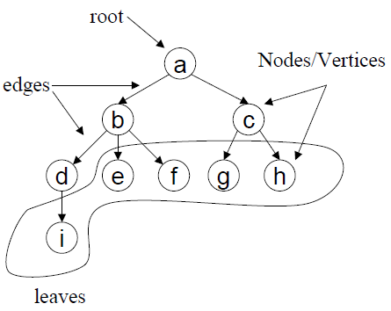
Tree – Basic Terminology
Example: {a, b, d, i } is path
Path

Slide 18
Path in a Tree
A path from node n₁ to n_{k} is defined as a sequence of nodes n₁, n₂, …, n_{k} such that n_{i} is the parent of n_{i+1} for 1<= i <= k.
The length of this path is the number of edges on the path namely k-1.
The length of the path from a node to itself is 0.
There is exactly one path from from the root to each node.

Slide 19
What is a Tree?
Models the parent/child relationship between different elements
Each child only has one parent
From mathematics:
“a directed acyclic graph”
At most one path from any one node to any other node
Different kinds of trees exist.
Trees can be used for different purposes.
In what order to we visit elements in a tree?

Slide 20
How Many Types of Trees are there?
Far too many:
General tree
Binary Tree
Red-Black Tree
AVL Tree
Partially Ordered Tree
B+ Trees
… and so on
Different types are used for different things
To improve speed
To improve the use of available memory
To suit particular problems

Slide 21
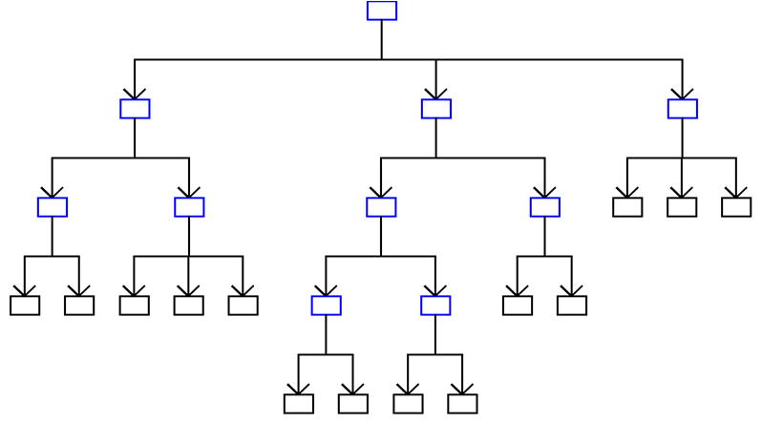
General tree

Slide 22
A Tree Node
Every tree node:
object – useful information
children – pointers to its children nodes
O
O
O
O
O

Slide 23

Representation of Trees
List Representation (n-ary tree).
( A ( B ( E ( K, L ), F ), C ( G ), D ( H ( M ), I, J ) ) )
The root comes first, followed by a list of sub-trees
data
link 1
link 2
...
link n
How many link fields are
needed in such a representation?

Slide 24
Left Child – Right Sibling
data
A
left child
right sibling
B
C
D
E
F
G
H
I
J
K
L
M

Slide 25
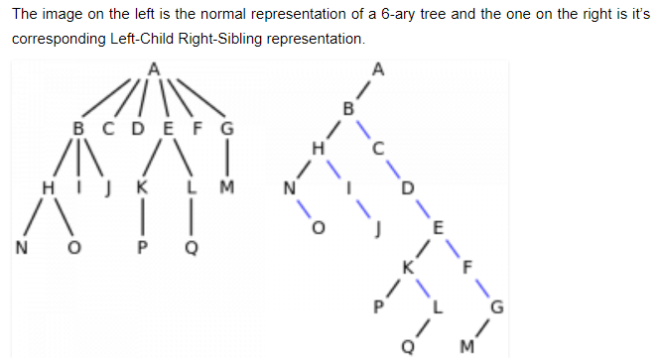
Left Child – Right Sibling

Slide 26
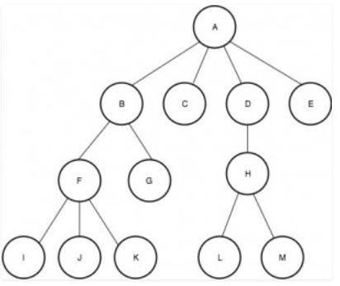
Example ?

Slide 27
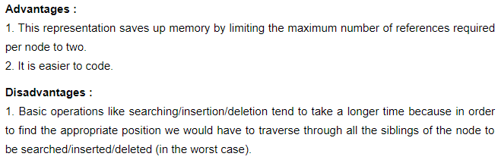
Left Child – Right Sibling
data
left child
right sibling
A
B
C
D
E
F
G
H
I
J
K
L
M

Slide 28
Tree ADT
Objects: any type of objects can be stored in a tree
Methods:
accessor methods
root() – return the root of the tree
parent(p) – return the parent of a node
children(p) – returns the children of a node
query methods
size() – returns the number of nodes in the tree
isEmpty() - returns true if the tree is empty
elements() – returns all elements
isRoot(p), isInternal(p), isExternal(p)

Slide 29
Tree Implementation
struct tnode {
int key;
struct tnode* lchild;
struct tnode* sibling;
} *ptnode;
Create a tree with three nodes (one root & two children)
Insert a new node (in tree with root R, as a new child at level L)
Delete a node (in tree with root R, the first child at level L)

Slide 30
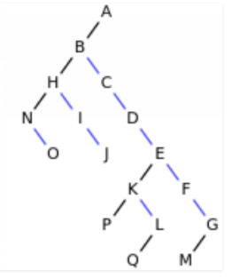
Binary Tree
A special class of trees:
max degree for each node is 2
Recursive definition:
A binary tree is a finite set of nodes that is either empty or consists of a root and two disjoint binary trees called the left subtree and the right subtree.
Any tree can be transformed into binary tree.
by left child-right sibling representation

Slide 31
Binary Tree - Example
A
B
C
E
G
D
K
F
H
L
M
I
J

Slide 32
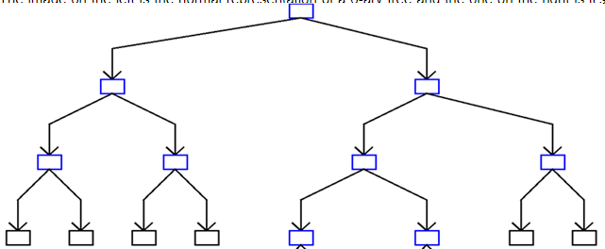
Maximum number of nodes in a binary tree
Tree size is limited by the depth/height of the tree
For binary tree, nodes at level k = 2^{k}
Size for full Binary is: 1 + 2 + … + k = 2^{(k+1)} – 1 where depth/height = k.

Slide 33
Binary Tree
A binary tree is a tree in which no node can have more than 2 children
These children are described as “left child” and “right child” of the parent node
A binary tree T is defined as a finite set of elements called nodes such that
T is empty if T has no nodes called the null or empty tree
T contains a special node R, called root node of T
remaining nodes of T form an ordered pair of disjoined binary trees T1 and T2. They are called left and right sub tree of R

Slide 34
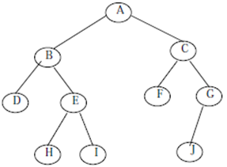
Binary Tree
‘A’ is the root node of the tree
‘B’ is left child of ‘A’ and ‘C’ is right child of ‘A’
‘A’ is the father of ‘B’ and ‘C’
The nodes ‘B’ and ‘C’ are called siblings

Slide 35
Relation between Number of Leaf Nodes and Nodes of Degree 2
For any nonempty binary tree, T, if n0 is the number of leaf nodes and n2 the number of nodes of degree 2, then n0=n2+1

Slide 36
Maximum Nodes in Binary Tress
The maximum number of nodes on level i of a binary tree is 2^{i-1}, I >= 1. (in books where level starts from 1)
The maximum number of nodes in a binary tree of depth k is 2^{k}-1, k >= 1. . (in books where level starts from 1)
Prove by Induction

Slide 37
Sample of Binary Trees
A
A
Complete Binary Tree
1
A
B
B
Skewed Binary Tree
2
B
C
C
D
3
D
E
F
G
E
5
4
H
I

Slide 38
Full Binary Tree and Complete BT
A full binary tree A Binary Tree is full if every node has 0 or 2 children. Following are examples of full binary tree. We can also say a full binary tree is a binary tree in which all nodes except leaves have two children.
Complete Binary Tree: A Binary Tree is complete Binary Tree if all levels are completely filled except possibly the last level and the last level has all keys as left as possible
A
A
B
C
B
C
D
E
F
G
D
E
F
G
H
I
J
K
L
M
N
O
H
I
Complete binary tree
Full binary tree of depth 4

Slide 39
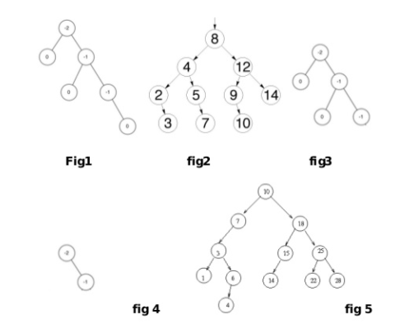
Identify?

Slide 40
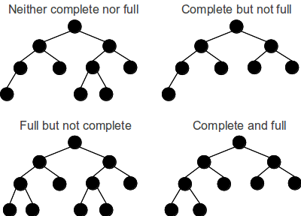

Slide 41
Sequential Representation
[1]
[2]
[3]
[4]
[5]
[6]
[7]
[8]
[9]
A
B
C
D
E
F
G
H
I
(1) waste space
(2) insertion/deletion
problem
A
[1]
[2]
[3]
[4]
[5]
[6]
[7]
[8]
[9]
.
[16]
A
B
--
C
--
--
--
D
--
.
E
B
A
C
B
C
D
D
E
F
G
E
H
I

Slide 42
Linked Representation
struct tnode {
int data;
ptnode left, right;
};
tnode *ptnode;
data
left
data
right
left
right

Slide 43
Summary
Trees
Concept
Examples and Applications
Definition
Terminology
Types of Trees
General Trees
Representation and Traversal
Binary Tree
Types and Representations

