Slide 1
Objectives Overview
Operations on Binary Tree
Binary Tree Traversal
InOrder, PreOrder and PostOrder
Binary Search Tree (BST)
Concept and Example
BST Operations
Minimum and Maximum
Successor and Predecessor
BST Traversing
InOrder, PreOrder and PostOrder
Insertion and Deletion

Slide 2
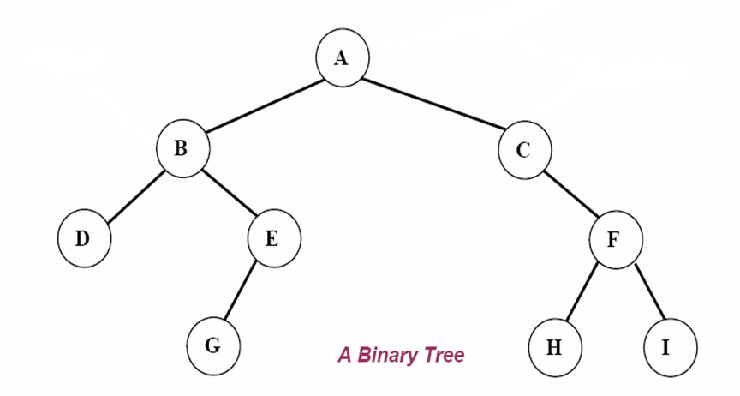
Binary Tree - Basics
root
left subtree
right subtree

Slide 3
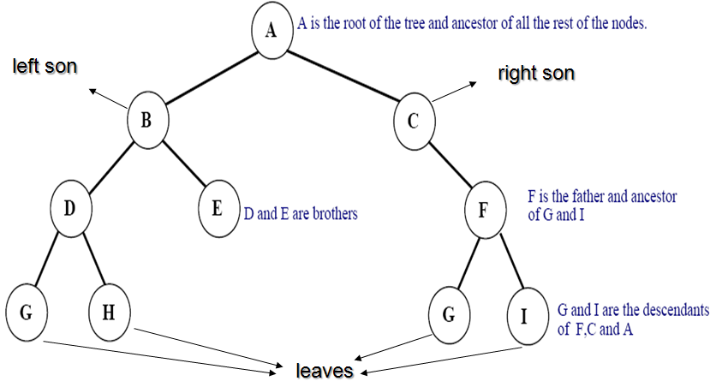
Binary Tree Basics

Slide 4
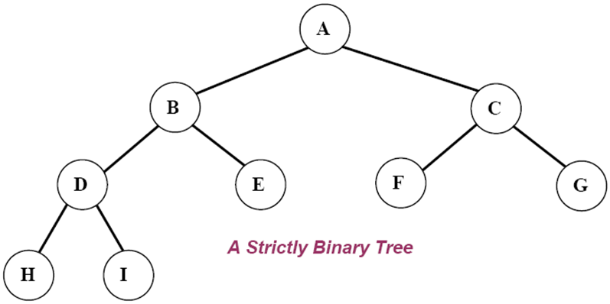
Strictly Binary Tree
If every non-leaf node in a binary tree has nonempty left and right subtrees, the tree is called a strictly binary tree.

Slide 5
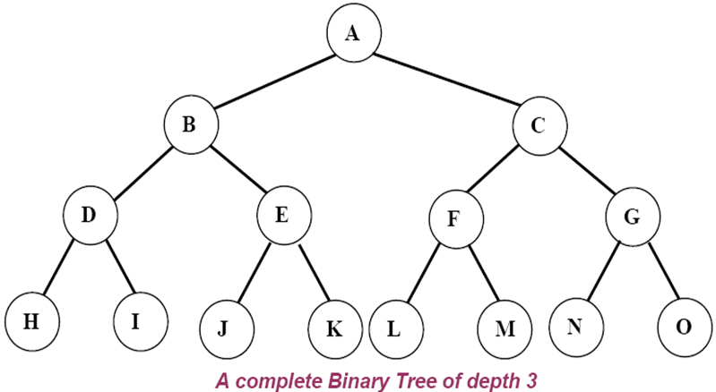
Complete Binary Tree
A complete binary tree of depth d is the strictly binary all of whose leaves are at level d
A complete binary tree with depth d has 2^{d} leaves and 2^{d}-1 non-leaf nodes

Slide 6
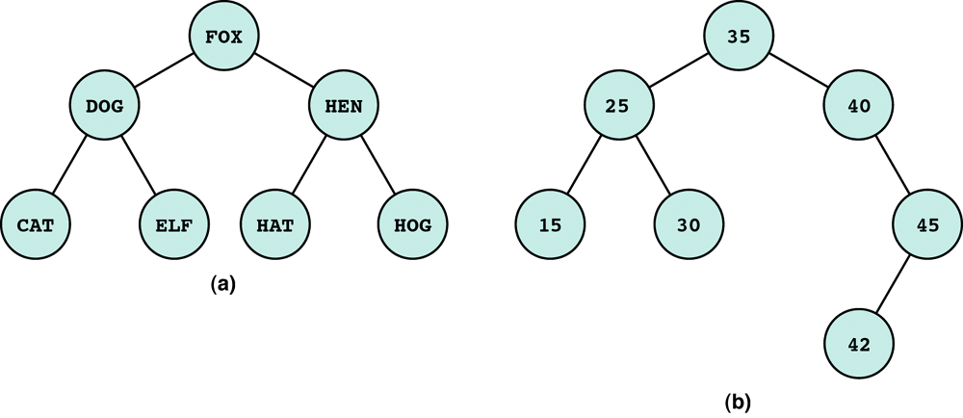
Binary Tree
We can extend the concept of linked list to binary trees which contains two pointer fields.
Leaf node: a node with no successors
Root node: the first node in a binary tree.
Left/right subtree: the subtree pointed by the left/right pointer.

Slide 7
Binary Tree - Linked Representation
struct tnode {
int data;
tnode *left, *right;
};
data
left
data
right
left
right

Slide 8
Binary Tree - Operations
insert(ptnode p, int x) – sets the left child
Binary Tree Traversal
PreOrder preOrder(ptnode tree)
Post Order postOrder(ptnode tree)
InOrder inOrder(ptnode tree)

Slide 9
PreOrder Traversal (Depth-first order)
1. Visit the root.
2. Traverse the left subtree in preorder.
3. Traverse the right subtree in preorder.
void preOrder(tnode tree) {
if(tree != NULL) {
printf(“%d\n”, tree->data); // Visit the root
preOrder(tree->left); //Recursive preOrder traverse
preOrder(tree->right); //Recursive preOrder traverse
}
}

Slide 10
InOrder Traversal (Symmetric order)
1. Traverse the left subtree in inOrder.
2. Visit the root
3. Traverse the right subtree in inOrder.
void inOrder(tnode tree) {
if(tree != NULL) {
inOrder(tree->left); //Recursive inOrder traverse
printf(“%d\n”, tree->data); // Visit the root
inOrder(tree->right); //Recursive inOrder traverse
}
}

Slide 11
PostOrder Traversal
1. Traverse the left subtree in postOrder.
2. Traverse the right subtree in postOrder.
3. Visit the root.
void postOrder(tnode tree) {
if(tree != NULL) {
postOrder(tree->left); //Recursive postOrder traverse
postOrder(tree->right); //Recursive postOrder traverse
printf(“%d\n”, tree->data); // Visit the root
}
}

Slide 12
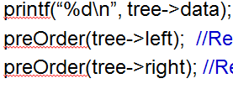
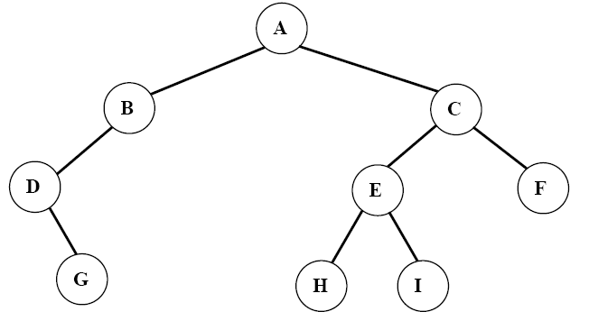
PreOrder Traversal - Trace
Preorder: ABDGCEHIF

Slide 13
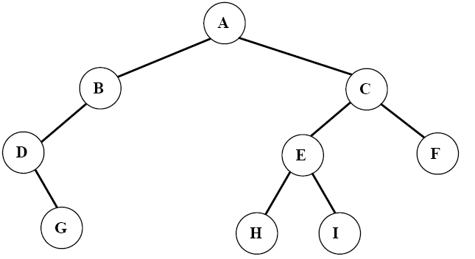
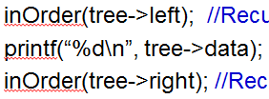
InOrder Traversal - Trace
Inorder: DGBAHEICF

Slide 14

PostOrder Traversal - Trace
Postorder: GDBHIEFCA

Slide 15
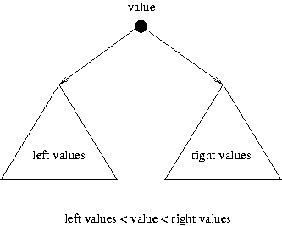
Binary Search Tree - Application
An application of Binary Trees
Binary Search Tree (BST) or Ordered Binary Tree has the property that
All elements in the left subtree of a node N are less than the contents of N and
All elements in the right subtree of a node N are greater than or equal to the contents of N

Slide 16
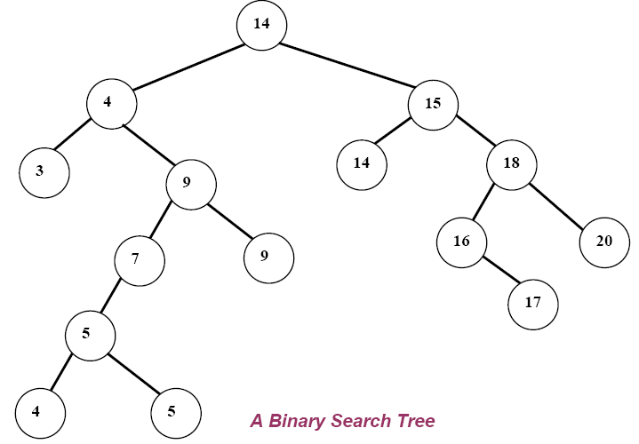
Binary Search Tree
Given the following sequence of numbers,
14, 15, 4, 9, 7, 18, 3, 5, 16, 4, 20, 17, 9, 14, 5
The following binary search tree can be constructed.

Slide 17
Binary Search Tree
The inorder (left-root-right) traversal of the above Binary Search Tree and printing the info part of the nodes gives the sorted sequence in ascending order
Therefore, the Binary search tree approach can easily be used to sort a given array of numbers

Slide 18
Binary Search Tree
The inorder traversal on the Binary Search Tree is:
3, 4, 4, 5, 5, 7, 9, 9, 14, 14, 15, 16, 17, 18, 20

Slide 19
Searching Through Binary Search Tree
The recursive function
BinSearch(ptnode P, int key)
can be used to search for a given key element in a given array of integers
The array elements are stored in a binary search tree
Note that the function returns
TRUE (1) if the searched key is a member of the array and
FALSE (0) if the searched key is not a member of the array

Slide 20
BinSearch() Function
int BinSearch( ptnode p, int key ) {
if ( p == NULL )
return FALSE;
else {
if ( key == p->data )
return TRUE;
else {
if ( key < p->data )
return BinSearch(p->left, key);
else
return BinSearch(p->right, key);
}
}
} // end of function

Slide 21
Application of Binary Search Tree - 1
Suppose that we wanted to find all duplicates in a list of numbers
One way of doing this to compare each number with all those that precede it
However this involves a large number of comparison
The number of comparison can be reduced by using a binary tree

Slide 22
Application of Binary Search Tree
The first number in the list is placed in a node that is the root of the binary tree with empty left and right sub-trees
The other numbers in the list is than compared to the number in the root
If it is matches, we have duplicate
If it is smaller, we examine the left sub-tree
if it is larger we examine the right sub-tree
If the sub-tree is empty, the number is not a duplicate and is placed into a new node at that position in the tree
If the sub-tree is nonempty, we compare the number to the contents of the root of the sub-tree and the entire process is repeated with the sub-tree
A program for doing this follows

Slide 23
Binary Search Tree
A binary search tree is either empty or has the property that the item in its root has
a larger key than each item in the left subtree, and
a smaller key than each item in its right subtree.

Slide 24
Binary Search Tree (BST) - Example
10
root
7
14
5
9
16
leaf
2
6
8
leaf
leaf
leaf

Slide 25
Operations on BST
10
Search
Minimum
Maximum
Predecessor
Successor
Insert
Delete
7
14
5
9
16
2
6
8

Slide 26
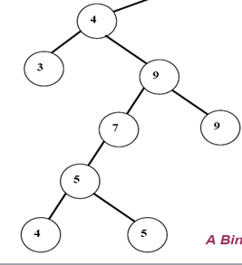
Binary Search Tree Property
10
x
7
14
5
9
z
16
y
For any node x
let y be a node in the left subtree of x, then key[y] < key[x].
If z is a node in the right subtree of x, then key[x]≤key[z].
2
6
8

Slide 27
Binary Search Tree Traversals
10
Inorder
Preorder
Postorder
7
14
5
9
16
2
6
8

Slide 28
BST – InOrder Traversal
Inorder(node x)
If x ≠ NIL
Inorder(x→left)
print(x)
Inorder(x→right)
10
7
14
5
9
16
2
6
8
2, 5, 6, 7, 8, 9, 10, 14, 16
(that’s exactly the sorted ordering!)

Slide 29
BST – PreOrder Traversal
Preorder(node x)
If x ≠ NIL
print(x)
Preorder(x→left)
Preorder(x→right)
10
7
14
5
9
16
2
6
8
10, 7, 5, 2, 6, 9, 8, 14, 16

Slide 30
BST – PostOrder Traversal
Postorder(node x)
If x ≠ NIL
Postorder(x→left)
Postorder(x→right)
print(x)
10
7
14
5
9
16
2
6
8
2, 6, 5, 8, 9, 7, 16, 14, 10

Slide 31
Minimum and Maximum
Minimum(node x)
while x → left ≠ NIL
do x = x→left
return x
Maximum(node x)
while x → right ≠ NIL
do x = x→right
return x
10
7
14
5
9
16
2
6
8

Slide 32
BST - Search
Recursive
Search(node x, k)
if x == NIL or k ==key[x]
then return x
if k < key[x]
then return Search(x→left,k)
else return Search(x→right,k)
Iterative
Search(node x,k)
while x≠NIL and k≠key[x]
if k < key[x]
then x ← x→left
else x ← x→right
return x
x
10
7
14
5
9
16
k=11?
2
6
8
k=6

Slide 33
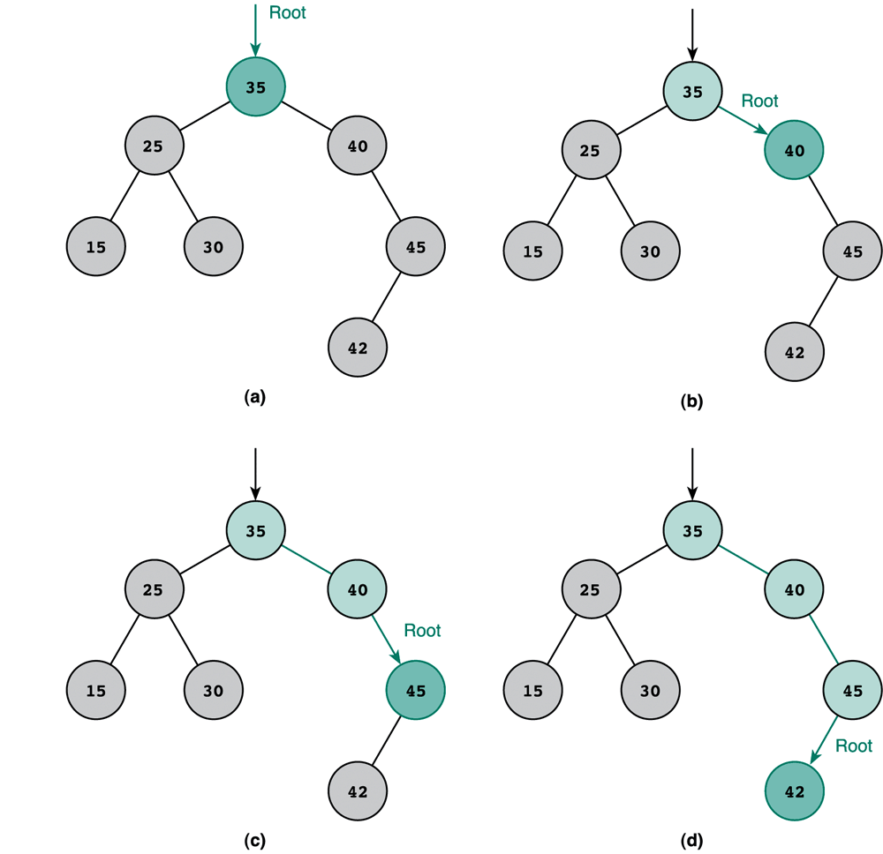
BST- Search Trace
Key is 42
Recursive
Search(node x, k)
if x == NIL or k ==key[x]
then return x
if k < key[x]
then Search(x→left,k)
else Search(x→right,k)
Iterative
Search(node x, k)
while x≠NIL and k≠key[x]
if k < key[x]
then x ← x→left
else x ← x→right
return x

Slide 34
Successor
Def: successor (x ) = y, such that key [y] is the smallest key > key [x]
E.g.: successor (15) =17
successor (13) =15
successor (9) =13
Case 1: right (x) is non empty
successor (x ) = the minimum in right (x) including parent.
Right is leaf, then right is successor
Case 2: right (x) is empty
Find the current node that is a left child by moving in a tree up:
successor (x ) is the parent of the current node
if you cannot go further (and you reached the root): x is the largest element
15
6
18
3
7
17
20
2
4
13
9

Slide 35
Successor
Def: successor (x ) = y, such that key [y] is the smallest key > key [x]
E.g.: successor (4) =
successor (17) =
successor (20) =
successor (18) =
successor (2) =
successor (3) =
successor (6) =
6
15
18
20
6
18
20
3
7
17
20
3
2
4
13
4
9
7
Successor of 4 is 6 using case-II part I.
Successor of 17 is 18 using case-II part I.
Successor of 20 is 20 using case-II part II.
Successor of 18 is 20 using case-I part II.
Successor of 2 is 3 using case-II part I.
Successor of 3 is 4 using case-II part I.
Successor of 6 is 7 using case-II part I.
Notes:
Parent of 7 is smallest in its right since its right is non-empty

Slide 36
Predecessor
Def: predecessor (x ) = y, such that key [y] is the biggest key < key [x]
E.g.: predecessor (15) =
predecessor (9) =
predecessor (13) =
Case 1: left (x) is non empty
predecessor (x ) = the maximum in left (x)
left is leaf, then left is predecessor
Case 2: left (x) is empty
Find the current node is a right child by moving up in tree
: predecessor (x ) is the parent of the current node
if you cannot go further (and you reached the root): x is the smallest element
15
13
7
6
18
9
3
7
17
20
2
4
13
9

Slide 37
Predecessor
Def: successor (x ) = y, such that key [y] is the biggest key < key [x]
E.g.: predecessor(4) =
predecessor (7) =
predecessor (20) =
predecessor (13) =
predecessor (18) =
predecessor (2) =
predecessor (3) =
predecessor (6) =
predecessor (9) =
predecessor (17) =
predecessor (9) =
3
15
6
18
6
18
9
3
7
17
20
17
2
4
13
2
9
2
4
7
15
7
predecessor of 4 is 3 using case-II part I. predecessor of 7 is 6 using case-II part I.
predecessor of 20 is 18 using case-II part I. predecessor of 13 is 7 using case-II part I.
predecessor of 18 is 15 using case-II part I. predecessor of 2 is 2 using case-II part II.
predecessor of 3 is 2 using case-II part I. Etc etc

Slide 38
Building a Binary Search Tree
If the tree is empty
Insert the new key in the root node
else if the new key is smaller than root’s key
Insert the new key in the left subtree
else
Insert the new key in the right subtree (also inserts the equal key)
The parent field will also be stored along with the left and right child

Slide 39
BST - Insertion
10
7
14
5
9
16
2
6
8
9.5
z
Insert a new node z with key[z]=v into a tree T

Slide 40
BST - Insertion
x
Insert(T,z)
y ← NIL
x ← root(T)
While x ≠ NIL
y ← x
if key[z] < key[x]
then x ← x→left
else x ← x→right
z→p ← y
10
7
14
5
9
16
2
6
8
9.5
z

Slide 41
BST - Insertion
y
Insert(T,z)
y ← NIL
x ← root(T)
While x ≠ NIL
y ← x
if key[z] < key[x]
then x ← x→left
else x ← x→right
z→p ← y
10
x
7
14
5
9
16
2
6
8
9.5
z

Slide 42
BST - Insertion
y
Insert(T,z)
y ← NIL
x ← root(T)
While x ≠ NIL
y ← x
if key[z] < key[x]
then x ← x→left
else x ← x→right
z→p ← y
10
7
x
14
5
9
16
2
6
8
9.5
z

Slide 43
BST - Insertion
Insert(T,z)
y ← NIL
x ← root(T)
While x ≠ NIL
y ← x
if key[z] < key[x]
then x ← x→left
else x ← x→right
z→p ← y
10
y
7
x
14
5
9
16
2
6
8
9.5
z

Slide 44
BST - Insertion
Insert(T,z)
y ← NIL
x ← root(T)
While x ≠ NIL
y ← x
if key[z] < key[x]
then x ← x→left
else x ← x→right
z→p ← y
10
y
7
14
5
9
x
16
2
6
8
9.5
z

Slide 45
BST - Insertion
Insert(T,z)
y ← NIL
x ← root(T)
While x ≠ NIL
y ← x
if key[z] < key[x]
then x ← x→left
else x ← x→right
z→p ← y
10
7
14
y
5
9
16
x ← NIL
2
6
8
9.5
z

Slide 46
BST - Insertion
Insert(T,z)
y ← NIL
x ← root(T)
While x ≠ NIL
y ← x
if key[z] < key[x]
then x ← x→left
else x ← x→right
z→p ← y
10
7
14
y
5
9
16
2
6
8
9.5
z
Parent of z is assigned the value of y

Slide 47
BST - Insertion
Insert(T,z)
y ← NIL
x ← root(T)
While x ≠ NIL
y ← x
if key[z] < key[x]
then x ← x→left
else x ← x→right
z→p ← y
If x = NIL then root[T]←z
else if key[z] < key [y]
then y→left ← z
else y→right ← z
10
7
14
y
5
9
16
2
6
8
9.5
z

Slide 48
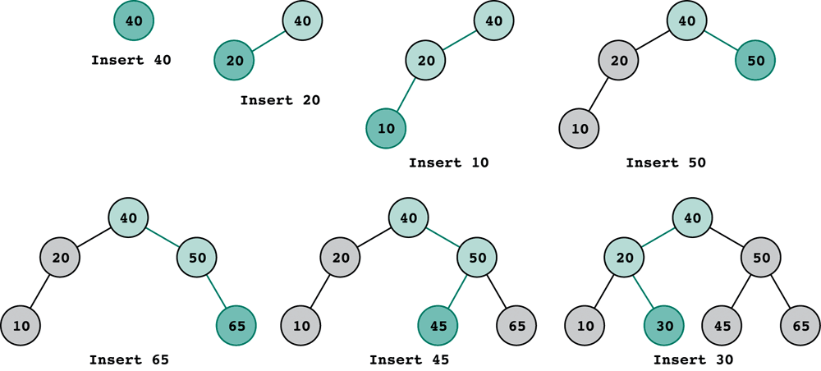
Building a Binary Search Tree
Assume 40, 20, 10, 50, 65, 45, 30 are inserted in order.

Slide 49
Deletion – 3 Cases
10
z
z
7
14
5
9
16
Deleting a leaf node (6)
Deleting a root node of a subtree (14) having one child
Deleting a root node of a subtree (7) having two children
2
6
8
z

Slide 50
Deletion of a Leaf Node
10
7
14
5
9
16
X
2
6
8
z

Slide 51
Delete a Root Node Having One Child
10
X
z
7
14
X
5
9
16
2
6
8

Slide 52
Delete a Root Node having 2 Children
10
z
7
14
5
9
16
2
6
8
Find the successor y of z
Replace z with y
Delete y (careful, as y might have a right child)

Slide 53
Delete a Root Node having 2 Children
10
z
8
14
5
9
16
X
X
2
6
8
Find the successor y of z
Replace z with y
Delete y (careful, as y might have a right child)

Slide 54
Deletion – Algorithm
1. if z→left=NIL or z→right=NIL
then y ← z
else y ← Successor(z)
4. if y→left≠NIL
then x ← y→left
else x ← y→right
7. if x ≠ NIL
then x→p ← y→p
9. if y→p = NIL
10. then root[T] ← x
else if y = (y→p)→left
then (y→p)→left ← x
else (y→p)→right ← x
7. if x = NIL
if y = (y→p)→left
then (y→p)→left ← NULL
else (y→p)→right ← NULL
14.if y≠z
then k=key[z] (Replace)
key[z] ← key[y] && key[y]= k
call delete function again for node y
10
z
z
7
14
5
9
16
2
6
8
z
8.5

Slide 55
Deletion – Algorithm
1. if z→left=NIL or z→right=NIL
then y ← z
else y ← Successor(z)
4. if y→left≠NIL
then x ← y→left
else x ← y→right
7. if x ≠ NIL
then x→p ← y→p
9. if y→p = NIL
10. then root[T] ← x
else if y = (y→p)→left
then (y→p)→left ← x
else (y→p)→right ← x
7. if x = NIL
if y = (y→p)→left
then (y→p)→left ← NULL
else (y→p)→right ← NULL
14.if y≠z
then k=key[z] (Replace)
key[z] ← key[y] && key[y]= k
call delete function again for node y
10
z
z
7
14
y
5
9
16
2
6
8
y
z
8.5
y

Slide 56
Deletion – Algorithm
1. if z→left=NIL or z→right=NIL
then y ← z
else y ← Successor(z)
4. if y→left≠NIL
then x ← y→left
else x ← y→right
7. if x ≠ NIL
then x→p ← y→p
9. if y→p = NIL
10. then root[T] ← x
else if y = (y→p)→left
then (y→p)→left ← x
else (y→p)→right ← x
7. if x = NIL
if y = (y→p)→left
then (y→p)→left ← NULL
else (y→p)→right ← NULL
14.if y≠z
then k=key[z] (Replace)
key[z] ← key[y] && key[y]= k
call delete function again for node y
10
z
z
7
14
y
5
9
16
x
2
6
8
y
z
8.5
x
y
x = NIL

Slide 57
Deletion – Algorithm
1. if z→left=NIL or z→right=NIL
then y ← z
else y ← Successor(z)
4. if y→left≠NIL
then x ← y→left
else x ← y→right
7. if x ≠ NIL
then x→p ← y→p
9. if y→p = NIL
10. then root[T] ← x
else if y = (y→p)→left
then (y→p)→left ← x
else (y→p)→right ← x
7. if x = NIL
if y = (y→p)→left
then (y→p)→left ← NULL
else (y→p)→right ← NULL
14.if y≠z
then k=key[z] (Replace)
key[z] ← key[y] && key[y]= k
call delete function again for node y
10
z
z
7
y
14
5
9
16
x
2
6
8
y
z
8.5
x
y
x = NIL

Slide 58
Deletion – Algorithm
1. if z→left=NIL or z→right=NIL
then y ← z
else y ← Successor(z)
4. if y→left≠NIL
then x ← y→left
else x ← y→right
7. if x ≠ NIL
then x→p ← y→p
9. if y→p = NIL
10. then root[T] ← x
else if y = (y→p)→left
then (y→p)→left ← x
else (y→p)→right ← x
7. if x = NIL
if y = (y→p)→left
then (y→p)→left ← NULL
else (y→p)→right ← NULL
14.if y≠z
then k=key[z] (Replace)
key[z] ← key[y] && key[y]= k
call delete function again for node y
10
X
z
z
7
y
14
X
5
9
16
x
X
2
6
8
y
8.5
x

Slide 59
Deletion – Algorithm
1. if z→left=NIL or z→right=NIL
then y ← z
else y ← Successor(z)
4. if y→left≠NIL
then x ← y→left
else x ← y→right
7. if x ≠ NIL
then x→p ← y→p
9. if y→p = NIL
10. then root[T] ← x
else if y = (y→p)→left
then (y→p)→left ← x
else (y→p)→right ← x
7. if x = NIL
if y = (y→p)→left
then (y→p)→left ← NULL
else (y→p)→right ← NULL
14.if y≠z
then k=key[z] (Replace)
key[z] ← key[y] && key[y]= k
call delete function again for node y
10
z
z
8
y
14
5
9
16
x
2
6
7
y
8.5
x

Slide 60
Deletion – Algorithm
1. if z→left=NIL or z→right=NIL
then y ← z
else y ← Successor(z)
4. if y→left≠NIL
then x ← y→left
else x ← y→right
7. if x ≠ NIL
then x→p ← y→p
9. if y→p = NIL
10. then root[T] ← x
else if y = (y→p)→left
then (y→p)→left ← x
else (y→p)→right ← x
7. if x = NIL
if y = (y→p)→left
then (y→p)→left ← NULL
else (y→p)→right ← NULL
14.if y≠z
then k=key[z] (Replace)
key[z] ← key[y] && key[y]= k
call delete function again for node y
10
z
z
7
y
14
5
9
16
x
2
6
8
y
8.5
x

Slide 61
Deletion – Algorithm
1. if z→left=NIL or z→right=NIL
then y ← z
else y ← Successor(z)
4. if y→left≠NIL
then x ← y→left
else x ← y→right
7. if x ≠ NIL
then x→p ← y→p
9. if y→p = NIL
10. then root[T] ← x
else if y = (y→p)→left
then (y→p)→left ← x
else (y→p)→right ← x
7. if x = NIL
if y = (y→p)→left
then (y→p)→left ← NULL
else (y→p)→right ← NULL
14.if y≠z
then k=key[z] (Replace)
key[z] ← key[y] && key[y]= k
call delete function again for node y
10
z
z
7
y
5
9
16
x
2
6
y
8.5
x

Slide 62
Tree Rotation
Tree rotation is an operation on a binary tree that changes the structure without interfering with the order of the elements
A tree rotation moves one node up in the tree and one node down
It is used to change the shape of the tree, and in particular to decrease its height by moving smaller subtrees down and larger subtrees up
Thus resulting in improved performance of many tree operations

Slide 63
Tree Rotation
Single right rotation
3
2
2
1
3
1

Slide 64
Tree Rotation Example
Left side single rotation
5
5
3
6
2
6
2
1
3
Grand father have only one child, so rotate it
Grand father is now at his right child’s place
1

Slide 65
Tree Rotation Example
Right Side Single rotation
5
5
3
8
3
6
6
9
1
1
8
Grand father have only one child, so rotate it
9

Slide 66
Summary
Operations on Binary Tree
Binary Tree Traversal
InOrder, PreOrder and PostOrder
Binary Search Tree (BST)
Concept and Example
BST Operations
Minimum and Maximum
Successor and Predecessor
BST Traversing
InOrder, PreOrder and PostOrder
Insertion and Deletion

