Slide 1
Course: Data Structure(CS-204)
BS IT
Instructor: Fakhera Nazir
Email: fakhera.nazir@uog.edu.pk

Slide 2
Objectives Overview
Doubly Linked List
Concepts
Double List Operations
Insert
Delete

Slide 3
Singly Linked List (SLL) - More Terminology
A node’s successor is the next node in the sequence
The last node has no successor
A node’s predecessor is the previous node in the sequence
The first node has no predecessor
A list’s length is the number of elements in it
A list may be empty (contain no elements)
Head
87
34
78
65

Slide 4
Doubly Linked List (DLL)
In a singly linked list (SLL) one can move beginning from the head node to any node in one direction only (from left to right)
SLL is also termed as one –way list
On the other hand, Doubly Linked List (DLL) is a two-way list
One can move in either direction from left to right and from right to left
This is accomplished by maintaining two linked fields instead of one as in a SLL

Slide 5
Motivation
Doubly linked lists are useful for playing video and sound files with “rewind” and “instant replay”
They are also useful for other linked data which require “rewind” and “fast forward” of the data

Slide 6
Doubly Linked List
Each node on a list has two pointers.
A pointer to the next element.
A pointer to the previous element
The beginning and ending nodes' previous and next links, respectively, point to some kind of terminator, typically a sentinel node or null, to facilitate traversal of the list
…
…
…
…

Slide 7
Doubly-Linked Lists (DLL)
Here is a doubly-linked list (DLL):
Head
56
67
93
Each node contains a value, a link to its successor (if any), and a link to its predecessor (if any)
The header points to the first node in the list and to the last node in the list (or contains null links if the list is empty)

Slide 8
Doubly Linked Lists
In a Doubly Linked List each item points to both its predecessor and successor
prev points to the predecessor
next points to the successor
10
20
40
55
70
Head
Cur->prev
Cur
Cur->next

Slide 9
DLLs compared to SLLs
Advantages:
Can be traversed in either direction (may be essential for some programs)
Some operations, such as deletion and inserting before a node, become easier
Disadvantages:
Requires more space to store backward pointer
List manipulations are slower
because more links must be changed
Greater chance of having bugs
because more links must be manipulated

Slide 10
Double Linked List – Definition in C++
struct Node{
int data;
struct Node* next;
struct Node* prev;
} *Head;

Slide 11
Operations on DLL
The two node links allow traversal of the list in either direction
While adding or removing a node in a doubly linked list requires changing more links than the same operations on a singly linked list
The operations are simpler and potentially more efficient (for nodes other than first nodes)
because there is no need to keep track of the previous node during traversal or
no need to traverse the list to find the previous node, so that its link can be modified

Slide 12
Doubly Linked List Operations
insertNode(int item)
//add new node to ordered doubly linked list
deleteNode(int item)
//remove a node from doubly linked list
searchNode(int item)
print()

Slide 13
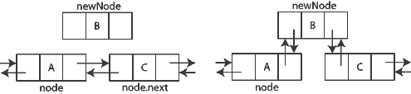
DLL - Insertion

Slide 14
Inserting a Node
Insert a node NewNode before Cur (not at front or rear)
NewNode->next = Cur;
NewNode->prev = Cur->prev;
Cur->prev = NewNode;
(NewNode->prev)->next = Newnode;
10
20
55
70
40
Head
Cur
NewNode

Slide 15
Doubly – Linked List
DELETE:
Pointer change for implementation of a Deletion

Slide 16
Deleting a node from a DLL
Node deletion from a DLL involves changing two links
In this example, we will delete node 67
Head
56
67
93
We don’t have to do anything about the links in node 67
Deletion of the first node or the last node is a special case

Slide 17
Deleting a Node
Delete a node Cur (not at front or rear)
(Cur->prev)->next = Cur->next;
(Cur->next)->prev = Cur->prev;
delete Cur;
10
20
40
55
70
Head
Cur

Slide 18
Other operations on linked lists
Most “algorithms” on linked lists
such as insertion, deletion, and searching—are pretty obvious;
you just need to be careful
Sorting a linked list is just messy,
since you can’t directly access the n^{th} element
you have to count your way through a lot of other elements

Slide 19
Circular Linked lists
a
b
c
d
head
Insertion and Deletion implementation left as an exercise

Slide 20
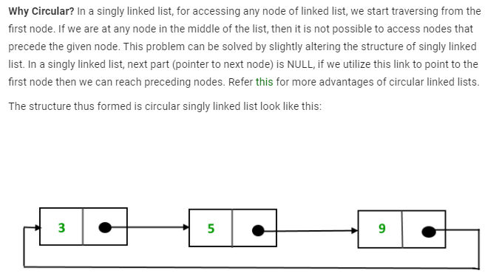
Usage

Slide 21
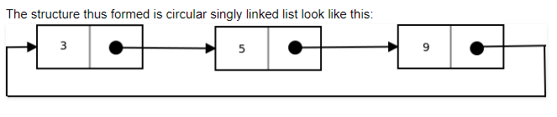
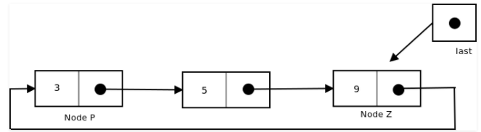
Concept

Slide 22
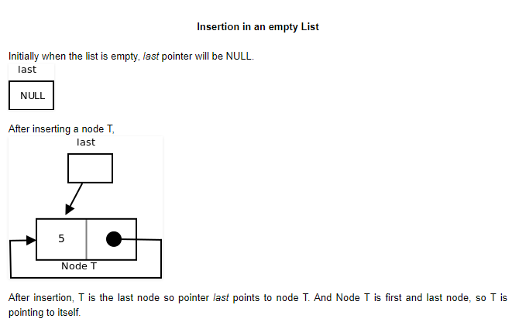
Activities

Slide 23
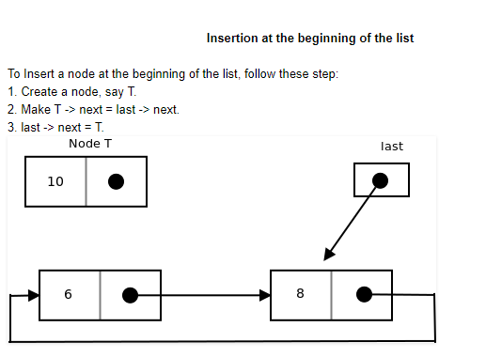

Slide 24
Self Learning
Insertion at the end of the list
Insertion in between the nodes

Slide 25

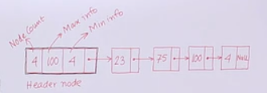
DLL with Dummy Head Node
To simplify insertion and deletion by avoiding special cases of deletion and insertion at front and rear, a dummy head node is added at the head of the list

Slide 26
Summary
Doubly Linked List
Concept
Operations on Doubly Linked List
Insertion
Deletion

Slide 27
Summary
Dynamic structure (Memory Allocated at run-time).
We can have more than one datatype.
Re-arrange of linked list is easy (Insertion-Deletion).
It doesn’t waste memory.

Slide 28
Summary
Disadvantages:
They have a tendency to waste memory due to pointers requiring extra storage space.
Nodes are stored in contiguously, greatly increasing the time required to access individual elements within the list.
Difficulties arise in linked lists when it comes to reverse traversing. Singly linked lists are extremely difficult to navigate backwards, and while doubly linked lists are somewhat easier to read, memory is wasted in allocating space for a back pointer.

Slide 29
Summary
Disadvantages of Linked Lists
In linked list, if we want to access any node it is difficult.
It is occupying more memory.

