Slide 1
Objectives Overview
Stacks
Concept
Stack Operations
Push and Pop
Stack Implementation
Static Array Based
Dynamic Linked List

Slide 2

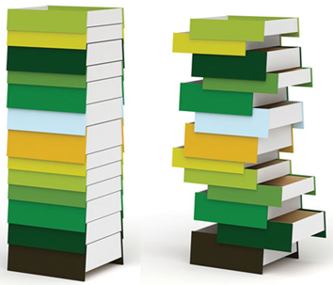
Stacks
Real Life Examples
Shipment in a Cargo
Plates on a tray
Stack of Coins
Stack of Drawers
Shunting of Trains in Railway Yard
Follows the Last-In First-Out (LIFO) strategy
2

Slide 3
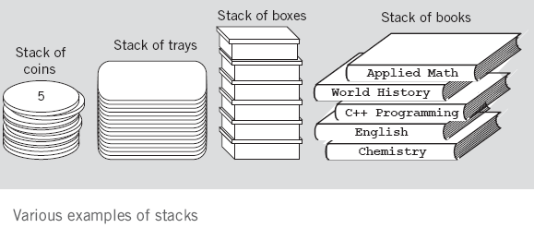
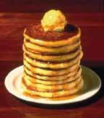
Stack Examples

Slide 4
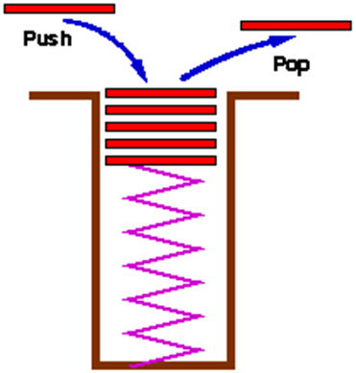
Stack
An ordered collection of homogeneous data elements where the insertions and deletions take place at one end only called Top
New elements are added or pushed onto the top of the stack
The first element to be removed or popped is taken from the top - the last one in

Slide 5
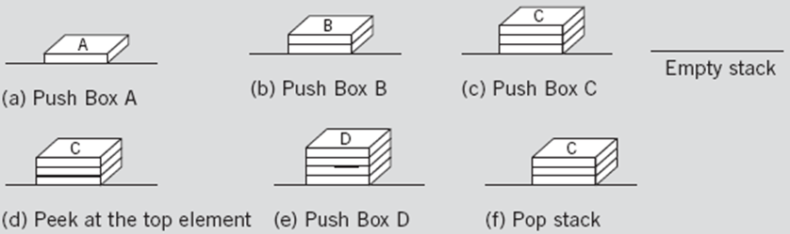
Stack Operations
Insertion
Deletion
Bottom Top

Slide 6
Stack Operations
A stack is generally implemented with only two principle operations
Push adds an item to a stack
Pop extracts the most recently pushed item from the stack
Other methods such as
Top returns the item at the top without removing it
Isempty determines whether the stack has anything in it

Slide 7
Common Stack Operations
MAKENULL(): Make Stack S be an empty stack.
TOP( ): Return the element at the top of stack .
POP( ): Remove the top element of the stack.
PUSH(x): Insert the element x at the top of the stack.
ISEMPTY() Return true if it is an empty stack; return false otherwise.

Slide 8
Stack Operations

Slide 9
Stack – Array Implementation
First Implementation
Elements are stored in contiguous cells of an array.
New elements can be inserted to the top of the list
First Element
Second Element
List
top
Last Element
Empty
maxlength

Slide 10
Push– Array Implementation
4
3
2
1
0
4
4
4
4
top
4
5
3
3
3
top
3
4
3
4
2
2
top
2
9
2
9
2
9
Push 8
Push 9
Push 7
Push 4
Push 5
1
1
8
1
8
1
8
1
8
top
top
0
7
0
7
0
7
0
7
0
7
Empty stack
StackSize = 5
top = -1
top = StackSize – 1,
Stack is full,
We can’t push more elements

Slide 11
Push – Array Implementation
void push(int element)
{
if (top == StackSize – 1)
cout<<“stack is full”;
else
Stack[++top] = element;
}

Slide 12
Pop – Array Implementation
top
4
3
2
1
0
4
5
4
4
4
4
3
4
top
3
4
3
3
3
2
9
2
9
top
2
9
2
2
Pop
Pop
Pop
Pop
Pop
1
8
1
8
1
8
1
8
1
top
0
7
0
7
0
7
0
7
top
0
7
Empty stack top = -1
We can’t pop more
elements
top = StackSize – 1,
Stack is full,
We can’t push more elements.

Slide 13
Pop – Array Implementation
int pop( )
{
if (top == –1)
cout<<“stack is empty”;
else
return Stack[top--];
}

Slide 14
Other Stack Operations
//returns the top element of stack without removing it
int top () {
if (top == –1)
cout<<“stack is empty”;
else
return Stack[top]; }
int isEmpty() { //checks stack is empty or not
if (top == –1)
return 1;
else
return 0; }

Slide 15
Stack – Linked Representation
PUSH and POP operate only on the header cell and the first cell on the list
struct Node{
int data;
Node* next;
} *top;
top = NULL;
Top
7
8
9

Slide 16
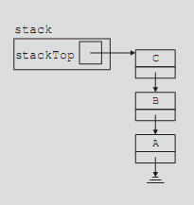
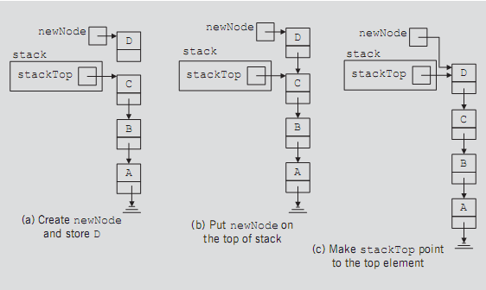
Push Operation - Trace

Slide 17
Push operation - Algorithm
void push (int item) {
Node *newNode;
// Insert at Front of the list
newNode->data = item;
newNode->next = top;
top = newNode;
}

Slide 18
Pop Operation - Algorithm
int pop () {
Node *temp; int val;
if (top == NULL)
return -1;
else { // delete the first node of the list
temp = top;
top = top->next;
val = temp->data;
delete temp;
return val;
}
}

Slide 19
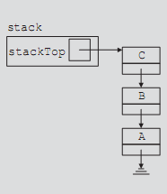
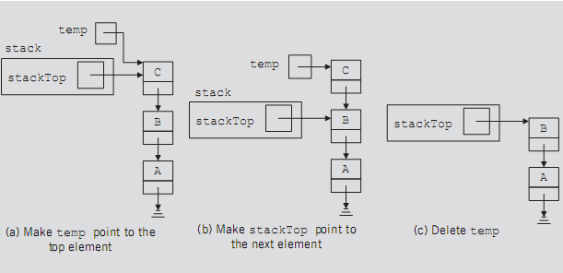
Pop Operation - Trace

Slide 20
Practice Excercises
1- Circular Singly Linked List
Insertion at the beginning
Insertion at the end
Insertion at the middle
1- Circular Doubly Linked List
Insertion of first element,
Insertion at the beginning
Insertion at the end
Insertion at the middle
Write functions for top() and IsEmpty() for stack using linked list.

