Slide 1
Objectives Overview
Queues
Concept
Operations on Queues
Insertion
Deletion
Traversing
Search
Implementation Code

Slide 2
Problem to be Solved
It is so often necessary to wait one’s turn before having access to something.
We may want to simulate a real life situation of a waiting line, like
A line of people waiting to purchase tickets, where the first person in line is the first person served.
With in a computer system there may be lines of tasks
Waiting for the printer
Waiting for access to disk storage
Or in a time sharing system for use of the CPU.
The data structures used to solve this type of problems is called Queue

Slide 3
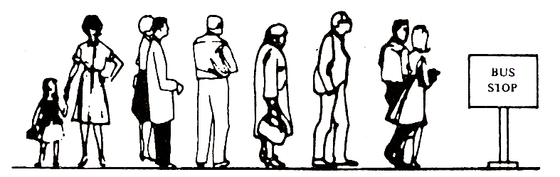
Queue
A linear list in which items may be added only at one end and items may be removed-only at the other end
The name "queue" likely comes from the everyday use of the term e.g. queue at Bus Stop
Another example of a queue is a batch of jobs waiting to be processed, assuming no job has higher priority than the others

Slide 4
Queue
We define a queue to be a list in which
All additions to the list are made at one end, and
All deletions from the list are made at the other end
Queues are also called First-In, First-Out lists, or FIFO for short.
The entry in a queue ready to be served, will be
the first entry that will be removed from the queue,
We call this the front of the queue.
The last entry in the queue is the one most recently added, we call this the rear of the queue

Slide 5
Queue
Deletion (Dequeue) can take place only at one end, called the front
Insertion (Enqueue) can take place only at the other end, called the rear
The general Queue model is
Queue Q
Dequeue( ) Enqueue (x)
5

Slide 6
Graphic Model of Queue
Rear:
All new items
are added on
this end
Head:
All items are
deleted from
this end

Slide 8
Common Operations on Queue
Create an empty queue
Destroy a queue
Determine whether a queue is empty
Add a new item to the queue
Remove the item that was added earliest

Slide 9
Common Operations on Queue
MAKENULL(): Makes Queue be an empty list.
FRONT(): Returns the first element on Queue .
ENQUEUE(x): Inserts element x at the end of Queue .
DEQUEUE(): Deletes the first element of Queue.
EMPTY(): Returns true if and only if Queue is an empty queue.

Slide 10
Representation of Queue
Static
Queue is implemented by an array and
the size of the queue remains fix
Dynamic
A queue can be implemented as a linked list and
expand or shrink with each enqueue or dequeue operation
10

Slide 11
Queue – Array representation
Maintained by a linear array QUEUE and
Two variables:
FRONT containing the location of the front element of the queue; and
REAR, containing the location of the rear element of the queue
Condition FRONT = -1 will indicate that the queue is empty
whenever an element is deleted from the queue, FRONT = FRONT + 1
whenever an element is added to the queue, REAR = REAR +1

Slide 12
Queue – Array representation
After N insertions, the rear element of the queue will occupy QUEUE [N] or,
eventually the queue will occupy the last part of the array
This occurs even through the queue itself may not contain many elements
Suppose we want to insert an element ITEM into a queue at the time the queue does occupy the last part of the array, i.e., when REAR = N
One way to do this is to simply move the entire queue to the beginning of the array, changing FRONT and REAR accordingly, and then inserting ITEM as above
This procedure may be very expensive.

Slide 13
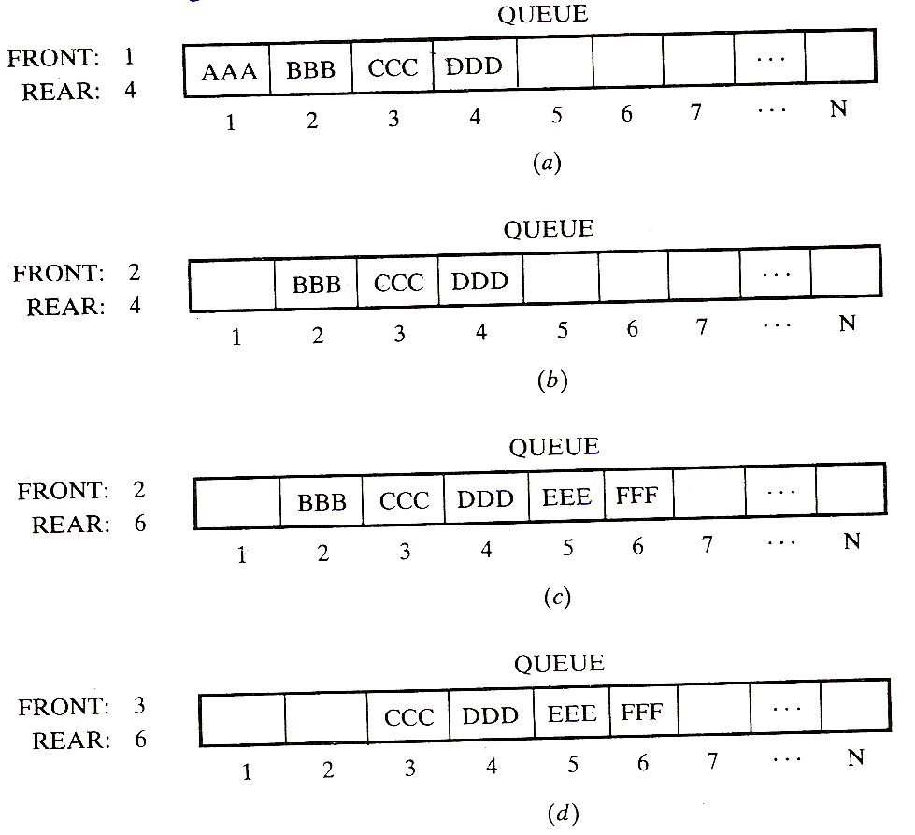
Queue – Array representation

Slide 14
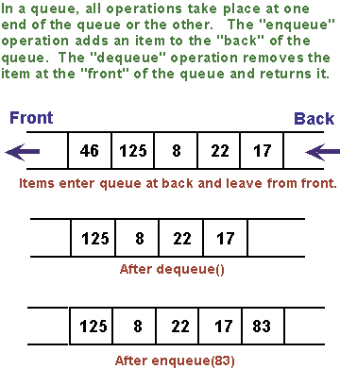
Enqueue and Dequeue Operations

Slide 15
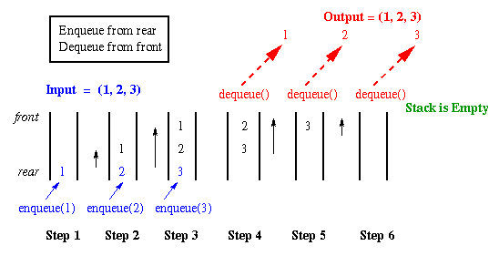

Slide 16
Array Representation
When queue is empty both front and rear are set to -1
While enqueueing increment rear by 1, and while dequeueing increment front by 1
When there is only one value in the Queue, both rear and front have same index
Front
First Element
Second Element
Rear
Last Element
maxlength

Slide 17
Array Implementation
5
4
6
7
8
7
6
0 1 2 3 4 5 6 7 8
Front=0
Rear=6
8
7
6
0 1 2 3 4 5 6 7 8
Front=4
Rear=6
7
6
12
67
0 1 2 3 4 5 6 7 8
Front=5
Rear=8
How can we insert more elements? Rear index can not move beyond the last element….

Slide 18
Queue – Linked Representation
Assume that front and rear are the two pointers to the front and rear nodes of the queue
struct Node{
int data;
Node* next;
} *front, *rear;
front = NULL;
Rear = NULL;

Slide 19
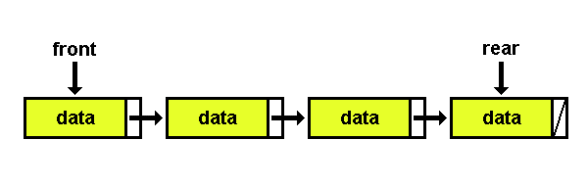
Queue – Linked Representation

Slide 20
Implementing Queue – Linked List
front
rear
front
rear
1
7
5
2
1
7
5
2
dequeue()
front
rear
front
rear
7
5
2
1
7
5
2
enqueue(9)
front
rear
front
rear
7
5
2
9
7
5
2
9

Slide 21
Enqueue Operation - Algorithm
//(linked list) enqueue:
Make newNode point at a new node allocated from heap
Copy new data into node newNode
Set newNode's pointer next field to NULL
Set the next in the rear node to point to newNode
Set rear = newNode;

Slide 22
Implementing Enqueue Operation
void enqueue(int x){
Node* newNode;
newNode = new Node;
newNode->data = x;
newNode->next = NULL;
if (rear == NULL) { // queue is empty
rear = newNode;
front = rear; }
else {
rear->next = newNode;
rear = newNode; }
}

Slide 23
Dequeue Operation - Algorithm
//(linked list) dequeue:
If front is NULL then message “Queue is Empty”
Else
copy front to a temporary pointer
Set front to the next of the front
Delete the temporary pointer

Slide 24
Implementing Dequeue Operation
void dequeue() {
Node *p; // temporary pointer
if (front ==NULL)
cout<< “Queue is Empty”;
else {
p = front;
front = front->next;
if (front == NULL)
rear = NULL;
delete p;
}
}

Slide 25
Implementing Queue operations
int front() {
if (front == NULL)
return 0;
else
return front->data;
}
int isEmpty() {
if (front == NULL)
return 1;
else
return 0;
}

Slide 26
Summary
Queues
Concept
Operations on Queues
Insertion
Deletion
Traversing
Search
Implementation Code

Slide 27
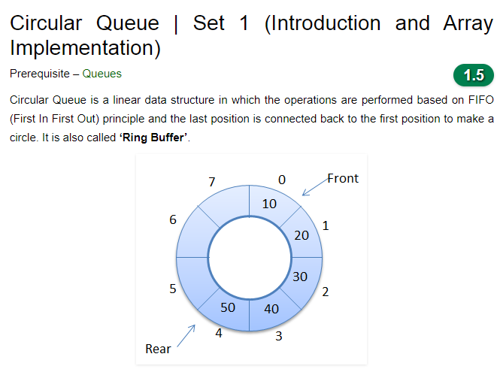

Slide 28
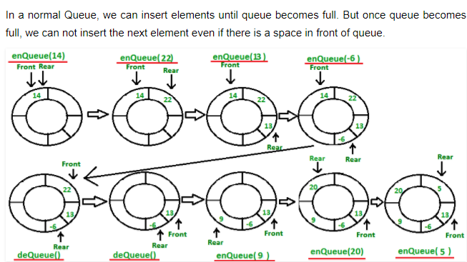

Slide 29
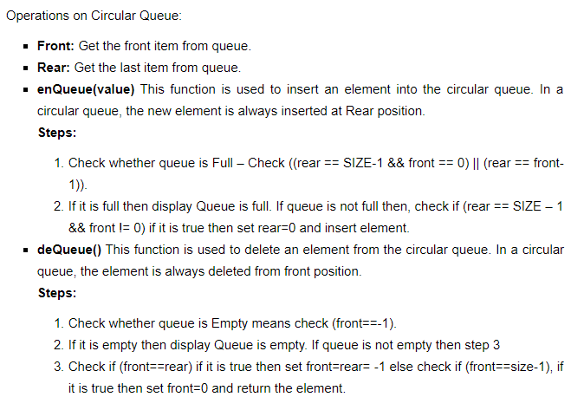

Slide 30
Assignment 2
Q: 1 Write complete program for Circular Queue implementation using linked list.
To be submitted in next week’s class.

