Slide 1
Ocean Plastic Pollution
It’s time to do something ...
Reporter：Group 1
Time：2022.11.09

Slide 2
Contents
01
Cause — Jiahui Wang
02
Effect — Yuxuan Yue
03
Solution — Junxi Wu
04
Appeal — Group 1

Slide 3
01
Cause—Jiahui Wang

Slide 4
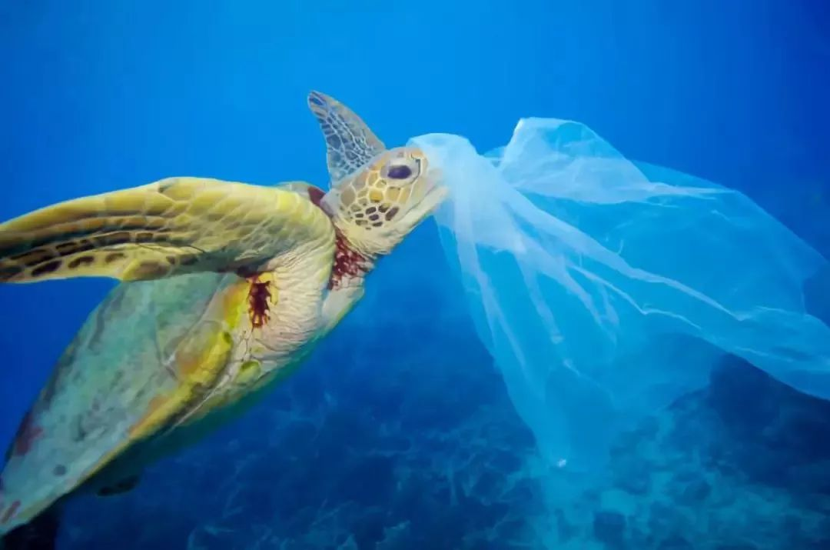
85%
triple by 2040
23-37 million tonnes

Slide 5
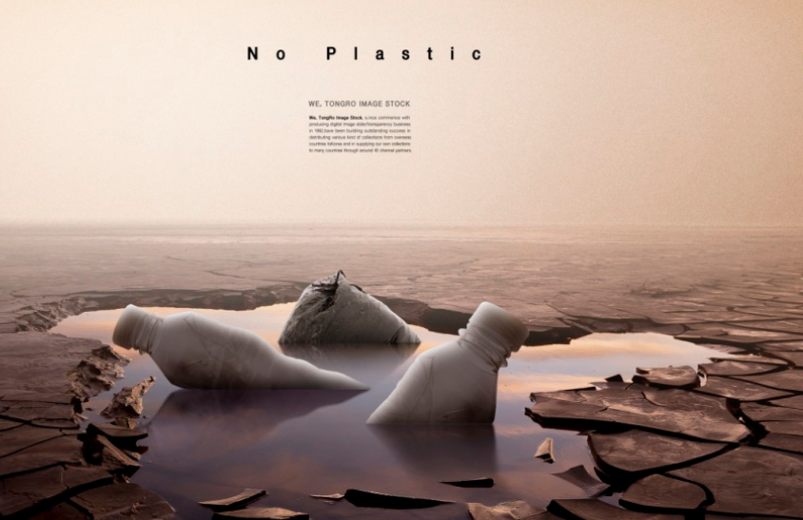
Cause
1.fishing----Fishing nets
2.overpopulation
3.excessive consumption of resources

Slide 6
02
Effect — Yuxuan Yue

Slide 7
Pollution Chain

Slide 8
Pollution Chain
People throw plastic rubbish into the sea

Slide 9
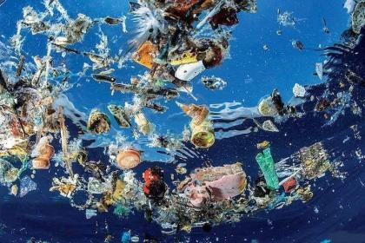
Pollution Chain
People throw plastic rubbish into the sea

Slide 10
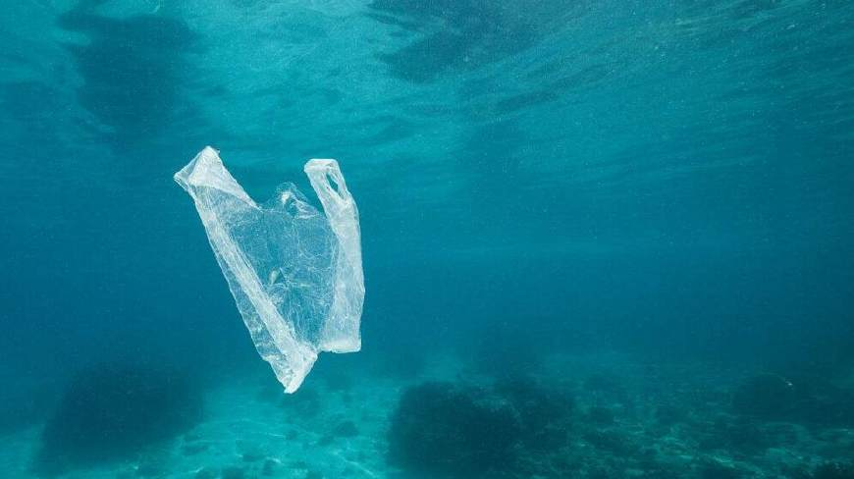
Pollution Chain
People throw plastic rubbish into the sea
Plastic waste is difficult to degrade

Slide 11
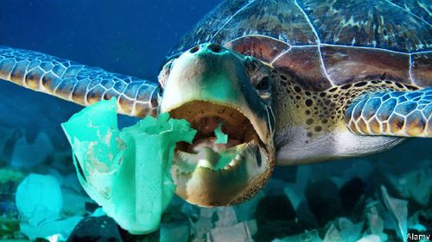
Pollution Chain
People throw plastic rubbish into the sea
Plastic waste is difficult to degrade
Small fragments are eaten by marine animals

Slide 12
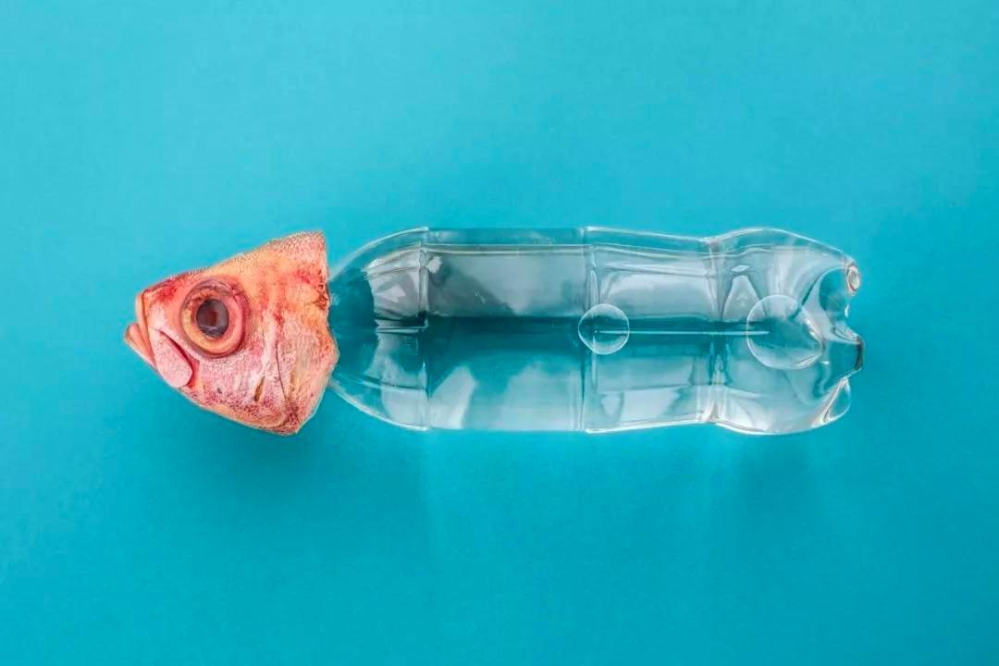
Pollution Chain
People throw plastic rubbish into the sea
Plastic waste is difficult to degrade
Small fragments are eaten by marine animals
Fish meal at the table

Slide 13
Pollution Chain
People throw plastic rubbish into the sea
People throw plastic rubbish into the sea
Plastic waste is difficult to degrade
Small fragments are eaten by marine animals
Fish meal at the table

Slide 14
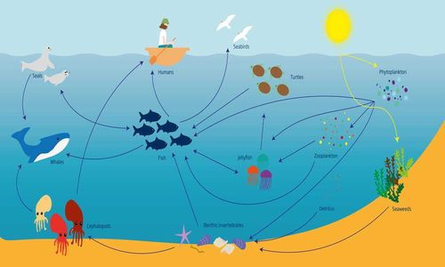
Pollution Chain
People throw plastic rubbish into the sea
Harmful to ecosystem self-regulation ability

Slide 15

Pollution Chain
People throw plastic rubbish into the sea
Harmful to ecosystem self-regulation ability
Harmful to biodiversity

Slide 16
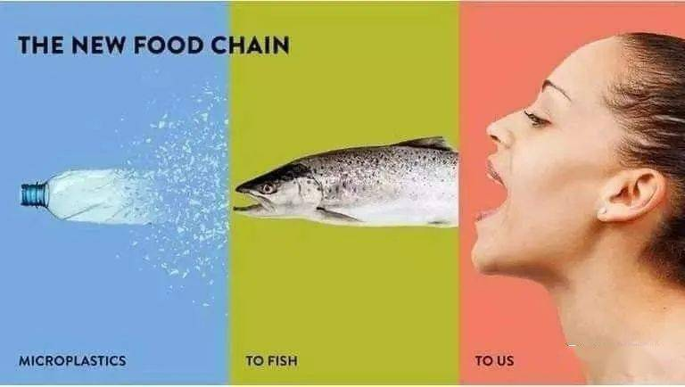
Pollution Chain
People throw plastic rubbish into the sea
Harmful to ecosystem self-regulation ability
Harmful to biodiversity
Harmful to human’s health

Slide 17
03
Solution-Junxi Wu

Slide 18
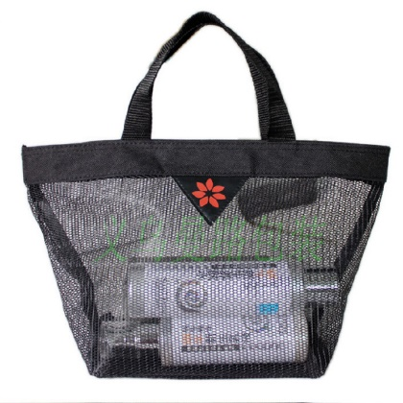
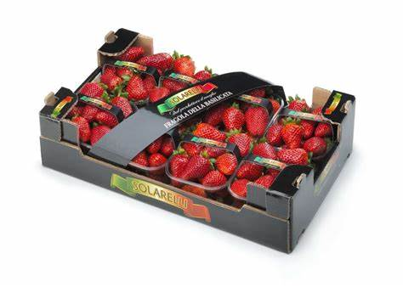
Luxurious packaging
eco-friendly shopping bag

Slide 19
04
Appeal — Group1

Slide 20
It’s time to do sth ...
Let's take action now, making our own contributions to reduce the ocean plastic pollution.

Slide 21
Thanks For Watching
——By Group 1

