Slide 1
RANJANA S
Final Project
3/21/2024 Annual Review

Slide 2
PROJECT TITLE
PAWSOME RECOGNITION: CAT VS DOG IMAGE CLASSIFIER
3/21/2024 Annual Review

Slide 3


AGENDA
Our agenda covers project introduction, problem statement, overview, target users, solution, key features, modeling approach, results, and conclusion. We'll explore challenges, unveil our innovative image recognition system, and discuss its impact, supported by empirical evidence, culminating in reflections and future directions.
3/21/2024 Annual Review

Slide 4

PROBLEM STATEMENT
Classifying images of cats and dogs accurately is a challenging task due to their similarities. The goal of this project is to develop an image recognition system capable of distinguishing between cats and dogs with high accuracy.
3/21/2024 Annual Review

Slide 5

PROJECT OVERVIEW
Our project aims to create an efficient and accurate image recognition system that can differentiate between images of cats and dogs. Leveraging machine learning and computer vision techniques, we intend to build a model capable of automating this classification task.
3/21/2024 Annual Review

Slide 6

WHO ARE THE END USERS?
The end users of our image recognition system include pet owners, veterinarians, animal shelters, and researchers. These users can benefit from a reliable tool for quickly identifying the animals in images.
3/21/2024 Annual Review

Slide 7

YOUR SOLUTION AND ITS VALUE PROPOSITION
Our solution is a state-of-the-art deep learning model trained on a large dataset of labeled cat and dog images. It offers:
High accuracy in distinguishing between cats and dogs
Fast and efficient processing of images
User-friendly interface for easy interaction
Potential integration with existing pet-related applications and services
Streamlined workflow for pet identification tasks
3/21/2024 Annual Review

Slide 8

THE WOW IN YOUR SOLUTION
One of the most impressive aspects of our solution is its ability to accurately classify images even in challenging scenarios, such as images with multiple animals or obscured views. Additionally, the model continuously learns and improves over time, ensuring consistent performance.
3/21/2024 Annual Review
8

Slide 9
MODELLING
Teams cam add wireframes
Our model architecture involves leveraging convolutional neural networks (CNNs) trained on a diverse dataset of cat and dog images. We employed techniques such as transfer learning and data augmentation to enhance the model's performance and generalization capabilities.
3/21/2024 Annual Review
9

Slide 10
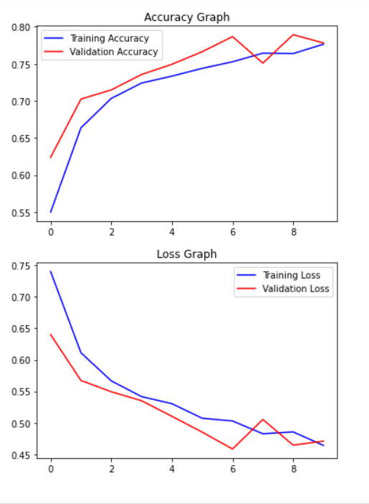
RESULTS
Demo Link
https://github.com/190203/Pawsome-Recognition.git
3/21/2024 Annual Review
10

