Slide 1

The Poke Cloud
The world’s first user ran pokedex On AWS

Slide 2

How does the Poke-Cloud Work?
It is like wikipedia, but for pokemon! Any pokemon you want can be added or modified by you or any other individual browsing the website

Slide 3
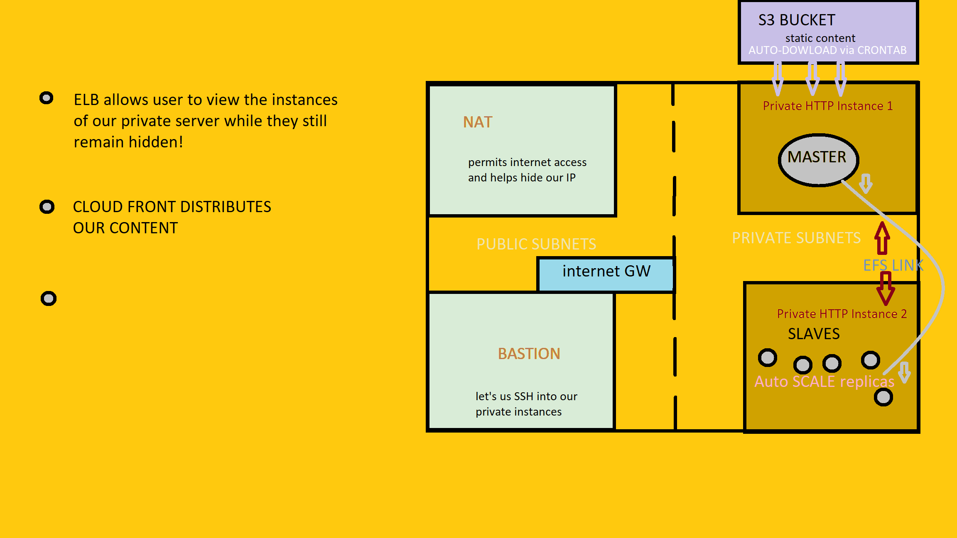
SO HOW DOES
IT WORK?

Slide 4
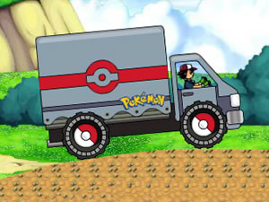
And coming soon...
Poke-Mobile
For those who want to transition their stored pokemon to the cloud

