Slide 1
DOC.ONLINE
Online Hospital Appointment Application
Team Members :
G SRIHARI (SCRUM Master)
K Darshan Raj Kumar
K Prem Kumar
GVP Varun
B Lokesh

Slide 2
Topics
INTRODUCTION
CASE LIFE CYCLE
PROCESS
RESULT

Slide 3

Introduction
DOC.ONLINE is a user-friendly doctor booking application which aims to provide information of doctor that would facilitate easy doctor appointment booking. Here, the User is responsible for the registration of a User Account, the user can Change the password, can view the number of doctors available and can book appointment. Whereas, an Receptionist is responsible for maintaining right information about the doctors, appointment and approving it.

Slide 4
CASE LIFE CYCLE

Slide 5
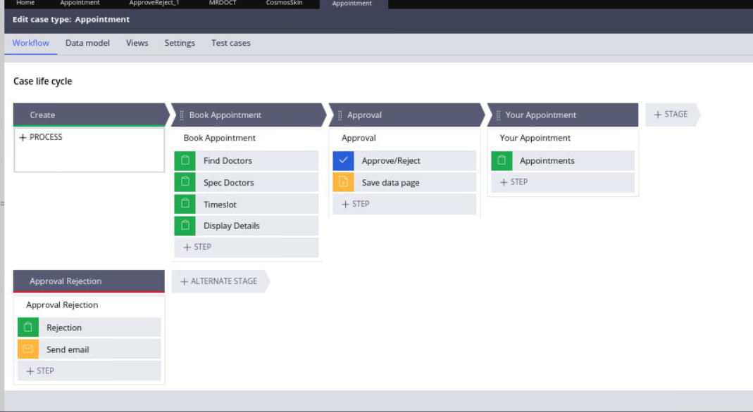
CASELIFE CYCLE

Slide 6
PROCESS OVERVIEW
Registration
Login
Appointment Booking
Approval
Attend Patient

Slide 7
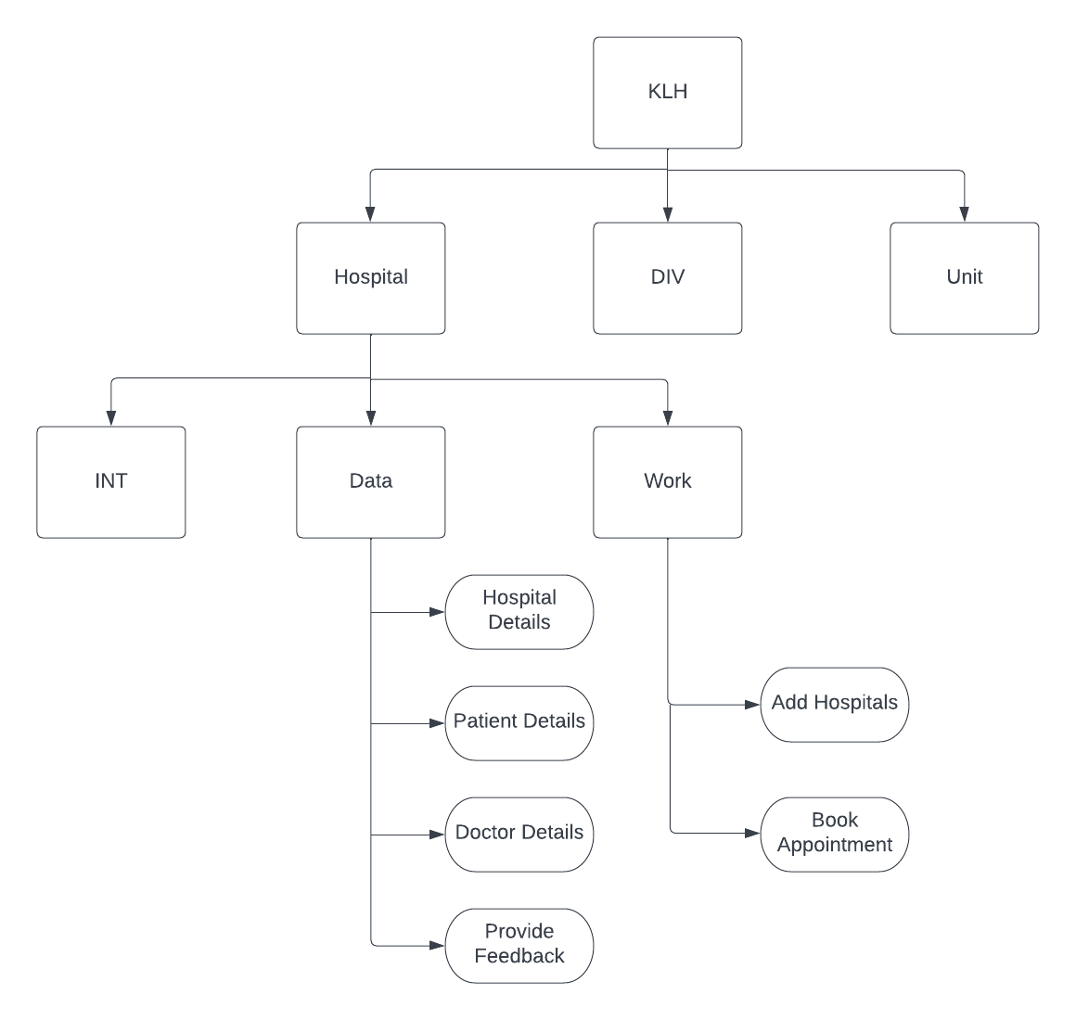
Flow Design

Slide 8
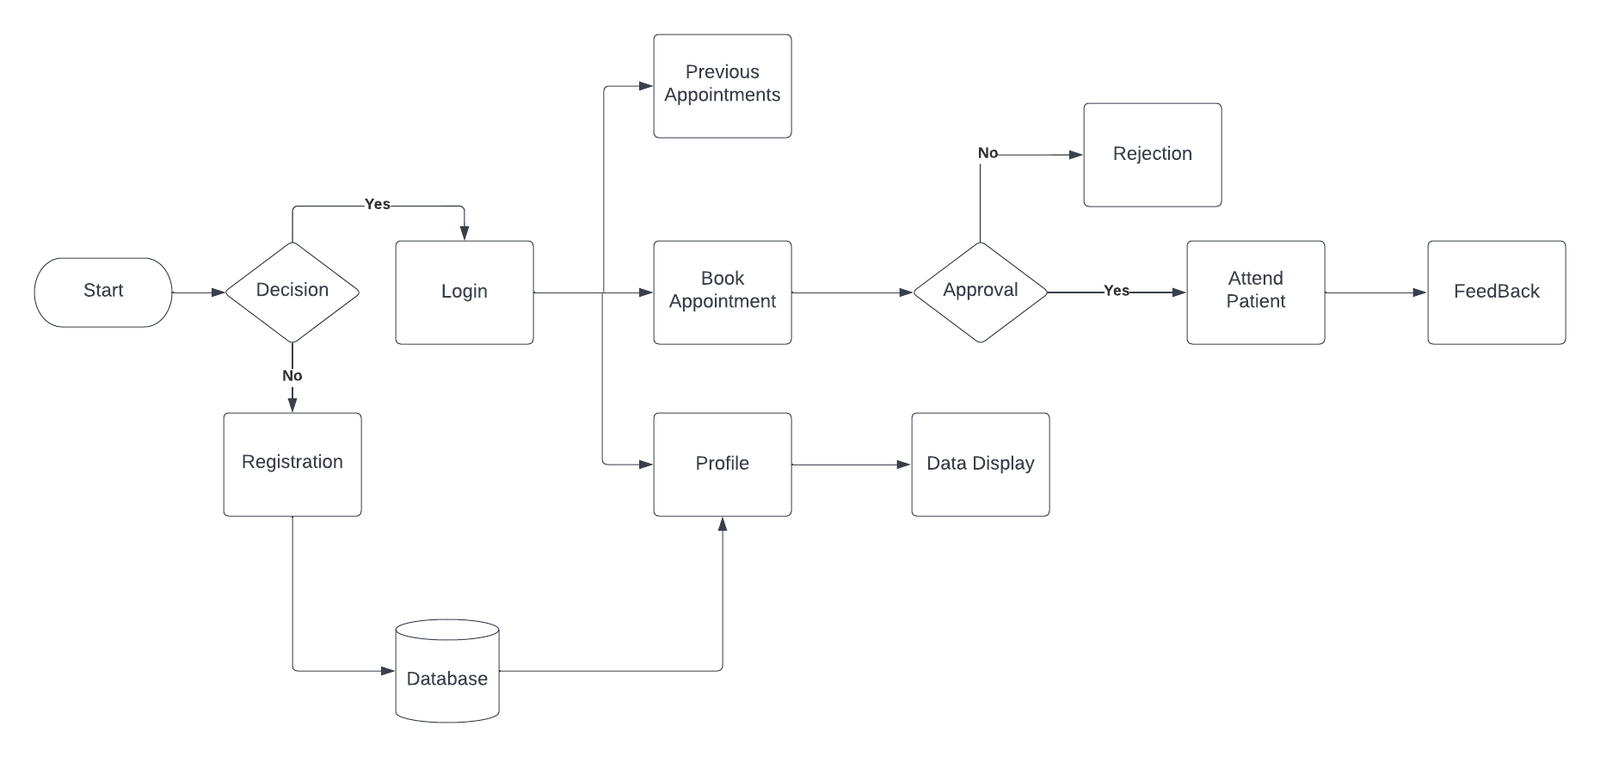
Flow Design

Slide 9
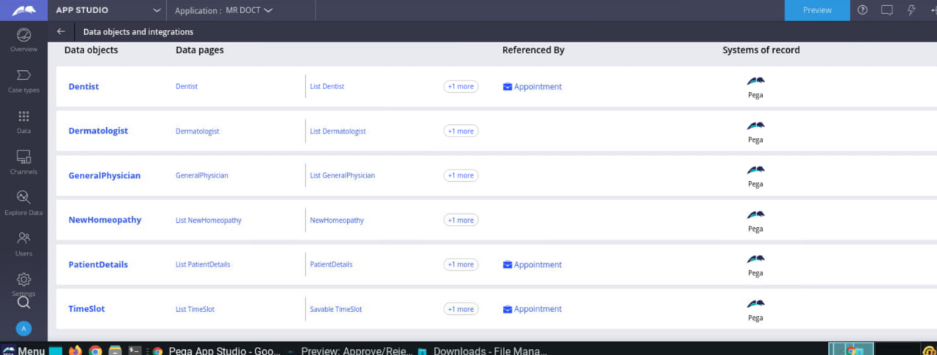
DATA TYPES
Dentist
Dermatologist
General Physician
New Homeopathy
Patient Details
Timeslot

Slide 10
Result
B2B MARKET SCENARIOS
Develop winning strategies to keep ahead of the competition
Capitalize on low-hanging fruit to identify a ballpark value
Visualize customer directed convergence​
CLOUD-BASED OPPORTUNITIES
Iterative approaches to corporate strategy
Establish a management framework from the inside

Slide 11
how we get there
ROI
NICHE MARKETS
SUPPLY CHAINS
Envision multimedia-based expertise and cross-media growth strategies
Visualize quality intellectual capital
Engage worldwide methodologies with web-enabled technologies
Pursue scalable customer service through sustainable strategies
Engage top-line web services with cutting-edge deliverables
Cultivate one-to-one customer service with robust ideas
Maximize timely deliverables for real-time schemas

Slide 12
Thank you
.

