Slide 1
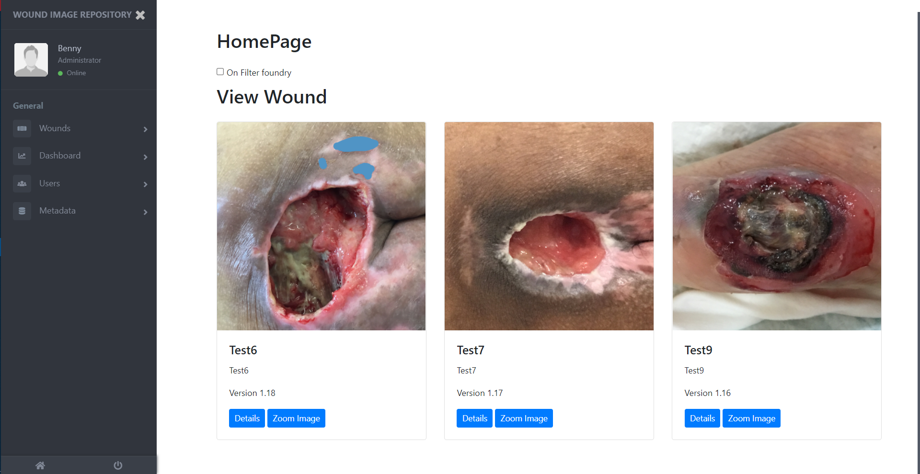
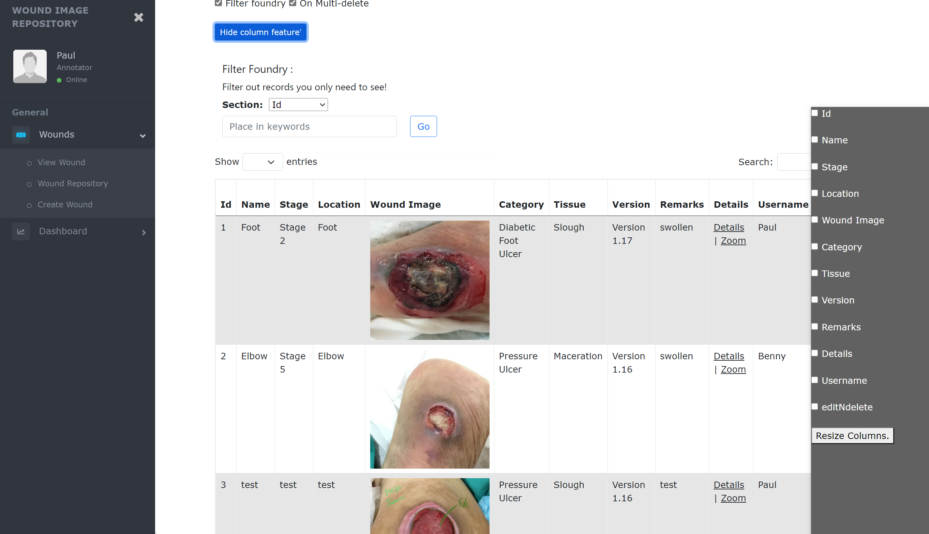
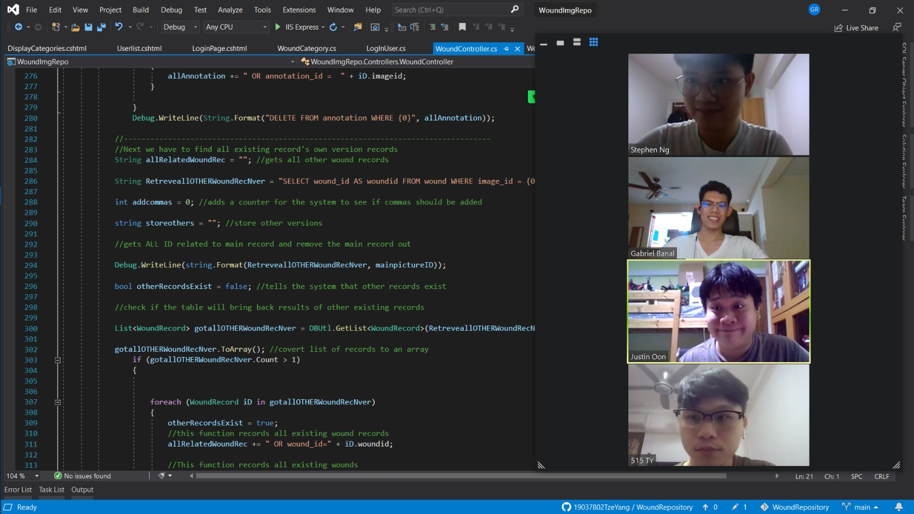
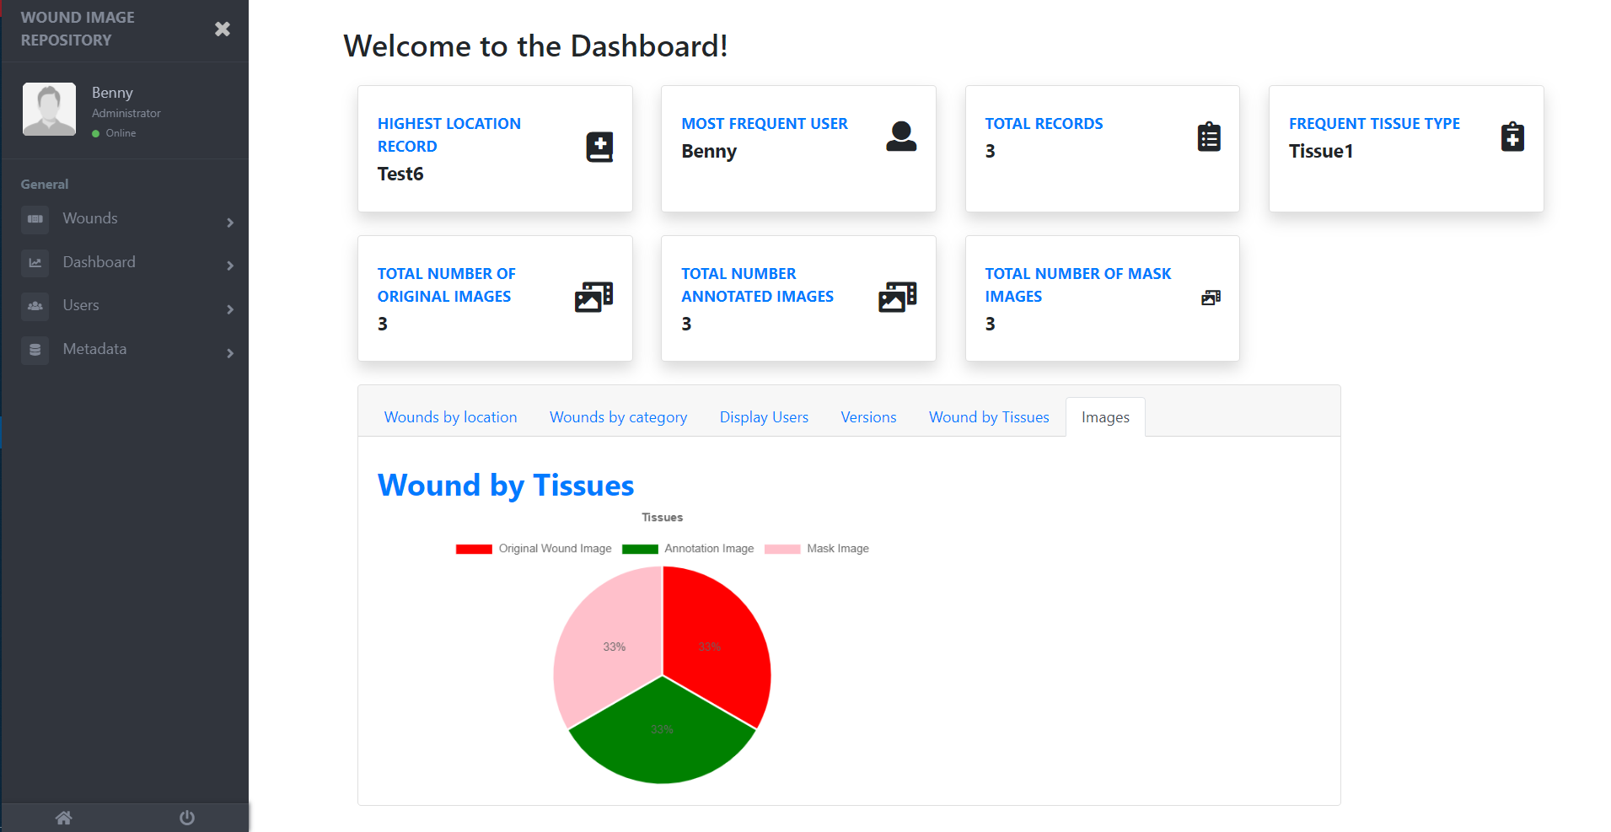
Wound Image Repository In conjunction with : Tetsuyu Healthcare Holdings Pte Ltd
Project Overview
The project: To provide a website application that collects wound images from various sources. The images will be added to a repository where users are allowed to upload their wound, mask, and annotation images where they can label metadata parameters: Wound Category, Wound Stage, Wound Location, and Tissue Types.
In which the users can also view wounds, search wounds, and view a dashboard of the overall summary of the wounds.
Key technologies: C# (Back-end), JavaScript (Front-end User Interface), HTML (Front-end User Interface) , CSS(Bootstrap), SQL (database)
Application Home Page
Application Repository
Application Dashboard
Team Members
NG GE LIANG, STEPHEN , GABRIEL PETER LIANGCO BANAL
JUSTIN OON JING YANG , CHEW TZE YANG
Supervisor: Ms Deborah
Notes:
NOTES
Refer to write ups in ‘Past Projects for Reference’ Booklet for Project overview write ups - http://intranet.rp.edu.sg/soi/students/SOI%20Module%20Resources/Project.aspx
ENGLISH - British E.g. organisation VS organization
Font: RP approved font - Arial family only.
Header: Arial Bold
Copy text: Arial regular or Arial Bold. Use Emphasis of our SOI orange in moderation.
Picture frame – Give a 4.5 or 6pt orange outline.

