Slide 1
Project One:
Reimbursement Project
Peterson Etienne
Revature

Slide 2
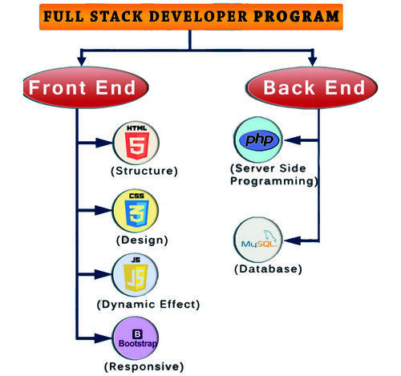
Technology
Full Stack Developer
Front to Back End
Multiple Technology
  Java
  SQL
  Html

Slide 3
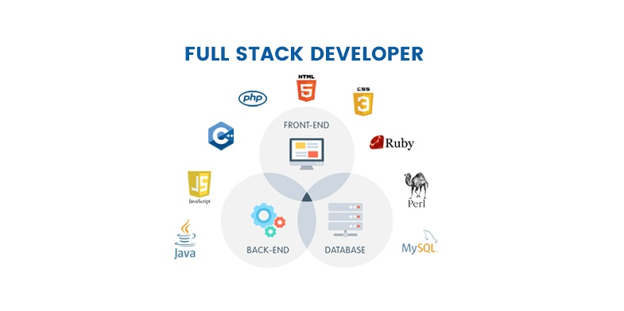
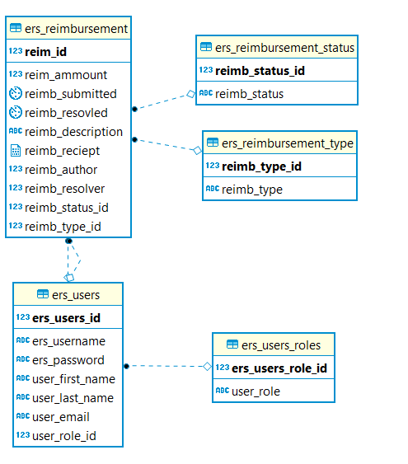
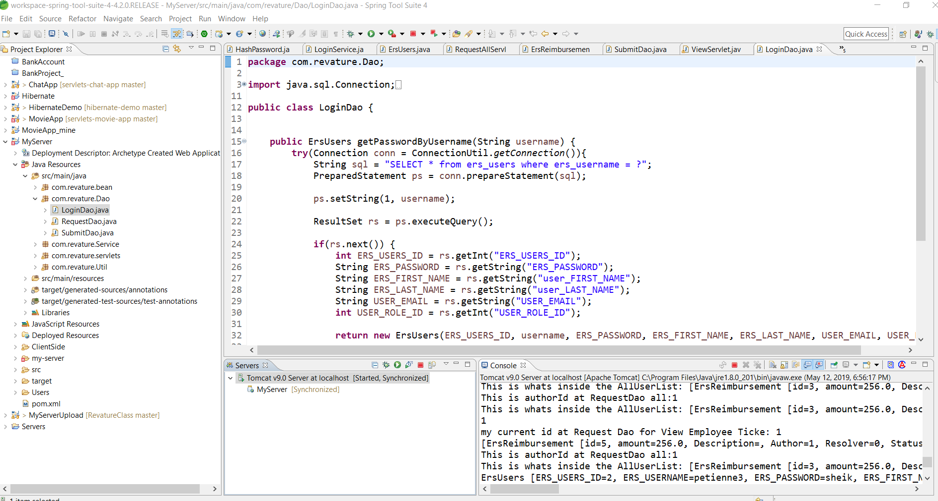
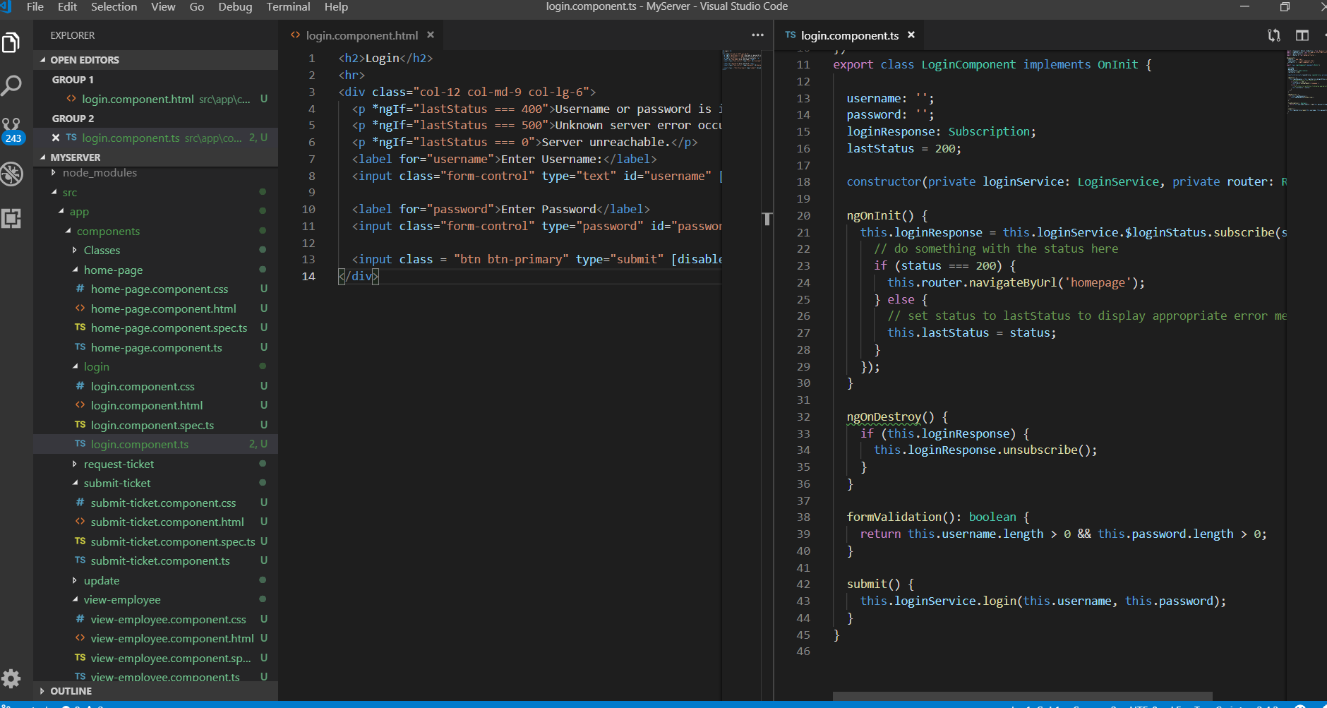
Project One Implements

Slide 4


