Slide 1
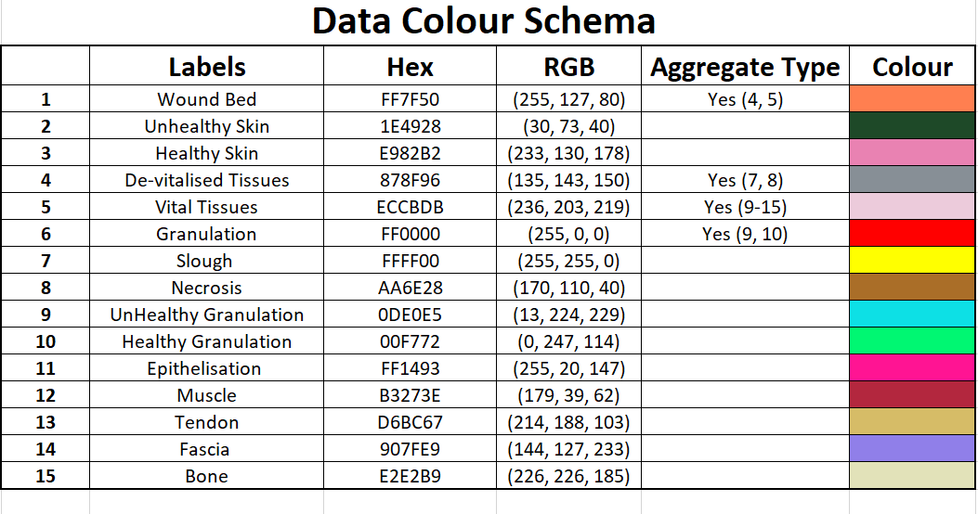

Slide 2
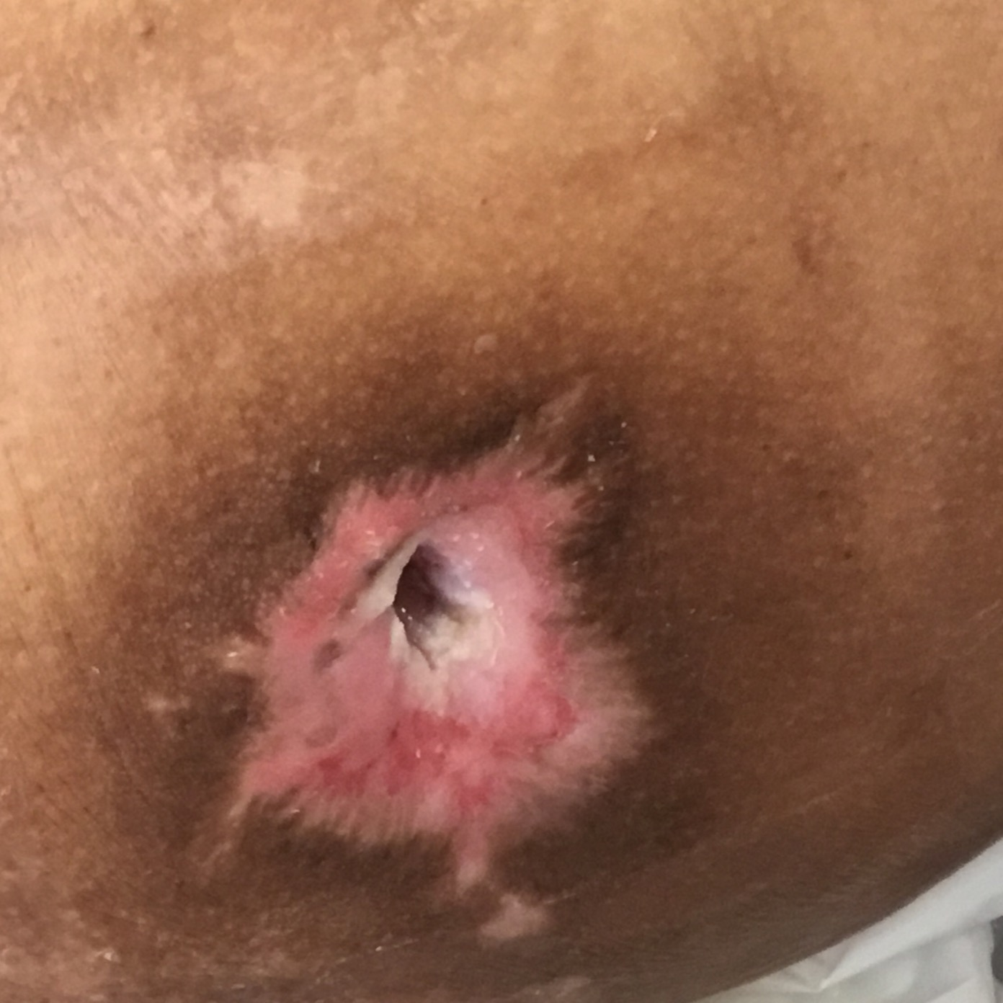


Original Wound Img
Latest Annotation
Original Mask
Metadata Wound Location: Wound Type:

Slide 3

not sure if this area is considered epithelizing
Normal Skin
Notes:
Normal skin.

Slide 4
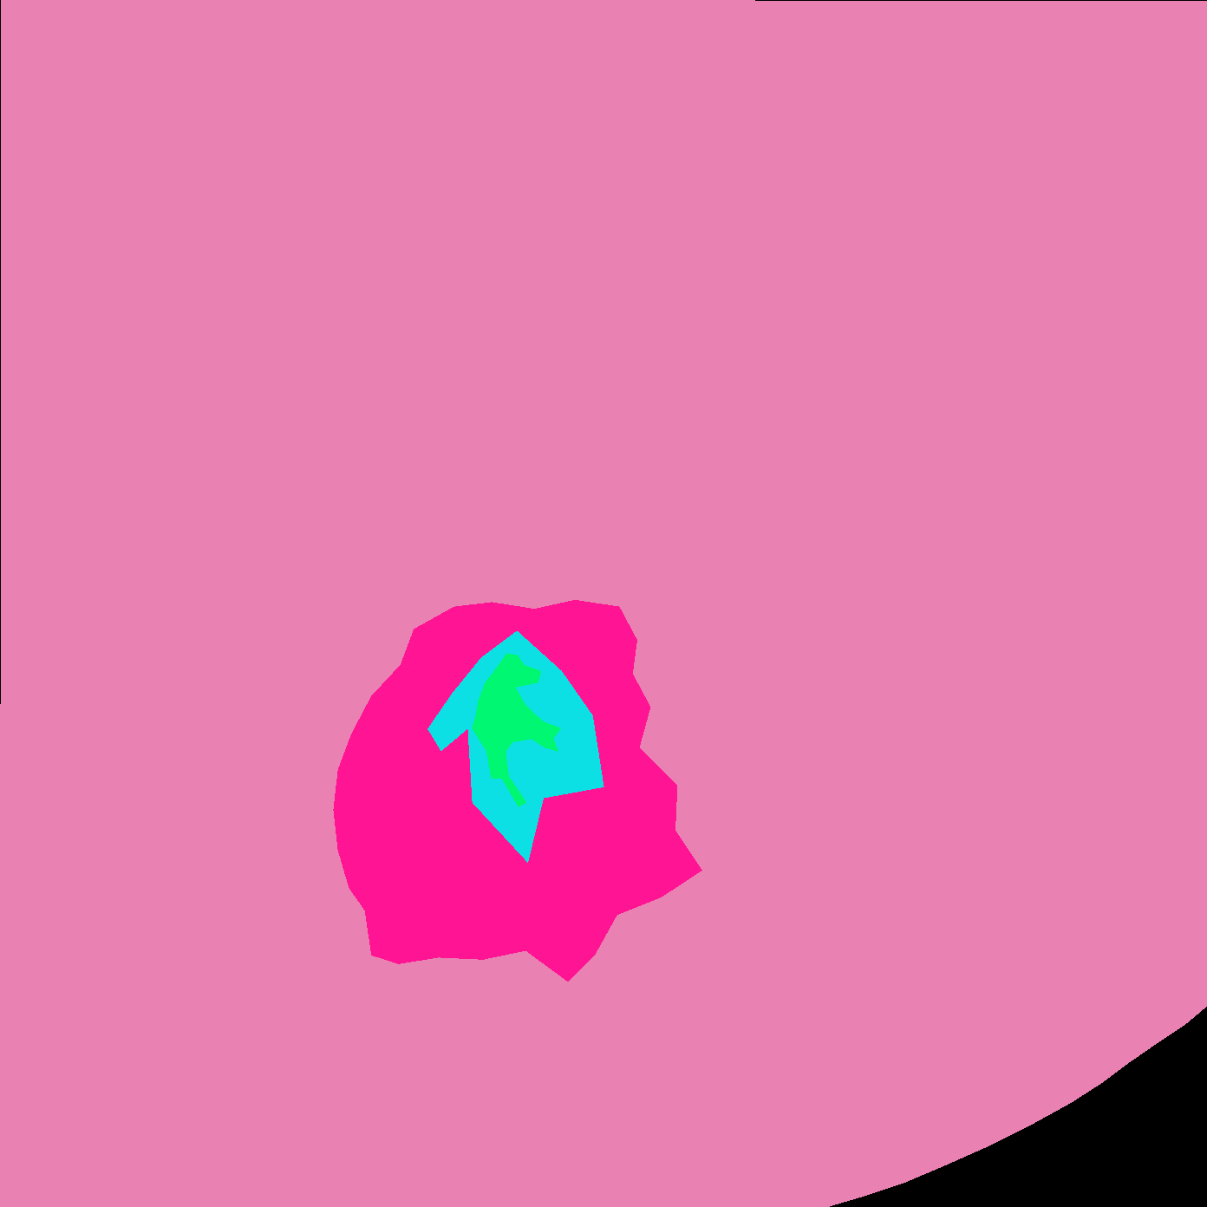
Original Wound Img
New Mask
Original Mask
Notes:
Your unhealthy granulation is actually maceration - unhealthy skin

Slide 5
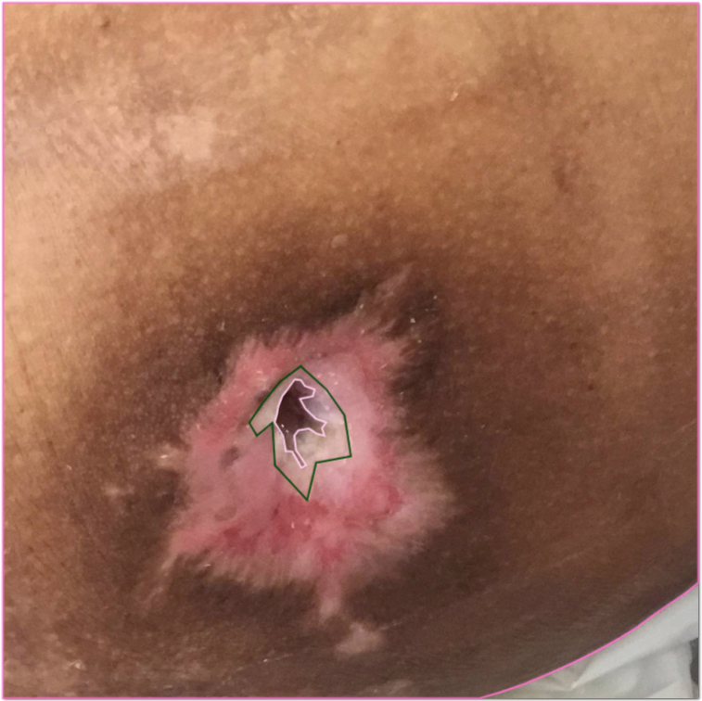

Slide 6

SD: Accepted

