Slide 1
MJ_CAR DEALERSHIP
Application
M. Sow / J. Gascon

Slide 2
Table of Contents
MJ. Entity Relational Diagram (ERD)
Show case of Logging System
MJ Demo.
Lessons learnt
Resources
Conclusion

Slide 3

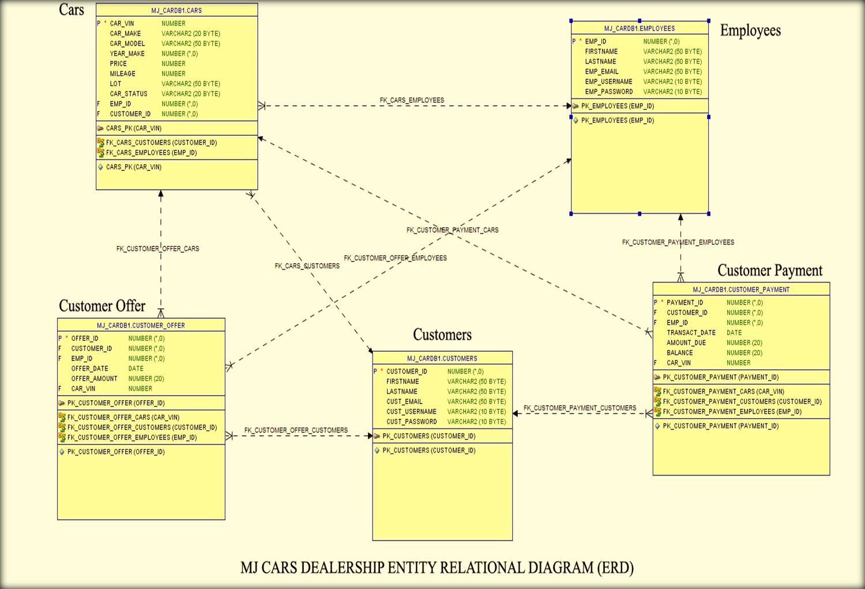
Entity Relational Diagram (ERD)

Slide 4
public static void employeelogging() {
String u, p;
System.out.println("Please provide your username");
System.out.println(">>>");
username = sc.nextLine();
System.out.println("Please provide your password");
System.out.println(">>>");
password = sc.nextLine();
Connection conn = cf.getConnection();
Statement stmt = null;
try {
stmt = conn.createStatement();
} catch (SQLException e) {
// TODO Auto-generated catch block
e.printStackTrace();
}
try {
ResultSet rs = stmt.executeQuery("SELECT EMP_USERNAME, EMP_PASSWORD FROM EMPLOYEES ");
} catch (SQLException e) {
// TODO Auto-generated catch block
e.printStackTrace();
}
Employees e = null;
u = e.getEmpusername();
p = e.getEmppw();
if (u == username && p == password) {
System.out.println("Logging Successes");
EmployeScreen.showempaccount();
}
}

Slide 5
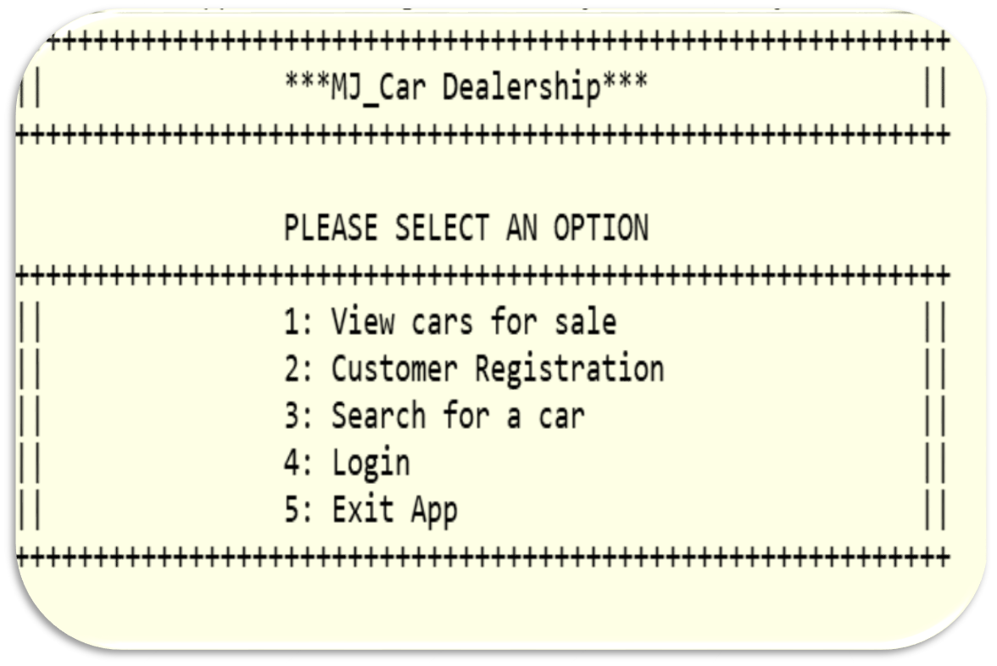
MJ Demo

Slide 6

Lessons learnt
Java application development integrates many features
SQL benefits
Teamwork

Slide 7
Resources… and thanks!!
Class notes
Research
Subject Matter Experts (SMEs)

