Slide 1

MJ_CAR DEALERSHIP Application

Slide 2
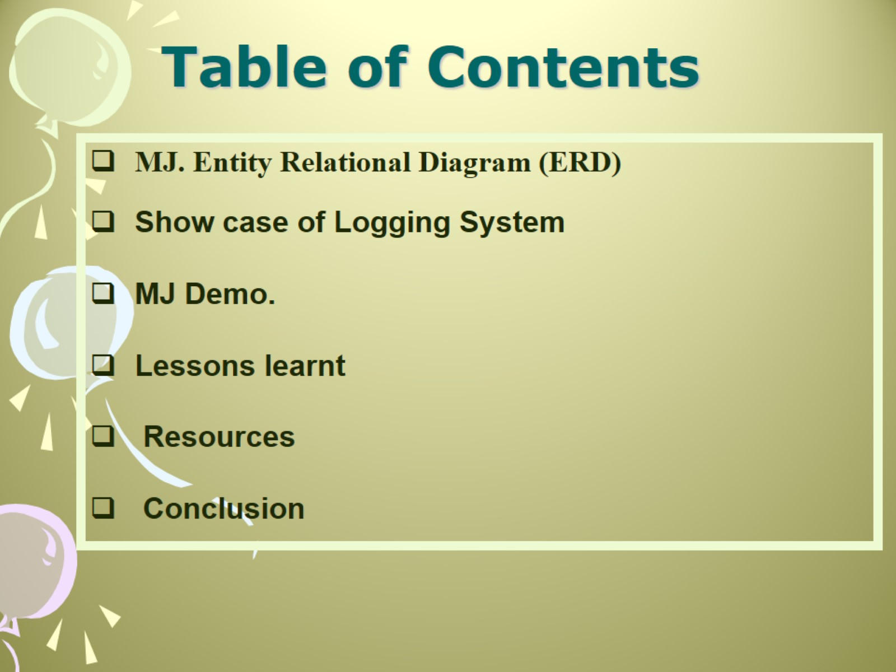
Table of Contents

Slide 3
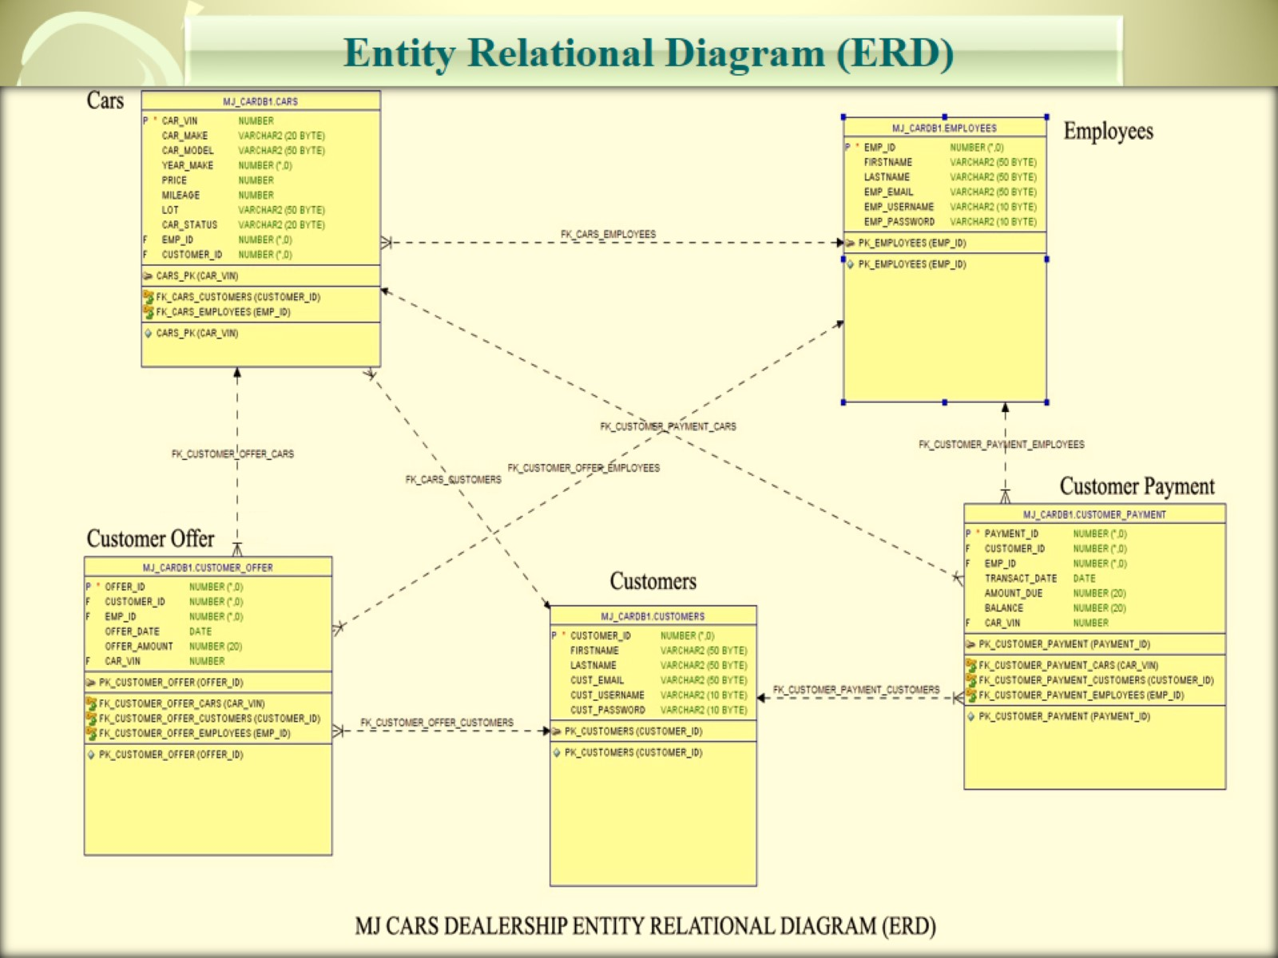

Slide 4
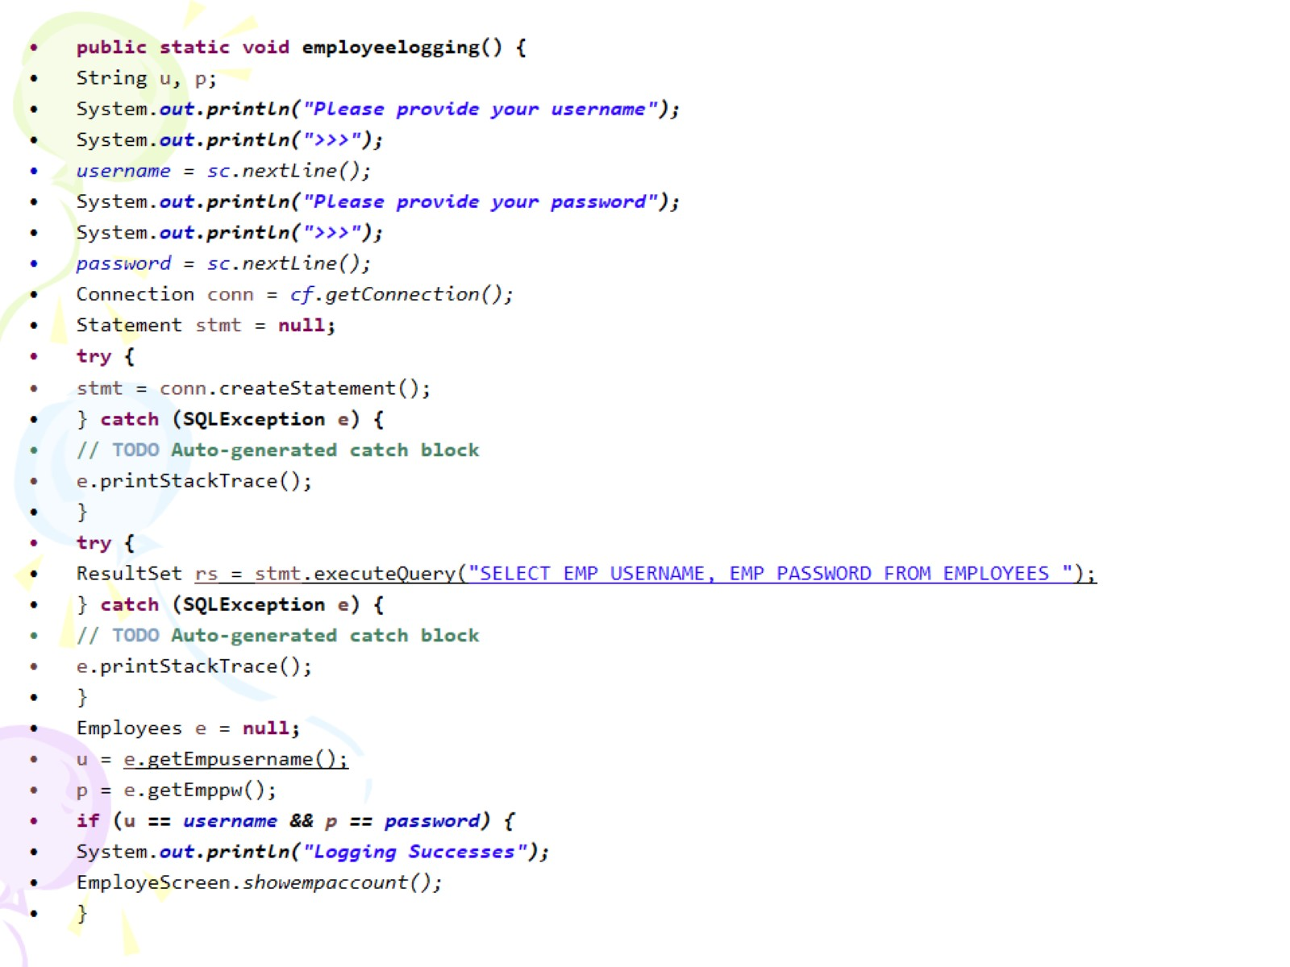

Slide 5
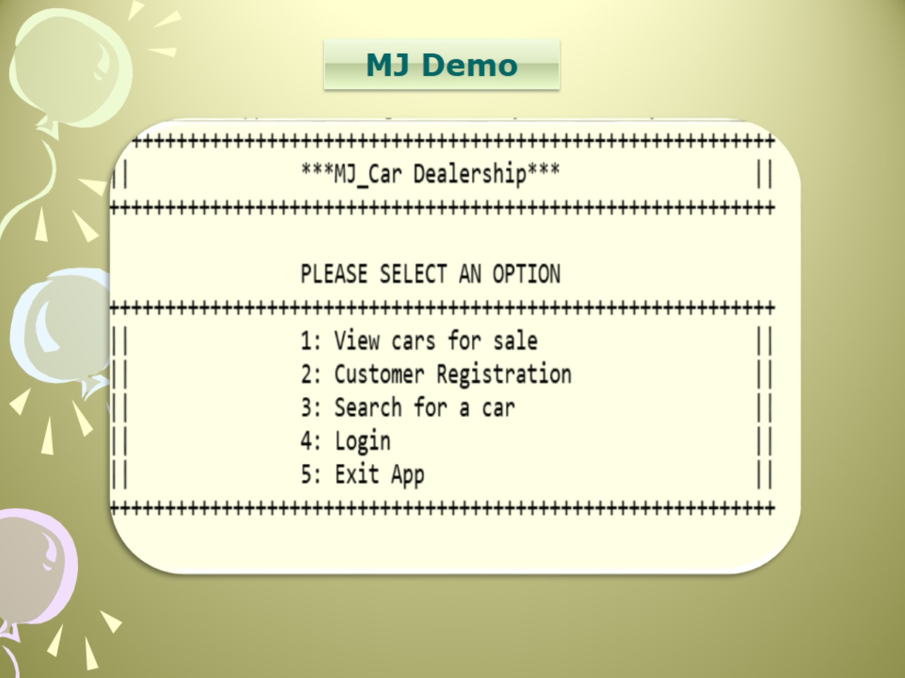

Slide 6
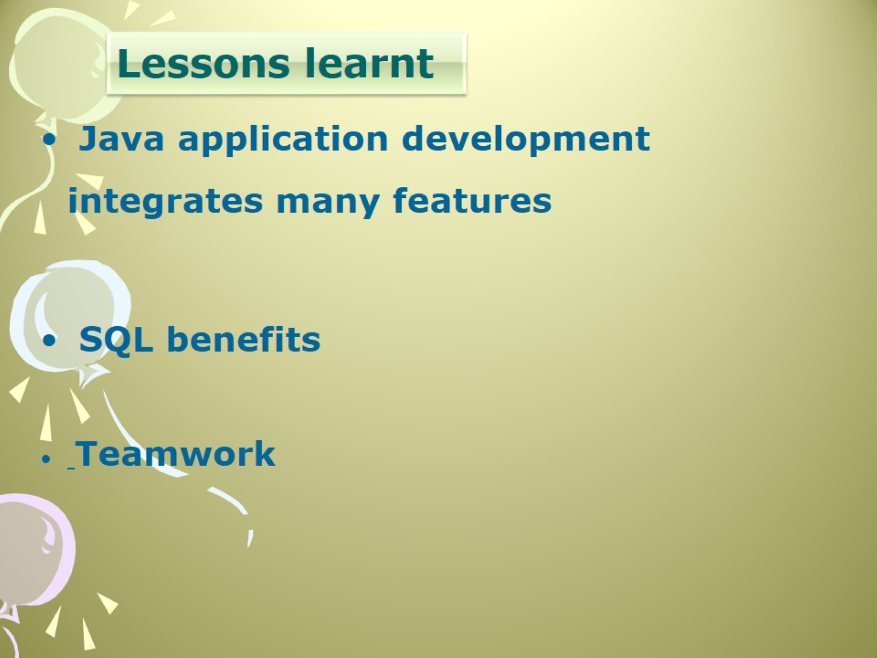

Slide 7

Resources… and thanks!!

