Slide 1
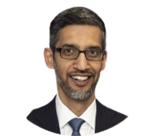
Borhan Arif
CS Student
About me
I am a 4th-year student pursuing a Bachelor's degree in Computer Science and Engineering at Khulna University of Engineering & Technology (KUET). I am eager to enhance my technical skills and academic knowledge to contribute effectively to innovative projects and further develop as a professional in the tech industry.
Contact
Location: S123 Main Street, Dhaka
Phone:(555) 123-4567
LinkedIn: linkedin.com/in/arif
Website: arifs.com

Slide 2
Borhan Arif
CS Student
Education
Bachelor of Science in Computer Science and Engineering
Khulna University of Engineering & Technology (KUET)
Expected Graduation: May 2025
GPA: 3.75/4.00
Higher Secondary Certificate (HSC)
Dhaka College, Dhaka
GPA: 4.00/4.00
Projects
E-commerce Website
A fully functional e-commerce website using Django framework.
Student Grade Management System
A web-based application for managing student grades.
Skills
Programming Languages: Python, Java, C++
Web Development: HTML, CSS, JavaScript, React
Software Development: Git, Django, Flask

