Slide 1
Bank app
Welcome

Slide 2
Technicals specifications
Customer needs and wishes, so we have:
Register
Login and logout
View balance
Withdraw
Make deposit
View all past transactions

Slide 3
Technicals skills needs
Python 3.7
Disign pattern MVC
UML (Unified Modeling Language)
MySQL
Commands linux (Red Hat or Centos 7)
Git (manage version)

Slide 4
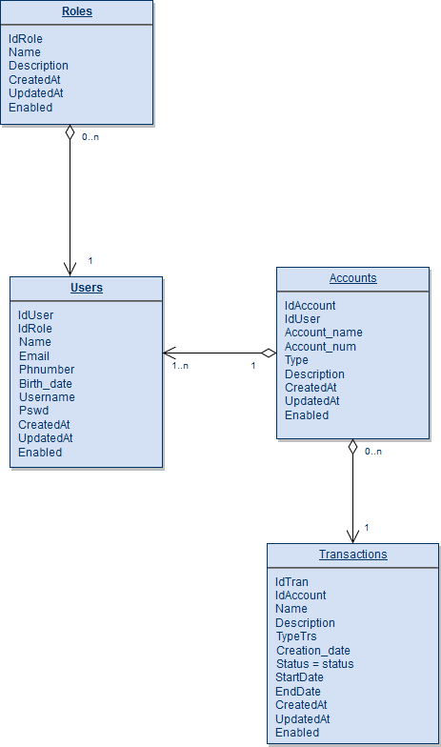
UML Diagram (in Python 3.7)

Slide 5
MVC Architecture
Entities
Roles.py
Users.py
Accounts.py
Transactions.py
menu.py
RolesService.py
UsersService.py
AccountsService.py
TransactionsService.py
UI
(Console)
Database
(MySQL)
Services
Controllers
DAO
RolesDao.py
UsersDao.py
AccountsDao.py
TransactionsDao.py
RolesController.py
UsersController.py
AccountsController.py
TransactionsController.py

Slide 6
Presentation Bank P0

Slide 7
Requirements
Pool of connection to database
Data is persisted (saved)
Disign pattern MVC
Make at least 2 test cases
Use the logging module
Handle exceptions
Create at least 2 custom errors
Input/Output through the console

