Slide 1
Intro to Javascript

Slide 2
Introduction to JavaScript

Slide 3
Topics
What is JavaScript?
Why JavaScript?
Including JavaScript in HTML
Hello World Example Script
JavaScript Comments

Slide 4
What is JavaScript?
Created by Netscape
Originally called LiveWire then LiveScript
A client-side scripting language
Client-side refers to the fact that it is executed in the client (software) that the viewer is using. In the case of JavaScript, the client is the browser.
A server-side language is one that runs on the Web server. Examples: PHP, Python
Interpreted on-the-fly by the client
Each line is processed as it loads in the browser

Slide 5
JavaScript is not Java
Completely different types of languages that just happen to be similarly named
JavaScript - programs are interpreted in the browser
Java - programs are compiled and can be run as stand alone applications

Slide 6
Why JavaScript?
It’s easier to learn than most programming languages
It allows you to make interactive Web pages
It can be fun!

Slide 7
What is Javascript?
a lightweight programming language ("scripting language")
used to make web pages interactive
insert dynamic text into HTML (ex: user name)
react to events (ex: page load user click)
get information about a user's computer (ex: browser type)
perform calculations on user's computer (ex: form validation)

Slide 8
What is Javascript?
a web standard (but not supported identically by all browsers)
NOT related to Java other than by name and some syntactic similarities

Slide 9
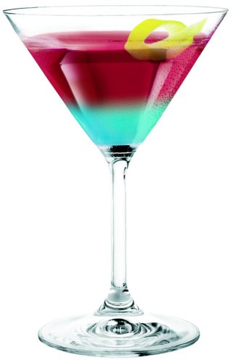
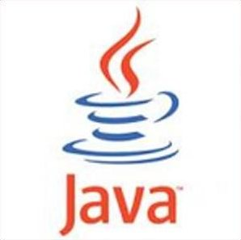
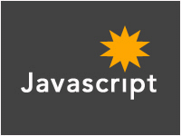
Javascript vs Java
+
=

Slide 10
JavaScript vs. PHP
similarities:
both are interpreted, not compiled
both are relaxed about syntax, rules, and types
both are case-sensitive
both have built-in regular expressions for powerful text processing

Slide 11

JavaScript vs. PHP
differences:
JS is more object-oriented: noun.verb(), less procedural: verb(noun)
JS focuses on user interfaces and interacting with a document; PHP is geared toward HTML output and file/form processing
JS code runs on the client's browser; PHP code runs on the web server
JS <3

Slide 12
Javascript vs Java
interpreted, not compiled
more relaxed syntax and rules
fewer and "looser" data types
variables don't need to be declared
errors often silent (few exceptions)
key construct is the function rather than the class
"first-class" functions are used in many situations
contained within a web page and integrates with its HTML/CSS content

Slide 13
Including JavaScript in HTML
Two ways to add JavaScript to Web pages
Use the <script>…</script> tag
Include the script in an external file -- more about this later in the semester
Initially, we will only use the <script>…</script> tag

Slide 14
Hello, World!
Typically, in any programming language, the first example you learn displays “Hello, World!”
We are going to take a look at a Hello World example and then examine all of its parts.

Slide 15
Hello World in JavaScript
<!DOCTYPE html>
<html>
<head>
<title>Hello World Example</title>
</head>
<body>
<script type="text/javascript">
<!--
document.write("<h1>Hello, world!</h1>");
//-->
</script>
</body>
</html>

Slide 16
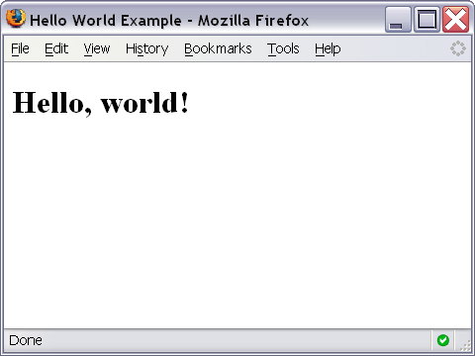
Hello World Screenshot

Slide 17
The <script>…</script> tag
The code for the script is contained in the <script>…</script> tag
<script type="text/javascript">
.
.
.
</script>

Slide 18
Hiding JavaScript from Older Browsers
Some older browsers do not support JavaScript
We need to tell those browsers to ignore what is in the <script> tag
<script type="text/javascript">
<!--
some JavaScript code
//-->
</script>

Slide 19
Displaying text
The document.write() method writes a string of text to the browser
<script type="text/javascript">
<!--
document.write("<h1>Hello, world!</h1>");
//-->
</script>

Slide 20
document.write()
Ends in a semicolon
document.write("<h1>Hello,world!</h1>");
Enclosed in quotes -- denotes a "string"

Slide 21
Comments in JavaScript
Two types of comments
Single line
Uses two forward slashes (i.e. //)
Multiple line
Uses /* and */

Slide 22
Single Line Comment Example
<script type="text/javascript">
<!--
// This is my JavaScript comment
document.write("<h1>Hello!</h1>");
//-->
</script>

Slide 23
Multiple Line Comment Example
<script type="text/javascript">
<!--
/* This is a multiple line comment.
* The star at the beginning of this line is optional.
* So is the star at the beginning of this line.
*/
document.write("<h1>Hello!</h1>");
//-->
</script>

Slide 24
Find the Bug!
<script type="text/javascript">
<!--
/* This is my JavaScript comment
* that spans more than 1 line.
*
document.write("<h1>Hello!</h1>");
//-->
</script>

Slide 25
Linking to a JavaScript file: script
<script src="filename" type="text/javascript"></script> HTML
script tag should be placed in HTML page's head
script code is stored in a separate .js file
JS code can be placed directly in the HTML file's body or head (like CSS)
but this is bad style (should separate content, presentation, and behavior

Slide 26
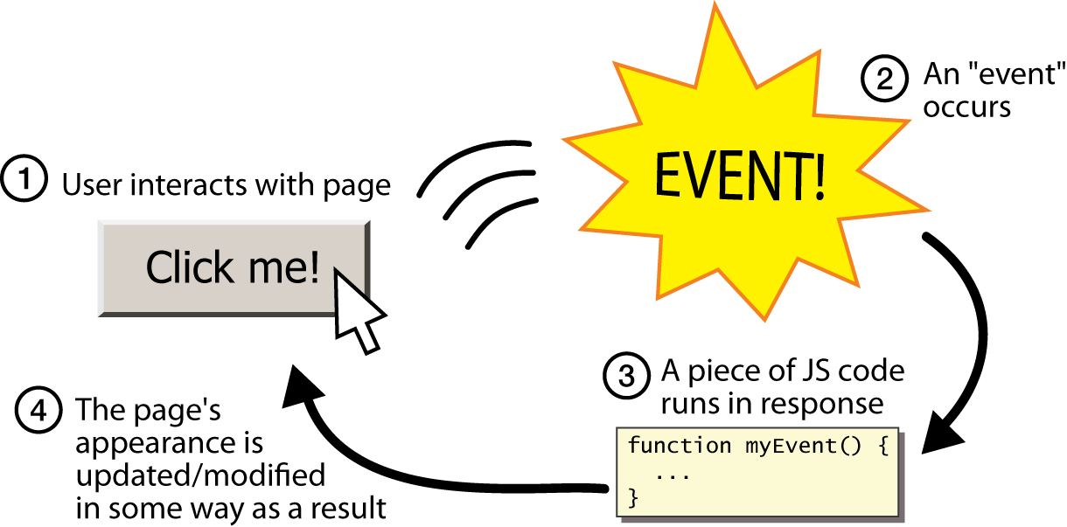
Event-driven programming
split breaks apart a string into an array using a delimiter
can also be used with regular expressions (seen later)
join merges an array into a single string, placing a delimiter between them

Slide 27
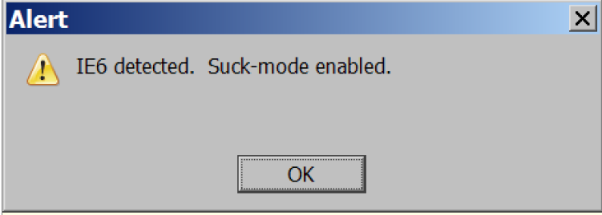
A JavaScript statement: alert
alert("IE6 detected. Suck-mode enabled."); JS
a JS command that pops up a dialog box with a message

Slide 28
Event-driven programming
you are used to programs start with a main method (or implicit main like in PHP)
JavaScript programs instead wait for user actions called events and respond to them
event-driven programming: writing programs driven by user events
Let's write a page with a clickable button that pops up a "Hello, World" window...

Slide 29
Buttons
<button>Click me!</button> HTML
button's text appears inside tag; can also contain images
To make a responsive button or other UI control:
choose the control (e.g. button) and event (e.g. mouse 1. click) of interest
write a JavaScript function to run when the event occurs
attach the function to the event on the control
Notes:
Reset is not working here! Debug! test1.html

Slide 30
JavaScript functions
function name() {
statement ;
statement ;
...
statement ;
} JS
function myFunction() {
alert("Hello!");
alert("How are you?");
} JS
the above could be the contents of example.js linked to our HTML page
statements placed into functions can be evaluated in response to user events

Slide 31
Event handlers
<element attributes onclick="function();">... HTML
<button onclick="myFunction();">Click me!</button> HTML
JavaScript functions can be set as event handlers
when you interact with the element, the function will execute
onclick is just one of many event HTML attributes we'll use
but popping up an alert window is disruptive and annoying
A better user experience would be to have the message appear on the page...

Slide 32
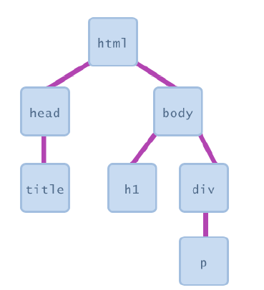
Document Object Model (DOM)
most JS code manipulates elements on an HTML page
we can examine elements' state
e.g. see whether a box is checked
we can change state
e.g. insert some new text into a div
we can change styles
e.g. make a paragraph red

Slide 33
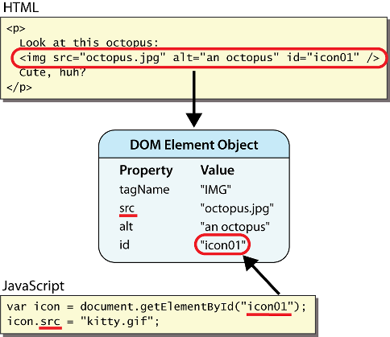
DOM element objects
Notes:
every element on the page has a corresponding DOM object access/modify the attributes of the DOM object with objectName.attributeName

Slide 34
Accessing elements: document.getElementById
var name = document.getElementById("id");
JS
<button onclick="changeText();">Click me!</button>
<span id="output">replace me</span>
<input id="textbox" type="text" /> HTML
function changeText() {
var span = document.getElementById("output");
var textBox = document.getElementById("textbox");
textbox.style.color = "red";
} JS
Notes:
span.innerHTML = textBox.value;

Slide 35
Accessing elements: document.getElementById
document.getElementById returns the DOM object for an element with a given id
can change the text inside most elements by setting the innerHTML property
can change the text in form controls by setting the value property

Slide 36
Changing element style: element.style
Attribute | Property or style object
color | color
padding | padding
background-color | backgroundColor
border-top-width | borderTopWidth
Font size | fontSize
Font famiy | fontFamily

Slide 37
Preetify
function changeText() {
//grab or initialize text here
// font styles added by JS:
text.style.fontSize = "13pt";
text.style.fontFamily = "Comic Sans MS";
text.style.color = "red"; // or pink?
} JS

Slide 38
More Javascript Syntax

Slide 39
Variables
var name = expression; JS
var clientName = "Connie Client";
var age = 32;
var weight = 127.4; JS
variables are declared with the var keyword (case sensitive)
types are not specified, but JS does have types ("loosely typed")
Number, Boolean, String, Array, Object, Function, Null, Undefined
can find out a variable's type by calling typeof

Slide 40
Number type
var enrollment = 99;
var medianGrade = 2.8;
var credits = 5 + 4 + (2 * 3); JS
integers and real numbers are the same type (no int vs. double)
same operators: + - * / % ++ -- = += -= *= /= %=
similar precedence to Java
many operators auto-convert types: "2" * 3 is 6

Slide 41
Comments (same as Java)
// single-line comment
/* multi-line comment */ JS
identical to Java's comment syntax
recall: 4 comment syntaxes
HTML: <!-- comment -->
CSS/JS/PHP: /* comment */
Java/JS/PHP: // comment
PHP: # comment

Slide 42
Math object
var rand1to10 = Math.floor(Math.random() * 10 + 1);
var three = Math.floor(Math.PI); JS
methods: abs, ceil, cos, floor, log, max, min, pow, random, round, sin, sqrt, tan
properties: E, PI

Slide 43
Special values: null and undefined
var ned = null;
var benson = 9;
// at this point in the code,
// ned is null
// benson's 9
// caroline is undefined JS
undefined : has not been declared, does not exist
null : exists, but was specifically assigned an empty or null value
Why does JavaScript have both of these?

Slide 44
Logical operators
> < >= <= && || ! == != === !==
most logical operators automatically convert types:
5 < "7" is true
42 == 42.0 is true
"5.0" == 5 is true
=== and !== are strict equality tests; checks both type and value
"5.0" === 5 is false

Slide 45
if/else statement (same as Java)
if (condition) {
statements;
} else if (condition) {
statements;
} else {
statements;
}
JS
identical structure to Java's if/else statement
JavaScript allows almost anything as a condition

Slide 46
Boolean type
var iLike190M = true;
var ieIsGood = "IE6" > 0; // false
if ("web devevelopment is great") { /* true */ }
if (0) { /* false */ } JS
any value can be used as a Boolean
"falsey" values: 0, 0.0, NaN, "", null, and undefined
"truthy" values: anything else
converting a value into a Boolean explicitly:
var boolValue = Boolean(otherValue);
var boolValue = !!(otherValue);

Slide 47
for loop (same as Java)
var sum = 0;
for (var i = 0; i < 100; i++) {
sum = sum + i;
} JS
var s1 = "hello";
var s2 = "";
for (var i = 0; i < s.length; i++) {
s2 += s1.charAt(i) + s1.charAt(i);
}
// s2 stores "hheelllloo" JS

Slide 48
while loops (same as Java)
while (condition) {
statements;
} JS
do {
statements;
} while (condition); JS
break and continue keywords also behave as in Java

Slide 49
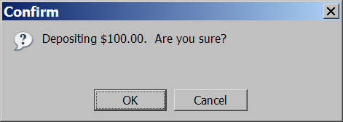
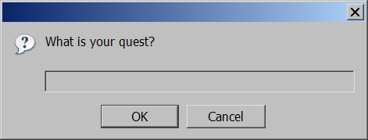
Popup boxes
alert("message"); // message
confirm("message"); // returns true or false
prompt("message"); // returns user input string JS

Slide 50
Arrays
var name = []; // empty array
var name = [value, value, ..., value]; // pre-filled
name[index] = value; // store element JS
var ducks = ["Huey", "Dewey", "Louie"];
var stooges = []; // stooges.length is 0
stooges[0] = "Larry"; // stooges.length is 1
stooges[1] = "Moe"; // stooges.length is 2
stooges[4] = "Curly"; // stooges.length is 5
stooges[4] = "Shemp"; // stooges.length is 5 JS
Notes:
two ways to initialize an array
length property (grows as needed when elements are added)

Slide 51
Array methods
var a = ["Stef", "Jason"]; // Stef, Jason
a.push("Brian"); // Stef, Jason, Brian
a.unshift("Kelly"); // Kelly, Stef, Jason, Brian
a.pop(); // Kelly, Stef, Jason
a.shift(); // Stef, Jason
a.sort(); // Jason, Stef JS
array serves as many data structures: list, queue, stack, ...
methods: concat, join, pop, push, reverse, shift, slice, sort, splice, toString, unshift
push and pop add / remove from back
unshift and shift add / remove from front
shift and pop return the element that is removed

Slide 52
String type
var s = "Connie Client";
var fName = s.substring(0, s.indexOf(" ")); // "Connie"
var len = s.length; // 13
var s2 = 'Melvin Merchant'; JS
methods: charAt, charCodeAt, fromCharCode, indexOf, lastIndexOf, replace, split, substring, toLowerCase, toUpperCase
charAt returns a one-letter String (there is no char type)
length property (not a method as in Java)
Strings can be specified with "" or ''
concatenation with + :
1 + 1 is 2, but "1" + 1 is "11"

Slide 53
More about String
escape sequences behave as in Java: \' \" \& \n \t \\
converting between numbers and Strings:
var count = 10;
var s1 = "" + count; // "10"
var s2 = count + " bananas, ah ah ah!"; // "10 bananas, ah ah ah!"
var n1 = parseInt("42 is the answer"); // 42
var n2 = parseFloat("booyah"); // NaN JS
accessing the letters of a String:
var firstLetter = s[0]; // fails in IE
var firstLetter = s.charAt(0); // does work in IE
var lastLetter = s.charAt(s.length - 1); JS

Slide 54
Splitting strings: split and join
var s = "the quick brown fox";
var a = s.split(" "); // ["the", "quick", "brown", "fox"]
a.reverse(); // ["fox", "brown", "quick", "the"]
s = a.join("!"); // "fox!brown!quick!the" JS
split breaks apart a string into an array using a delimiter
can also be used with regular expressions (seen later)
join merges an array into a single string, placing a delimiter between them

