Slide 1
Sweentened airline
Hsuan-Yu(Sam) Lin, Wesley Tang, Tri Nguyen, Dominik Johnson
D

Slide 2
Motivation
Airports are a hub for transportation. Everyone around the world uses them to conduct business, go on vacation, travel, etc.
Airports are a very important aspect of our lives. We heavily rely on them as one of the major means of transportation.
What we want is to make a user friendly airport website that is easy to navigate, informs the user of their flight status (delays, weather, etc.), displays how busy the particular airport is, compare prices of airports (like Trivago of airports), and have a login to store user data.
We know how stressful life is, airport experience does not have to be the same! Let us worry about the hard stuff!
D

Slide 3
Technology we use
Draw.io and dbdiagram.io to create script
Frond-End UI with Angular(TypeScript), HTML and CSS
Back-End Business Logic with C# with .NET Core
Back-End Data Access with ADO.NET EF and PostgreSQL
Checked Code Quality with SonarCloud
Use Azure Pipeline to build, test and deploy application to Azure App Service
D

Slide 4
Roles and REponsibilities
Front End
Dominik (main)
Wesley
Back End
Tri
Sam
Version Control、Pipeline、Quality Control
Sam

Slide 5
Demo Time !!

Slide 6
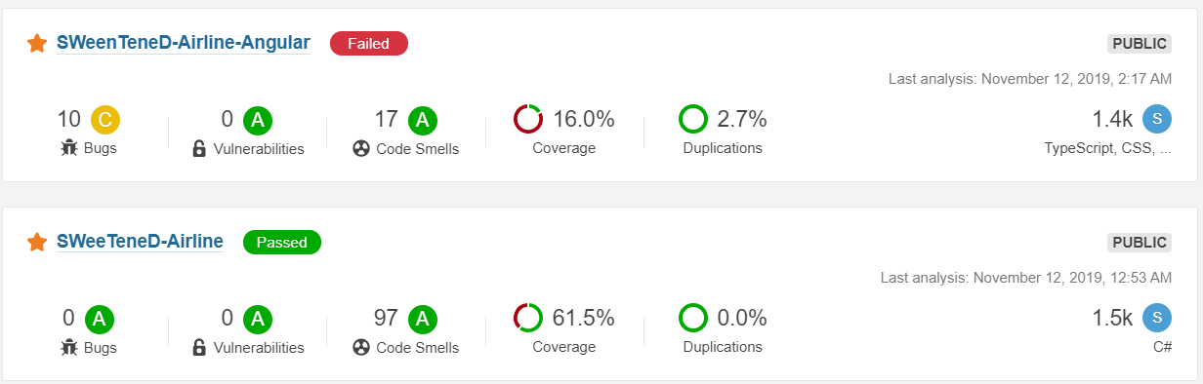

Slide 7
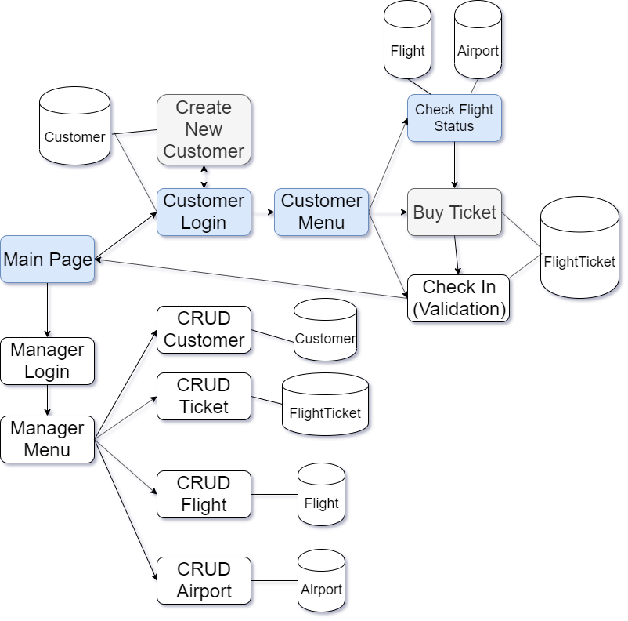
S

Slide 8
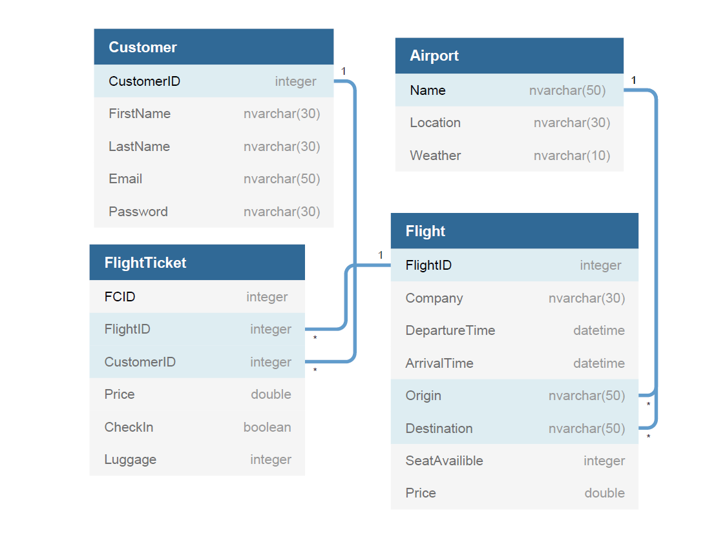

Slide 9
What if…
Complete full CRUD functions from UI(Angular)
Polish the Web page for a sleeker and more responsive design
Utilize 3rd party API
Achieve 50% or higher code coverage on Angular
Implement standard client and server side validation

Slide 10
Questions?

