Slide 1
Chapter 11 Multithreaded Programming

Slide 2
Multithreading Fundamentals
There are two distinct types of multitasking: process-based and thread-based.
Process-based multitasking is the feature that allows your computer to run two or more programs concurrently.
For example, it is process-based multitasking that allows you to run the Java compiler at the same time you are using a text editor or browsing the Internet. In process-based multitasking, a program is the smallest unit of code that can be dispatched by the scheduler.
In a thread-based multitasking environment, the thread is the smallest unit of dispatchable code. This means that a single program can perform two or more tasks at once. For instance, a text editor can be formatting text at the same time that it is printing, as long as these two actions are being performed by two separate threads.

Slide 3
Multithreading Fundamentals…
A principal advantage of multithreading is that it enables you to write very efficient programs because it lets you utilize the idle time that is present in most programs.
As you probably know, most I/O devices, whether they be network ports, disk drives, or the keyboard, are much slower than the CPU. Thus, a program will often spend a majority of its execution time waiting to send or receive information to or from a device.
By using multithreading, your program can execute another task during this idle time. For example, while one part of your program is sending a file over the Internet, another part can be reading keyboard input, and still another can be buffering the next block of data to send.

Slide 4
Multithreading Fundamentals…
Java’s multithreading features work in both types of systems.
In a single-core system, concurrently executing threads share the CPU, with each thread receiving a slice of CPU time.
Therefore, in a single-core system, two or more threads do not actually run at the same time, but idle CPU time is utilized.
However, in multiprocessor/multicore systems, it is possible for two or more threads to actually execute simultaneously. In many cases, this can further improve program efficiency and increase the speed of certain operations.

Slide 5
Multithreading Fundamentals…
A thread can be in one of several states. It can be running. It can be ready to run as soon as it gets CPU time. A running thread can be suspended, which is a temporary halt to its execution. It can later be resumed. A thread can be blocked when waiting for a resource. A thread can be terminated, in which case its execution ends and cannot be resumed.
Along with thread-based multitasking comes the need for a special type of feature called synchronization, which allows the execution of threads to be coordinated in certain well-defined ways. Java has a complete subsystemdevoted to synchronization

Slide 6
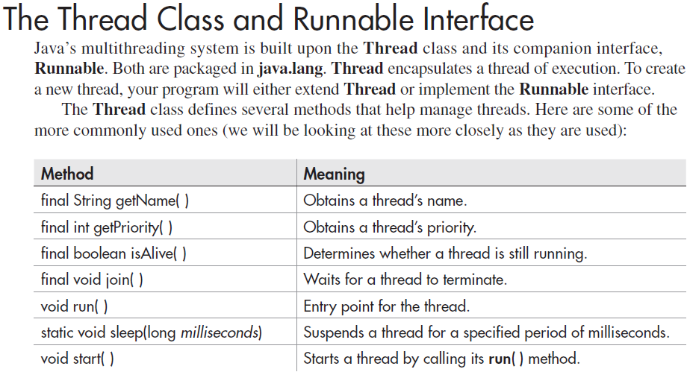

Slide 7
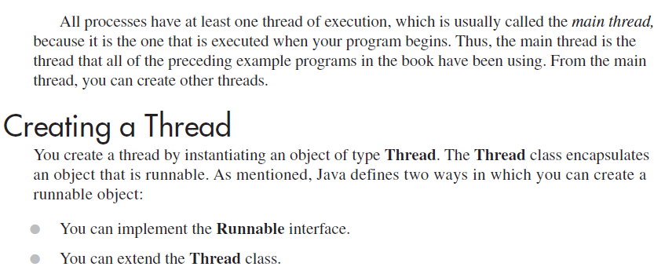

Slide 8
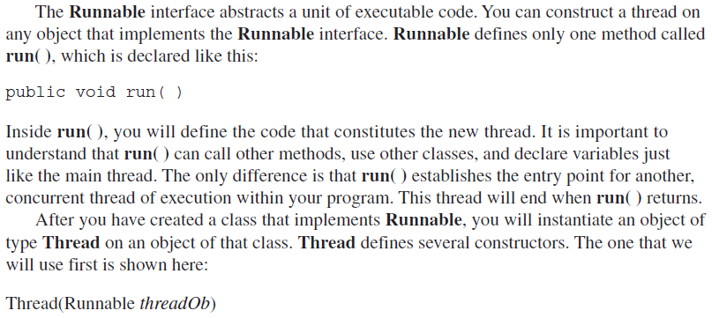

Slide 9
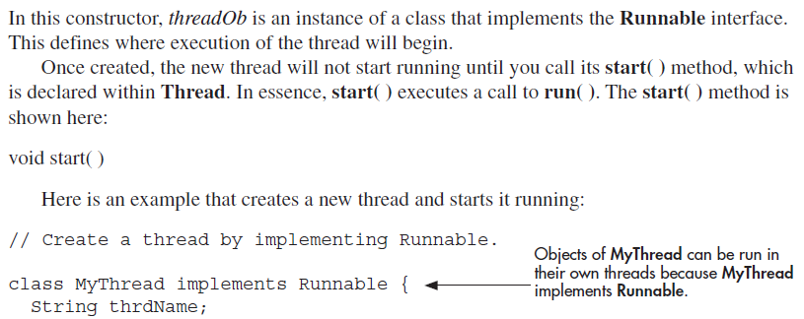

Slide 10
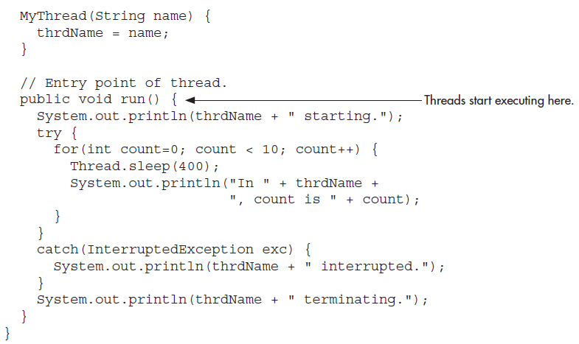

Slide 11
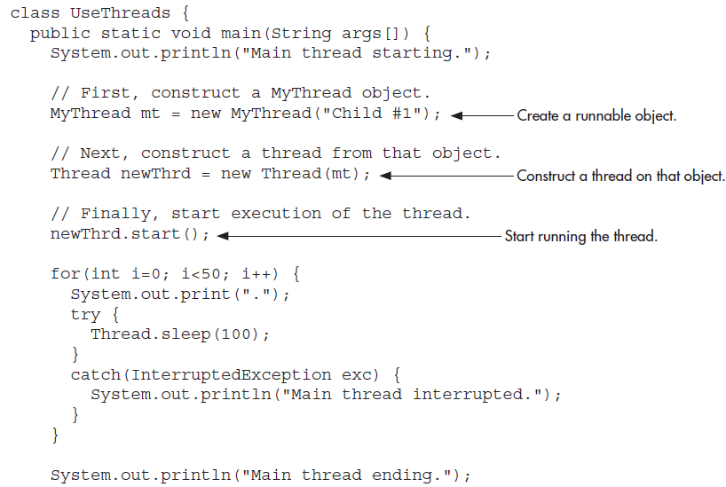

Slide 12
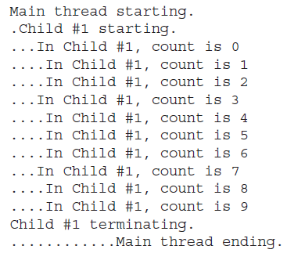


Slide 13
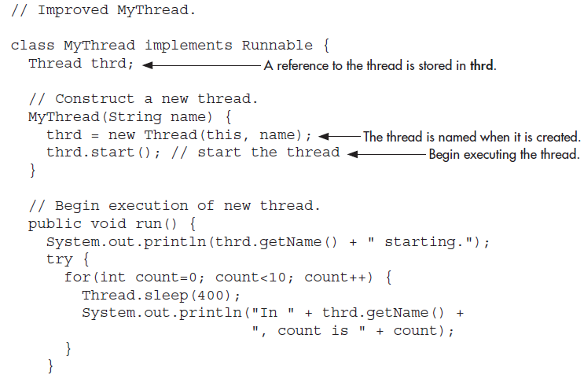

Slide 14
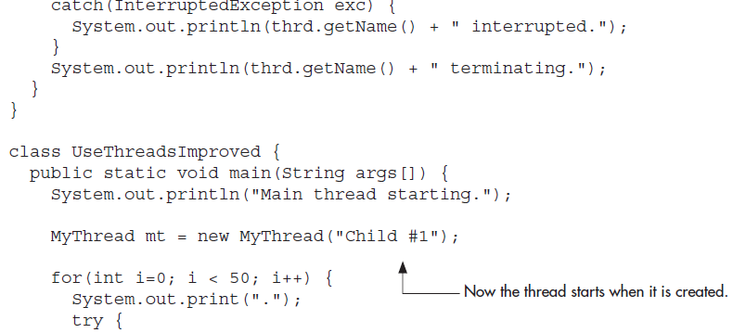
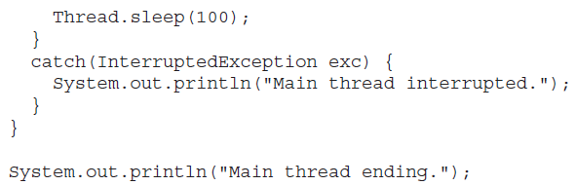

Slide 15
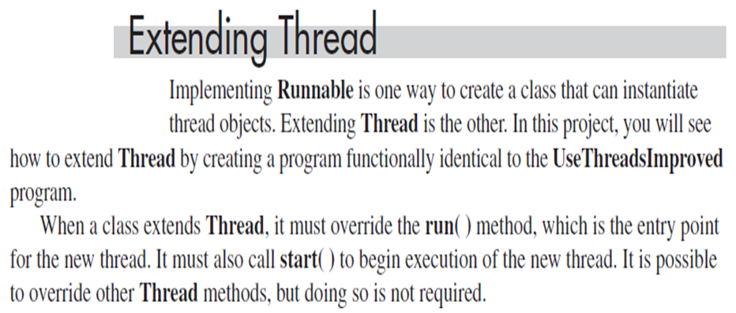
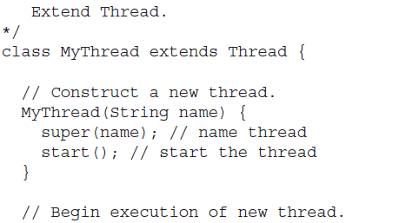

Slide 16
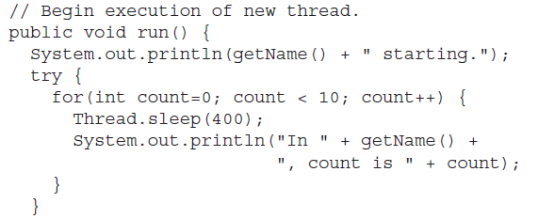
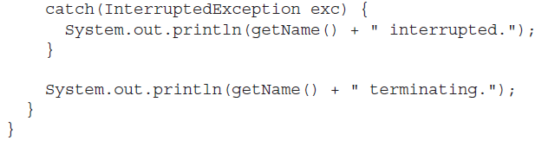

Slide 17
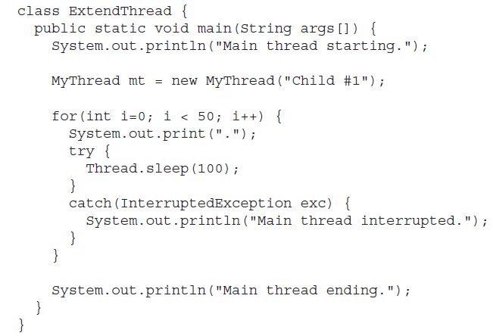

Slide 18
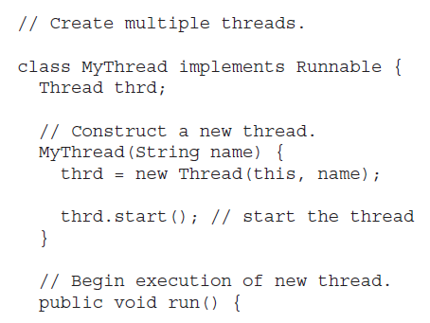

Slide 19
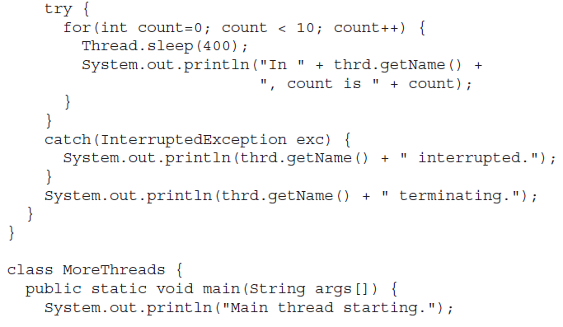

Slide 20
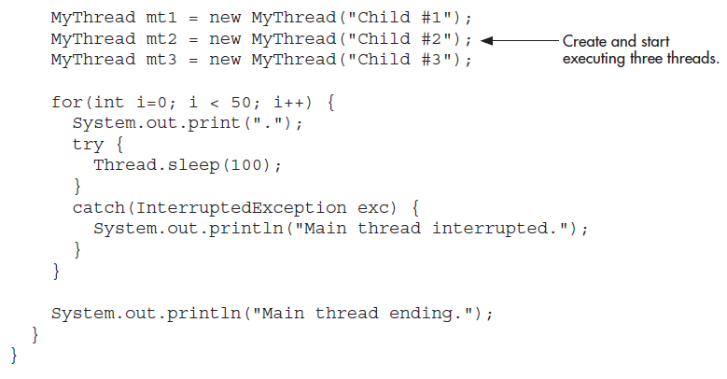

Slide 21
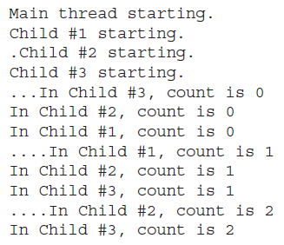
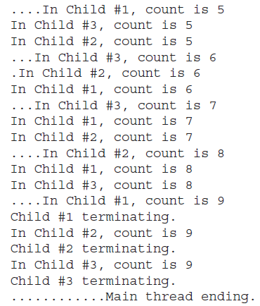
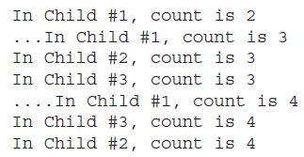

Slide 22
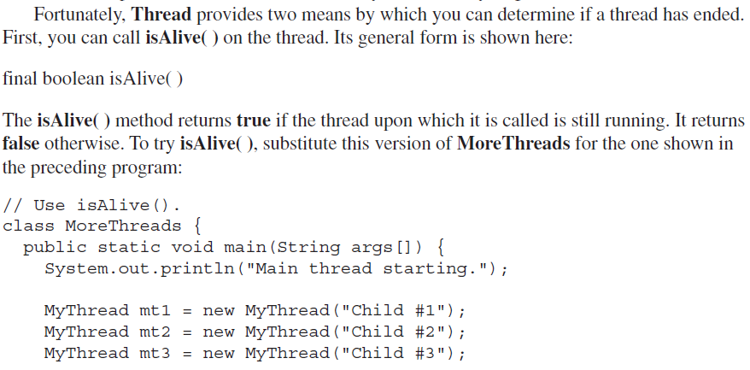

Slide 23

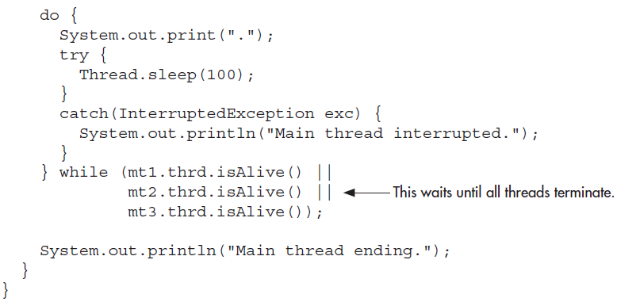

Slide 24
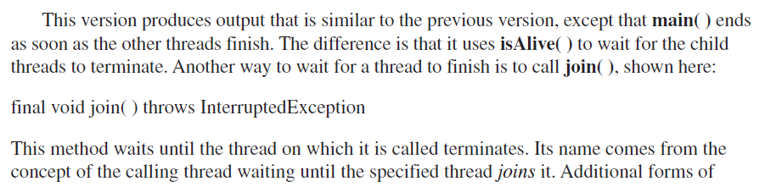
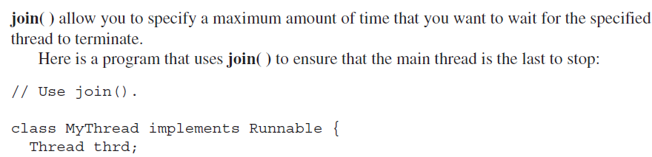

Slide 25
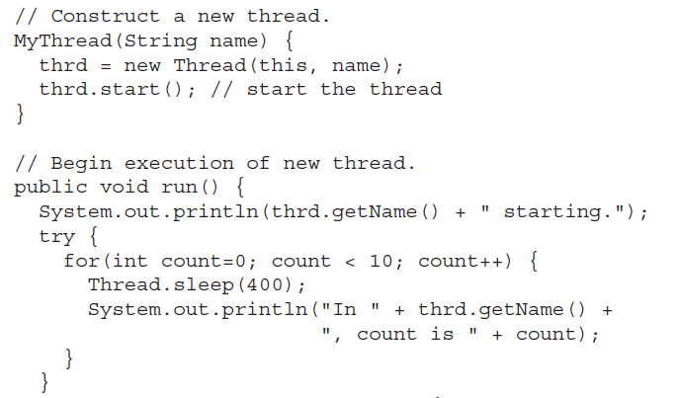

Slide 26
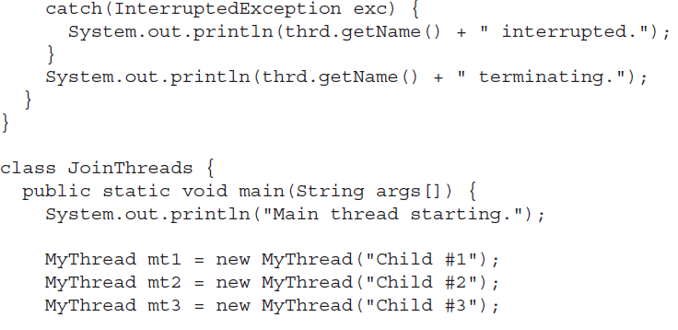

Slide 27
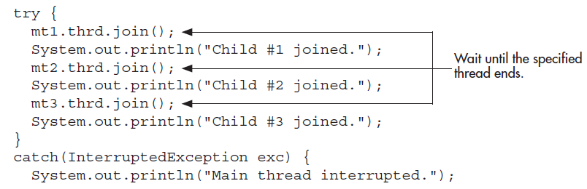
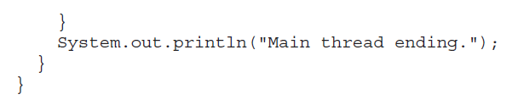

Slide 28
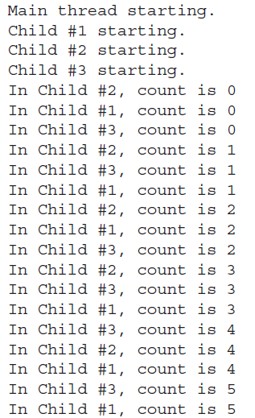
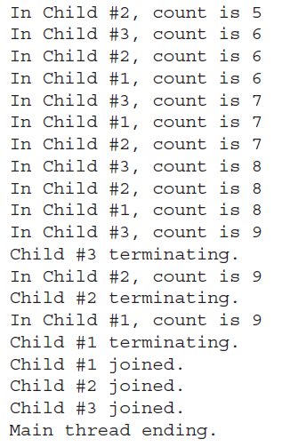

Slide 29
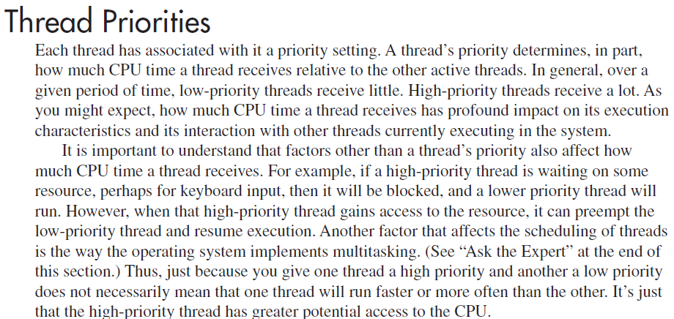

Slide 30
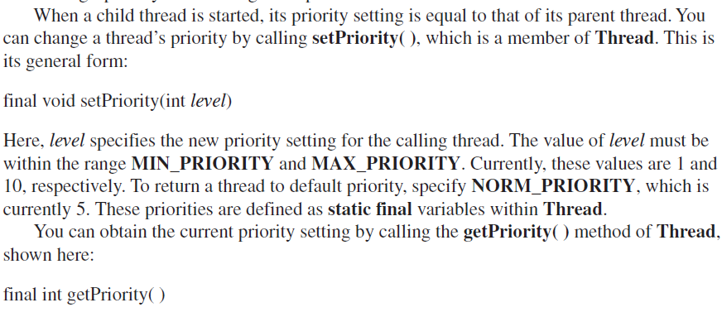

Slide 31
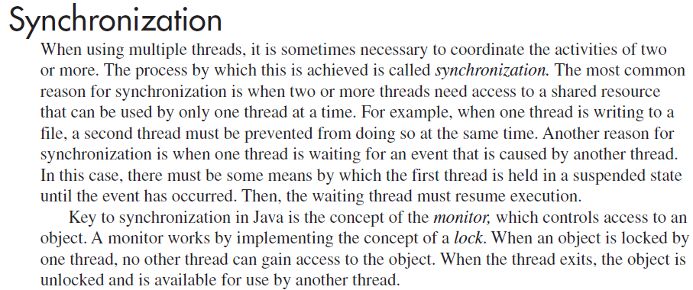

Slide 32
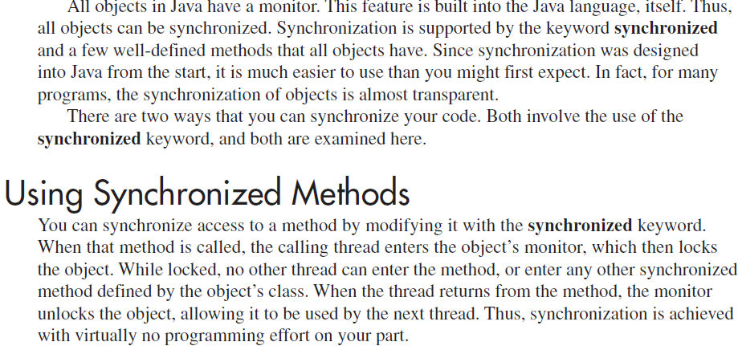

Slide 33
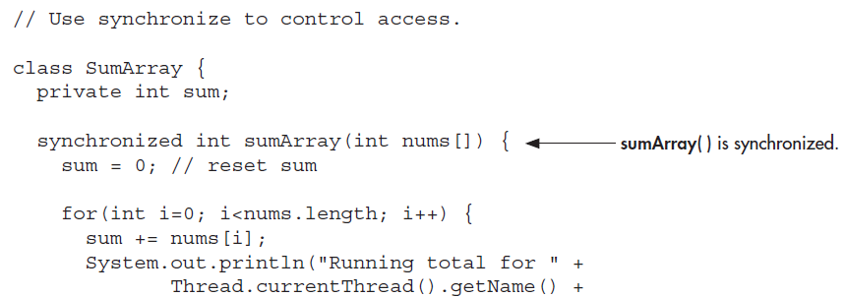
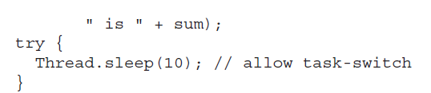

Slide 34
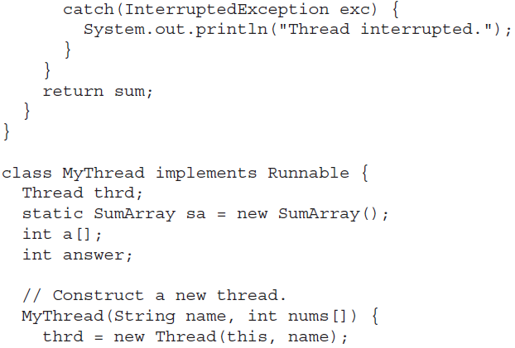

Slide 35
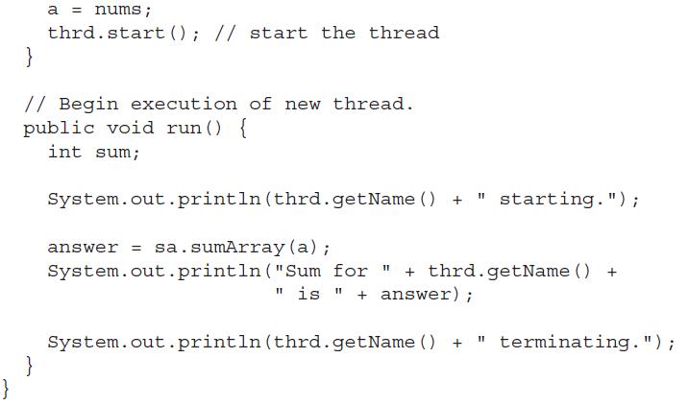

Slide 36
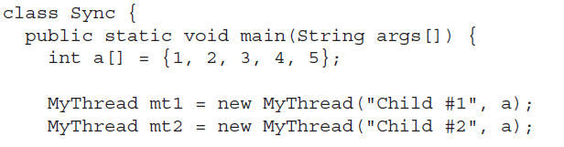
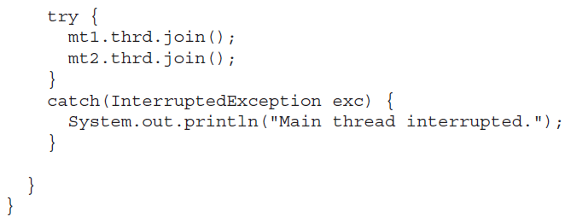

Slide 37
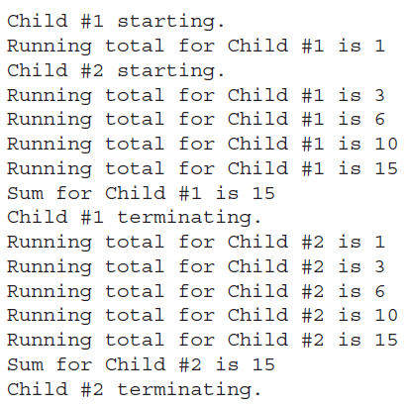

Slide 38
