Slide 1
SCREEN
SCREEN
SCREEN
SCREEN.X = 0
SCREEN.Y = 4
SCREEN.X = 0
SCREEN.Y = 8
SCREEN.X = 0
SCREEN.Y = 0
X = 15
Y = 24
Xc = 15 - 0 = 15
Yc = 28 – 8 = 20
X = 13
Y = 24
Xc = 13 - 0 = 13
Yc = 24 – 4 = 20
X = 15
Y = 20
Xc = 15 - 0 = 15
Yc = 20 – 0 = 20

Slide 2
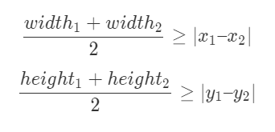


$$\left(x_{1}, y_{1}\right)$$
$$\left(x_{2}, y_{2}\right)$$

