Slide 1

Testen von Datenbanken
Christian Steyrer

Slide 2
Testdatenbank
Mocking vermeiden
Testen gegen echte Datenbanken
In-Memory-Datenbanken
schnell
Docker
Vorteil in der Konfiguration
Docker:
$ docker run -p 3306:3306 -e MYSQL_ROOT_PASSWORD=bob mysql

Slide 3
Datenbankvalidierungen
Data mapping
ACID
Data Integrity
Einhaltung der Geschäftsregeln

Slide 4
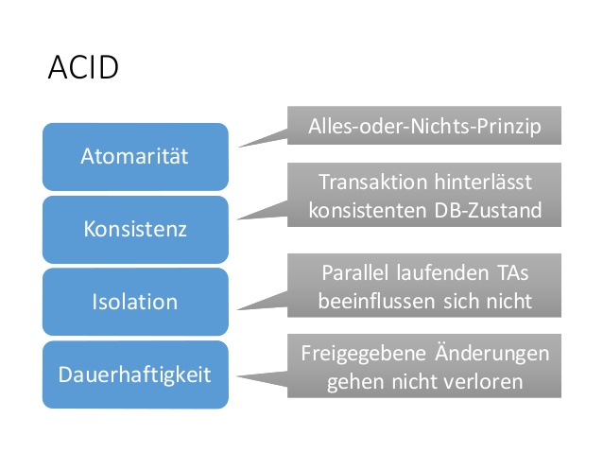
ACID

Slide 5
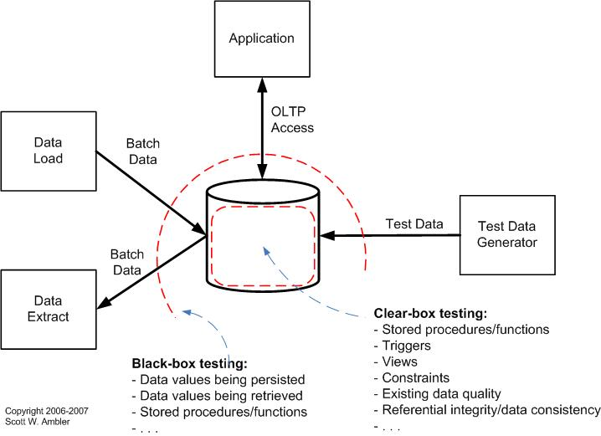
Types of Testing

Slide 6
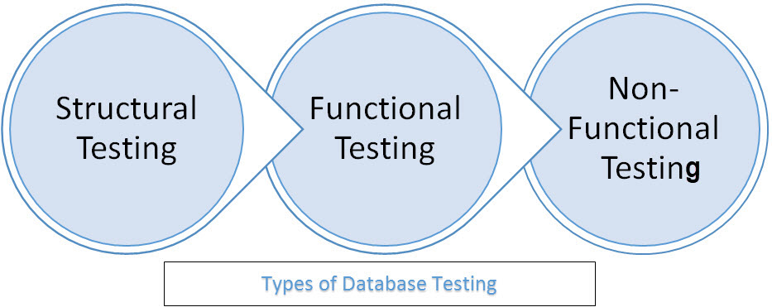
Types of Database Testing

Slide 7
Database Schema Testing
Tabellen, Spalten, Typen
Schlüssel und Indizes
Prozeduren and Funktionen
Trigger

Slide 8
Database Testing Tools
Database Benchmark
Database Rider
Db stress
DbUnit
DB Test Driven
HammerDB
JDBDT (Java DataBase Delta Testing)
NoSQLMap
NoSQLUnit
SeLite
sqlmap

Slide 9
Datenbank-Testschritte
Bereiten Sie die Umgebung vor
Führen Sie einen Test durch
Testergebnis prüfen
Validierung entsprechend der erwarteten Ergebnisse
Berichterstattung an die jeweiligen Stakeholder

Slide 10
Database Migrations
DB-Migration ermöglicht folgende Dinge:
Die Datenbank von Grund auf neu zu erstellen.
Den Zustand der Datenbank festzulegen.
Von der aktuellen Version der Datenbank zu einer neueren Version zu wechseln.

Slide 11
JDBC - Statements
Statement
PreparedStatement
CallableStatement

Slide 12
JDBC - CallableStatement
CallableStatement callableStatement = connection.prepareCall("{call calculateStatistics(?, ?)}"); callableStatement.setString(1, "param1"); callableStatement.setInt (2, 123); callableStatement.registerOutParameter(1, java.sql.Types.VARCHAR); callableStatement.registerOutParameter(2, java.sql.Types.INTEGER); ResultSet result = callableStatement.executeQuery(); while(result.next()) { ... } String out1 = callableStatement.getString(1); int out2 = callableStatement.getInt (2);

Slide 13
JDBC - Metadaten
try(ResultSet columns = connection.getMetaData().getColumns(null,null, tableName, null);) { while (columns.next()) { String columnName = columns.getString("COLUMN_NAME"); String datatype = columns.getString("DATA_TYPE"); String columnsize = columns.getString("COLUMN_SIZE"); String decimaldigits = columns.getString("DECIMAL_DIGITS"); String isNullable = columns.getString("IS_NULLABLE"); String is_autoIncrment = columns.getString("IS_AUTOINCREMENT"); } }

Slide 14

AssertJ-DB
Table
Request
Changes

Slide 15
Table
Table table = new Table(dataSource, "members", new Table.Order[] { Table.Order.asc("name")}, new String[] { "id", "name" }, new String[] { "id" });

Slide 16
Request
Request request = new Request(dataSource, "select name, firstname from members where id = 2 or id = 3");

Slide 17
Request mit Parameter
Request request = new Request(dataSource, "select name, firstname from members " + "where name like ? and firstname like ?;", "%e%", "%Paul%");

Slide 18
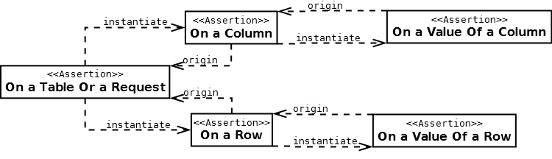
Navigation - Table or Request

Slide 19
root
assertThat(tableOrRequest)...

Slide 20
To a Row
assertThat(tableOrRequest).row()...
assertThat(tableOrRequest).row().row()...
assertThat(tableOrRequest).row(2)...
assertThat(tableOrRequest).row(2).row(6)...
assertThat(tableOrRequest).row(2).row()...

Slide 21
Return from row
assertThat(table).row().returnToTable()...
assertThat(request).row().returnToRequest()...
assertThat(table).row().returnToTable().row()...
assertThat(table).row().row()...

Slide 22
To a Column
assertThat(tableOrRequest).column().column()...
assertThat(tableOrRequest).column(2).column(6)...
assertThat(tableOrRequest).column(2).column()...
assertThat(tableOrRequest).column("surname")...

Slide 23
Return from column
assertThat(table).column().returnToTable()...
assertThat(request).column().returnToRequest()...
assertThat(table).column().returnToTable().column()...
assertThat(table).column().column()...

Slide 24
Rows and columns
assertThat(tableOrRequest).column(3).row(2).column()...
origin point: table or request

Slide 25
To a Value
origin point: Row or the Column
assertThat(tableOrRequest).column().value().value()...
assertThat(tableOrRequest).column().value(3).row(2).column(0).value()...
assertThat(tableOrRequest).row().value("surname")...
assertThat(table).column().value().returnToColumn()...
assertThat(request).row().value().returnToRow()...

Slide 26
Changes
Changes changes = new Changes(dataSourceOrTableOrRequest); changes.setStartPointNow(); -- makeChangesInTheData(); changes.setEndPointNow();

Slide 27
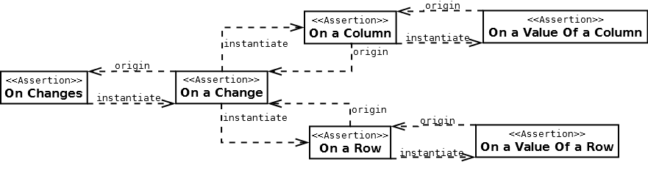
Navigation - Changes

Slide 28
Complex SQL
SELECT AUTHOR.FIRST_NAME, AUTHOR.LAST_NAME, COUNT(*) FROM AUTHOR JOIN BOOK ON AUTHOR.ID = BOOK.AUTHOR_ID WHERE BOOK.LANGUAGE = 'DE' AND BOOK.PUBLISHED_IN > 2008 GROUP BY AUTHOR.FIRST_NAME, AUTHOR.LAST_NAME HAVING COUNT(*) > 5 ORDER BY AUTHOR.LAST_NAME ASC NULLS FIRST LIMIT 2 OFFSET 1 FOR UPDATE

Slide 29
JOOQ
DSLContext create = DSL.using(dataSource); create.select(AUTHOR.FIRST_NAME, AUTHOR.LAST_NAME, count()) .from(AUTHOR) .join(BOOK).on(BOOK.AUTHOR_ID.eq(AUTHOR.ID)) .where(BOOK.LANGUAGE.eq("DE")) .and(BOOK.PUBLISHED_IN.gt(2008)) .groupBy(AUTHOR.FIRST_NAME, AUTHOR.LAST_NAME) .having(count().gt(5)) .orderBy(AUTHOR.LAST_NAME.asc().nullsFirst()) .limit(2) .offset(1) .forUpdate() .fetch();

Slide 30

Database Rider
Database Unit Tests
JUnit 5
DataSets
YAML, XML, JSON, CSV or XLS

Slide 31
POM
<dependency> <groupId>com.github.database-rider</groupId> <artifactId>rider-junit5</artifactId> <version>1.9.1</version> <scope>test</scope> </dependency>

Slide 32
DataSet YML
public.author: - id: 1 first_name: George last_name: Orwell date_of_birth: 1903-06-25 year_of_birth: 1903 address: null - id: 2 first_name: Paulo last_name: Coelho date_of_birth: 1947-08-24 year_of_birth: 1947 address: null

Slide 33
Database Rider verwenden
@QuarkusTest @ExtendWith({DBUnitExtension.class}) public class DBUnit { @Inject AgroalDataSource dataSource; private ConnectionHolder connectionHolder = () -> dataSource.getConnection();

Slide 34
Database Rider verwenden
@Test @DataSet(value = "books.yml") public void shouldFindAllBooks() { List<Book> books = repository.findAll(); assertThat(books) .isNotNull() .hasSize(4) .extracting("title") .contains("H2G2","Dune", "Nineteen Eighty-Four", "The Silmarillion"); }

Slide 35
Database Rider verwenden
@Test @DataSet("empty.yml") @ExpectedDataSet(value = "empty.yml") public void empty() { }

Slide 36
DataSet exportieren
@Test @ExportDataSet(format = DataSetFormat.YML,outputName="src/test/resources/output/allTables.yml") public void shouldExportAllTablesInYMLFormat() { }

Slide 37
Quellen
https://www.xenonstack.com/insights/what-is-database-testing/
https://jaxenter.de/wohl-oder-uebel-es-muss-gemacht-werden-datenbank-tests-26109
http://www.agiledata.org/essays/databaseTesting.html
http://www.agiledata.org/essays/whatToTest.html
https://www.testbytes.net/blog/database-testing/
https://www.guru99.com/data-testing.html
https://www.tutorialspoint.com/database_testing/
https://www.softwaretestinghelp.com/database-testing-process/
https://www.techbeamers.com/database-testing/#what-is-database-testing-and-why-is-it-important
https://de.wikipedia.org/wiki/ACID
https://image.slidesharecdn.com/bigdata20153-150312093513-conversion-gate01/95/bigdataanalyse-und-nosqldatenbanken-44-638.jpg?cb=1426153163
https://github.com/database-rider/database-rider
https://joel-costigliola.github.io/assertj/assertj-db.html
https://joel-costigliola.github.io/assertj/assertj-db-concepts.html

