Slide 1

IoT and Cloud-Driven Forest Monitoring System for Wildlife Conservation and Threat Detection
CSA1507:CLOUD COMPUTING AND BIG DATA ANALYTICS FOR DATA CENTER
PRESENTED BY:
A.NARENDRA KUMAR REDDY-192211960
P. BHANU MURALIDHAR REDDY-192211961
SAVEETHA SCHOOL OF ENGINEERING
SIMATS
UNDER THE SUPERVISION OF:
DR. GNANA SOUNDARI
SAVEETHA SCHOOL OF ENGINEERING
SIMATS

Slide 2
LIST OF CONTENTS
S. No | Content
1 | INTRODUCTION
2 | OBJECTIVES
3 | EXISTING SYSTEM & DRAWBACKS
4 | PROPOSE SYSTEM
5 | BLOCK DIAGRAM
6 | TECHNIQUES USED
7 | MODULES
8 | CONCLUSION & FUTURE ENHANCEMENTS
9 | REFERENCES

Slide 3
Introduction
Forest Sustainability
Challenges Facing Forests
Forests are vital ecosystems that provide numerous benefits, from clean air and water to biodiversity and climate regulation.
Forests are facing growing threats like deforestation, wildfires, and illegal logging, impacting their health and our planet.
Cloud computing integration
Role of IOT in forest monitoring
IoT involves deploying sensors, cameras, drones, and other devices in forest environments. These devices collect real-time data on wildlife movements, environmental conditions, and human activity.
Centralized cloud platforms store and process the massive data collected by IoT devices. Advanced analytics and machine learning on the cloud enable pattern recognition and anomaly detection.

Slide 4
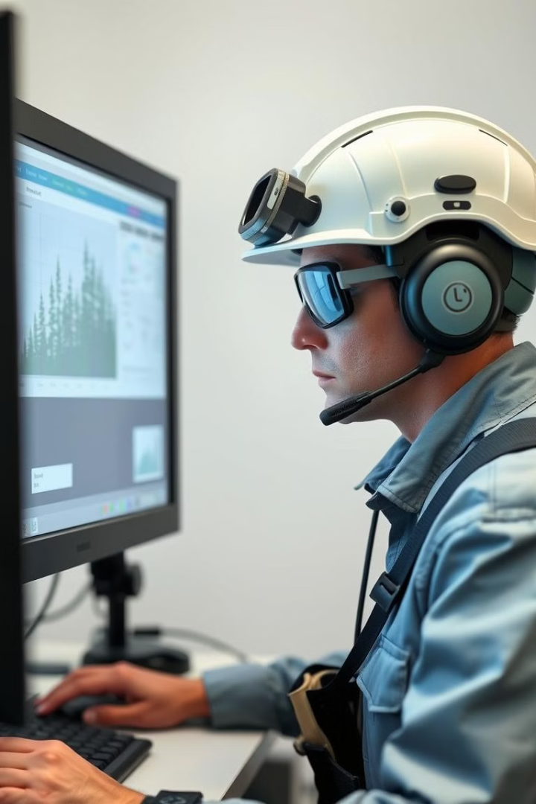
Objectives
1
1. Real-time Monitoring
2
2. Early Detection and Response
Develop a system that provides real-time data on forest conditions, including fire hazards, insect infestations, and illegal activities.
Enable early detection of threats and facilitate swift response through automated alerts and coordinated efforts.
3
3. Data-driven Management
Leverage data analytics to optimize forest management practices, enhance resource allocation, and improve conservation outcomes.

Slide 5
Existing System & Drawbacks
Sensor based monitoring systems
Use sensors like motion detectors, sound recorders, cameras, and GPS trackers to monitor wildlife activities and human presence.
Sensors collect data on environmental conditions like temperature, humidity, and soil moisture to detect fire risks or habitat degradation.
Drone and UAV Integration:
Drones equipped with thermal cameras and sensors are used for aerial surveys and monitoring.
Useful for tracking animal movements or detecting poachers.
Connectivity Challenges
Forest areas often lack reliable communication infrastructure, leading to data transmission delays or failures.
Limited coverage of cellular networks or low-power wide-area networks (LPWANs) in remote regions.

Slide 6
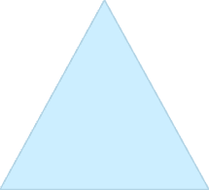



Proposed System
Smart Forest Guardian
A comprehensive, intelligent system that leverages cutting-edge technologies to monitor and protect forests.
1
Sensor Networks
2
Deploying a network of sensors to collect data on forest conditions, including temperature, humidity, and air quality.
Artificial Intelligence
3
Utilizing machine learning algorithms to analyze sensor data, detect anomalies, and predict potential threats.
Decision Support
4
Providing real-time alerts, notifications, and decision support tools to forest managers and responders.

Slide 7
SAMPLE IMPLEMENTATION
The system is deployed in a forest or a monitoring region with a maximum range of 20 km.
Sensors, such as temperature, humidity, and smoke detectors, are spread across the area to detect signs of threats.

Slide 8





Block Diagram
Sensor Network
A network of diverse sensors deployed across the forest to collect data on various environmental parameters
Data Acquisition
Sensors collect real-time data on temperature, humidity, air quality, and other forest conditions.
Data Processing
Data is transmitted to a central processing unit where machine learning algorithms analyze and interpret the data.
Alert System
The system generates alerts and notifications when anomalies or potential threats are detected.
Decision Support
Forest managers receive real-time insights and decision support tools to respond to emerging threats effectively.

Slide 9
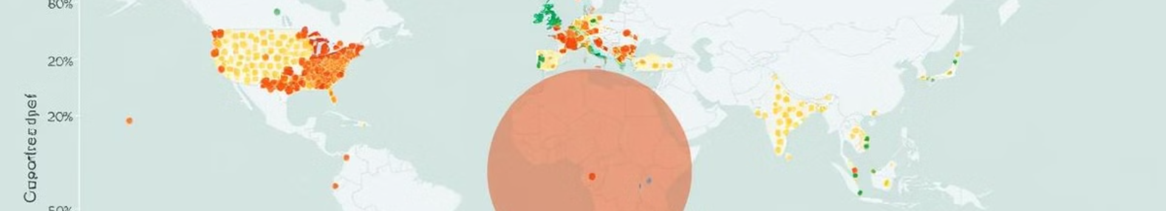
Techniques Used
Internet of Things (IoT)
Machine Learning
Utilizing a network of connected devices to collect and transmit data in real-time.
Employing algorithms to analyze data, detect patterns, and predict potential threats.
Cloud Computing
Data Visualization
Storing and processing data on a secure, scalable cloud platform.
Presenting data in a clear and intuitive way to support informed decision-making.

Slide 10
Modules
Monitoring Module
Analysis Module
Responsible for collecting and transmitting data from sensors across the forest.
Utilizes machine learning algorithms to analyze data, detect anomalies, and generate alerts.
Decision Support Module
Alert System Module
Generates alerts and notifications to forest managers and responders based on detected threats.
Provides forest managers with real-time insights, decision support tools, and visualizations.

Slide 11
Conclusion & Future Enhancements
Benefits
1
The Smart Forest Guardian system provides a powerful solution for enhancing forest monitoring and protection.
Next Steps
2
Further research and development will explore advanced AI models, drone integration, and collaboration with local communities.

Slide 12
References
"IoT Applications in Wildlife Conservation: Tracking and Protecting Endangered Species" (2024)Discusses IoT networks for tracking animals, monitoring habitats, and providing real-time alerts for conservation efforts. IEEE Xplore, 2024【6】
"IoT-Based Forest and Wildlife Monitoring Systems for Conservation Efforts" (2019) Highlights IoT-enabled virtual barriers and environmental sensors for fire prevention and wildlife protection. IRJET, 2019【7】.
"How IoT Can Revolutionize Forest Monitoring and Wildfire Detection" (2023) Explains IoT systems using sensors for real-time wildfire detection and rapid response. IoT Insider, 2023【8】.
"Connected Conservation: Protecting Habitats with Technology" (2024) Discusses the use of drones, motion-triggered cameras, and AI for wildlife tracking and habitat protection in challenging terrains. Highlights real-world examples like Ol Pejeta Conservancy. ITU Insights, 2024
"IoT Networks for Wildlife and Habitat Monitoring" (2020) Covers the deployment of IoT devices like GPS collars and environmental sensors to track animal migration and detect habitat threats in real time. Environmental Science & Technology Journal, 2020.

