Slide 1
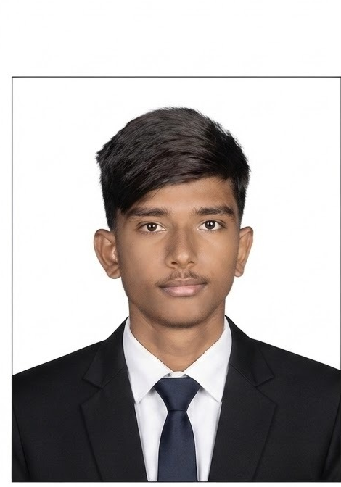

T
TrachCare — Tracheostomy Home Care App
A Flutter mobile application that guides discharged tracheostomy patients through daily care — structured vitals reports, a timed spigotting schedule, therapy videos and a doctor review console.
Presented by
Scan to connect
Santhosh L
LinkedIn
Scan the QR code to view my profile
Reg. No. 192321178
santhoshl1178.sse@saveetha.com
Department: BTech IT
Timeline: 03 Months — 25th Oct 2026
Patient · Doctor · Admin — one platform

Slide 2
Problem Statement
2
Ravi, a post-operative tracheostomy patient recovering at home, needs a structured way to record daily tube care, vitals and spigotting progress because today his follow-up depends on phone calls and memory — and his doctor cannot see deterioration between visits.
• Daily care reported informally over calls or chat — clinical detail is lost.
• No day-by-day record: missed dressing changes or failed spigotting attempts surface only at the next visit.
• Doctors cannot track weaning progress remotely; patients have no guided routine at home.
TrachCare | Virtusa Project

Slide 3
Project Planner
3
September
October
November
December
January
Concept dev
Research
Frontend dev
Backend dev
Database
Redesign
Launch
15-week plan: analysis → design → Flutter build → PHP/MySQL backend → hardening → demo
TrachCare | Virtusa Project

Slide 4
Competitive Analysis
4
Criteria | TrachCare | Generic telehealth | WhatsApp / phone | Physical review
Tracheostomy-specific care | ✓ | — | — | Partial
Structured daily vitals form | ✓ | — | — | At visit only
Spigotting session schedule | ✓ | — | — | —
Guided exercise videos | ✓ | Rarely | Ad hoc links | Verbal
Calendar of daily reports | ✓ | Partial | — | —
PDF export of patient record | ✓ | Partial | — | File copies
Gap Analysis
Our Uniqueness
• No structured daily record of home care
• Spigotting / weaning progress untracked
• No shared record between patient, doctor and admin
• No audit trail of reported care
• Complete tracheostomy home-care tracking in one app
• Role-based access for Patient, Doctor and Admin
• Daily reports, timed spigotting, videos and PDF export
TrachCare | Virtusa Project

Slide 5
User Persona : Ravi (Patient)
5
“I want my daily tube care recorded properly without a hospital visit every week.”
R
Goals & Needs
Frustrations
• Follow daily tracheostomy care steps correctly
• Record vitals and tube-care tasks without paperwork
• Track spigotting (weaning) progress day by day
• Learn correct care from guided exercise videos
• Stay connected to the treating doctor between visits
• Unsure which readings matter and how often to record
• Forgets care steps and session timings
• Cannot reach the doctor quickly when worried
• No feedback on whether readings are normal
• Paper diary entries are lost or incomplete
AGE
58
OCCUPATION
Retired clerk
STATUS
Married
LOCATION
Chennai, India
TrachCare | Virtusa Project

Slide 6
User Persona : Dr. Meera (Doctor)
6
“I need to see each patient’s daily progress at a glance, not reconstruct it from phone calls.”
M
Goals & Needs
Frustrations
• Register discharged patients with full clinical baseline
• Review each patient’s daily report by date on a calendar
• See who submitted today’s update at a glance
• Track spigotting session completion remotely
• Export a complete patient record as PDF
• Verbal phone updates lose clinical detail
• No comparable day-by-day history between visits
• Worsening vitals trends are invisible until urgent
• Managing many home-care patients by memory
• No printable record for the patient file
AGE
41
OCCUPATION
ENT surgeon
STATUS
Married
LOCATION
Chennai, India
TrachCare | Virtusa Project

Slide 7
Empathy Maps
7
SAYS
DOES
• “It is easy to log my daily care now”
• “My records feel secure”
• “The videos show me exactly what to do”
• Submits a daily vitals + care-task form
• Follows the timed spigotting sessions
• Watches therapy videos and checks the calendar
THINKS
FEELS
• Is my breathing-hold time improving?
• Did the doctor see today’s report?
• Am I doing the dressing correctly?
• Reassured — doctor watches progress daily
• Confident — guided routine at home
• Motivated — visible day-by-day recovery
Users: patient · caregiver · doctor · admin
TrachCare | Virtusa Project

Slide 8
Pain Points
8
1
2
3
Daily care is complex and paper diaries are incomplete, so clinically important details are lost.
Spigotting weaning sessions are easy to forget and impossible to review without a timed record.
Doctors cannot see patient progress between visits — a worsening trend stays invisible until it becomes an emergency.
TrachCare turns daily tracheostomy care into structured digital reports with a timed schedule and a doctor review console.
TrachCare | Virtusa Project

Slide 9
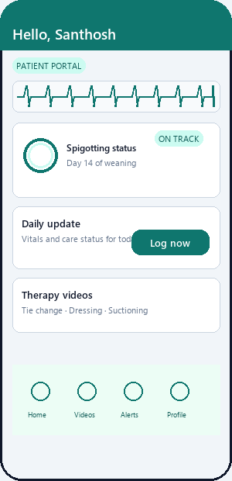
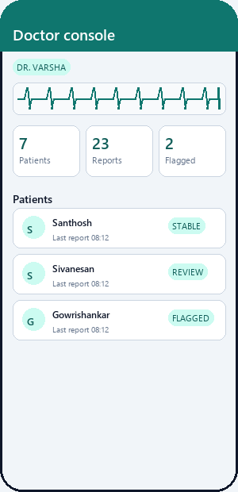
Storyboard
9
1
2
3
4
5
Discharge
Daily care
Spigotting
Review
Export
Doctor registers the patient with baseline clinical details
→
Patient logs vitals and care tasks in a guided form
→
Timed sessions tracked through the day on the dashboard
→
Doctor reviews reports on a calendar, flags issues
→
Full patient record exported as PDF for the file
Patient dashboard — daily update, spigotting status, videos
Doctor monitor — today’s updates and patient list
TrachCare | Virtusa Project

Slide 10
User Journey Map
10
Stage | Awareness | Onboarding | Daily Care | Doctor Review | Recovery
Actions | Hears about app at discharge | Doctor registers patient; patient logs in | Submits vitals, care tasks, spigotting | Doctor checks today’s reports on calendar | PDF export; follow-up completed
Goals | Understand home-care routine | Get set up quickly | Keep a consistent record | Catch problems early | Evidence of progress
Touchpoints | Hospital counselling | Role login screens | Dashboard, daily form, session chips | Calendar, report detail, alerts | Reports, PDF, visits
Feeling | Anxious | Hopeful | Building habit | Reassured | Motivated
TrachCare | Virtusa Project

Slide 11
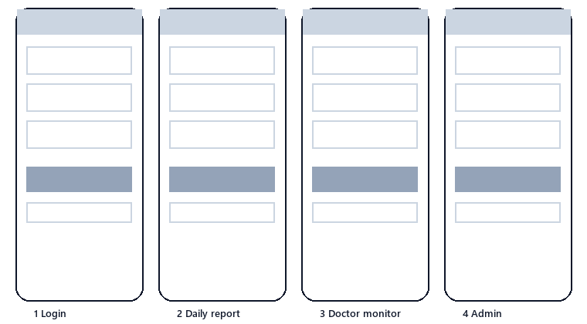
Paper Wireframes
11
Early sketches of the three role flows — patient daily check-in, doctor review and admin management.
TrachCare | Virtusa Project

Slide 12
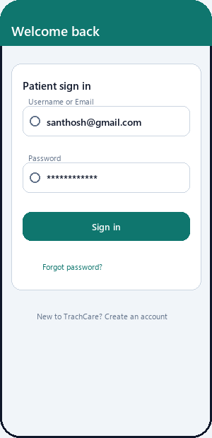
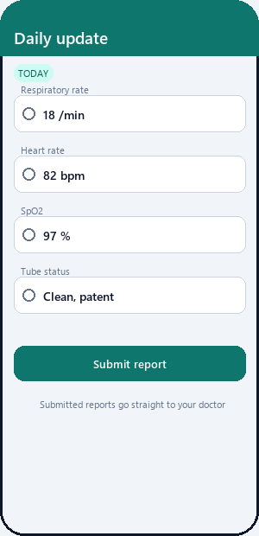
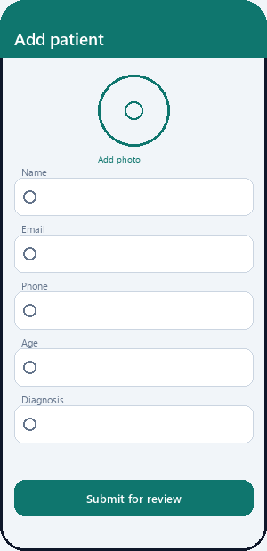
Low Fidelity UI Design
12
Role login
Daily update form
Add patient
TrachCare | Virtusa Project

Slide 13

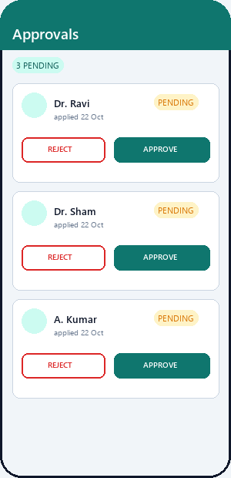
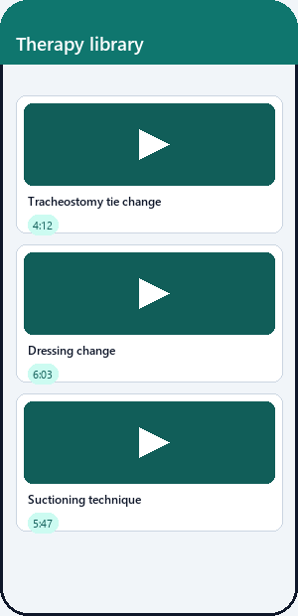
High Fidelity UI Design
13
Splash
Patient home
Doctor monitor
Approvals
Video library
Teal healthcare theme · shared design system · IBM Plex Sans
TrachCare | Virtusa Project

Slide 14
Development Stack
14
FRONT END
BACK END
DATABASE
Flutter (Dart)
PHP REST API
MySQL / MariaDB
Role-based screens for Patient, Doctor and Admin · one codebase for Android, Windows and web · media_kit video, table_calendar, image_picker
JSON endpoints over HTTPS on Apache · auth/Patient/Doctor/Admin routes · multipart uploads for photos, videos and thumbnails
trachcare schema — patients, daily reports, spigotting status, video catalogue · triggers auto-provision login, profile and status rows
Flutter client → HTTP/JSON → PHP endpoints → MySQL — three-tier design with role-separated APIs
TrachCare | Virtusa Project

Slide 15
Gestalt's Principles : UXD Design Iterations
15
VERSION 0.1
VERSION 0.2
• Washed-out pastel green/peach palette
• Heavy shadows, inconsistent widgets
• Duplicated name cards and video lists
• One teal healthcare theme + shared design system
• Recognizable icons, clear card-based layout
• Colour-coded statuses and good visual hierarchy
→
Similarity
Proximity
Shared AppCard / VideoCard / PatientNameCard widgets keep repeated content visually consistent
Daily-update fields grouped into Vitals / Daily care / Spigotting cards
Common region
Figure-ground
Status chips and story rings group related patient state
Gradient headers separate identity from content
TrachCare | Virtusa Project

Slide 16
Nielsen's Heuristic Principles : Iterations
16
Visibility of system status
Match with the real world
Spigotting session chips show done / current / locked states with colour coding.
Care tasks use clinical wording (dressing, tie change, suctioning) with Yes/No chips.
User control & freedom
Error prevention
Edit profile, back navigation and explicit dialogs on every destructive action.
Required vitals validated before submit; sessions unlock only in time order.
Recognition over recall
Feedback
Dashboard shows next appointment, today’s sessions and last report without searching.
Toasts, upload progress and empty states confirm every action.
TrachCare | Virtusa Project

Slide 17
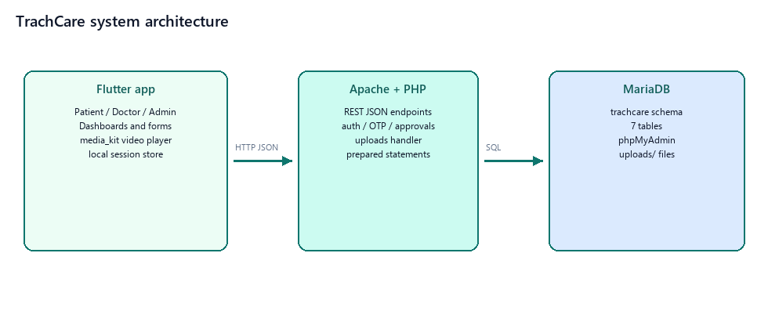
Software Architecture
17
Three-tier design: Flutter app → PHP REST API (JSON over HTTPS) → MySQL "trachcare" schema with provisioning triggers.
TrachCare | Virtusa Project

Slide 18
WCAG — Accessibility Considerations
18
1
Simple, clear layouts with readable contrast and the teal theme make the app easy for all users to understand.
2
Large touch targets (≥48 dp), readable text and Yes/No chips let elderly patients log daily care with few taps.
3
Guided exercise videos, clear labels and status feedback support caregivers with limited clinical or digital experience.
TrachCare | Virtusa Project

Slide 19
Takeaways
19
Impact
What I learned
TrachCare gives discharged tracheostomy patients a guided daily routine and gives doctors a structured record between visits.
It replaces informal phone-call follow-up with an auditable, day-by-day clinical history.
The same role-based pattern extends to other post-surgical home-care pathways.
A shared design system keeps ~40 role screens consistent and fast to iterate.
Database triggers can safely auto-provision related rows on patient registration.
Shipping an MVP early and iterating on feedback beats polishing in isolation.
TrachCare | Virtusa Project

Slide 20
Next Steps
20
1
2
3
Usability testing
Clinical alerts
Smarter care
Run structured walkthroughs with patients, caregivers and the care team; refine the daily form from feedback.
Flag abnormal vitals and escalate missed daily reports to the treating doctor with push notifications.
Offline-first sync, multi-language support, medication schedules and AI-assisted trend summaries.
TrachCare | Virtusa Project

Slide 21
Let's Connect
Thank you for your time reviewing my work. Scan the QR code or reach out to keep in touch.
Santhosh L
Reg. No. 192321178
santhoshl1178.sse@saveetha.com
BTech IT · TrachCare Project
Scan — LinkedIn profile
TrachCare | Virtusa Project

