Slide 1
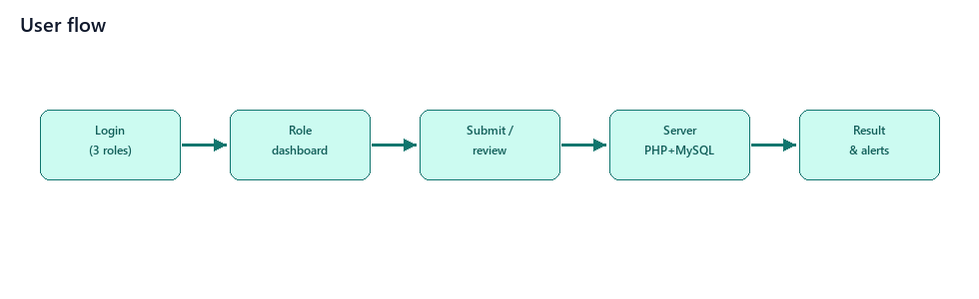
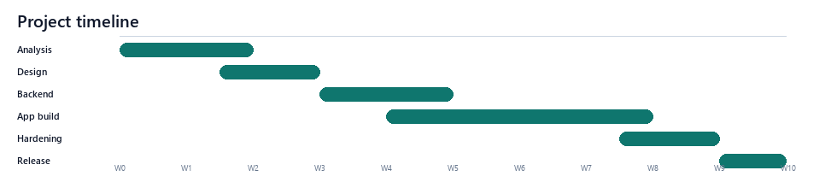
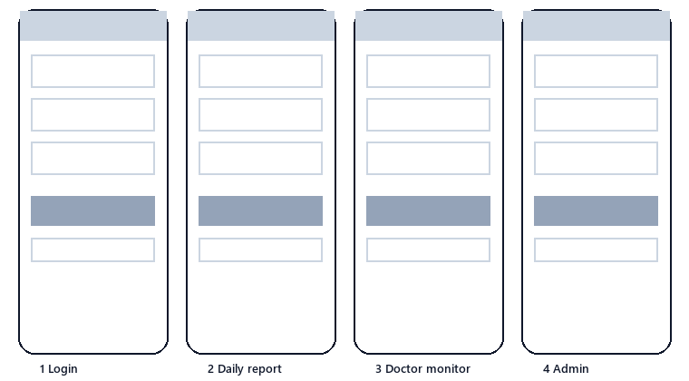
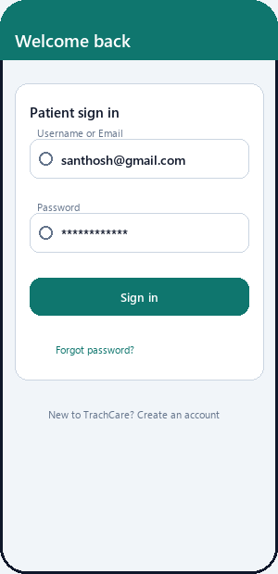
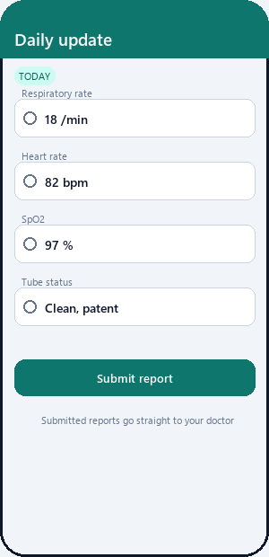
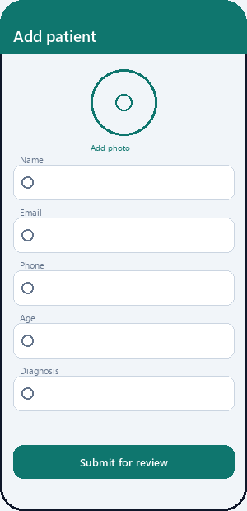
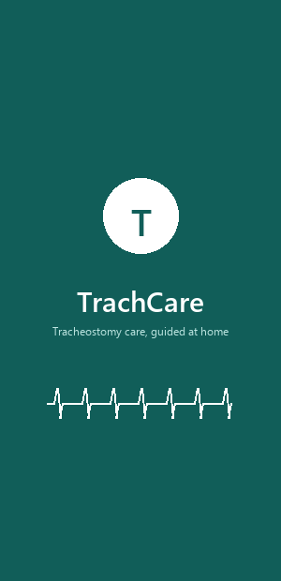
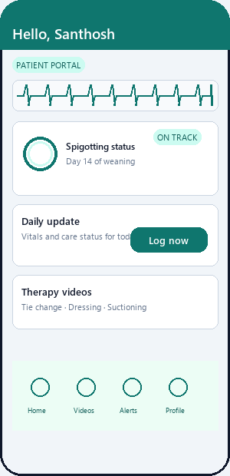
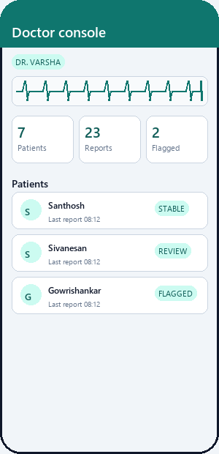
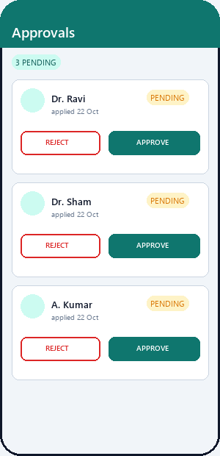
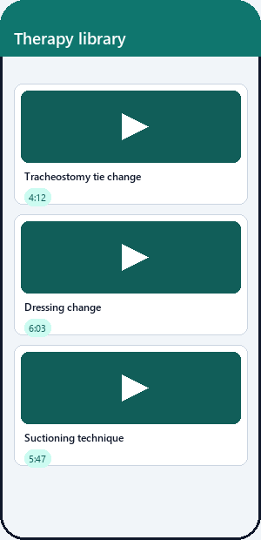

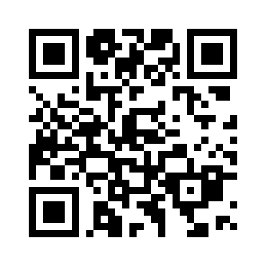
T
TrachCare: A Tracheostomy Care and Monitoring App
Guided tracheostomy care at home — connecting patients, doctors and admins on one platform
Concept
Methods
User Flow Diagram
TrachCare is a tracheostomy self-management app: patients log daily vitals (RR, HR, SpO2, tube and surgery status) from their phone; doctors review every report and see flagged abnormal entries; admins manage accounts and a therapy-video library. Patient, Doctor and Admin roles share one backend.
• Daily health report: vitals, tube status, comorbidities and labs.
• Doctor monitoring: patient list, report review, flagged alerts.
• Secure onboarding: role login, OTP email verification, admin approval.
• Education library: admin-published therapy videos streamed in-app.
• Spigotting tracker: weaning status visible to patient and doctor.
Competitive Analysis
MyTherapy
Medisafe
Problem Statement
Programming Specifications
CareClinic
Patient.info
Discharged tracheostomy patients must perform daily care and watch for warning signs — today tracked on paper. Entries are missed, doctors see patients only at reviews weeks apart, and deterioration is invisible until it becomes an emergency.
Frontend
Flutter / Dart (Android)
Backend
PHP 8.2 REST API (JSON)
1. MyTherapy — medication reminders and a general diary; no procedure-specific tracking or doctor review loop.
2. Medisafe — strong pill reminders, but medication-focused with no clinician monitoring.
3. CareClinic — broad symptom and measurement diary; nothing specific to tracheostomy care.
4. Patient.info — education content only; no reporting or connection to the care team.
TrachCare's edge: the only app pairing a daily tracheostomy-specific vitals report with a doctor review workflow and a guided therapy-video library — purpose-built for post-surgical home care.
Database
MariaDB / MySQL "trachcare"
Server
Apache — XAMPP
User Persona
Auth
Role login + OTP + approval
Media
media_kit video · uploads ≤250 MB
S
Name: Santhosh Age: 58
Post-surgical tracheostomy patient recovering at home.
Pain points: unsure what to record daily, forgets care steps, cannot reach the doctor quickly, no feedback on readings.
Release
Signed APK/AAB · targetSdk 36
Project Timeline
Solution
Replaces the paper diary with a guided daily check-in: structured vitals go straight to the treating doctor, abnormal reports are flagged, and training videos keep care correct — closing the gap between hospital and home.
Business Potential
Hospitals & ENT departments · home-care providers · clinic subscriptions · extends to other post-surgical pathways.
Paper Wireframes
Low Fidelity Prototype
Login · Daily report · Patient chart
High Fidelity Prototyping → Final Product
Splash · Patient dashboard · Doctor monitor · Approvals · Video library
Sivanesan
IT Department · SIMATS
Reg. No. __________ · email@saveetha.com
Scan For
Details
TrachCare — tracheostomy care, guided at home
Patient · Doctor · Admin | Flutter + PHP + MySQL

