Slide 1


Artificial Neural Networks (ANNs)
ITA0603– MACHINE LEARNING
.
Name: Karan M
Reg no: 192412062

Slide 2
Introduction
• ANN is inspired by the human brain.
• Learns patterns from data.
• Used for classification, prediction and recognition.

Slide 3
Basic Structure of ANN
Input Layer → Hidden Layer(s) → Output Layer
Input: receives data
Hidden: learns features
Output: gives prediction

Slide 4
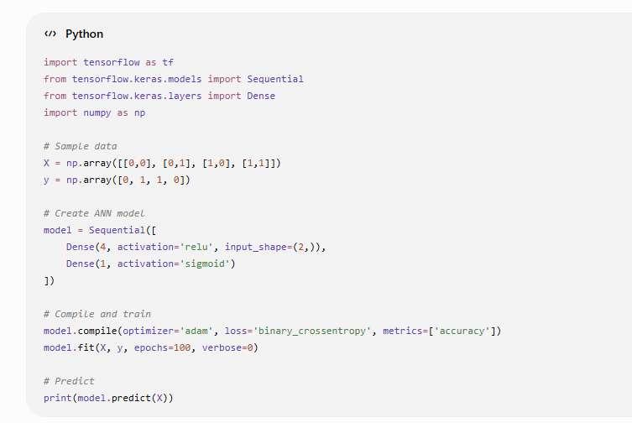
Python Implementation and Output

Slide 5
Advantages
• High accuracy
• Automatic feature extraction
• Handles complex data
• Scalable

Slide 6
Applications
• Face Recognition
• Medical Diagnosis
• Self-driving Cars
• Chatbots
• Fraud Detection

Slide 7
Conclusion
ANNs mimic the brain.
Backpropagation + Gradient Descent train the model.
Deep Learning solves complex real-world problems.

Slide 8
THANK YOU

