Slide 1

Email Spam and Threat Detection System Using Python
Guided by:
Dr Parthipan V
Presented by:
Hariharan G B (192412390)
Gunda Aswartha Manidheep(192425089)
Davis Damien M(192521124)
Pavankumar C(192511446)

Slide 2


INTRODUCTION
Email is a common method of communication and a target for cyberattacks.
Spam emails may contain phishing links and malicious content.
Threat Intelligence helps identify and analyze potential email threats.
Python and machine learning are used to classify emails as spam or legitimate.
Suspicious keywords and URLs are checked to identify possible threats.
The system helps users detect risky emails and improve email security.
OVERALL PROJECT FLOW
Email Input → Text Preprocessing → Feature Extraction → Machine Learning Model → Spam Classification → Threat Detection → Result Display → Security Alert

Slide 3
PROBLEM STATEMENT
Spam emails create unwanted messages and waste users’ time.
Phishing emails may contain fraudulent links and malicious content.
Traditional manual email checking is time-consuming.
Suspicious email threats may go unnoticed by users.
There is a need for an automated email detection system using Python.
The system should classify spam emails and identify potential threats using Threat Intelligence concepts.
Security alerts should help users recognize suspicious emails and improve email safety.

Slide 4
OBJECTIVES
To develop an email spam and threat detection system using Python.
To identify and classify spam and legitimate emails.
To analyze email content using machine learning techniques.
To detect suspicious links and phishing-related keywords.
To apply Threat Intelligence concepts to identify potential cyber threats.
To generate alerts for suspicious emails.
To improve email security and protect users from potential cyberattacks.

Slide 5
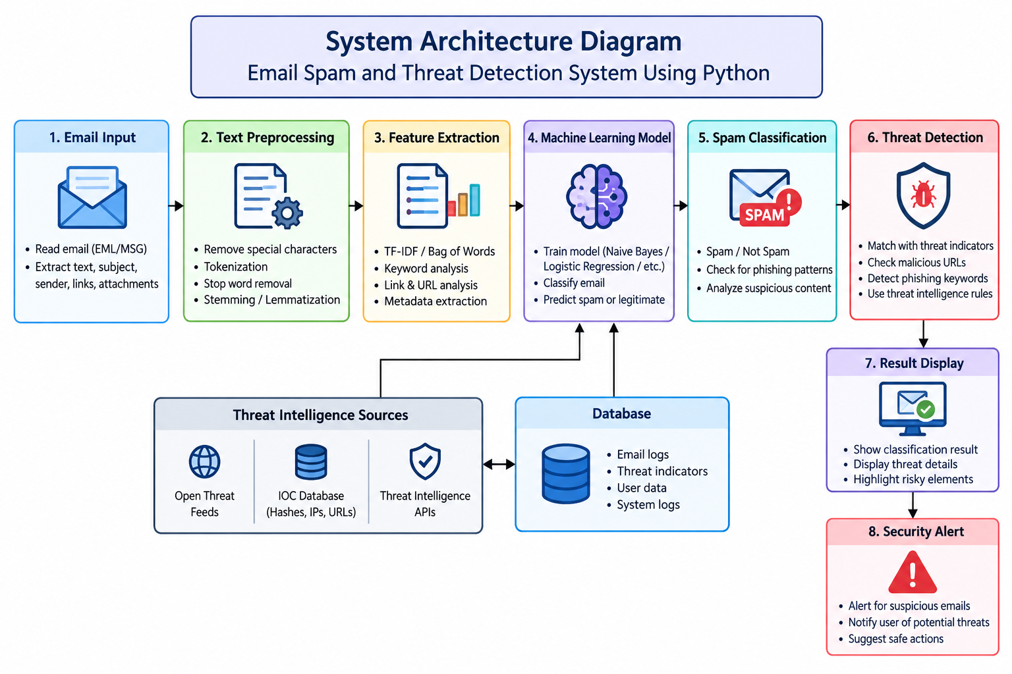
SYSTEM DESIGN ARCHITECTURE

Slide 6
LITERATURE SURVEY
S.NO | DETAILS OF THE JOURNAL | ALGORITHM / METHODOLOGY USED | ADVANTAGES | DISADVANTAGES
1 | Machine-Learning-Based Spam Mail Detector (2023) | Machine Learning | Automatically classifies spam emails | Depends on dataset quality(ScienceDirect)
2 | Improving Spam Email Classification Accuracy Using Ensemble Techniques (2024) | Ensemble Learning | Combines multiple classifiers | Requires additional processing(ScienceDirect)
3 | Phishing URL Detection Generalisation Using Unsupervised Domain Adaptation (2024) | Machine Learning and Domain Adaptation | Addresses detection of unfamiliar phishing URLs | Generalization remains difficult(Springer)
4 | Comparative Analysis of Machine Learning Algorithms for Email Phishing Detection (2024) | TF-IDF, Word2Vec, BERT | Compares text-processing Compares text-processing | Advanced models require more resources

Slide 7
MODULE 1: Email Dataset Collection and Loading
Use a labeled dataset containing spam and legitimate messages.
Load the dataset into Python using Pandas.
Check the dataset structure and message labels.
Divide the dataset into training and testing sets.

Slide 8
MODULE 2: Email Text Preprocessing and Feature Extraction
Convert text to a consistent format.
Remove unnecessary text noise where appropriate.
Apply TF-IDF vectorization.
Convert messages into numerical representations for classification.

Slide 9
MODULE 3: Spam and Threat Classification Using Machine Learning
Use the Multinomial Naive Bayes algorithm.
Train the model using labeled message data.
Test the model using unseen messages.
Predict the category of a new message.

Slide 10
MODULE 4: Result Display and Threat Alert Generation
Provide a text input field for the user.
Display the predicted result.
Show a warning for messages classified as spam.
Use Streamlit to create a simple web interface.

Slide 11
CONCLUSION
The proposed system detects spam and potentially harmful emails using Python.
Machine learning helps classify emails as spam or legitimate.
Threat Intelligence techniques help identify suspicious links and phishing patterns.
Security alerts help users recognize potential email threats.
Performance metrics help evaluate the accuracy of the detection model.
Overall, the system improves email security and helps protect users from potential cyberattacks.

Slide 12
FUTURE ENHANCEMENTS
Integrate advanced AI and machine learning algorithms for better email detection.
Use real-time Threat Intelligence feeds to identify emerging cyber threats.
Integrate URL reputation checking to detect malicious links.
Develop a web-based application for easy email analysis.
Add real-time security alerts for suspicious emails.
Improve detection accuracy by training with larger datasets.

Slide 13
REFERENCES
Yadav, D. K., et al. (2025). Enhancing Email Security: A Real-Time Machine Learning-Based Spam Detection System. Internet Technology Letters.
Jamal, S., Wimmer, H., and Sarker, I. H. (2024). An Improved Transformer-Based Model for Detecting Phishing, Spam and Ham Emails. Security and Privacy. Read paper
A Comprehensive Dual-Layer Architecture for Phishing and Spam Email Detection (2023). Computers & Security. Read paper
Comparative Analysis of Machine Learning Algorithms for Email Phishing Detection Using TF-IDF, Word2Vec, and BERT (2024). Computers, Materials & Continua. Read paper
A Systematic Literature Review on Phishing Email Detection Using Natural Language Processing Techniques (2022). IEEE Access, 10, 65703–65727. Read paper

Slide 14
THANK YOU

