Slide 1
CSA0618-DESIGN AND ANALYSIS OF ALGORITHMS CO1-AT3-TECHNICAL PRESENTATION
STRING MATCHING
NAME:GAYATHRI DEVI.M.S
REG NO:192421279
B.Tech IT

Slide 2
What is String Matching?
String Matching is the process of searching a small word (Pattern) inside a larger sentence (Text).
Definitions
Text (T) – The complete sentence in which we search.
Pattern (P) – The word or group of characters we want to find.
n – Length of the Text.
m – Length of the Pattern.

Slide 3
EXAMPLE PROBLEM
Text-LEARN ALGORITHMS
Pattern-ALGO
Step1: count the characters.
L E A R N _ A L G O R I T H M S
0 1 2 3 4 5 6 7 8 9 10 11 12 13 14
There are 16 characters (including the space).
So, n = 16
A L G O
1 2 3 4
Pattern has 4 letters.
So, m = 4

Slide 4
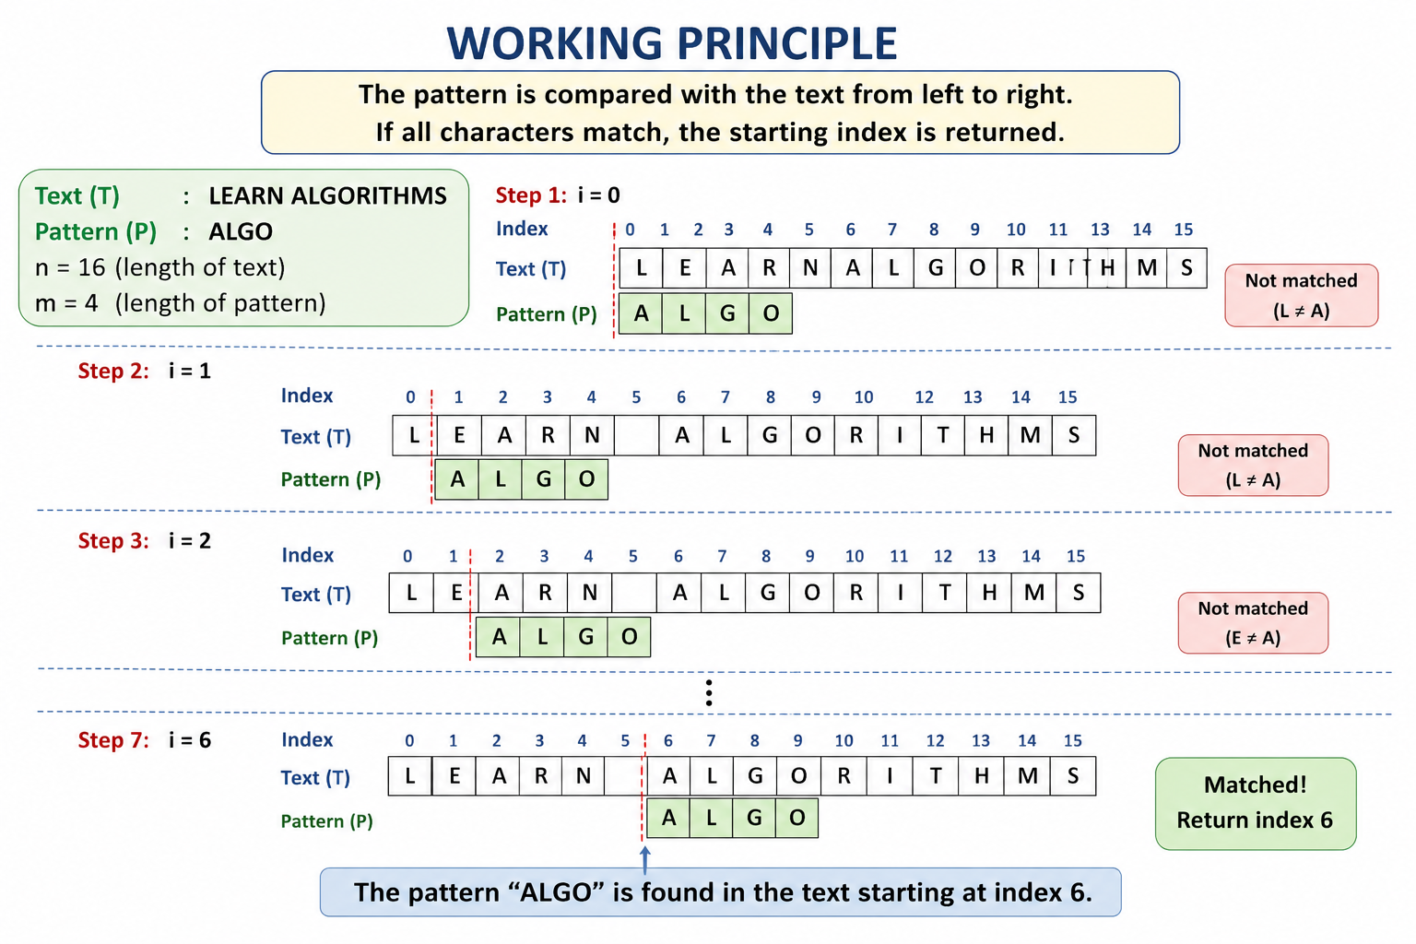
WORKING

Slide 5
PSEUDOCODE
for(i = 0; i <= n-m; i++)
{
j = 0;
while(j < m && P[j] == T[i + j])
{
j++;
}
if(j == m)
return i;
}
return -1;
Time Complexity
Best Case: O(m)
Worst Case: O(n × m)

Slide 6
Advantages
Advantages
Easy to understand.
Easy to implement.
Suitable for small texts.
Disadvantages
Slow for large texts.
Performs many repeated comparisons.

Slide 7
THANK YOU

