Slide 1
Data Independence in DBMS
Logical and Physical Data Independence
Prepared by: Niveditha S 192421440L

Slide 2
7. What is Data Independence?
Introduction
Data independence is the ability to modify the database structure without affecting application programs.
It provides flexibility and easy database maintenance.
It is an important feature of DBMS architecture.

Slide 3
Types of Data Independence
1. Physical Data Independence
Changes the physical storage of data.
Does not affect the logical schema.
Example: Changing file organization or storage devices.
2. Logical Data Independence
Changes the logical schema.
Does not affect user applications.
Example: Adding a new column or table.

Slide 4
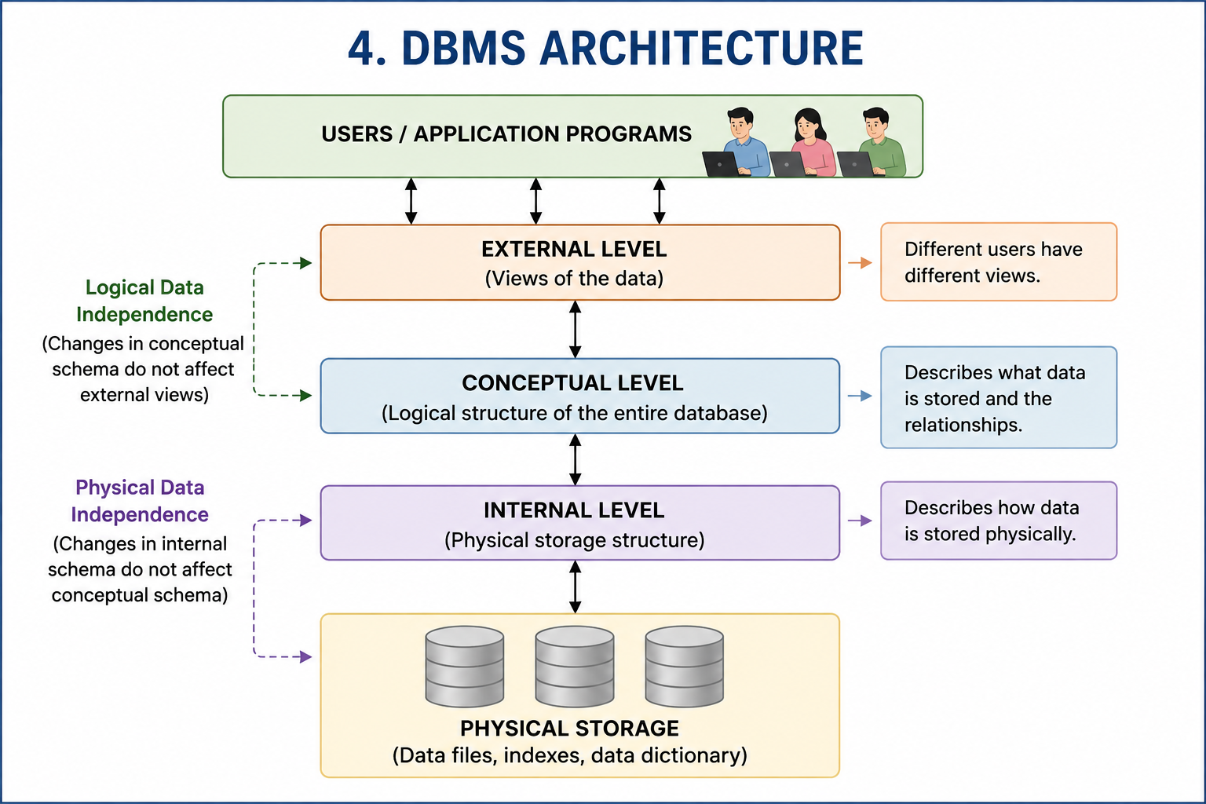

Slide 5
Types of Data Independence
1. Physical Data Independence
Changes the physical storage of data.
Does not affect the logical schema.
Example: Changing file organization or storage devices.
2. Logical Data Independence
Changes the logical schema.
Does not affect user applications.
Example: Adding a new column or table.

Slide 6
Conclusion
Data independence is a key feature of DBMS.
It consists of Logical and Physical data independence.
It allows database changes without affecting users or applications.
It makes databases efficient, reliable, and easy to maintain.

Slide 7


