Slide 1
Software Components of a DBMS
Query Processor, Storage Manager & Transaction Manager
Prepared by: Niveditha S 192421440L

Slide 2
8.What are DBMS Software Components?
Introduction
DBMS consists of different software components.
Each component performs a specific task.
The main components are:
Query Processor
Storage Manager
Transaction Manager

Slide 3
Query Processor
Functions
Accepts SQL queries from users.
Checks query syntax.
Optimizes the query.
Executes the query.
Returns the required results.

Slide 4
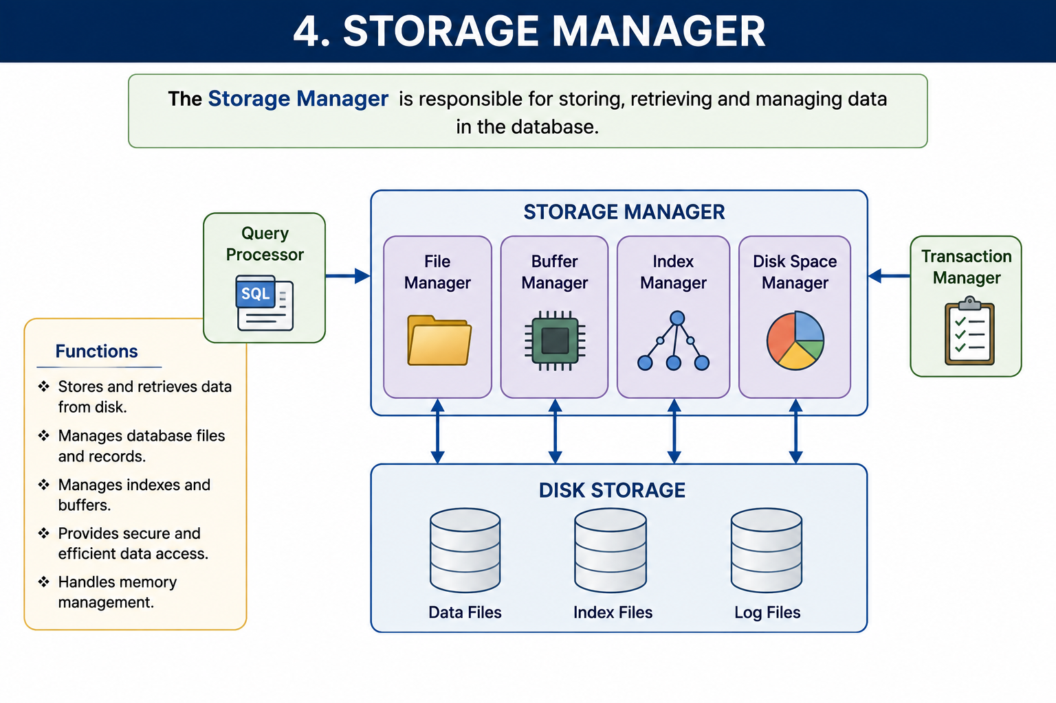

Slide 5
Transaction Manager
Functions
Controls database transactions.
Maintains data consistency.
Prevents data conflicts.
Supports Commit and Rollback.
Ensures ACID properties.

Slide 6
Conclusion
DBMS software components work together efficiently.
Query Processor executes SQL queries.
Storage Manager manages data storage.
Transaction Manager ensures safe and reliable transactions.
These components improve DBMS performance and security.

Slide 7


