Slide 1
Title
EER Diagram for Retail Chain Management System
Prepared by: Niveditha S 192421440L

Slide 2
10.What is an EER Diagram?
Introduction
EER is an extension of the ER model.
It represents complex database structures.
It includes entities, relationships, and specialization.
Used to design retail management databases.

Slide 3
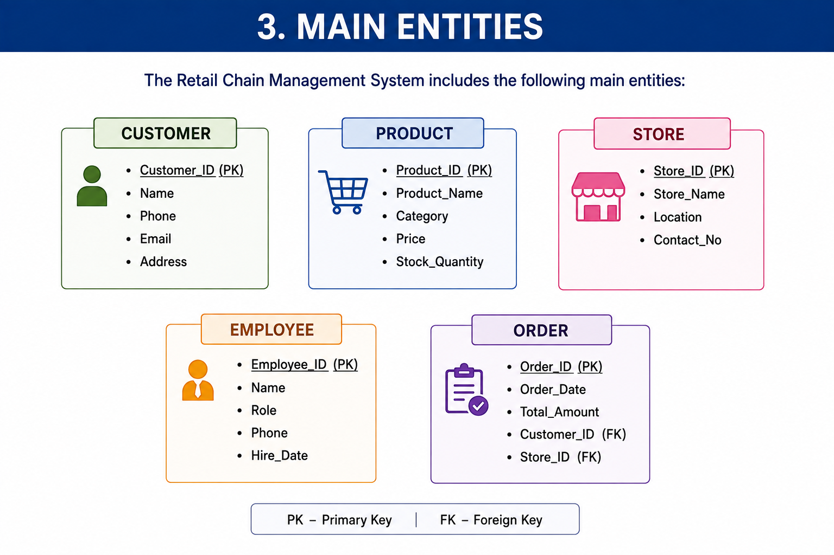

Slide 4
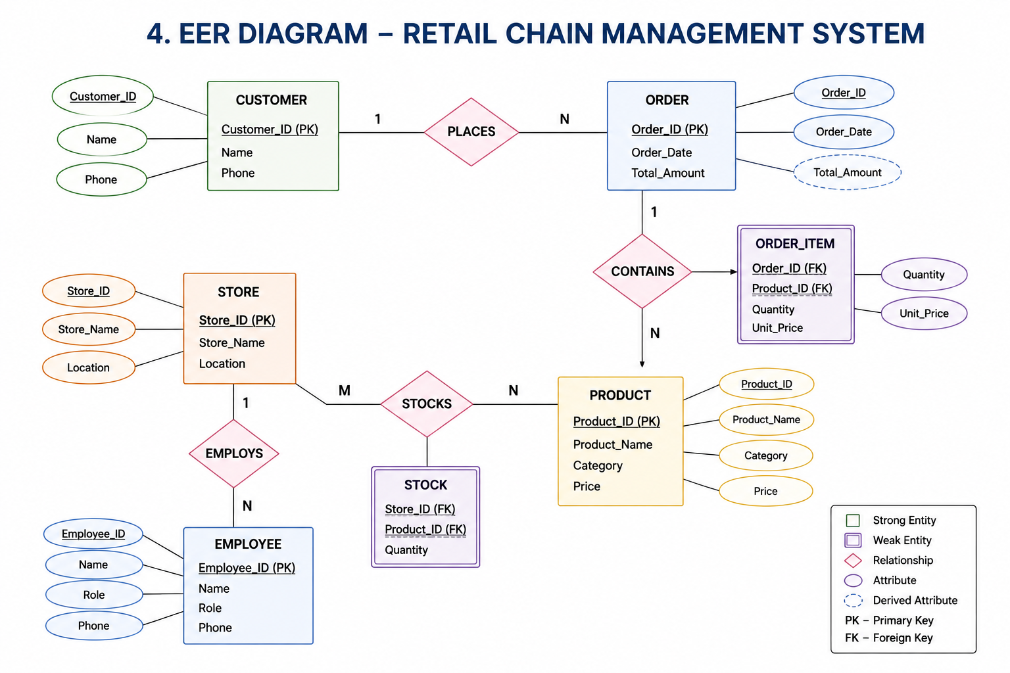

Slide 5
Design Walkthrough
Customer places an order.
Order contains one or more products.
Store stocks products.
Employees work in stores.
The system tracks customers, orders, products, and stores.

Slide 6
Conclusion
The EER model improves database design.
It organizes retail data efficiently.
It reduces redundancy.
It supports easy management of retail operations.

Slide 7


